Slide 1
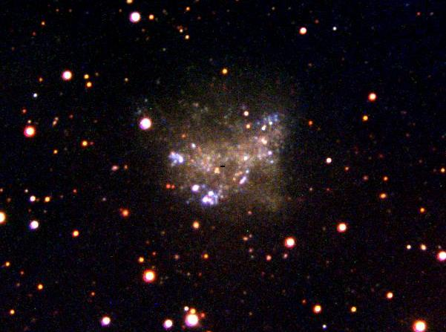

Star Birth at an Extreme: The Shrinking Womb
Deidre Hunter
Lowell Observatory
Civil Air Patrol, June 28, 2014

Slide 2
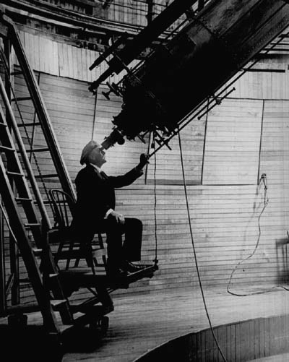
Lowell Observatory has a rich scientific history.
Percival Lowell observing Mars at the 24-inch refracting (Clark) telescope

Slide 3
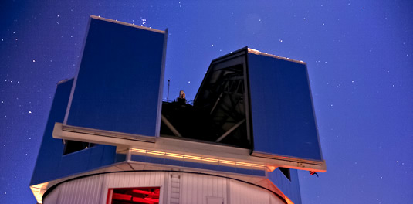
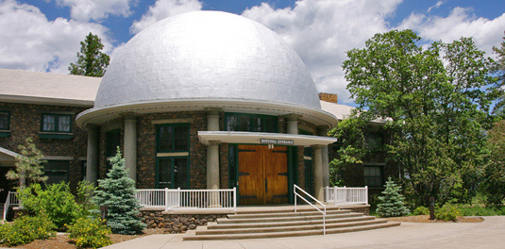

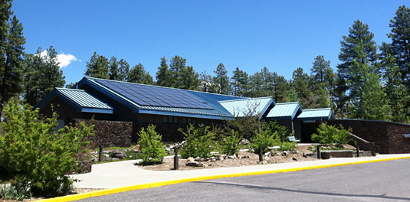
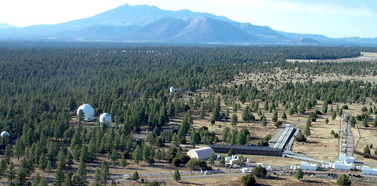

Lowell Observatory today
Mars Hill
Image: Len Bright
4.3-meter Discovery Channel Telescope
Visitor Center
Titan Monitoring Telescope
Anderson Mesa: NPOI, 1.8 m, 1.1 m, 0.8 m, LONEOS schmidt

Slide 4
Lowell Observatory today
Inner Solar System
Asteroids, comets
Outer Solar System
Pluto, KBOs, outer planet seasons, weather on Titan
Exoplanets
Searches, star-planet interactions
Low mass stars
Atmospheres, formation and evolution Intermediate mass stars
Long term variability of solar-type stars, binary star masses, circumstellar
disk evolution, fundamental properties
High mass stars
Evolution
Nearby Galaxies
Dwarf galaxies, disk dynamics
Scientific staff---
14 active PhD astronomers
1 assistant research scientist
2 post-docs
1 pre-doc
seasonal undergraduates
several research assistants

Slide 5
A bird’s eye view of star formation

Slide 6
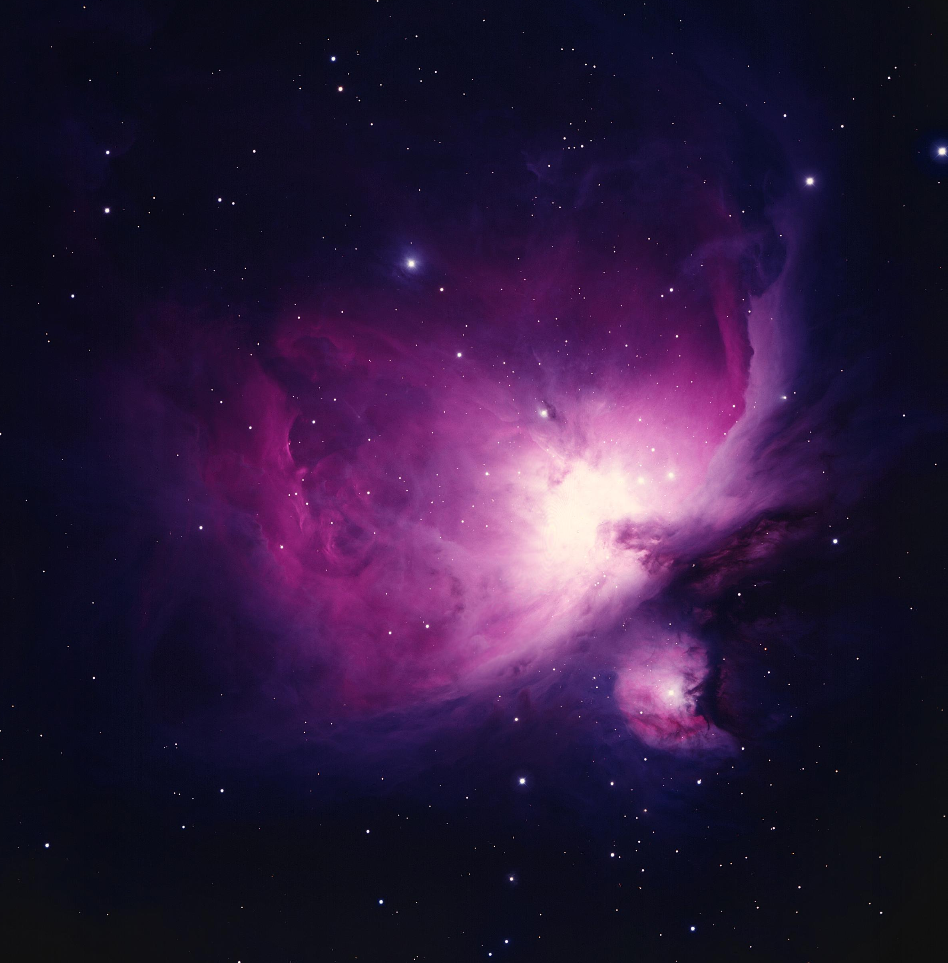
Stars form from clouds of gas.
Orion Nebula
Between the stars is a very tenuous gas.
Because galaxies are so big, there is a lot of mass in interstellar gas.
Originally the gas was just Hydrogen, 8% Helium
Schoening/NOAO/AURA/NSF
Notes:
1/100 billion billionth as dense as the air here
About 5 billion times the mass of the sun.
Today there are heavier elements made inside of stars--Nitrogen, Carbon, Oxygen

Slide 7
Molecular clouds form from atomic clouds
H₂ traced by CO
http://abyss.uoregon.edu/~js/ast122/lectures/lec22.html

Slide 8
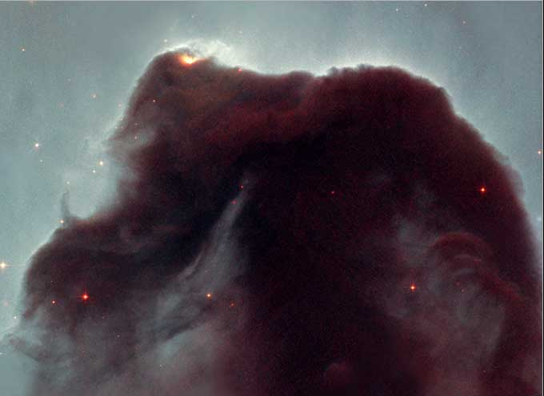
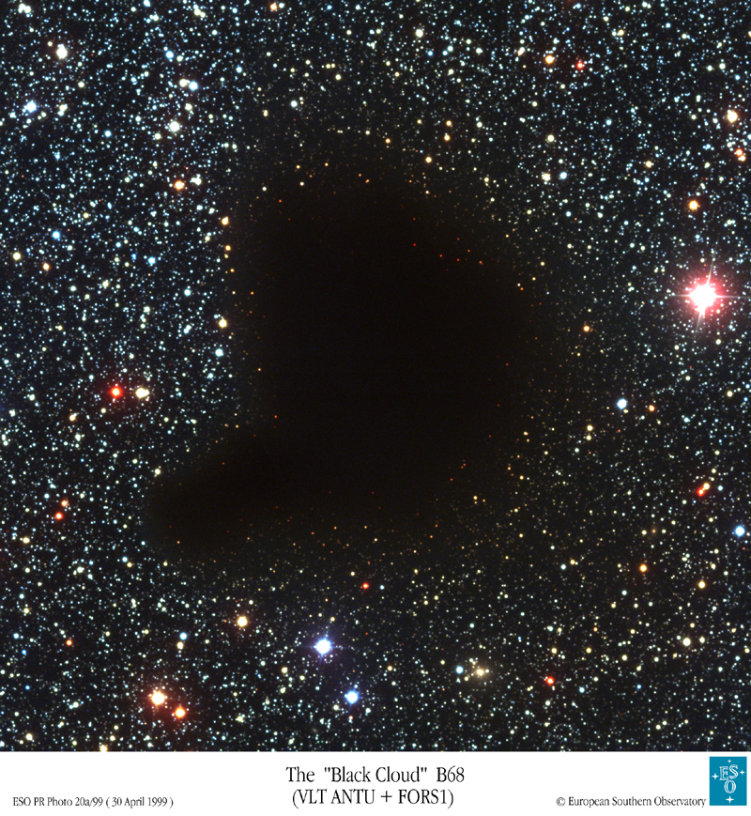
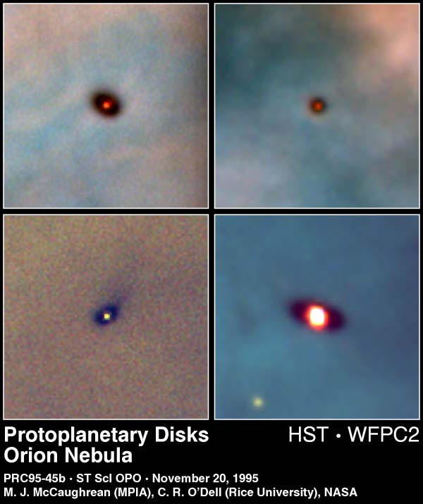
Stars form in “dense” molecular clouds – the womb
HST image,Hubble Heritage Team (STScI/AURA)/NASA
Notes:
8

Slide 9
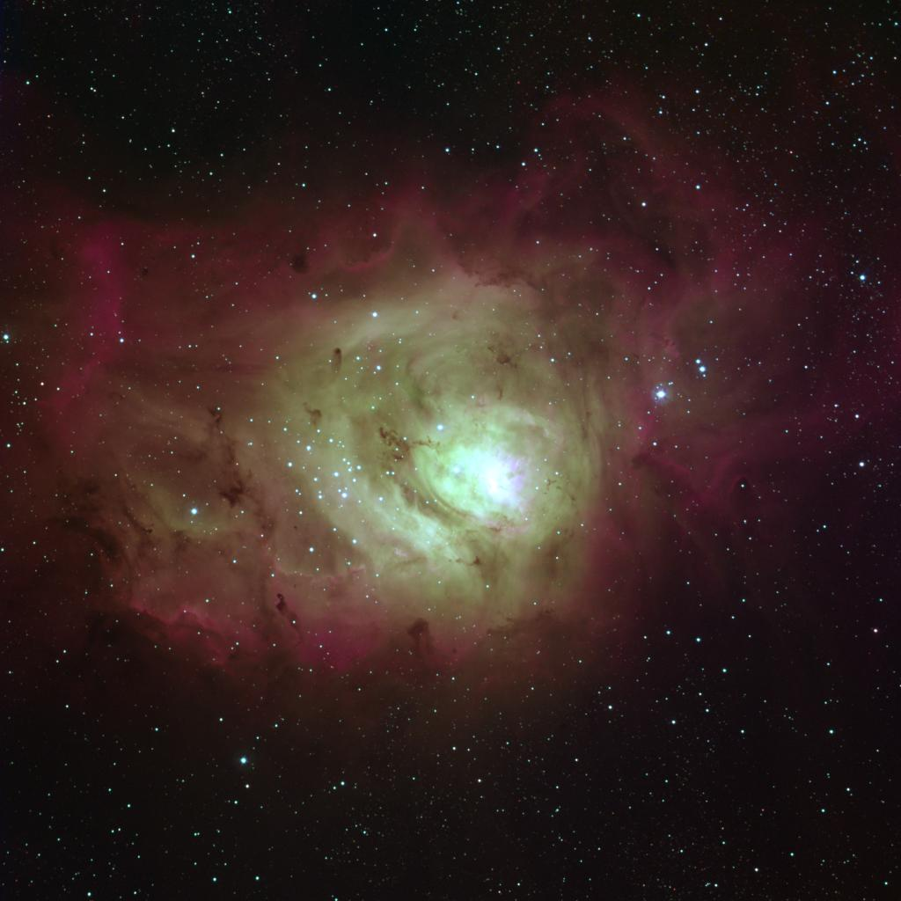
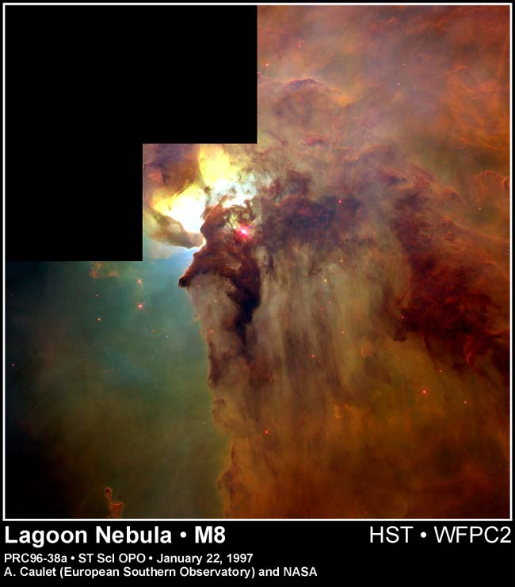
The process of star formation is inefficient: 50-95% of the gas is leftover.
Sharp, REU program/NOAO/AURA/NSF
Notes:
9

Slide 10
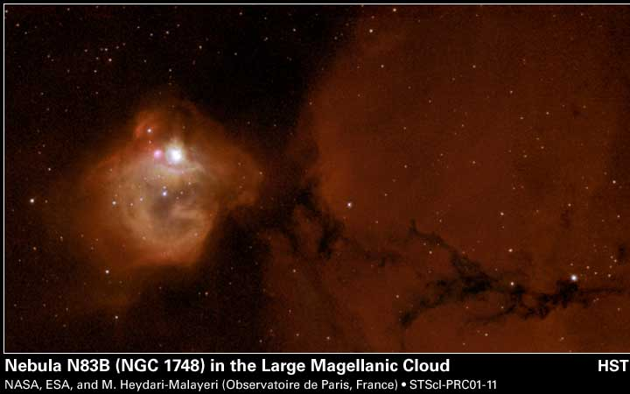
Massive stars break up their molecular cloud.
Notes:
10
Bubble is 25 light years across, star formed 30000 yrs ago, star is 30 Msolar

Slide 11
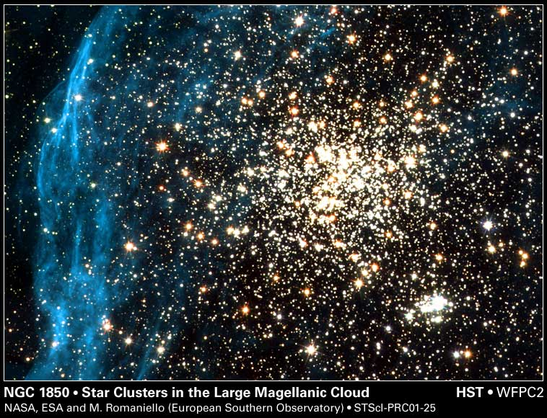
A massive star cluster in the LMC
Notes:
11

Slide 12
Formation of the molecular cloud depends on dust and heavy elements
As a shield: Protect the molecules from dissociation by UV radiation from stars
As a coolant: Remove energy so that a cold, dense cloud can form
But in the early universe the first stars formed from H+He only.
They slowly polluted the universe with dust and heavier atoms.
But not all galaxies are as polluted as the Milky Way.

Slide 13
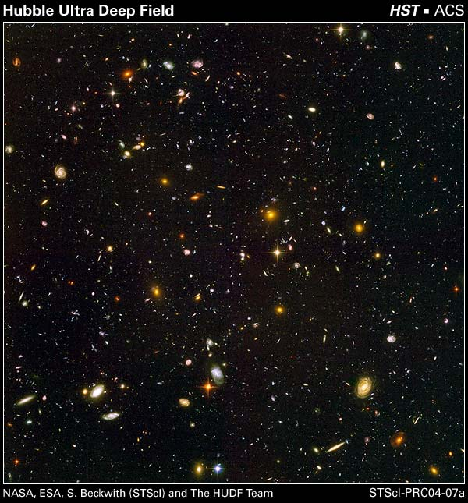
Dwarf galaxies as nearby sites of star birth at low abundances
Young dwarf galaxy?
Notes:
13

Slide 14
But what are dwarf irregular galaxies?

Slide 15
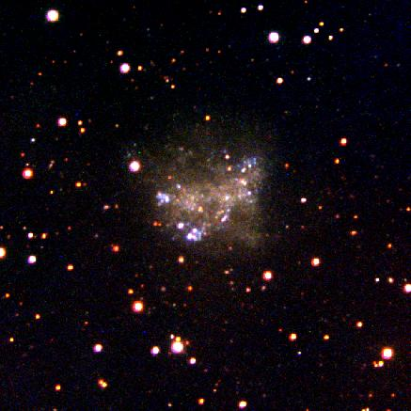
Dwarf Irregular galaxies are irregular.
DDO 63
Hunter & Elmegreen, Lowell 1.1 m

Slide 16
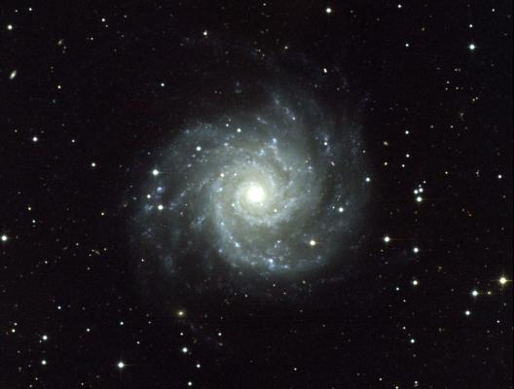
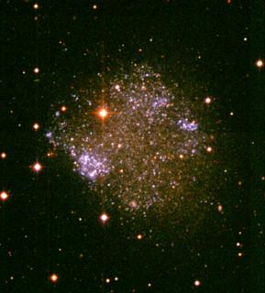
Dwarf galaxies are tiny.
M74
Boroson/AURA/NOAO/NSF
DDO 75: A dwarf galaxy Hunter & Elmegreen, CTIO 0.9 m
Notes:
Dwarf galaxies are building blocks for larger galaxies, objects in which the first stars formed.
M74: 30 Million lt yrs away; 80,000 light years across
1 light year = 5900 billion miles
1 light second = 7 times around the earth in 1 second

Slide 17
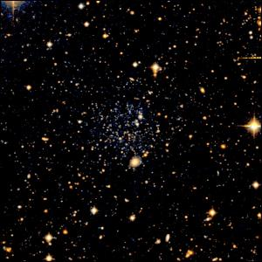
Dwarf galaxies are faint.
Leo T
Leo T is comparable in brightness to a large star cluster that contains several million stars.
Irwin et al. 2007
Notes:
Comparable to a large star cluster that contains only several millions of stars. Our Milky Way has something like 300 billion stars in it.

Slide 18
Dwarf galaxy abundances are low.
DDO 75
Low in heavy elements
  Down to 1/60th solar
Low in dust
Hunter & Elmegreen, CTIO 0.9 m
Notes:
18

Slide 19
Star forming clouds at low abundances

Slide 20
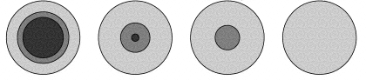
Consequence of low abundances: change in structure of molecular cloud
Theory
Solar abundance
Very low abundance
Core
Shell
Bolatto et al. 1999
Core usually traced by CO.
Shell bright in [CII]λ158 μm.

Slide 21
Collaborators
Phil Cigan (New Mexico Tech) - PhD dissertation on Herschel observations
Celia Verdugo (Univ of Chile) – Master’s student worked on APEX observations
Elias Brinks (Univ Hertfordshire)
Bruce Elmegreen (IBM T J Watson Research Center)
Monica Rubio (Univ of Chile)
Caroline Simpson (Florida International University)
Lisa Young (New Mexico Tech)

Slide 22
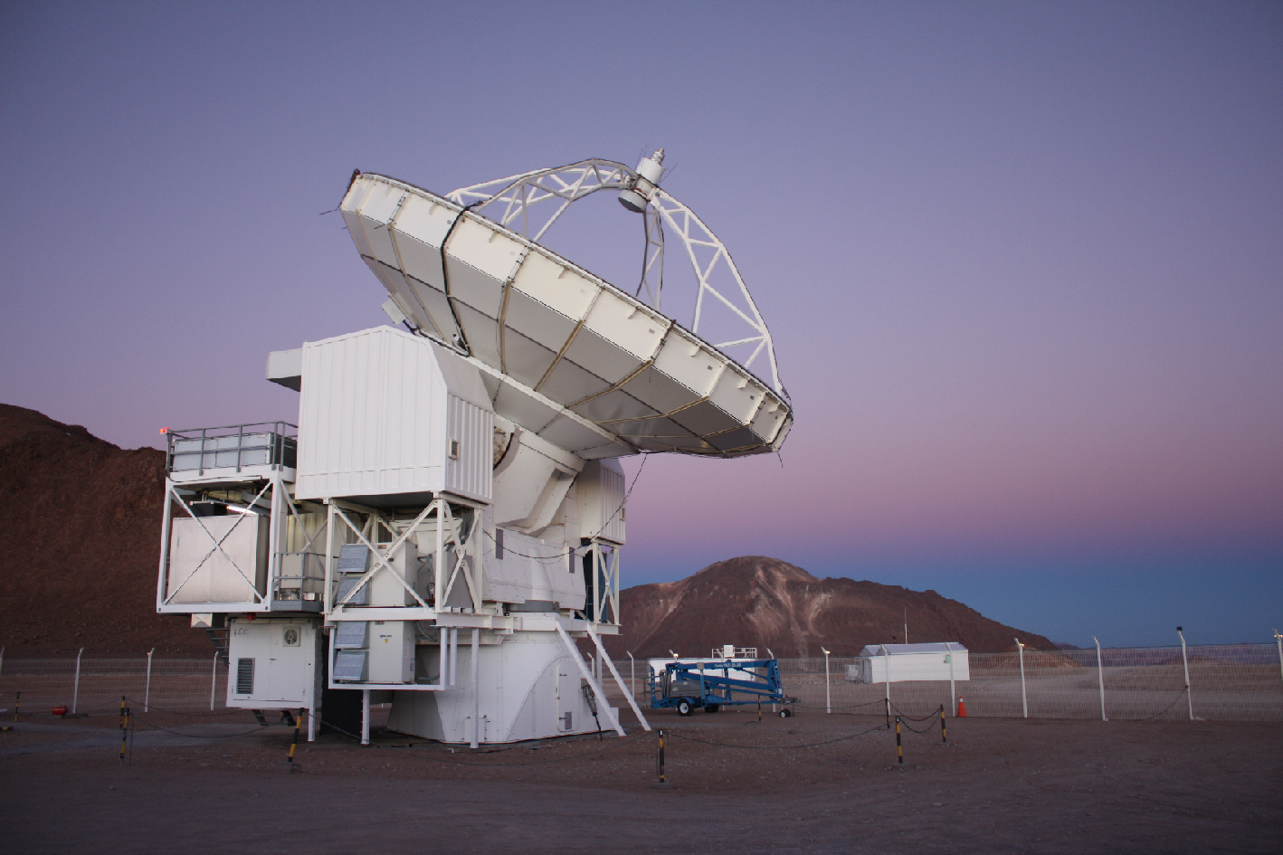
Shrinking CO core means they are harder to detect: CO “detection barrier” of 20%×solar abundance
APEX – sub-millimeter telescope in the Atacama Desert
CO (3-2)
Beam of 18” = 290 light years at WLM (87 parsecs)
Bérengčre Parise

Slide 23
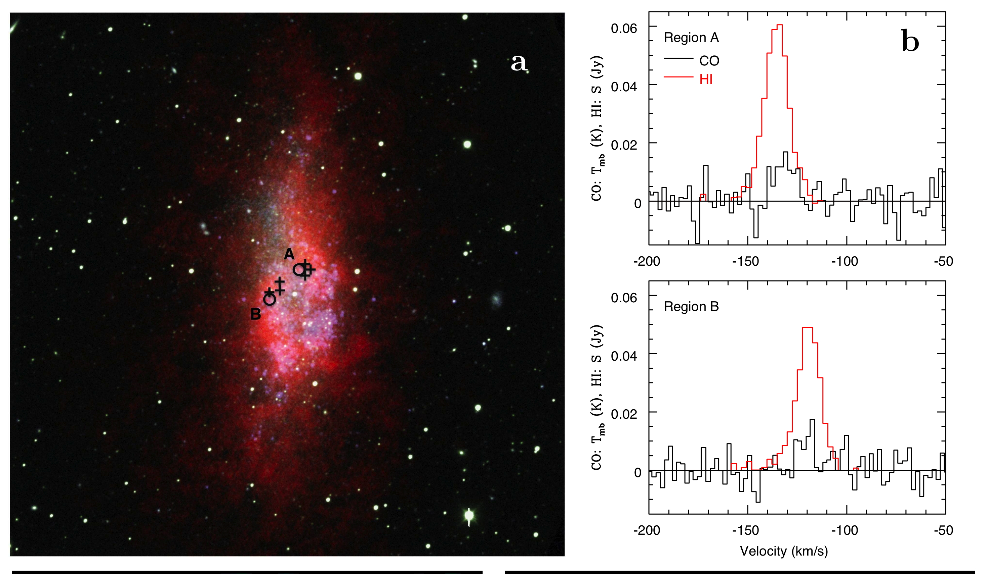
We detected molecules in the most heavy element poor galaxy ever!
8x lower abundances than the Sun
WLM
Atomic gas
Molecular gas
Intensity of emission
Elmegreen et al. 2013
Velocity of gas

Slide 24
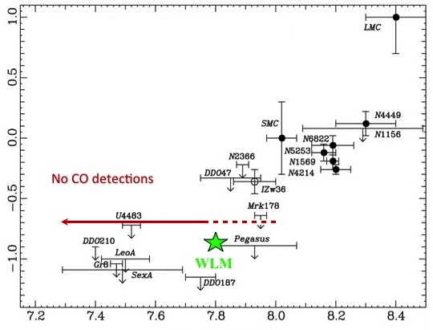
WLM detection in context
log I_{CO} (K km/s)
Lower oxygen abudance
M. Rubio
Non-WLM data: Tacconi & Young 1987; Taylor et al. 1998
WLM data: Elmegreen et al. 2013

Slide 25
The molecular clouds in WLM
Masses of H₂ are 1-2×10⁵ M_{O}
➔ Star formation is occurring in giant molecular clouds even at 13%×solar abundances.
Elmegreen et al. 2013

Slide 26
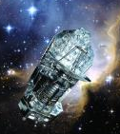
Herschel observations of the shells of molecular clouds in 5 abundance-poor dwarf galaxies
Cigan et al., in prep
Solar abundances
Theory
Very low abundances
Core
Shell
Bolatto et al. 1999

Slide 27
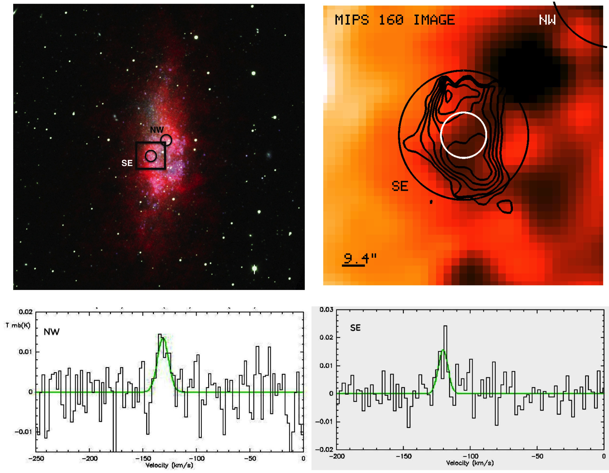
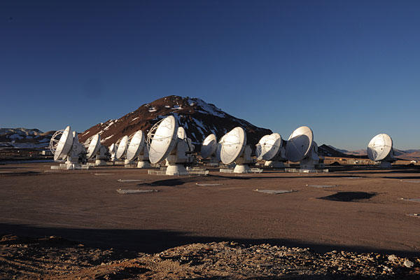
Molecular core + shell – like a baseball in a glove
Molecular cloud shell,
Observed with Herschel
Image: Warm dust
CO core from APEX
WLM
Region being mapped in CO with ALMA

Slide 28
WLM - Region B:
Shell annulus ≥ core diameter
Theoretical prediction: Size of shell ∝ 1/abundance
Molecular cloud structure at 13% of solar abundances

Slide 29
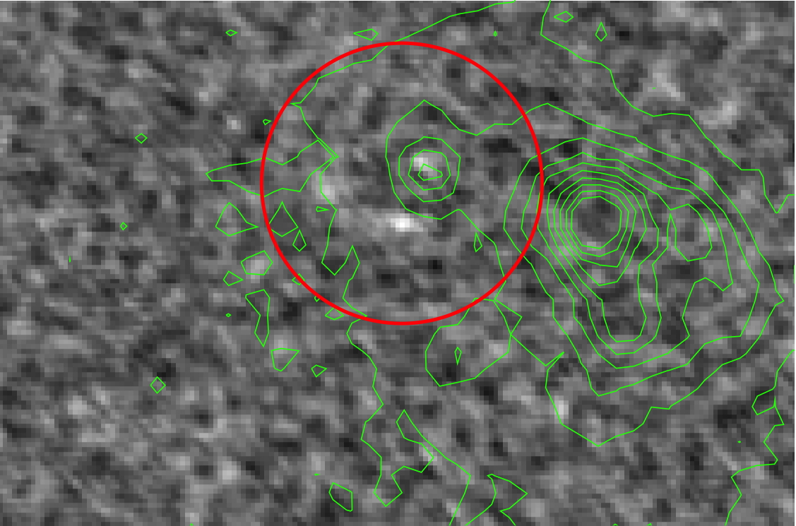
NW molecular cores observed by ALMA
WLM
Size ~ 1-3 arcseconds

Slide 30
To come…
Molecular cloud structure:
  Herschel images of the molecular cloud shells
  ALMA maps of the CO cores
  abundance relative to solar
WLM – 13%
DDO 155 – 10%
DDO 75 – 6%
DDO 69 – 5%
How does the molecular cloud structure change with abundance?
What difference does it make to the star formation?

