Slide 1
Status Report on SOFIA Exoplanet Transit Capability
Ted Dunham
Georgi Mandushev
Daniel Angerhausen

Slide 2
Introduction
Update on HD189733b transit observation on 10/1/2013 (UT) with FLIPO
  Originally Avi Mandell’s FLITECAM-only proposal
  Search for water in HD189733b using Pa alpha filter
  Morphed into a FLIPO demonstration transit
Talk Outline
  Introduction and practical matters (Ted)
  Data analysis, systematics, and results (Georgi)
  User’s perspective and independent data analysis (Daniel)
  Wrap-up (Ted)

Slide 3
Scientific Value of Transits
Atmospheric structure and chemistry
  Rayleigh scattering, scale height
  NIR spectrophotometry
    Search for presence of interesting compounds (e.g. water, methane)
    Appear as apparent radius differences with wavelength
Heat exchange -- exoplanet weather
  Phase functions, secondary eclipse
Starspot and plage size and color temperature
Primary interest is in 1-5 micron range
More later from Daniel

Slide 4
Observational Issues
The prize is not easily grasped.
Need to measure small features in shallow transits
  Overall fractional error ~few x 10⁻⁴
Not easy for anybody – systematics dominate at this level
  Kepler, HST, Spitzer, ground-based systems all have problems. We do too.
    Bill Rose: “Why don't you pick something hard to do??? Geeeesh.”
  Known problem areas for SOFIA:
    Water vapor, ozone, and Rayleigh extinction; static air density,
    Mach number (?), pointing, jitter, and focus.
  Reliable housekeeping data essential for correcting these
  Some instrument-specific details can be important
Differential photometry (field standard) is NOT a cure-all
  Usually doesn’t happen anyway
  When it does it works best if the differential correction is small

Slide 5
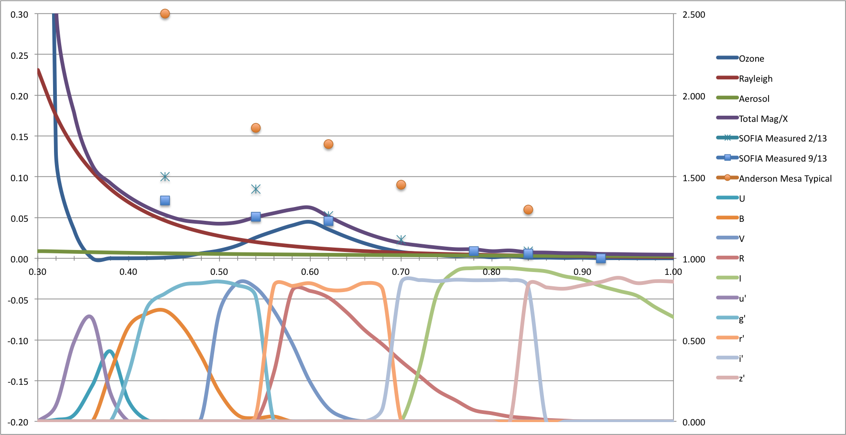
Systematics, I
Extinction
  Rayleigh scattering (optical; proportional to static pressure and airmass)
  Ozone (optical)
  Water (IR)
  Volcanic aerosols
    Can vary by 0.1-1%
    Episodic problem
    IR impact uncertain
Nabro eruption, 13 June 2011
(Bourassa, et al. (2012))

Slide 6
Systematics, II
Aero-optical PSF effects
  Optical PSF dominated by shear layer scattering
    Refractivity (ν = n-1) is proportional to density
    δρ/ρ_{static} is roughly constant
    Image FWHM expected to scale with static density
    Very broad PSF wings interact with aperture
      Perceptible additional enclosed flux across entire HIPO field!
    Rose expects FWHM dependence on Mach number
      We don’t see this, at least so far
    So far no obvious “dome seeing” contribution

Slide 7
Systematics, III
Other PSF-related effects
  Defocus, especially early in the flight
    Really should have automatic SMA_T1 focus update
  Jitter (causes erratic enlarged time-averaged PSF)
Pointing noise
  To first order, fixed by (proper) flat fielding, right?
    Never really works right. Stable pointing is best, decorrelated pointing errors are second best.
  Jitter increases noise, but uncompensated drift is fatal
    Exoplanet science occurs at low frequency

Slide 8
Systematics, IV
Instrument-related effects
  Carried out lab tests for HIPO (with small PSFs)
    Millimag photometric changes occur with large CCD temperature changes
    Perceptible CCD controller temperature sensitivity
      Important to operate controller uniformly. Kepler lesson.
    Kepler-like image position effects noticed but overwhelmed by the airborne environment
    Overscan may be a useful decorrelating variable
  No similar information available for FLITECAM

Slide 9
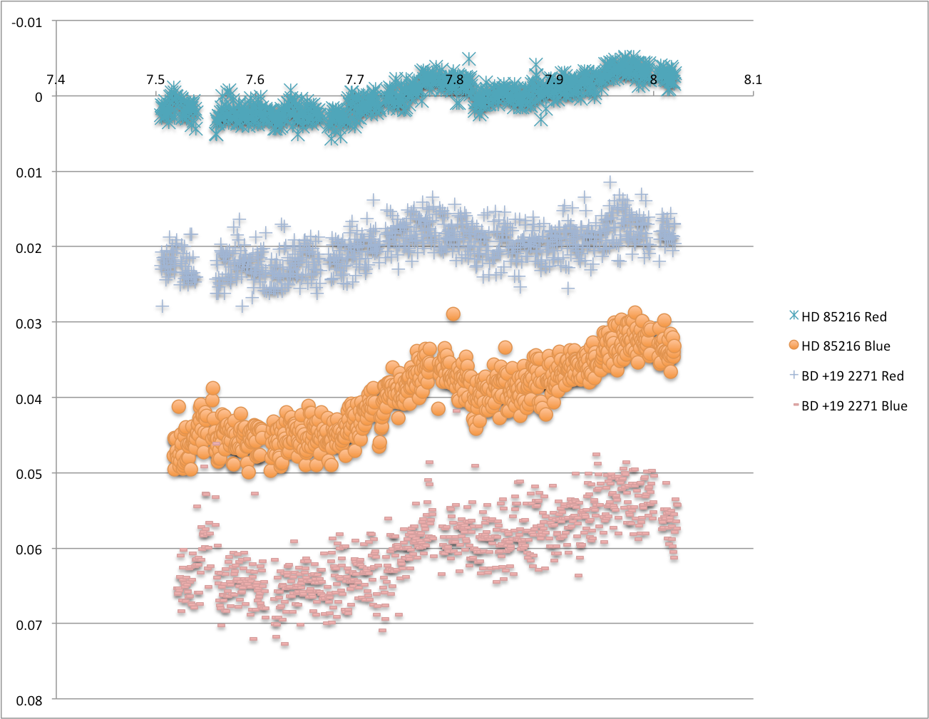
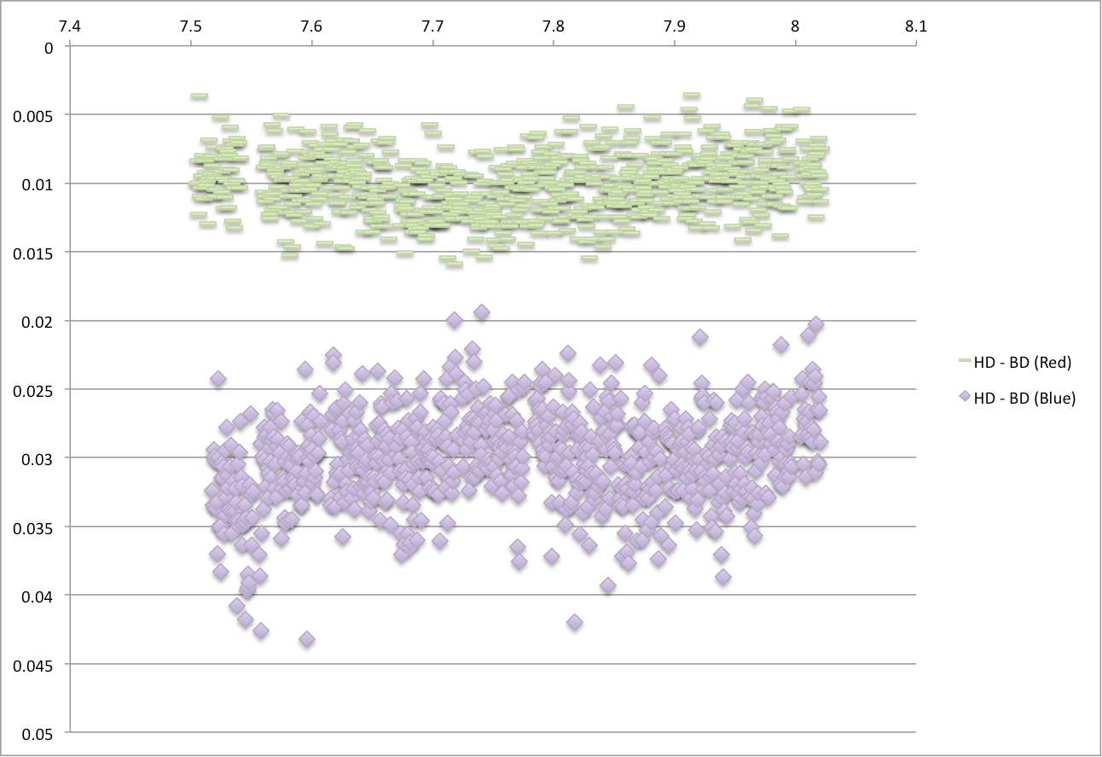
Differential Photometry
SCAI-9 Test
  HD 85216 (V=8.4, A3) and BD+19 2271 (V=8.8, F5)
  19” aperture (red) 26” (blue), open filters
  Raw photometry (left), differential (right)
  Systematics still there in differential light curves at a few millimags

Slide 10
Transit Observation Circumstances
Several problem areas known before takeoff
  Very little baseline before the event, none after
  Short FLITECAM LHe hold time
    Short flight; must observe transit first thing. Focus unstable.
  WVM not installed
In-flight problems
  FPI failed at start of leg (blown circuit breaker); fell back to FFI
    HIPO guiding not properly tested, so didn’t attempt that
    Lost the little pre-transit baseline we had
  Pointing was very poor. FFI in poor focus for a while.
Post-flight problems
  During data analysis found electronics-related problems in FLITECAM affecting global reset and co-adding.
  No useful FLITECAM data obtained.

Slide 11
HIPO Observational Details
Observed in Basic Occultation mode
  Full frames to maximize field standard possibilities
    Field standards all very much fainter than target.
  3 second integrations on red side, Sloan z’ filter
    ~2700 measurements
  7 second integrations on blue side, Johnson B filter
    ~1000 measurements
  Broken into chunks to keep file sizes manageable
Filters selected to avoid ozone problems

Slide 12
Image Processing
CCD Reductions
  Raw frames are overscan & bias –subtracted
  Trim off prescan, overscan, and dark pixels
Flat-fielding
  High S/N twilight sky flats taken during line op
  B flats show laser annealing pattern, 1-2% p-p
  Sloan z’ flats show only overall curvature

Slide 13
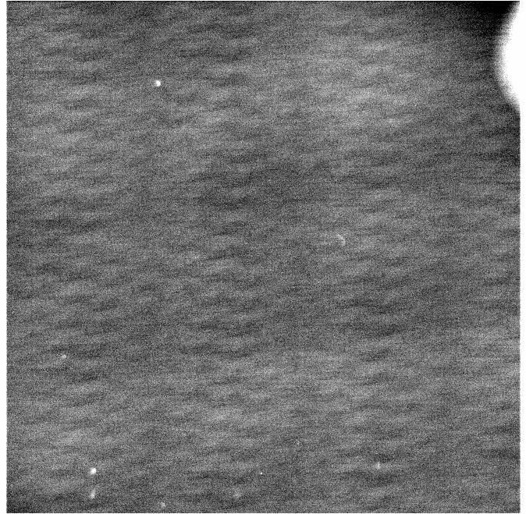
Trouble in Flat-Land
Photometry shows strong position dependence
  Incorrect flat
  Most likely due to sky seen around secondary
Solution (for now)
  Skip flat-fielding on red side
  Fit and subtract overall curvature on blue flat but retain annealing pattern. Flatten with that.

Slide 14
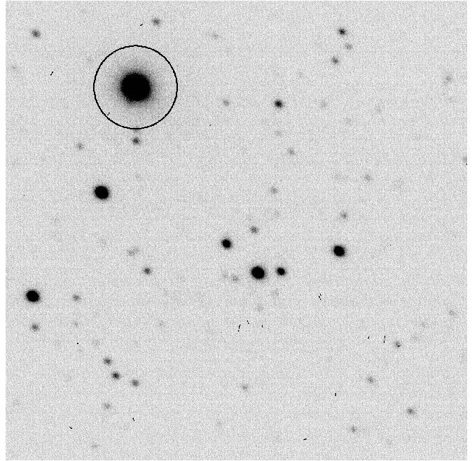
Photometry
Aperture photometry
  Large aperture (60”) to reduce effects of focus, jitter, centroiding
  Bright target; sky & read noise contributions each ~10% of shot noise on target even in huge aperture
Why not PSF fitting?
  PSF fitting best in very crowded fields
  Shear layer PSF is not well represented analytically
  PSF shape is variable anyway
  Bad experience with PSF fitting in PSST context
  But … did use PSF fit to estimate z’ brightness ratio of target & companion and for FWHM/ellipticity

Slide 15
Corrections, I
Extinction:
  6%/airmass in B, 0.5%/airmass in z’ at 40000 ft.
  Rayleigh scattering and ozone (mostly avoided)
  Correction based on measurement of Landolt standards on 2013-10-01 UT flight
Static density:
  Measured during shear layer test on 2013-01-24 flight
  0.01 kg/m³ density change => -6.8 x 10⁻⁴ photometric change
  Significant correction, ~ few millimags
Mach number:
  No noticeable dependence seen so far
Position dependence
  Can be a few percent, depending on flattening details
    Typical: ~ few x 10⁻⁵ per pixel of motion

Slide 16
Corrections, II
Setup leg, 2013-09-27 UT
  Short leg, little change in density or Mach number
  Strong positional effects
    Star moved across field
      Setting up position on FLITECAM array
  Position correction
    Fit and subtract polynomial of position jointly in X&Y
    Use this approach for correcting transit data

Slide 17
Corrections, III
Re-measure density/Mach/focus dependence
  Intended to do this with FLITECAM -- didn’t work
  Beautifully executed test on 2013-10-01 flight
    Density section ruined by clouds at 40000 feet!
  Will try again next month with FLITECAM
Why the bump in the Mach number test?
  Centroid offset

Slide 18
Light curves
(bias subtracted, Blue side flattened)

Slide 19
Transit Fit, I
To fit or not to fit:
  Ideally fit for astrophysical parameters only
  Important corrections need fitting too
  Try to fix the parameters you can
Fix variables we think we understand
  System parameters from HST data; limb darkening
    Epoch, period, impact parameter, radius, inclination
  Fix density.
    When fit the coefficient becomes too large to believe
    Possibly real structure is obliterated
    Weak point – we still need a better handle on this

Slide 20
Transit Fit, II
Fitted parameters include:
  Flux zero point in B and z’
  Differential atmospheric extinction in B & z’
    After removing measured extinction from Landolt stars
  Centroid corrections
    Differential X and Y offsets in B and z’
    Radial offset in B and z’
Fit is done simultaneously to both datasets

Slide 21
Transit Fit, III
What can we say about this?
  How much is real?
    189733 is active
  How much is not?
    Without baseline, can’t tell
  Density glitch is close to “star spot”.
    Cause & effect or coincidence?
    Klaus Huber’s model - hmmmmm

Slide 22
Switch to Daniel’s File Here

Slide 23
Improvements for next time
Get good FLITECAM data!
  Need WVM operating; calibration not required
Repeat shear layer test with FLITECAM (no clouds)
Observe bright stable star pair for a LONG leg
  Search for other possible systematic effects
Keep pointing and focus under tight control
  HIPO guiding, possibly automatic focus update
Get plenty of pre- and post-transit baseline!

Slide 24
Longer Term Issues
Deployments will be involved
  Short SOFIA leg lengths are a serious impediment
Sunrise constraint needs to be eliminated
Install Nasmyth blower
  Cool FLIPO periscope & FLITECAM window
  Biggest background contributors for FLITECAM
Install the fully reflective tertiary
  Systematics dominate only when shot noise is low enough.
  We’re stuck with an observing efficiency hit of 20% to 60%
    Using the FPI only wins back part of that
  But it’s worse – with time-limited events you can’t even make it up with more observing time.

