Slide 1
SOFIA, Kepler, and Exoplanets
Ted Dunham
Lowell Observatory
December 15, 2013

Slide 2
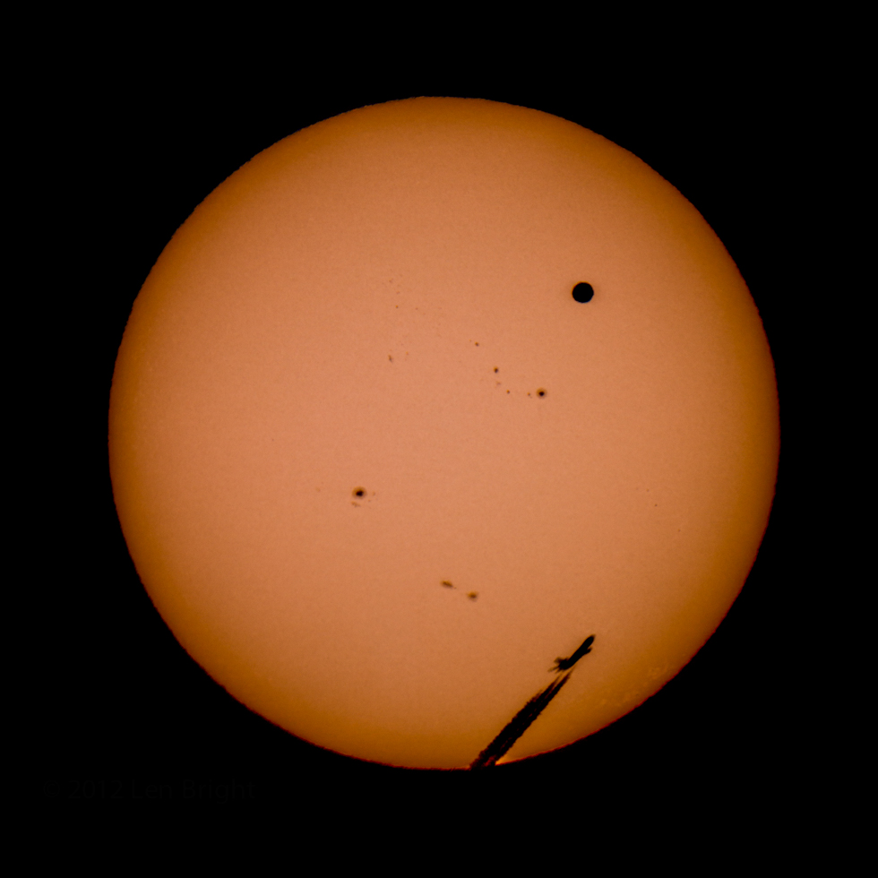
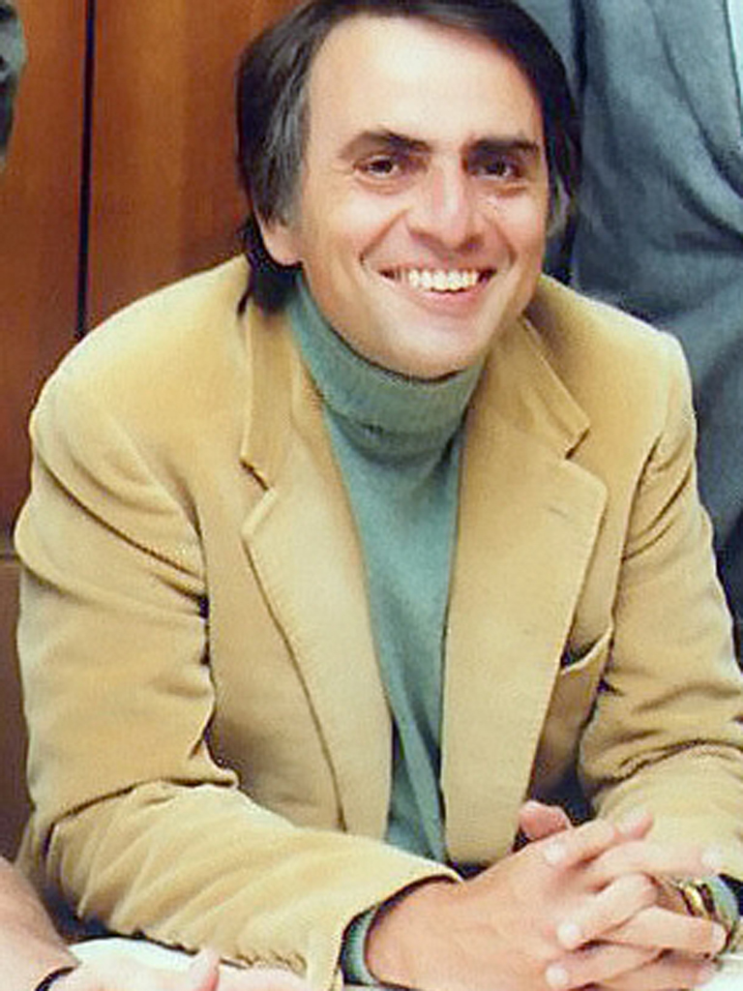
Len Bright
Lowell Observatory

Slide 3
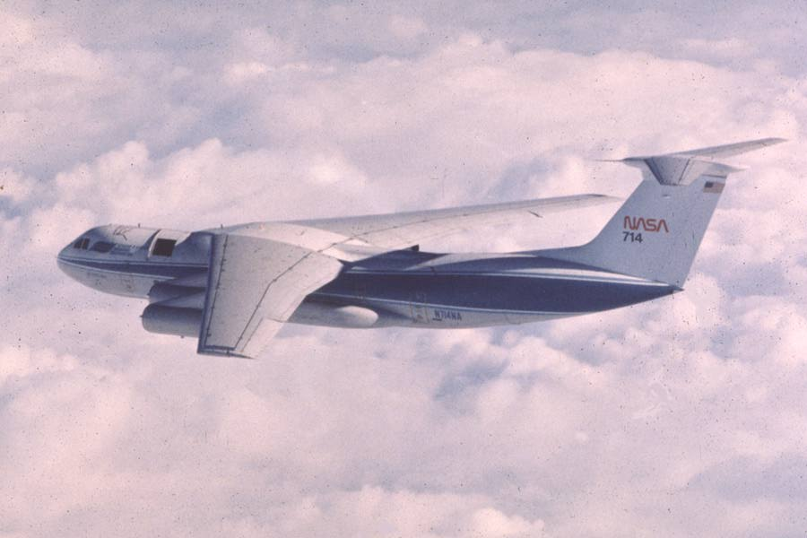
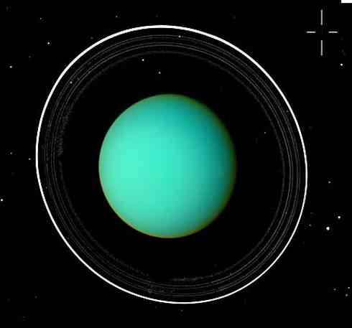

Slide 4
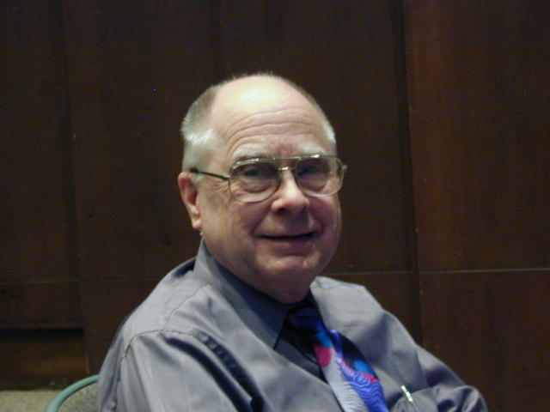

Slide 5
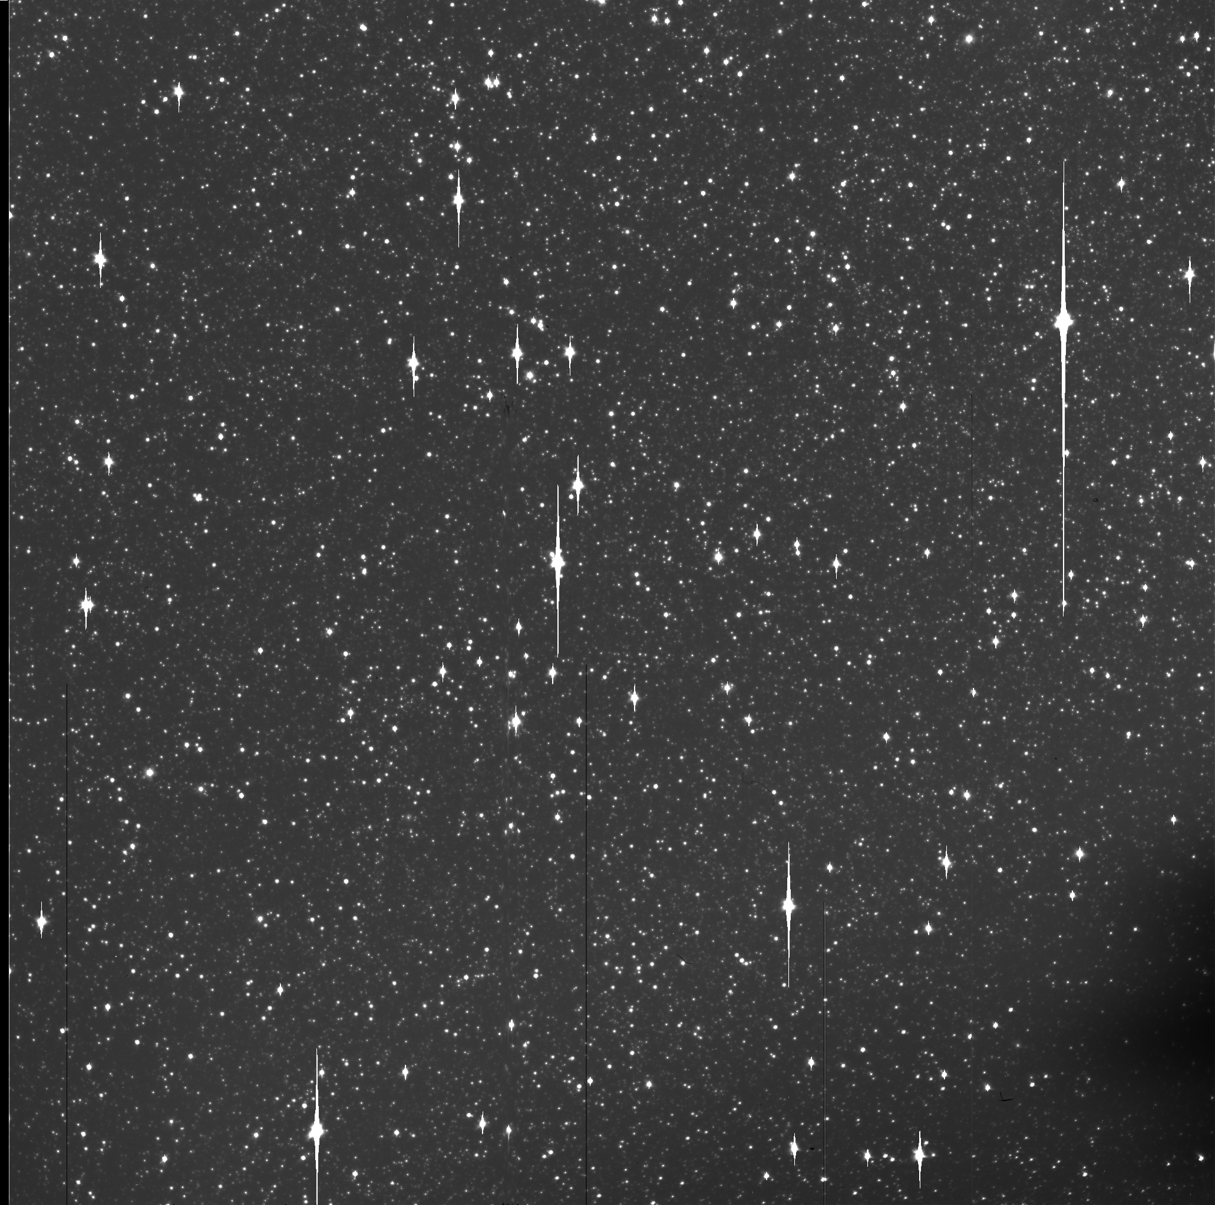
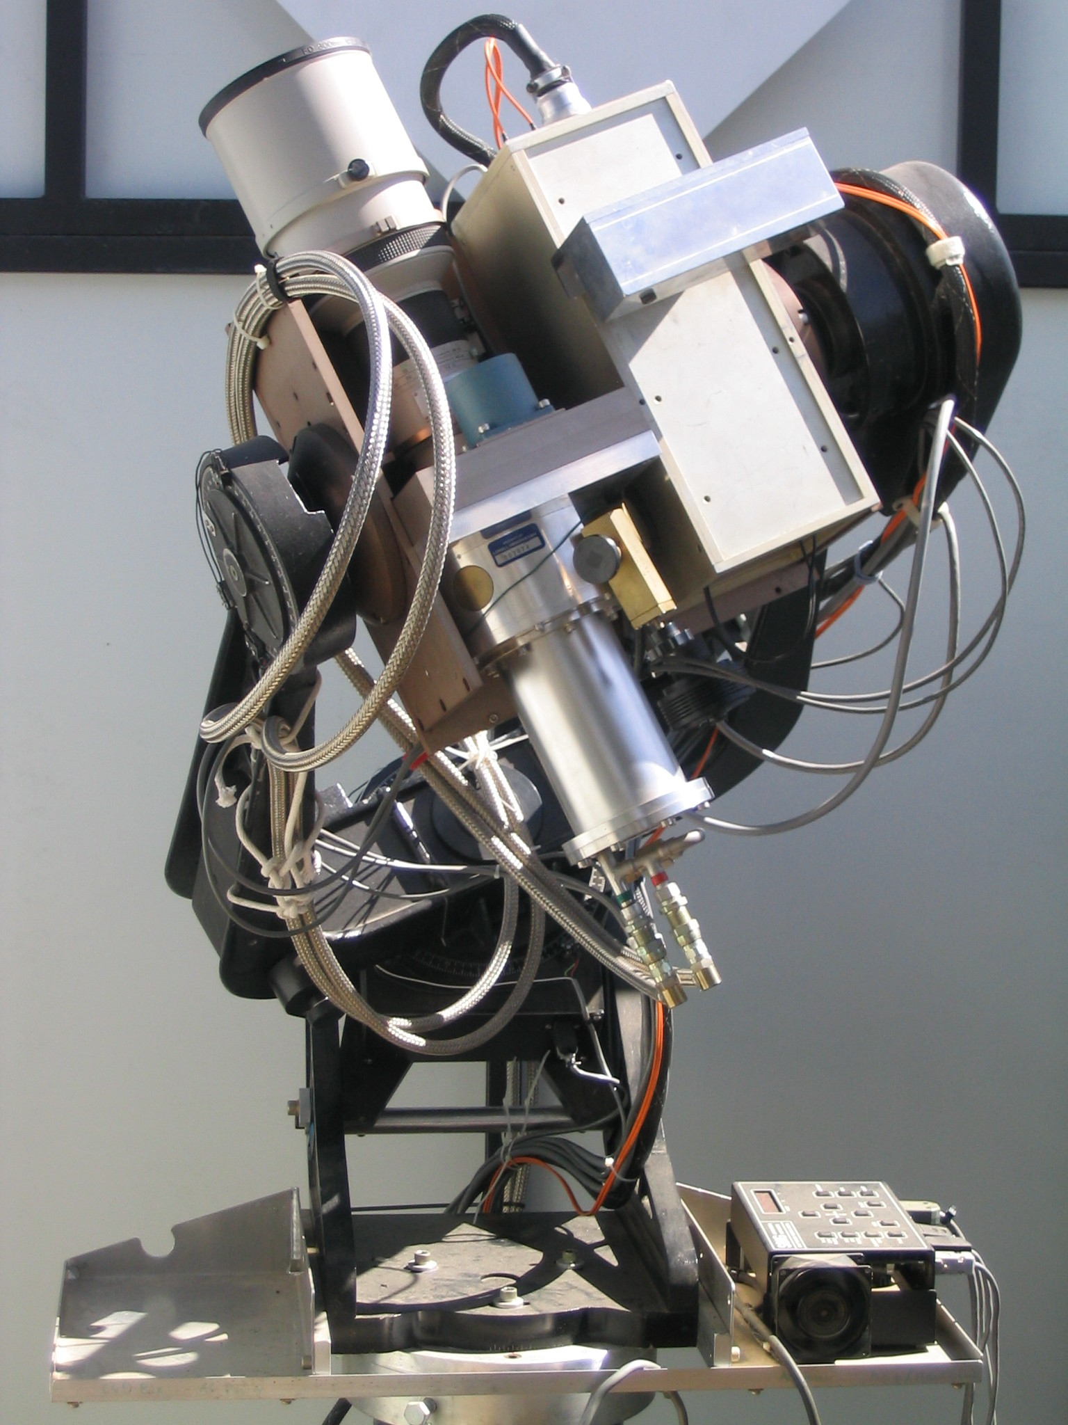

Slide 6
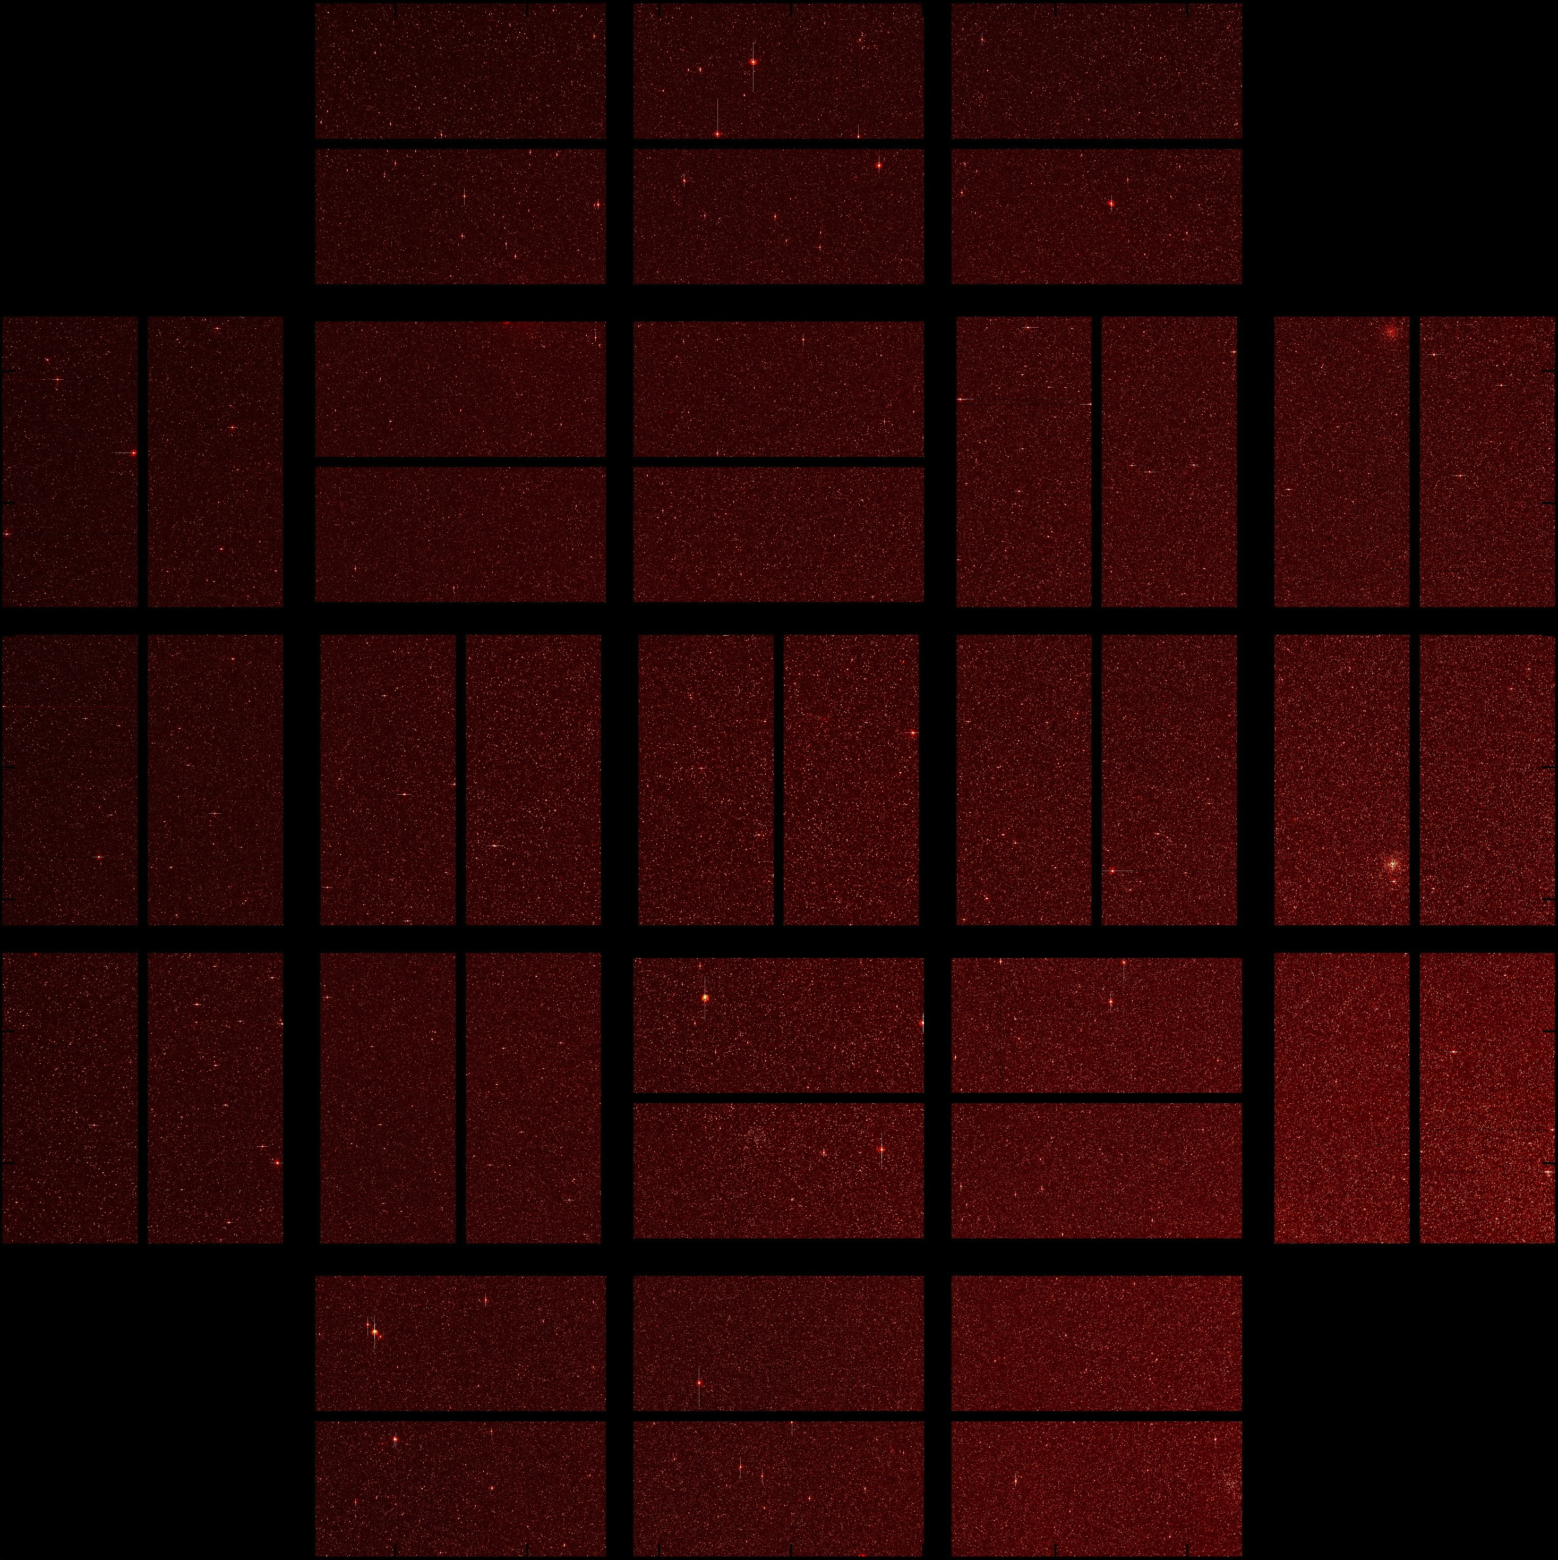
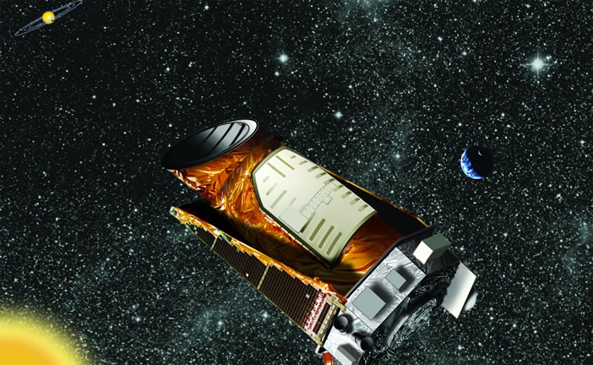
"After correcting for geometric and sensitivity biases, we find intrinsic frequencies of 5.4% for Earth-size candidates, 6.8% for super-Earth size candidates, 19.3% for Neptune-size candidates, and 2.4% for Jupiter-size candidates.”
After just 4 months of Kepler operations we knew the basic answer – there are planets everywhere, all manner of sizes, orbits, host stars.

Slide 7
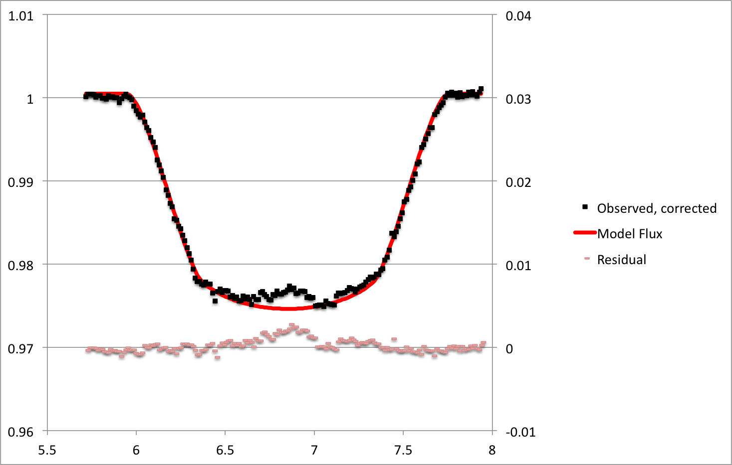
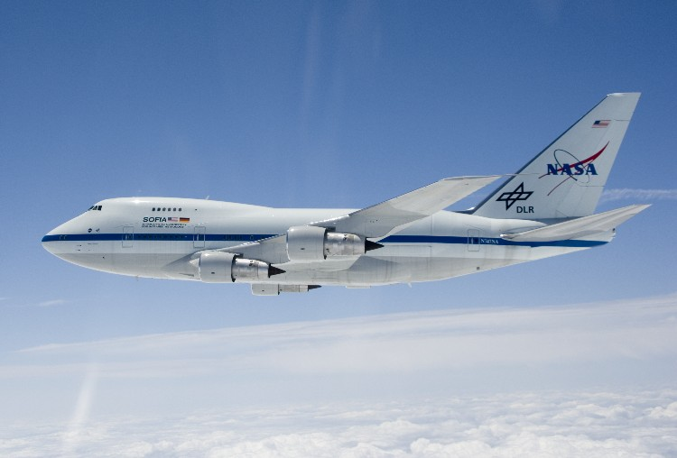
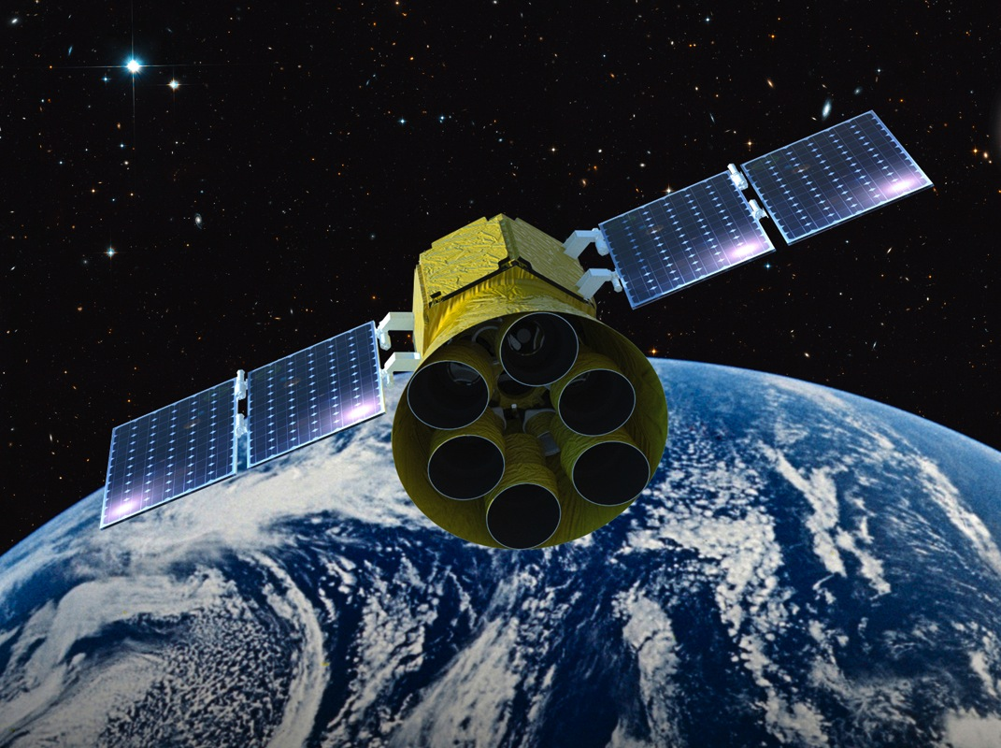
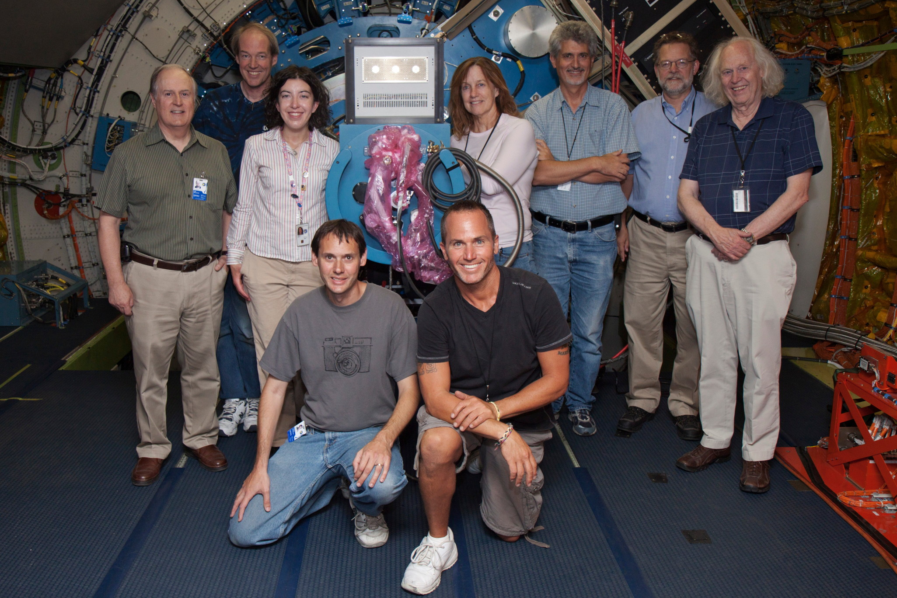

Slide 8
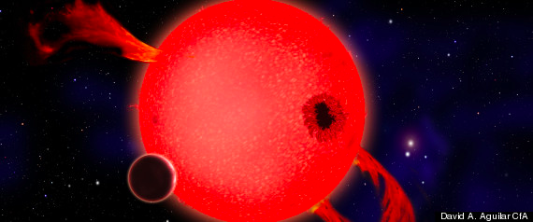
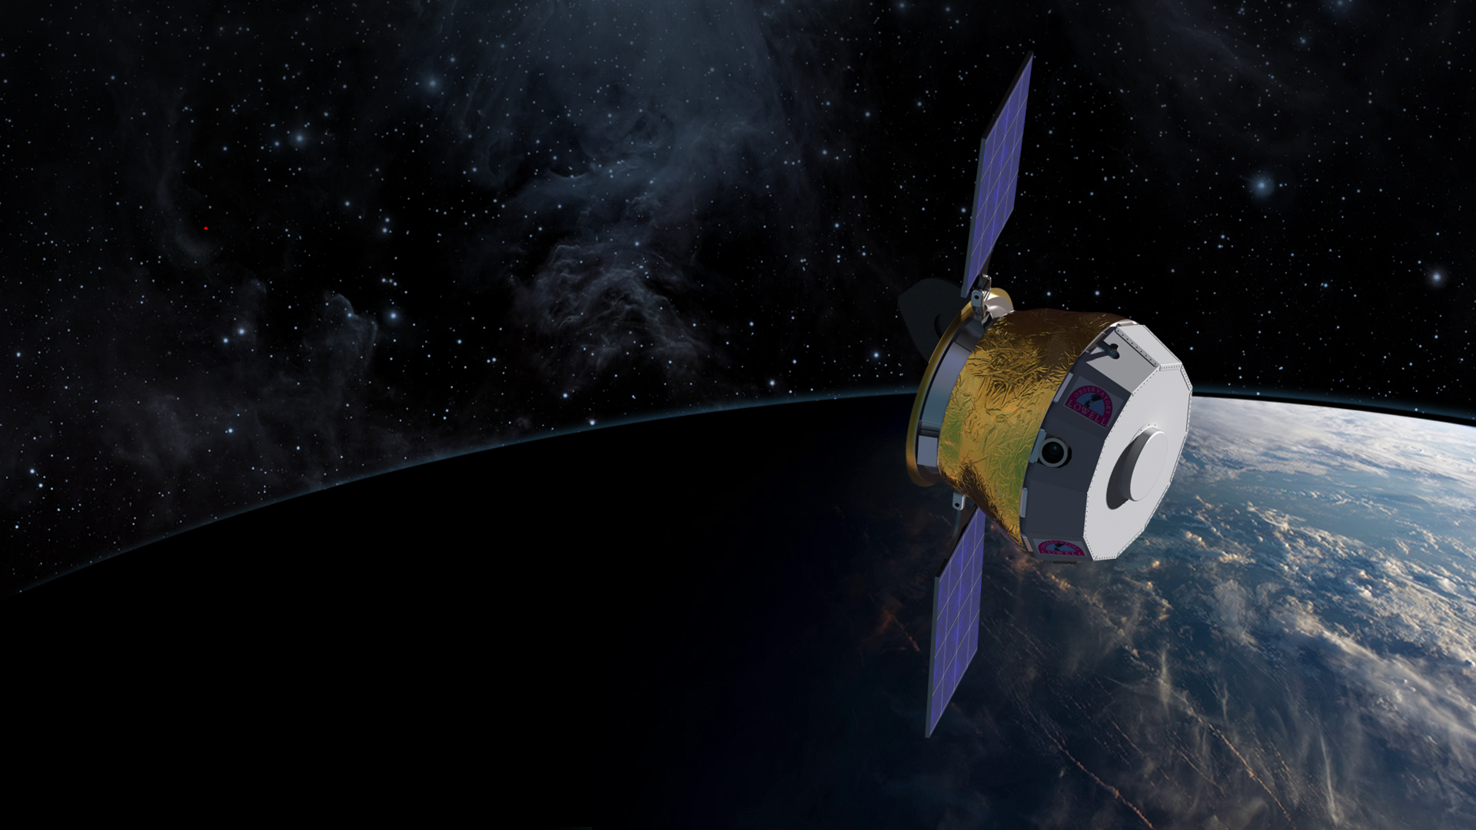
Planetary Resources, Inc.

Slide 9
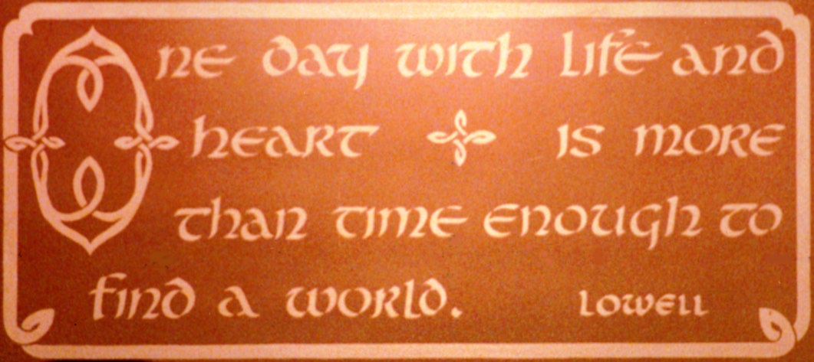
40 years with thousands of lives, hearts, and minds is time enough to begin to understand our place in the Galaxy.

