Slide 1
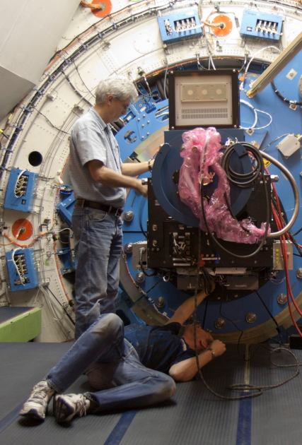
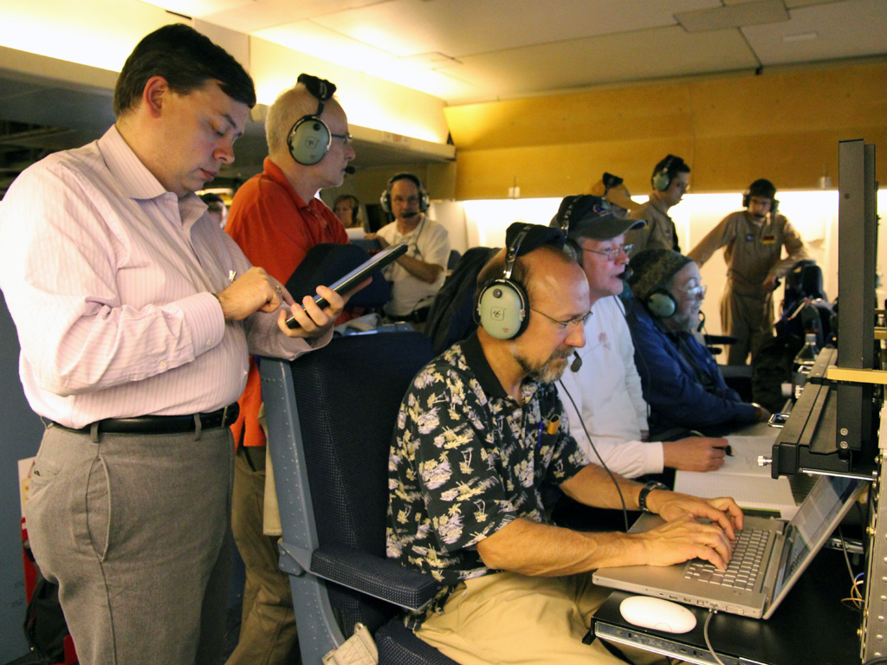
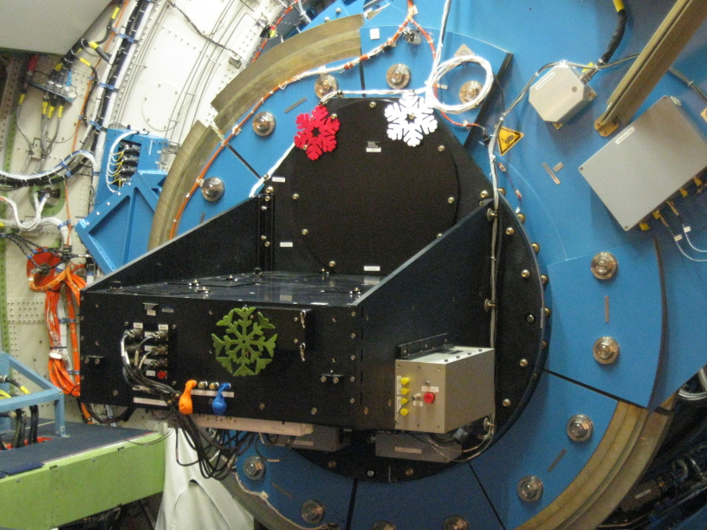
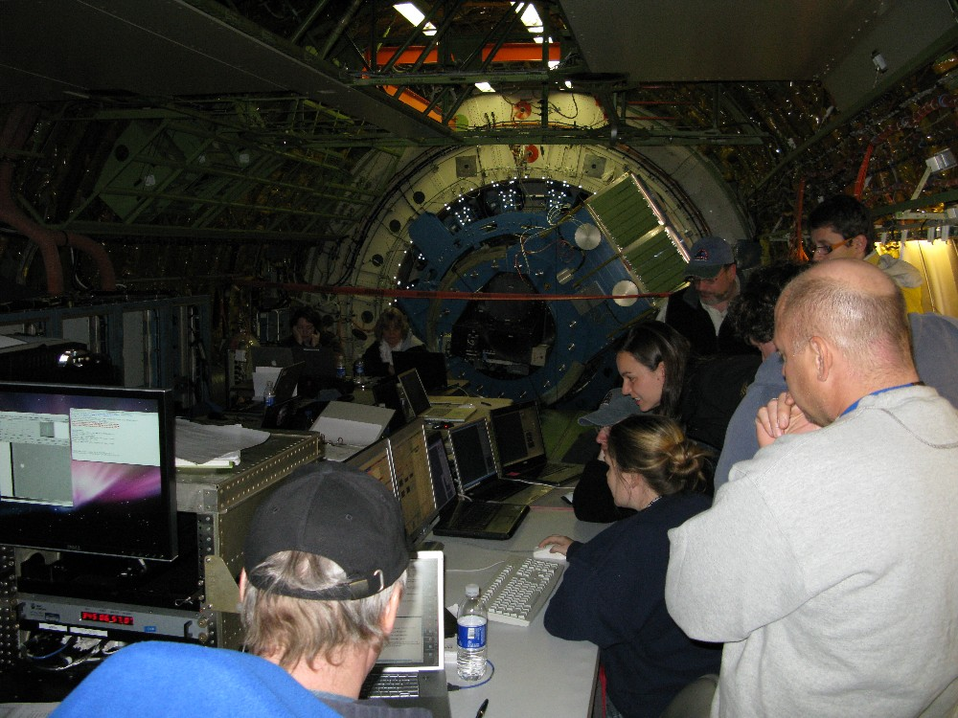
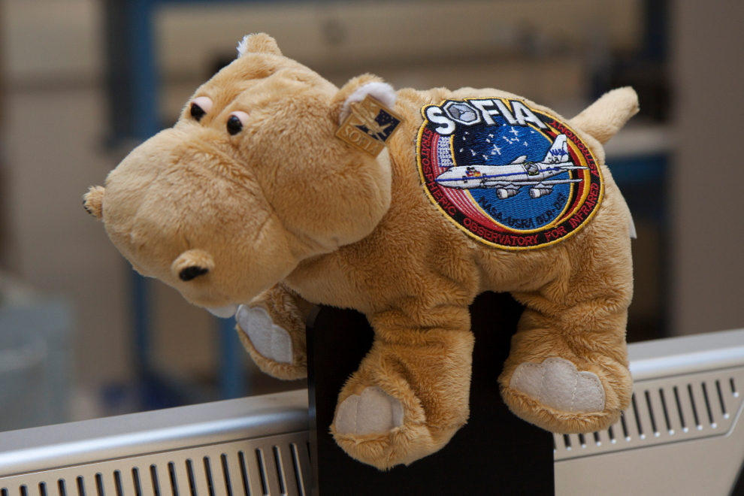
HIPO Commissioning Review
Ted Dunham
Lowell Observatory
6 May, 2014

Slide 2
Outline
Programmatic overview
Instrument Overview
Performance Test Results
Flight Hardware and GSE Status
Software Status
Concept of Operations
Verification and Documentation Status
Conclusion

Slide 3
Programmatic Overview I
Purpose of this review
  Demonstrate integrated HIPO performance
  Demonstrate HIPO readiness to conduct science operations on SOFIA
  Assess readiness of SOFIA Science Ops team to make HIPO available to community
Commissioning Criteria
  Validated SI capabilities and operating modes
  Determined SI performance and limitations
    Fully reflective tertiary
    INF blower
    Pre-cooling
  Delivered all SI documents and data products

Slide 4
Programmatic Overview II
HIPO is a Special-purpose Science Instrument (SSI)
  Operated, maintained, upgraded by PI team
  Resides at PI institution
  Descriptive documentation sufficient for GI to determine feasibility of proposed observation
  GI observations are collaborative
This is a “Commissioning” review, not an “Acceptance” review
  Nothing is being delivered or accepted
  Upgrades and modifications of the instrument, in consultation with USRA and NASA, are to be expected.
  The review is a snapshot of the current situation

Slide 5
Instrument Overview
Scientific Rationale
  Stellar occultation observations
    Mobility, freedom from clouds essential for these time-critical events
    Co-mount with FLITECAM important in some cases
      Original motivation for the FLIPO configuration.
  Extrasolar planet transits
    FLIPO capability looms large in this field
      Critical molecular transitions in FLITECAM/SOFIA wavelength range
      Optical data sensitive to high-altitude “clouds”
      Ability to adapt to developments with new filters may be important
Testing and Engineering Rationale
  Time-resolved imaging capability very useful for test work
  PI’s interest and KAO experience could be applied
  Ability to add specific test capabilities to our SSI is key
So far much more time spent on test than science.

Slide 6
HIPO Configuration
Configuration Options
  1. One or two optical channels
    Dichroic beamsplitter
  2. FLITECAM co-mount
    Gold dichroic beamsplitter
    Throughput reduction
  3. Gate valve window
    Eliminates possible seeing issue
  4. Bare CCD (no reimaging optics)
    Major reconfiguration, not shown
    ~30% better throughput
    ~1’ field at 0.055”/pixel
    Binning speed penalty
4
1
2
3

Slide 7
HIPO Observing Modes
Mode Name | Comments
Find | Repeated readout, used for field acquisition
Single Frames | Ordinary CCD imaging; most cameras only do this
Basic Occultation | Time series with full readout flexibility, multiple subframes.
Fast Occultation | Better duty cycle than basic occultation at high frame rates but only a single subframe can be supported
Pipelined Occultation | Faster integration interval than fast occultation, but only certain special subframes can be supported
Fast Dots | Very fast, uses CCD as analog storage so limited duration. Used for telescope test work.
Slow Dots | Not very useful with frame transfer CCDs.
Strip Scanning | Used for prediction astrometry and telescope test. Often called TDI mode.
Reference: Dunham, et al., Proc SPIE 7014, 164-173 (2008)

Slide 8
HIPO Performance
Parameter | Discussion
Read Noise | 3 e⁻ at 200 kpx/sec and 8 e⁻ at 1 Mpx/s, both unbinned. 11 e- at 1 Mpx/s binned 3x3. Sky limited in most cases.
Time Accuracy | 3.5 microsecond delay in DSP trigger loop
Position accuracy | 5 meters (SA off), GPS limited
Read rate | 11-22 Hz, 3 80x80 subframes binned 3x3 depending on pos’n 80 Hz, 1 80x80 subframe binned 3x3 in pipelined occ. mode
Optics Throughput | Blue side: 66-73% for 0.34 - 0.64 micron range Red side: 72-82% for 0.46 - 1.0 micron range
CCDs | e2v CCD47-20 1K frame transfer, thinned back-illuminated e2v CCD67 256x256 frame transfer, thinned back-illuminated
Field of View | 5.7’ square, 0.33 “/pixel (unbinned) w/ reimaging, CCD47 2.8’ square, 0.66 “/pixel (unbinned) w/ reimaging, CCD67
Potential upgrades | Special filters, low-resolution grism, new CCDs, IMC, …
Reference: Dunham, et al., Proc SPIE 7014, 164-173 (2008)

Slide 9
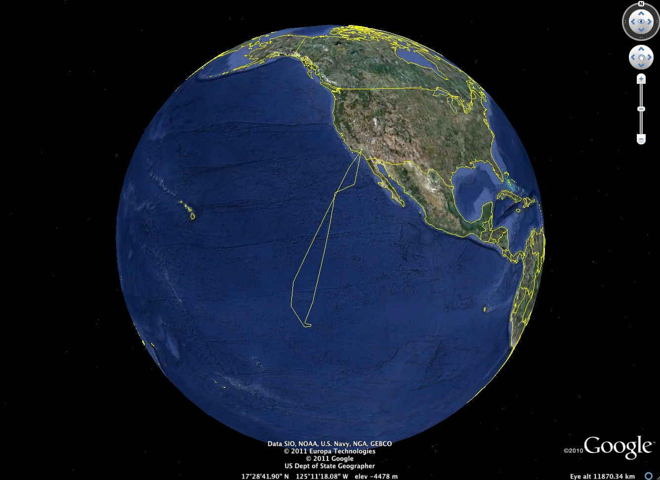
Pluto Occultation Observational Circumstances
Plan of attack:
Early calibration leg
Test work
Final prediction
  Data from USNO Flagstaff Station
  ftp to MIT for instant analysis
  Iridium telephone update to flight deck
  Flight plan updated
Turn at updated time
Observe event
Test work on the way home till sunrise

Slide 10
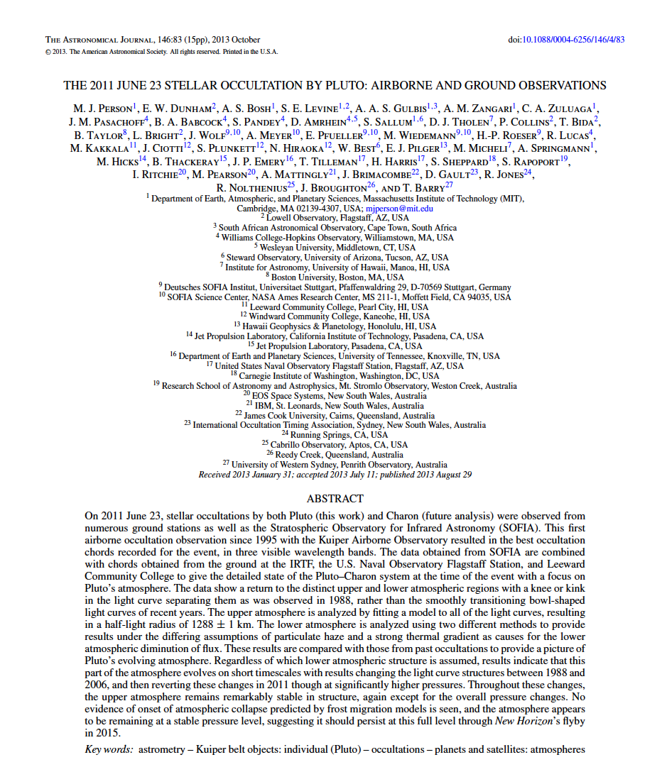
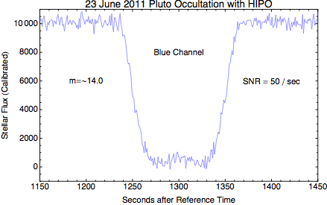
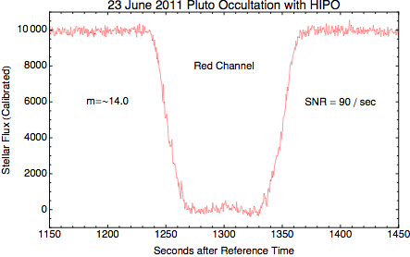
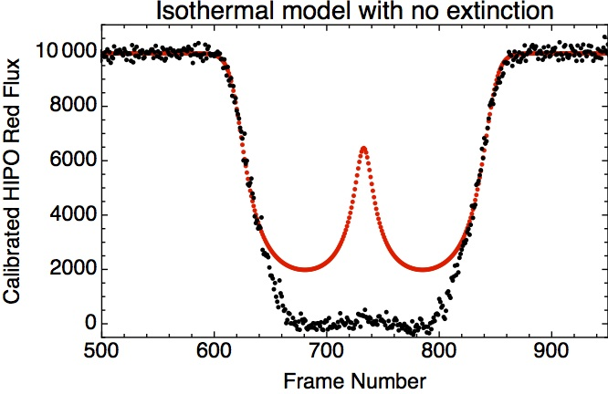
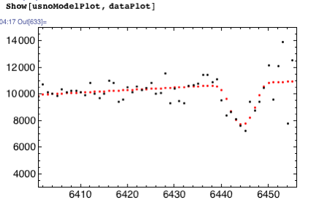
2011 Pluto Occultation Light Curves
Central brightening seen in all lightcurves
Post-event fit to two chords indicates impact parameter
~100 km
  Solution supported by USNO observation at high airmass
Expected to see a much brighter and sharper central flash than this
  Strong thermal inversion?
  Extinction?
    If so, episodic
  Atmospheric asymmetry?
    Easy to distort central flash, hard to move it.

Slide 11
HD 189733 Transit
Raw Data
Absolute photometry
  Bright star
  No field references
Slope is atmospheric extinction

Slide 12
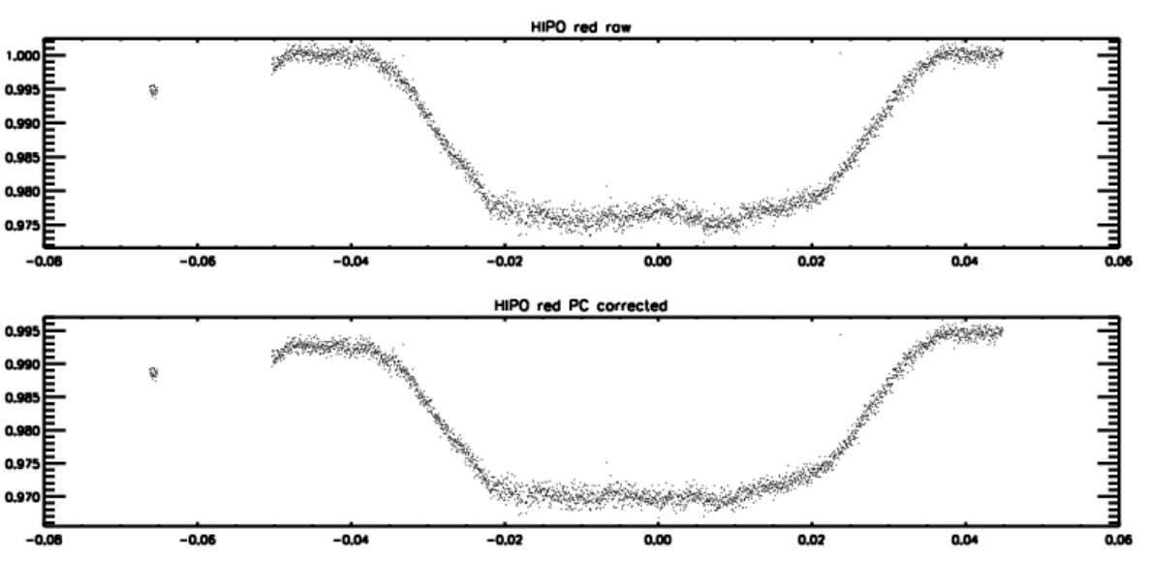
HD 189733 Transit
De-correlated lightcurves
  How much structure is real?
  Hash on blue side must be artifacts
  Too little baseline to tell
Paper in process

Slide 13
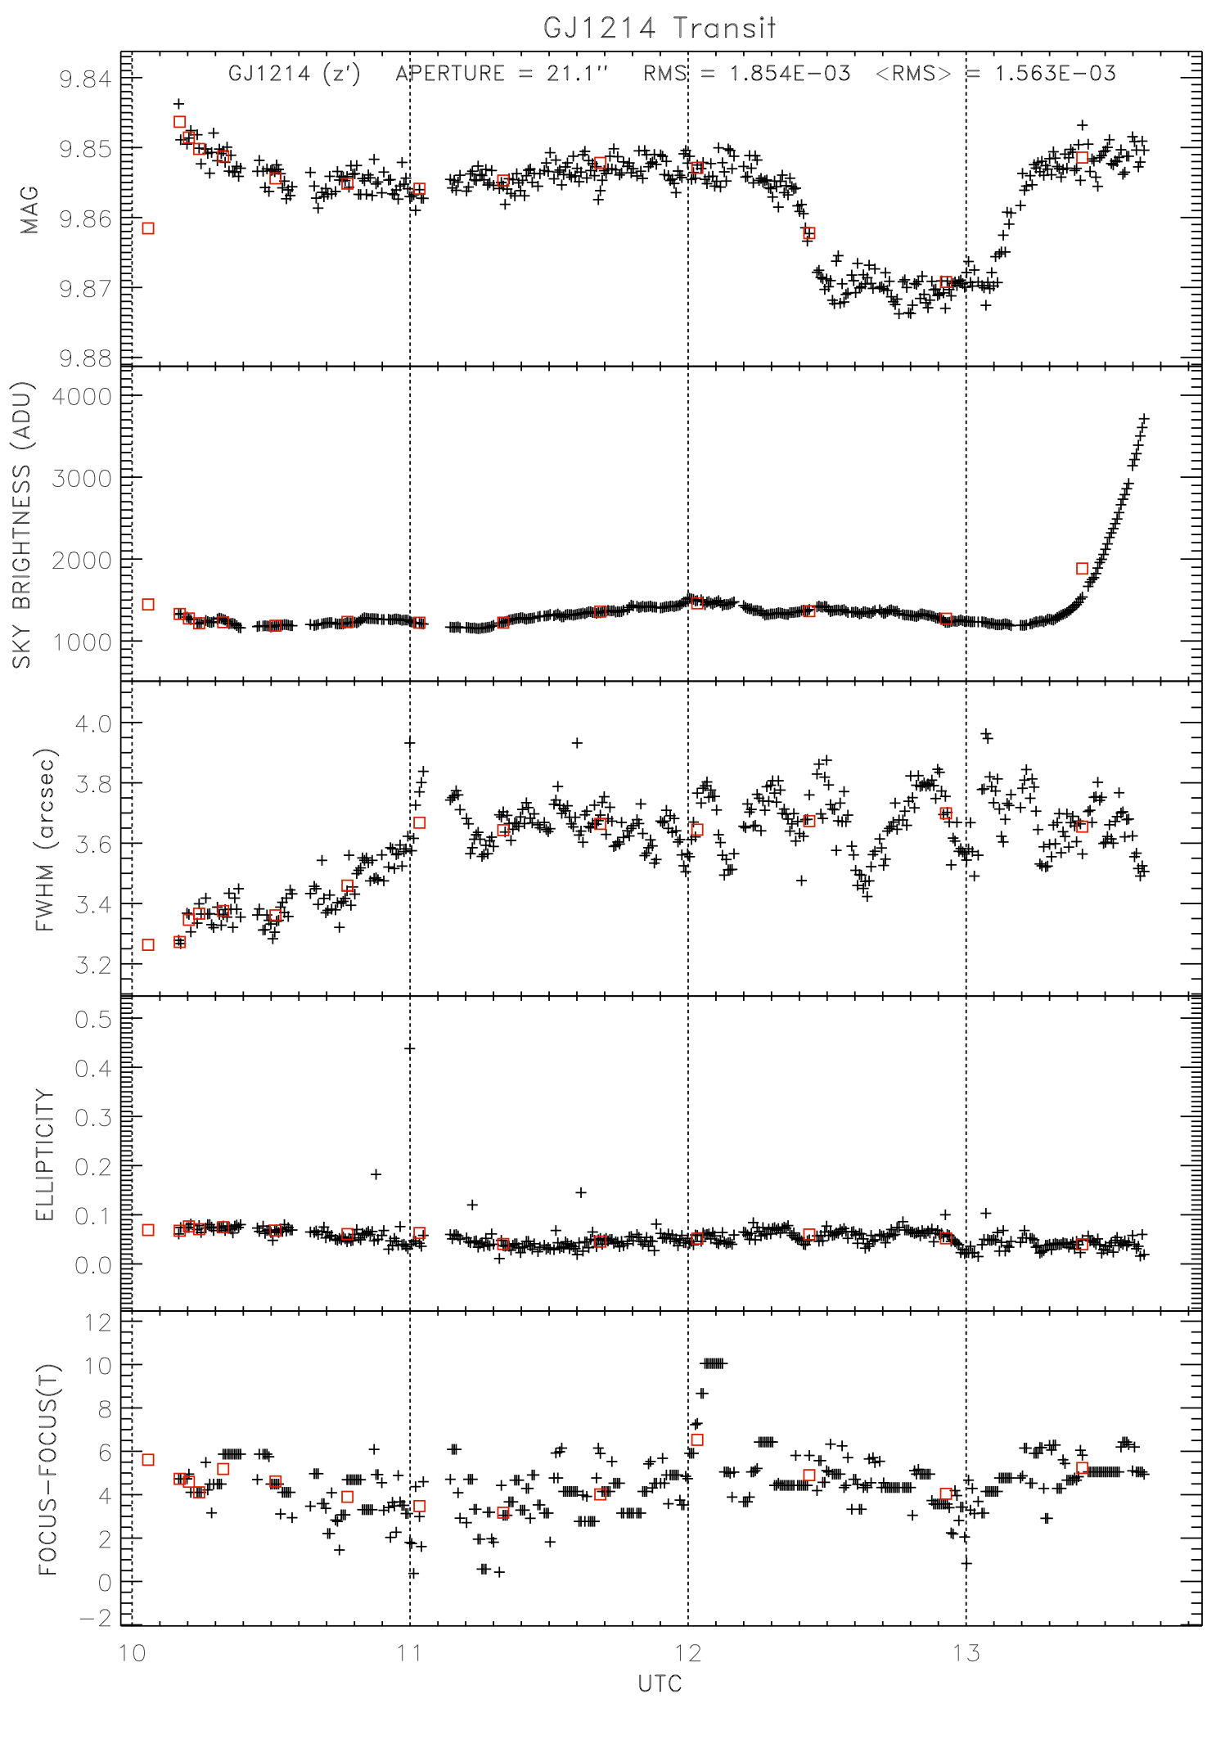
GJ1214 Transit
Target star ~100x fainter than HD 189733
  10x longer exposure time
  Photon starved.
  Heavily impacted by tertiary
    Had to use open blue.
Sunrise landing constraint
  Force flight plan too far E
  Lost post-event baseline
  When can we get rid of this?
Delete this slide if posted in a public location.

Slide 14
Special Test Capabilities
Flange Fiducial
  Defining artifact for the gyros, imagers, and SIRF
  Maps HIPO pixel grid to Si mounting flange
Pupil viewing
  Used to align aperture with TA
  Defined pupil alignment to transfer to TAAS
Shack-Hartmann Wavefront Sensing
  Used to define the current SMA_T1 focus calibration
  Special jig needed to inject “perfect” star in focal plane
Spherical button
  Used to track TCM and FCM performance in focal plane
    Inject artificial star image into TA; observe return image from concave spherical button on secondary.
    FCM and TCM scale factors, stability, repeatability, chopping tests, etc.
High speed imaging capability
  CCD67s increased imaging speed up to 2 KHz
Blue side jitter test jig
  Enabled check of jitter internal to HIPO
Scripting capability for various V&V tests
  4-corners test, nod settle time, matched chop/nod
  Auto-focusing, tweaking, guiding, etc.

Slide 15
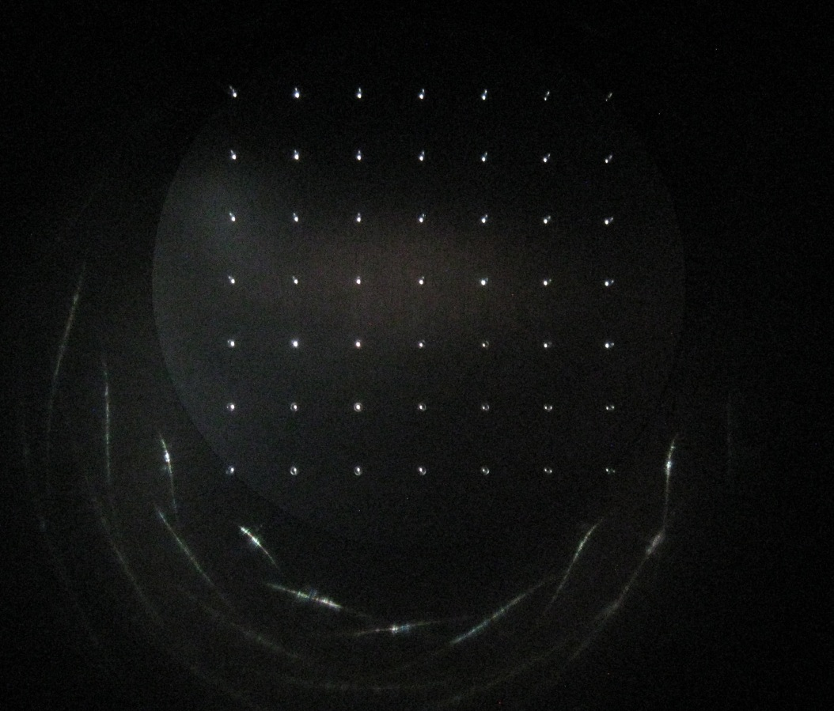
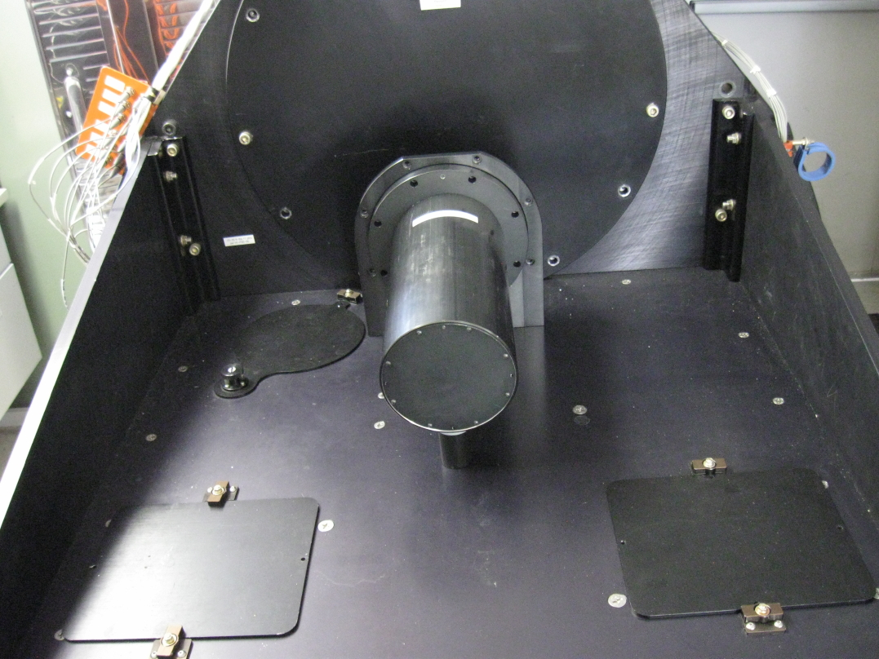
Flange Fiducial
Flange Fiducial
  Machined jig
  Precise hole pattern in TA focal plane
  Defines center of SI flange and orientation & scale.
  Gyros and imagers aligned to the flange fiducial during 2008 line-ops. See SCI-US-TRP-SV03-2012

Slide 16
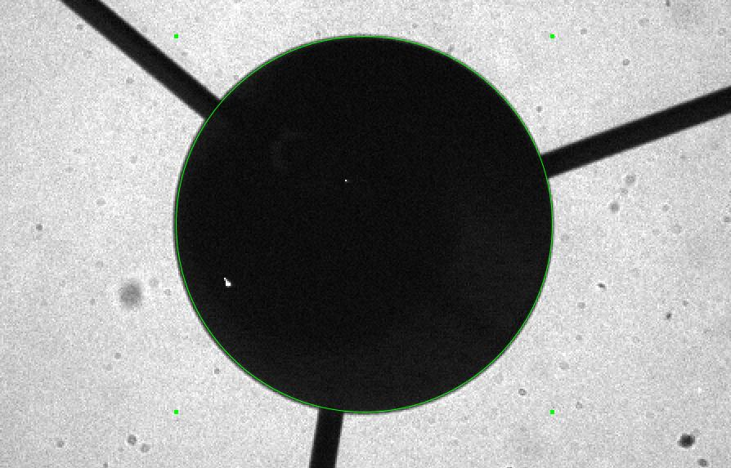
Pupil Viewing
Determined zero point for aperture, 2008
SCAI-2 image to record pupil position
  Transferred to the TAAS a few days later

Slide 17
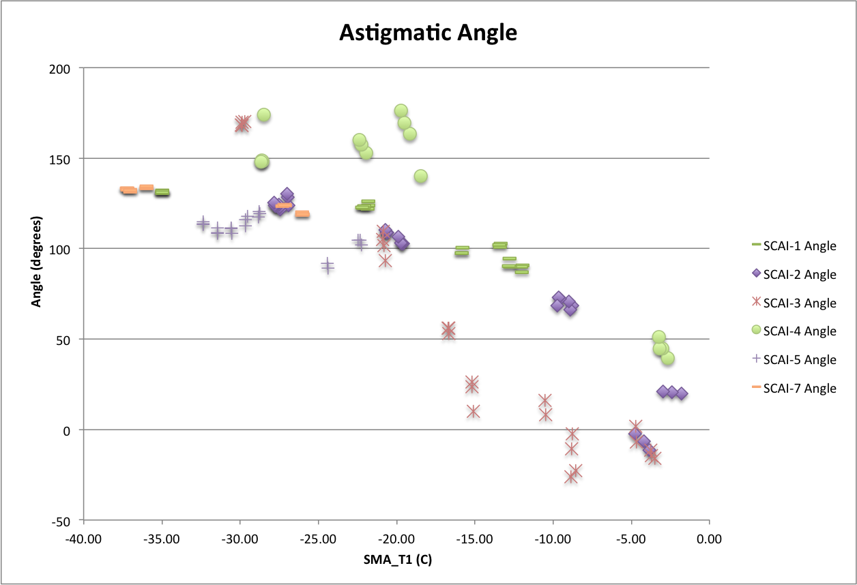
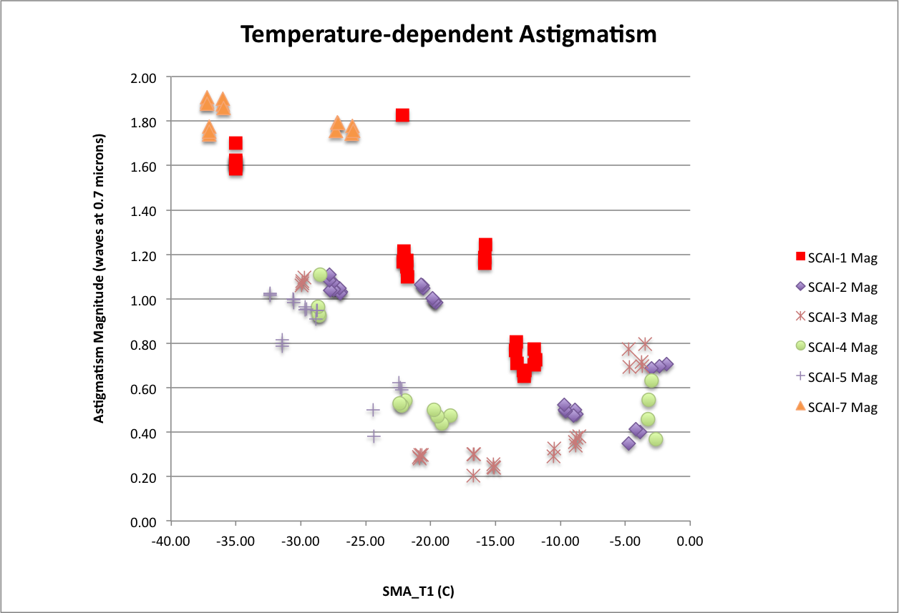
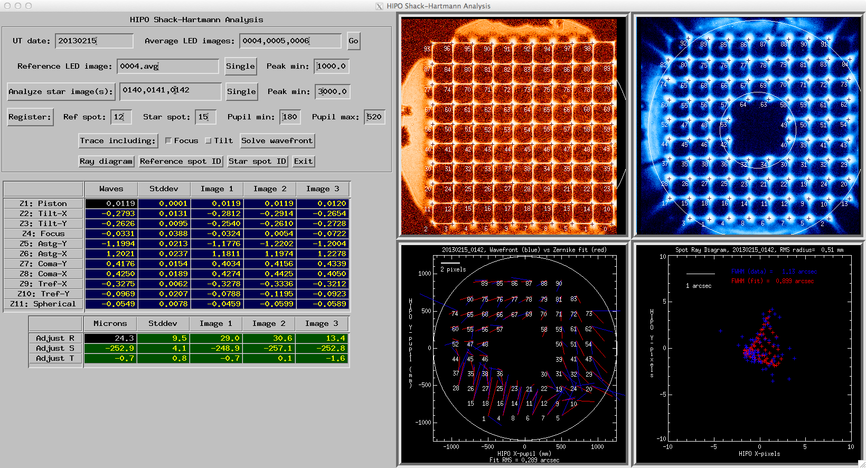
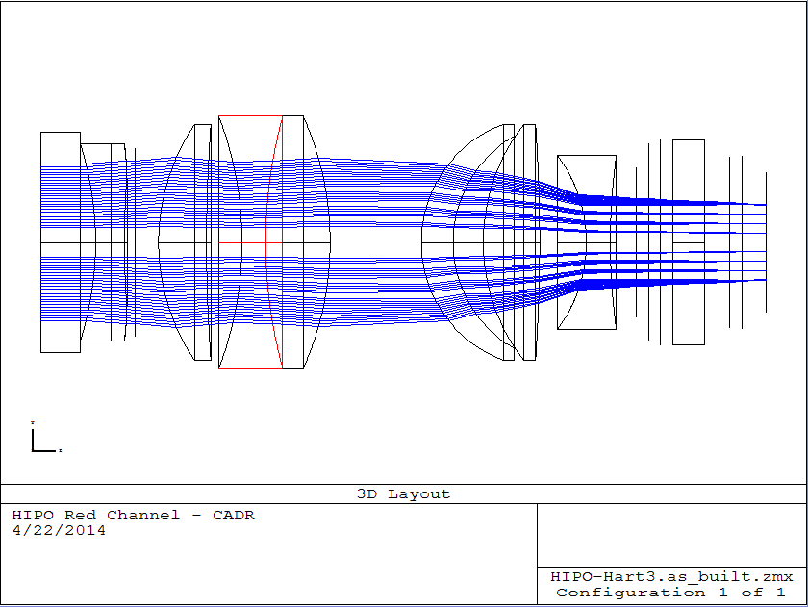
Instrument Overview
Shack-Hartmann wavefront sensing

Slide 18
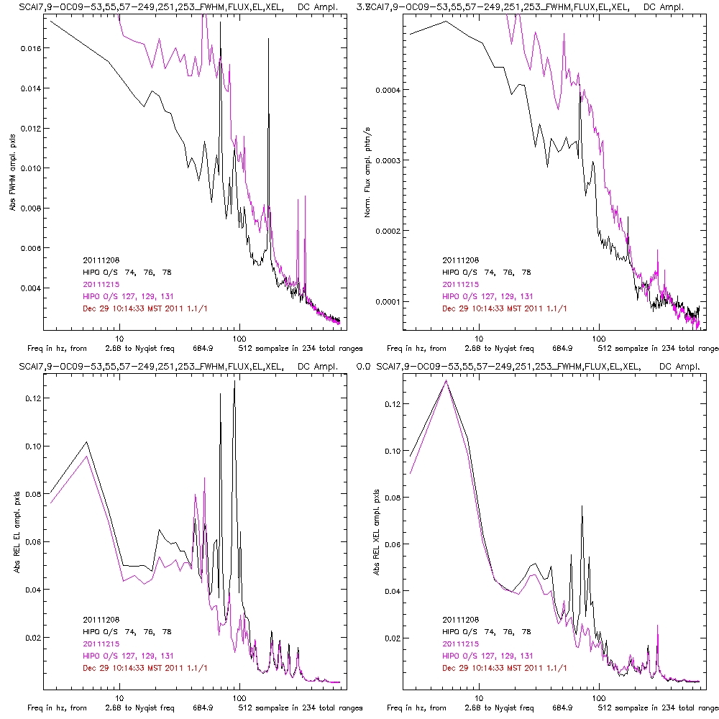
High-speed Imaging
Several approaches
Dots:
  Limited time duration
  ~20-30 KHz rates possible
  Chopper risetime (1 KHz)
Occultation modes
  Basic, fast, & pipelined
  Basics used for most things
  Pipelines for AMD work
    Figure shows AMDs off (black) and on (magenta) at 41000 ft
    UL: FWHM, UR: Flux
    LL: EL pos’n, LR: XEL
    Nyquist freq. 685 Hz

Slide 19
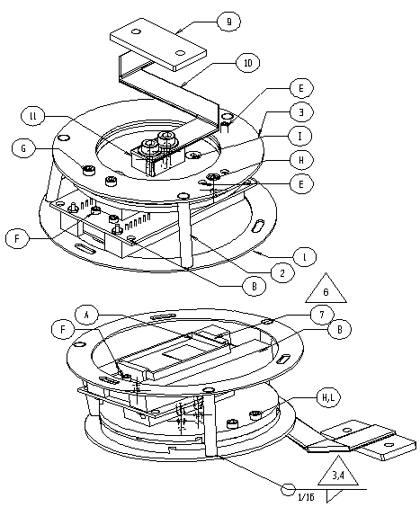
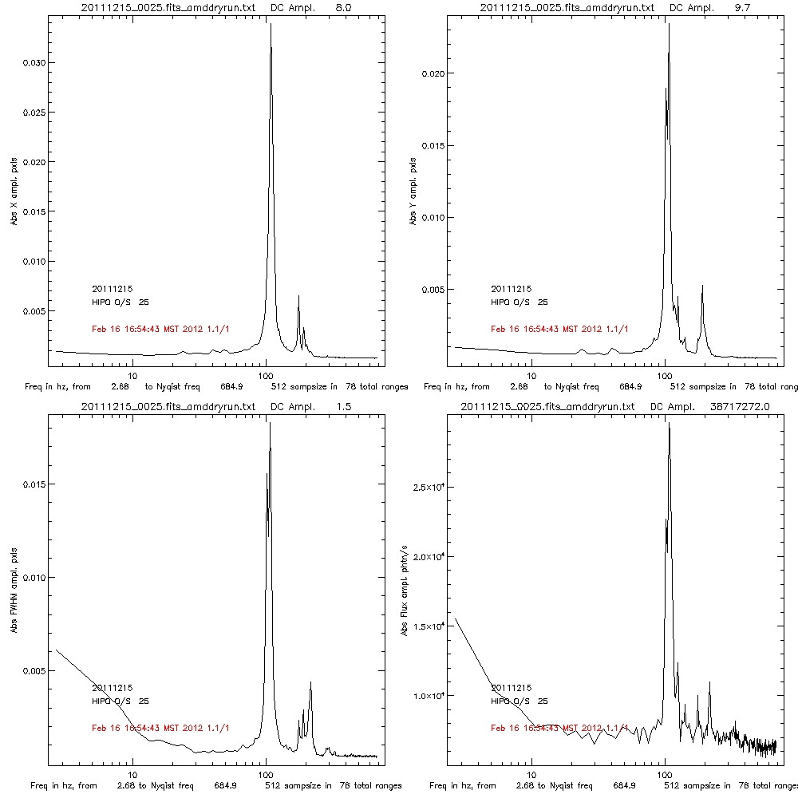
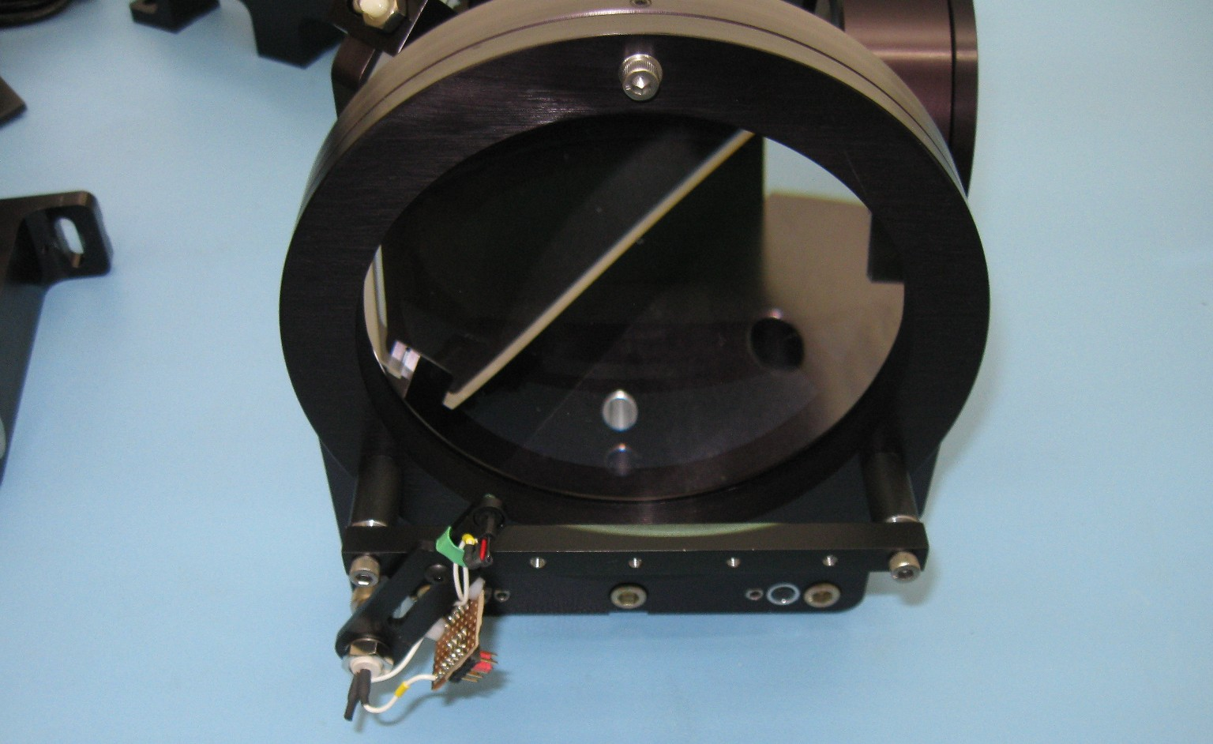
Internal Jitter Test Fixture
LED-illuminated pinhole in TA focal plane
Look at pinhole image motion in lab and in flight
  Amplitude ~0.1”
  Resonances at 100 & harmonic at 200 Hz
CCD mount likely culprit

Slide 20
Performance Test Results
HIPO Commissioning Tests:
  HC-01 Cosmic Rays Report
  HC-02 Sky brightness Report
  HC-03 Image Size &shape Report
  HC-04 Scintillation Ongoing work, mixed up with HC-09
  HC-05 SMA function SCI-US-TRP-SV03-2012 (2008 line-ops)
  HC-06 GPS check Report. Works well. Won’t discuss.
  HC-07 INF vacuum Report. Doesn’t leak. Won’t discuss.
  HC-08 Throughput Report
  HC-09 Precise photometry Major ongoing research area.
  HC-10 In-air prediction. Won't work. PSF too variable. Won’t discuss
  HC-11 Pluto occultation Paper published in AJ. Won’t discuss further.
  HC-12 TAAS alignment Report. Worked well for FLITECAM & FIFI-LS
  HC-13 Humidity/Temp Report
  HC-14 Blue internal jitter Report. Won’t discuss further.

Slide 21
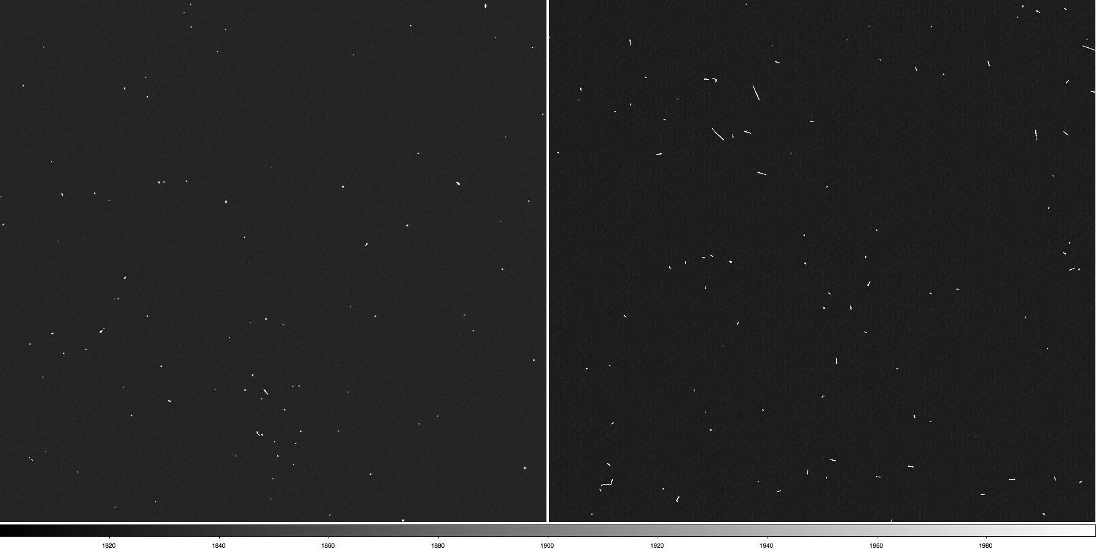
HC-01: Cosmic Rays
Concern:
  Photometric errors from CR strikes
  More serious with deep depletion CCDs – many more long streaks
Test:
  Take scripted sets of biases & dark frame pairs at various altitudes and latitudes
  Count impacted pixels and “clumps”

Slide 22
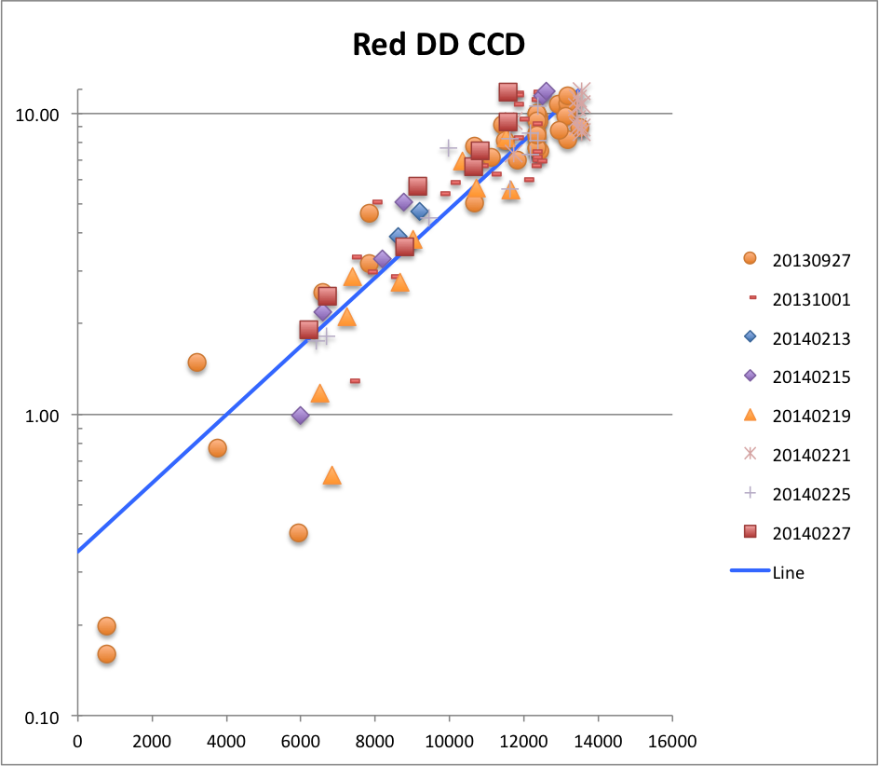
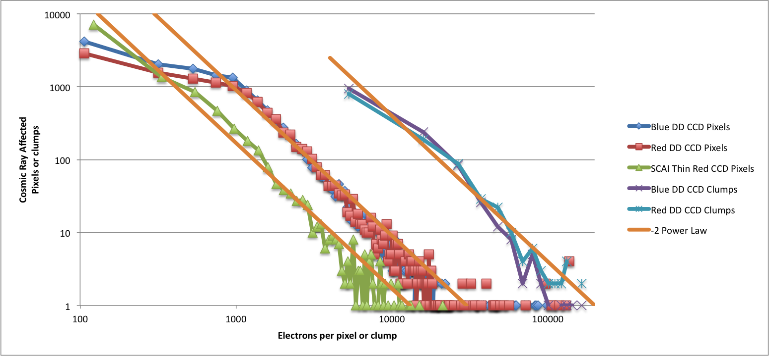
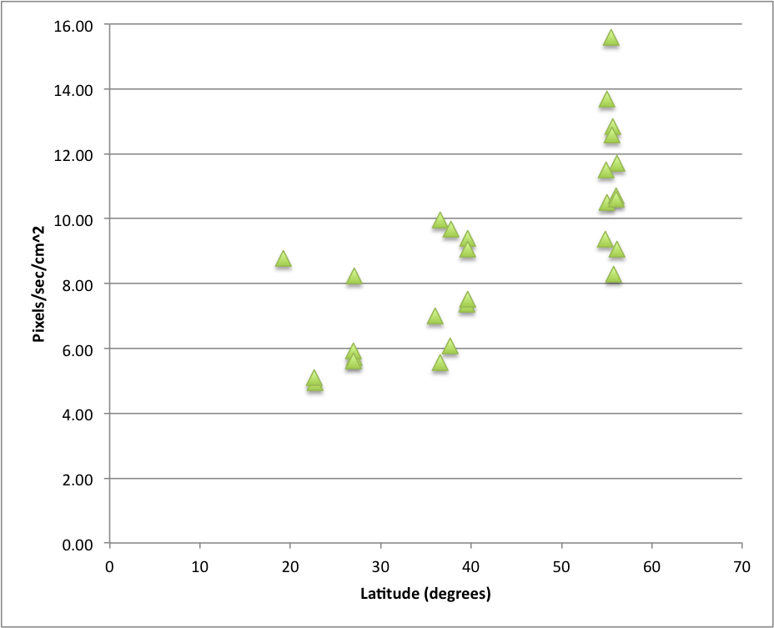
HC-01: Cosmic Rays
Results:
  Exponential altitude increase
  ~2x latitude dependence
  Power law pulse height distribution – but falls off at low signal level in DD CCDs.
  Cosmic ray rejection will be needed in some cases

Slide 23
HC-02: Twilight Sky Brightness
Concern:
  Sky brightness for low-elongation occultations
    November 2014 event is a perfect example
Test:
  Measure twilight sky brightness vs solar elevation angle, azimuth, TA elevation angle, and wavelength.
    This is the famous sunset twilight 360 degree circle test that was lost so many times!
  Determine a model for observed sky brightness for a given event

Slide 24
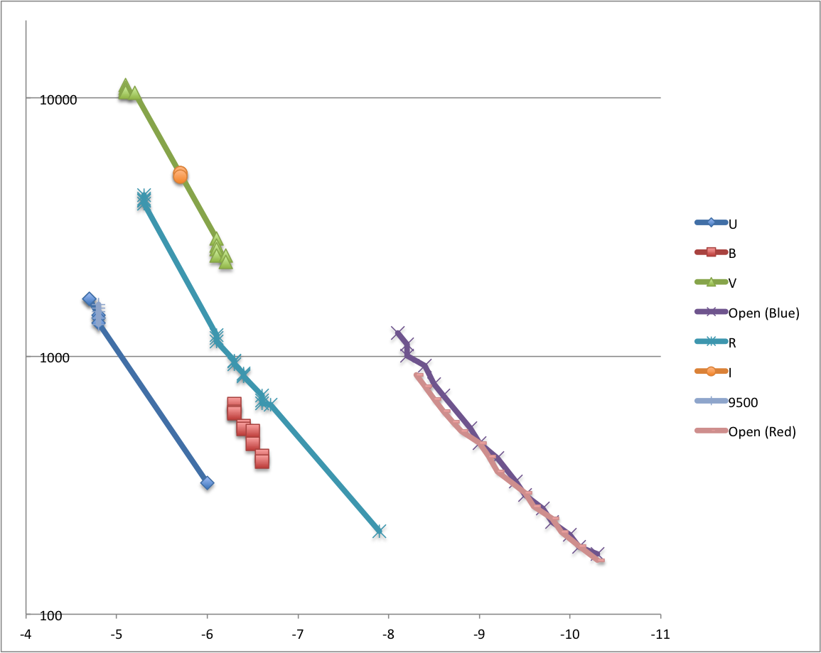
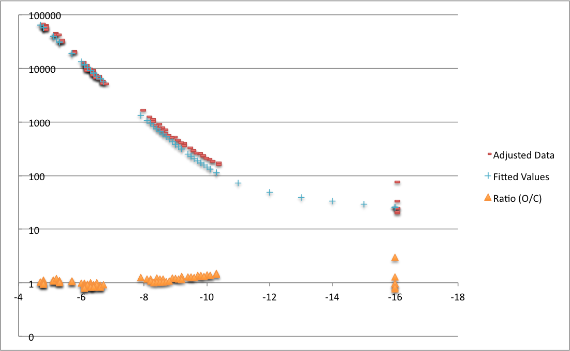
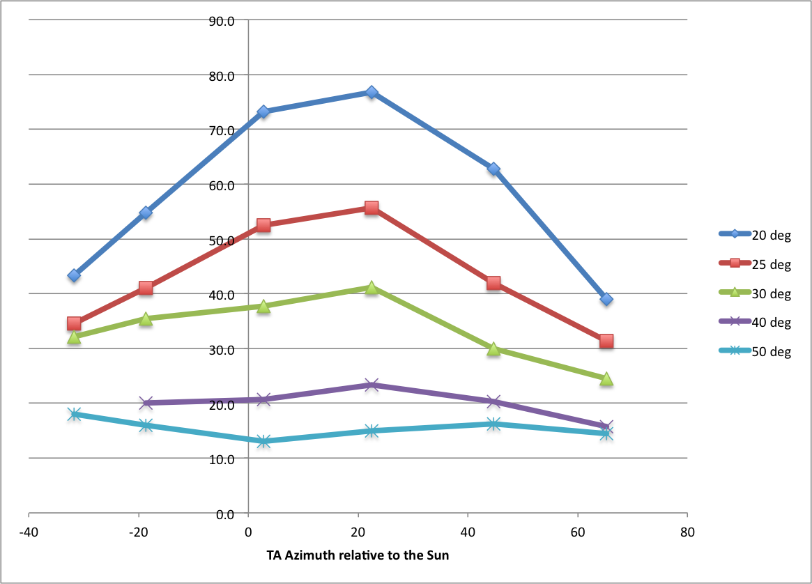
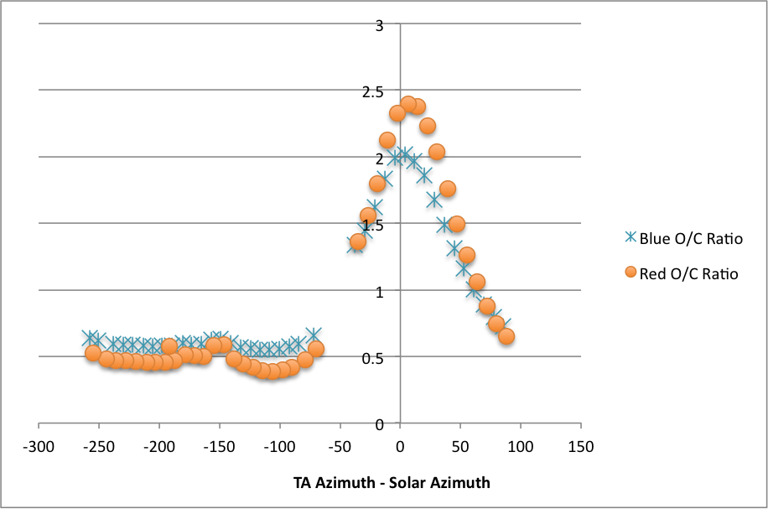
HC-02: Twilight Sky Brightness
Results:
  Sky brightness varies nearly exponentially with solar elevation
  Bright peak near solar azimuth, mostly at low elevation angle
  Variation in sky brightness only weakly dependent on wavelength
  Limits acceptable prediction offset

Slide 25
HC-03: Image Size and Shape
HIPO-centric interest:
  Triton & ring occultations
  Precise photometry
Broader interest
  Better spatial resolution
  Narrow slits
Long history of research
  KAO flight tests
  AOA & SOFIA wind tunnel
  SOFIA flight tests
Many contributors
  Shear layer
  Cavity seeing
  Optical figure & alignment errors
    Focus & astigmatism mainly
  Image jitter
Shear
Layer
We are
about here
Diffraction
Everything else
Predicted 50% EE diameter from SOFIA IV wind tunnel test

Slide 26
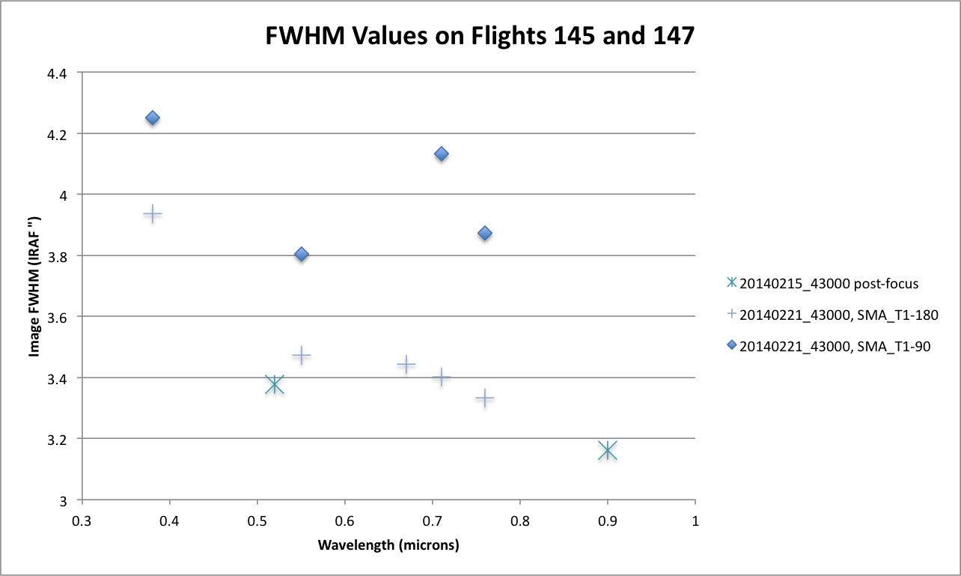
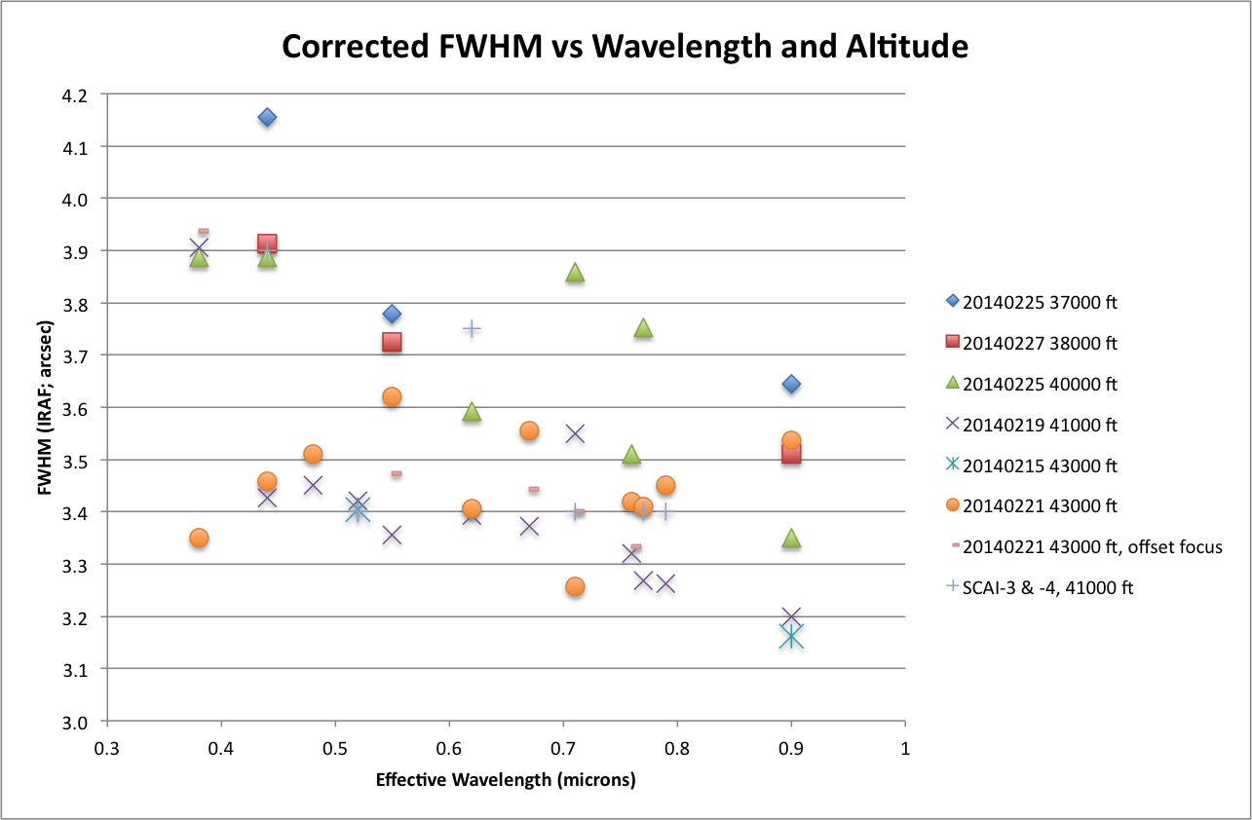
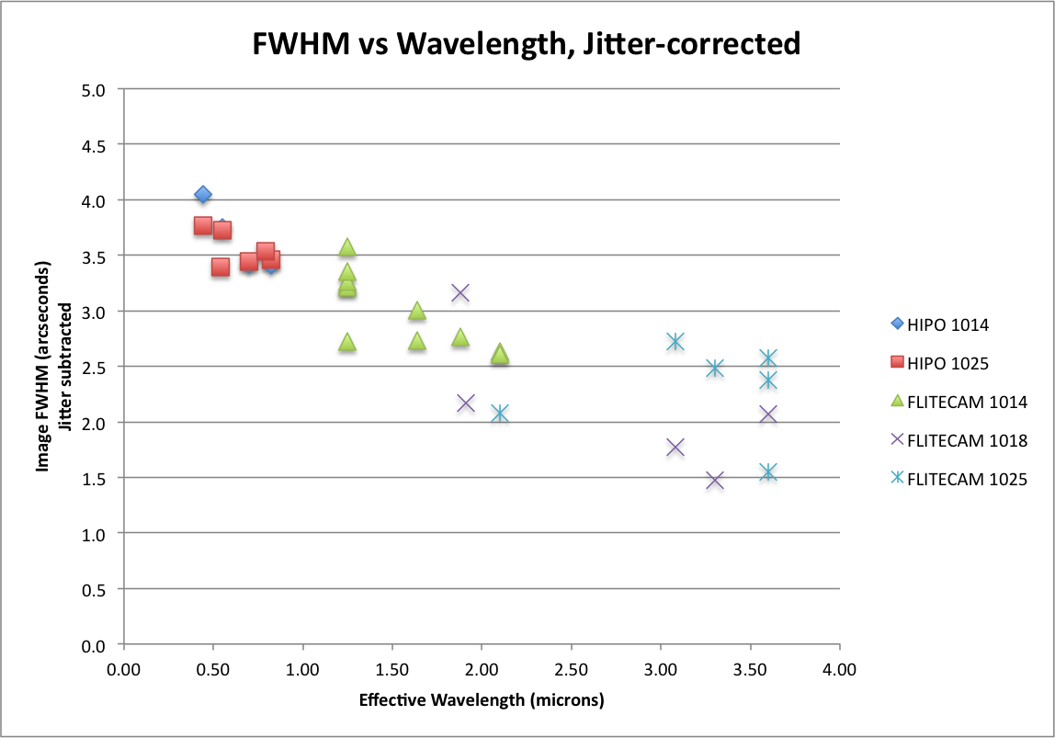
HC-03: Image Size and Shape
FWHM sensitivity
  Altitude
  (really density)
  Wavelength
  Temperature
    Astigmatism
Focus problem
Jitter correction
  SCAI data:
  1.5” rms jitter assumed
Work areas:
  Jitter
  Astigmatism
Feb. 2014

Slide 27
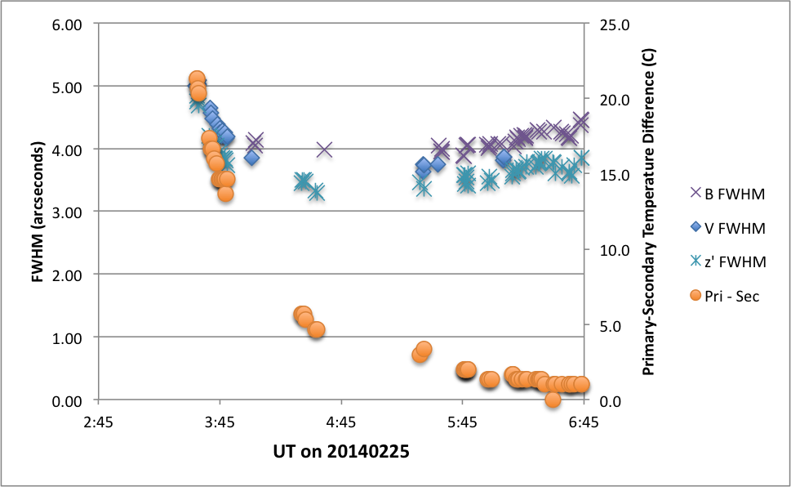
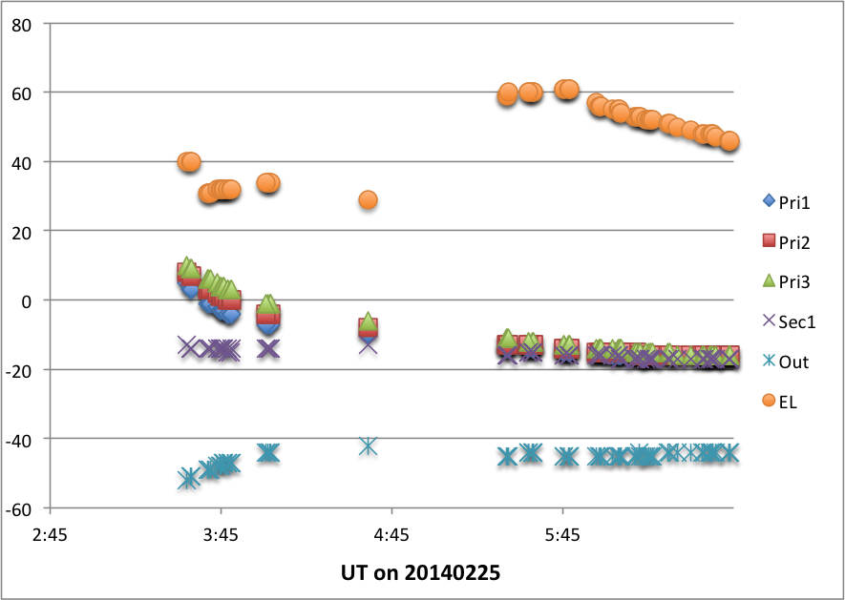
HC-03: Image Size and Shape
FWHM large early in flight
Tested in February
  SMA_T1 calibration enabled this test
  Happens every time
  First 60-90 minutes of science time affected
Cause?
  Possibly cavity seeing
  Possibly complex focus behavior
  Pre-cooling would fix this

Slide 28
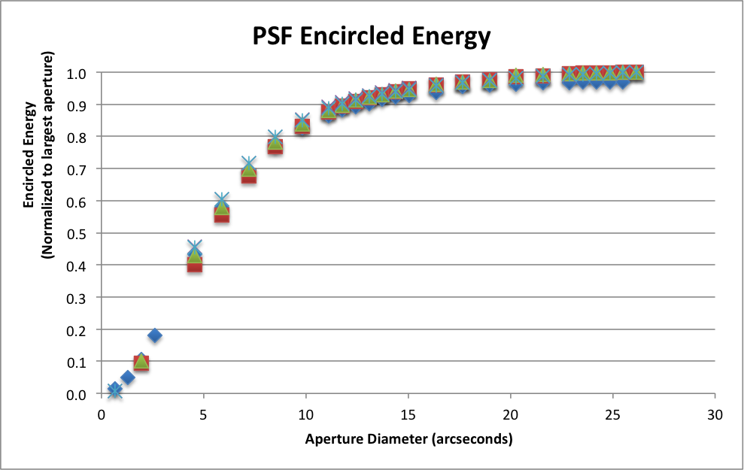
HC-03: Image Size and Shape
Encircled Energy
  41000 & 43000 ft
  SCAI data
Broad PSF wings
  2% flux between 1.5’ and 4.5’ aperture on KAO
  Shear layer scattering

Slide 29
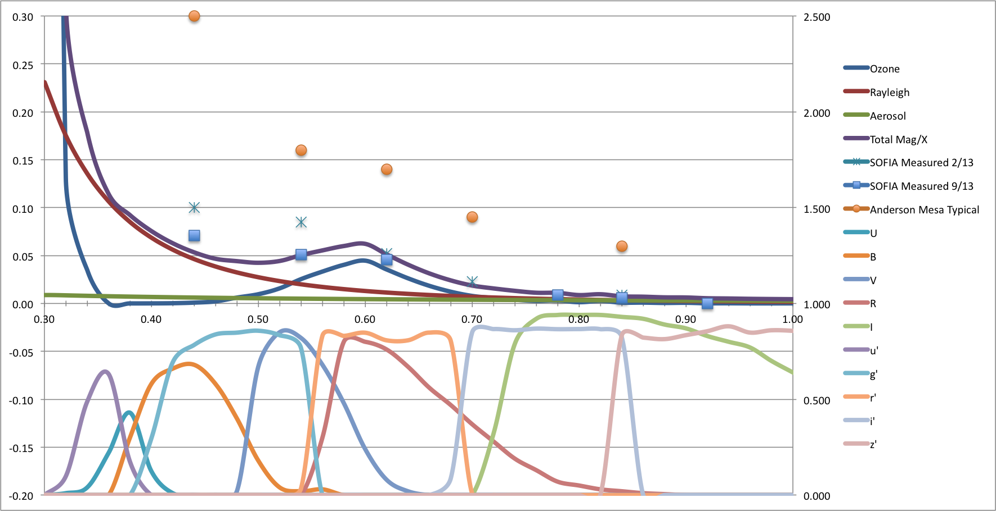
HC-08: Throughput and Extinction
Concern:
  Proper instrument performance
  Photometric impact of extinction
Test:
  Measure atmospheric extinction vs wavelength
  Observe spectrophotometric standards and compare to sensitivity spreadsheet
Extinction
(mag/airmass)
vs Wavelength
Rayleigh scattering proportional to static pressure
Ozone more problematic

Slide 30
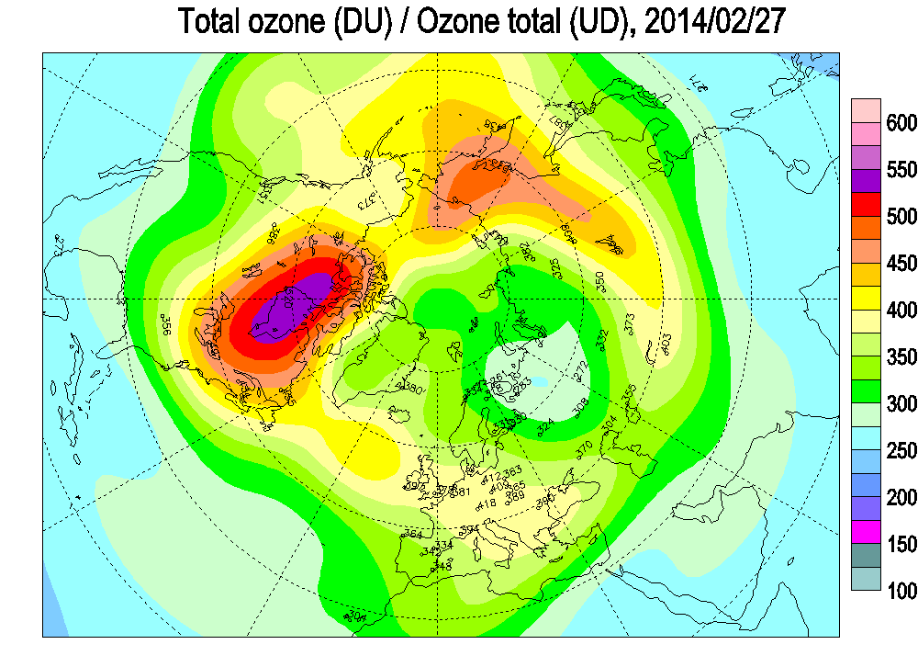
HC-08: Throughput and Extinction
Results:
  Throughput is as expected
  Ozone extinction in Chappuis band is a serious issue
    Need a few tenths of a mmag precision
    Ozone can vary by ~2x
    Better not choose the wrong filter!
Ozone Extinction (mmag/airmass
Filter | U | B | V | R | I
Ozone extinction | 3.3 | 2.4 | 25 | 26 | 1.2
Filter | u’ | g’ | r’ | i’ | z’
Ozone extinction | 22 | 8.3 | 30 | 3.6 | 0.3

Slide 31
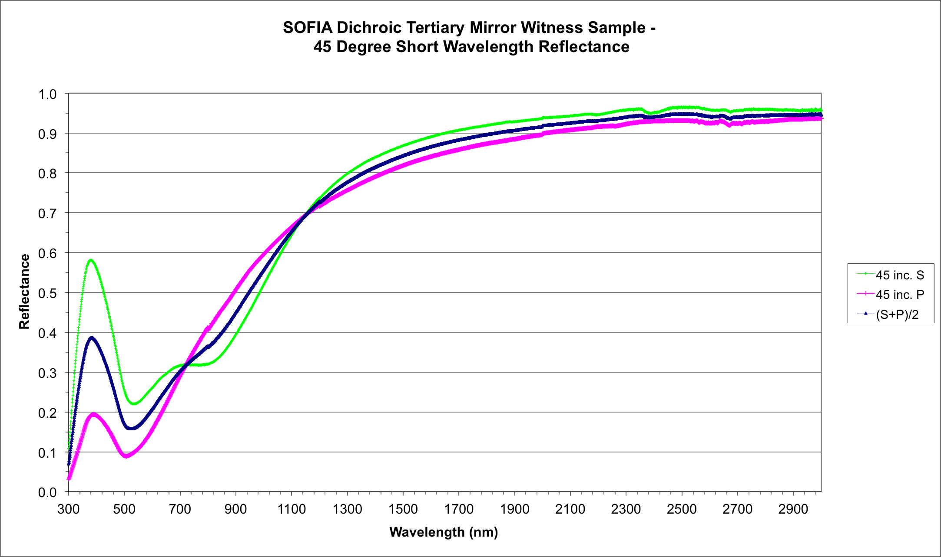
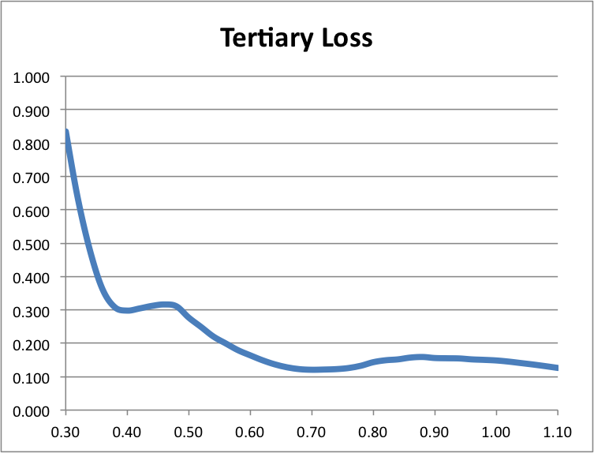
HC-08: Throughput and Extinction
Results:
  Loss at Tertiary 50% to 85%
  Equivalent to efficiency of 15-50%
    What if the chopper was this bad?
    How about MCCS delays?
    Horrible emissivity?
  Time-limited observations; can’t make it up with time
    Stuck with 40% to 240% worse SNR
    Lost opportunities for the program
    Exoplanet hazes and Rayleigh scattering need blue coverage
  Can make up part with FPI
    But tertiary absorbs in blue and UV
  No UV sensitivity at all

Slide 32
HC-09 and -04: Precise Photometry and Scintillation
Concern (desires and questions)
  Can SOFIA contribute to the exoplanet transit enterprise?
  Can we achieve photometric precision of ~3x10⁻⁴?
    30 sec to 1 min time resolution over periods of hours
    What are important flight and instrument parameters?
  What is the impact of scintillation at flight altitudes?
Tests
  Precise photometry:
    Expect Mach number and altitude to impact PSF
  Scintillation
    Observe bright stars at relatively high speed
    Look for excess multiplicative noise
      May not really be scintillation since we’re in the stratosphere
      Might be a shear layer effect
  Try differential correction with field stars

Slide 33
HC-09 and -04: Precise Photometry and Scintillation
Results
  HIPO precise photometry can reach ~3x10⁻⁴
    Corrections needed to get to this level
  Scintillation tests impacted by low frequency variation
  Work is still very much in progress
I want to re-do this slide

Slide 34
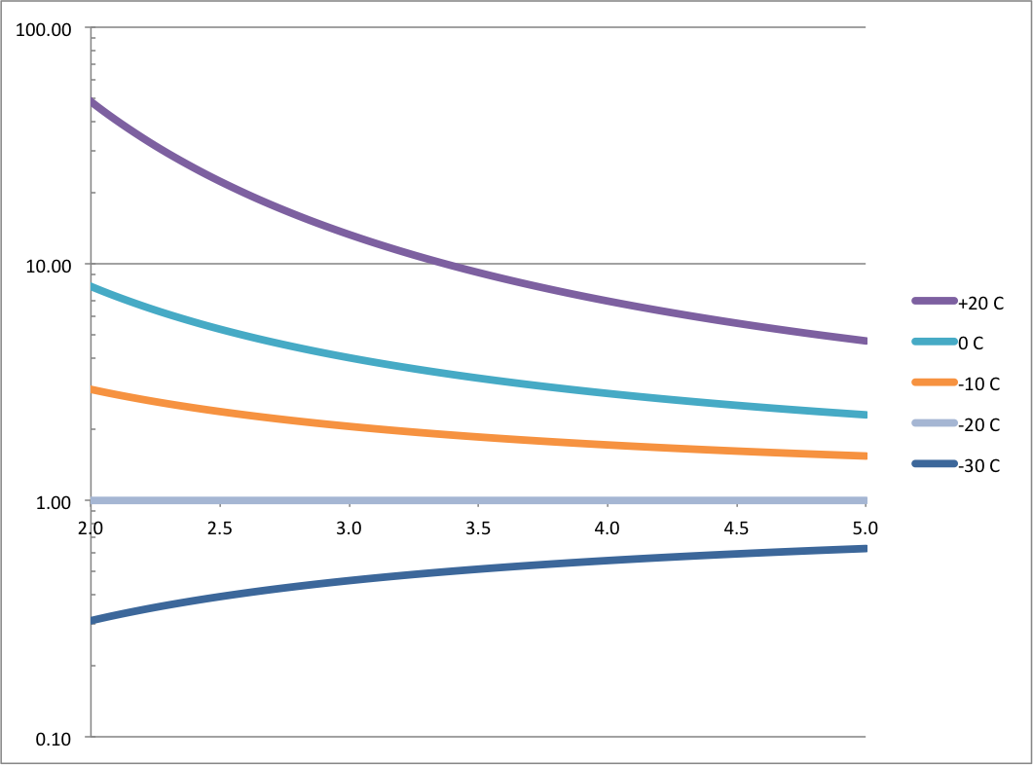
HC-13: Humidity and Temperature
Concern:
  Frost on entrance window
  FLITECAM background
Test:
  Measure periscope optics & window temperature
  Measure humidity in HIPO optical box
Results
  All optics stay at cabin temperature!
  Good news: No frost
  Bad news: Thermal emission
  Emissivity of affected optics:
    FLITECAM window: 8%
    FLIPO periscope: 7%
    (new beamsplitter in 2013)
  Nasmyth blower would reduce
  background at 3.3 microns by ~10x!
  FORCAST impacted also

Slide 35
Problem Areas
Remaining Problem Areas
  Lack of fully reflective tertiary
    15-50% efficiency or 40%-240% higher noise
  INF blower missing
    FLITECAM emissivity ~10x too high @ 3 microns
  Pre-cooling missing
    Poor image quality for first 60-90 minutes of science time
    I expect more serious problems for other instruments
  Constraint on landing after sunrise
    Serious problem for exoplanet transit observation scheduling.
I’m thinking this chart should disappear in favor of the last one. It was here to summarize the remaining problem areas for HIPO.

Slide 36
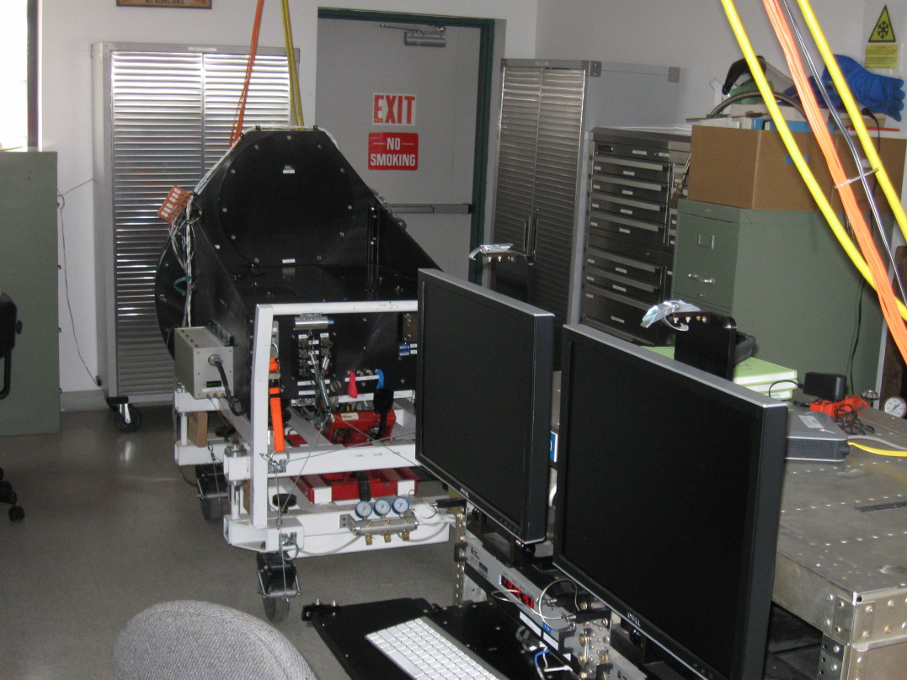
Flight Hardware and GSE Status
Flight Hardware
  FAA First Article Conformity, 2006
  Airworthiness long since established
  Many successful line-ops and flights since 2004
  Instrument, rack, cables, spares all complete
  Complete HIPO system shown here
    Instrument
    Rack
    Toolbox
    2 cabinets
  Computer and CCD controller upgrade in work

Slide 37
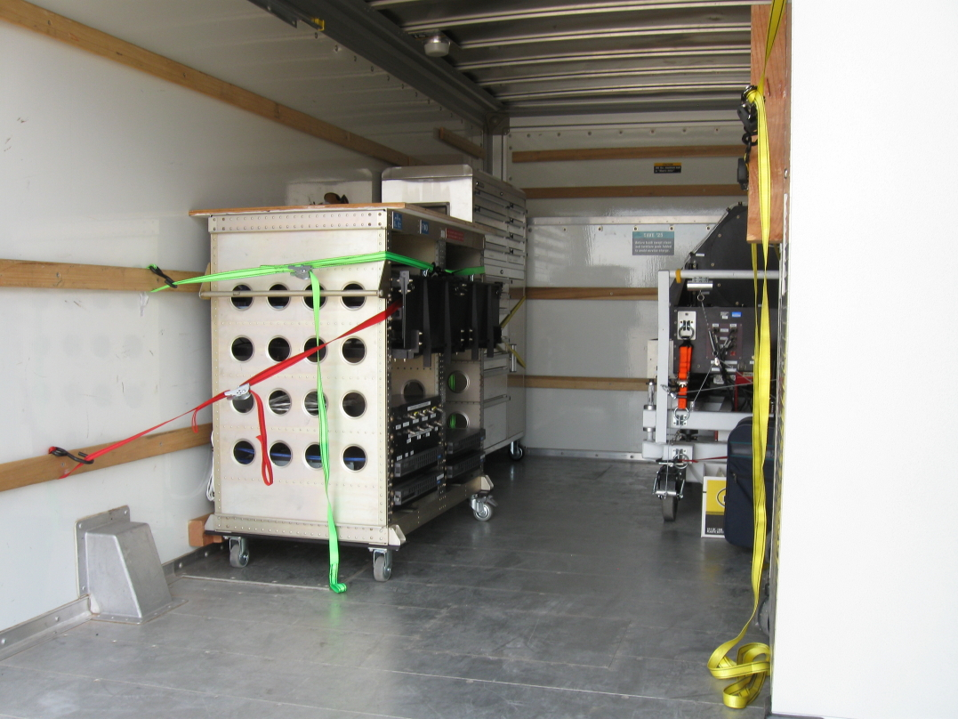
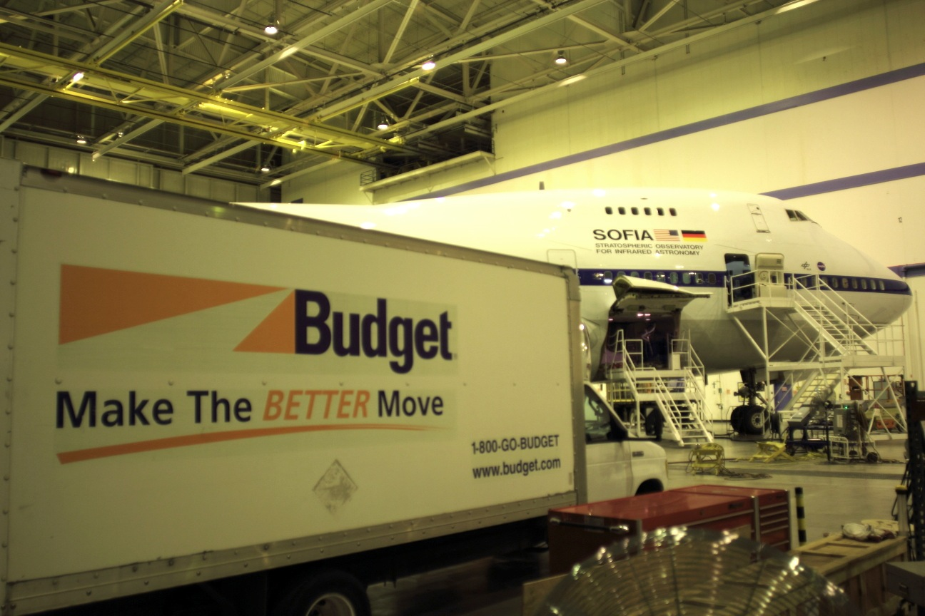
Flight Hardware and GSE Status
GSE Status
  “Lab” cart only used at Lowell
  Installation cart well-used now
    Load tested twice
  SI-specific test equipment, tools, spares, supplies kept in toolbox and rolling cabinets
  No shipping containers
    We ship using a rental truck
    16-ft Budget truck preferred
  Items not for flight are all clearly marked

Slide 38
Software Status
HIPO software diagram
Same configuration since 2008
Small mods from time to time
New computer system will include software changes – Solaris -> linux
MCCS interface software current to MCCS v39, February 2014
HIPO guiding still needs a little more line-op time
Blue timing & DSP software
Red timing & DSP software
Blue LOIS
Red LOIS
Broker
Blue LOUI
Red LOUI
HK viewer
MCCS

Slide 39
Concept of Operations
HIPO is a Special Purpose Science Instrument (SSI)
  Development, maintenance, repairs, improvements, and operations are all the responsibility of the SI team
Operations
  Instrument operated by HIPO team
  At DAOF depend on USRA staff for cryogen fills
    I’m not allowed to fill my own instrument at the DAOF
    During times of crew rest USRA support is essential
Hardware Servicing and Maintenance
  HIPO team responsibility
Software Maintenance
  HIPO team responsibility

Slide 40
Verification and Documentation Status
Drawing package complete at present time; changes expected
Hardware certification documentation at vendors
  Lot numbers and purchase data kept at Lowell
ICD Verification Matrix Complete
Final Commissioning Report
  Individual reports on specific commissioning tests
  Precise photometry and scintillation are research areas
  Image size/shape an ongoing V&V and engineering activity
  Validated science products
    Pluto paper published
    HD 189733 transit paper in work
    GJ1214 lightcurve extraction done
Maintenance manual complete (but will be updated)
Data Users Manual
  SPIE data products paper

Slide 41
Verification and Documentation Status
HIPO-DCS ICD complete
GI Proposer's manual
  HIPO chapter of SOFIA Observer's Handbook
  Sensitivity spreadsheet
HIPO Lab Procedures
  DAOF procedure, lab traveler, or maintenance manual
HIPO Aircraft Procedures
  Mostly DAOF procedures now
  Warm & cold functional tests in maintenance manual
Pre-flight checklist exists. No red-tag/green-tag items
Lab traveler done, but activities vary a lot
GTO Catalog. No GTO time requested yet. 2015 Pluto?

Slide 42
Conclusion
Purpose of review and commissioning criteria have been met
HIPO is ready to continue flying
  However HIPO will continue to be modified as agreed
  Optimizing precise photometry capability will be ongoing
    This includes further work toward understanding scintillation
Remaining Problem Areas
  Fully reflective tertiary
    15-50% efficiency or 40%-240% higher noise
  INF blower
    FLITECAM emissivity ~10x too high @ 3 microns
  Pre-cooling
    Poor image quality for first 60-90 minutes of science time
  Constraint on landing after sunrise
    Serious problem for exoplanet transit observation scheduling.

