Slide 1
Solar Variability After Dark
Photometric evidence and some dead ends from stars and planets
Wes Lockwood, Lowell Observatory

Slide 2
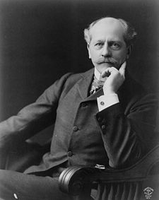
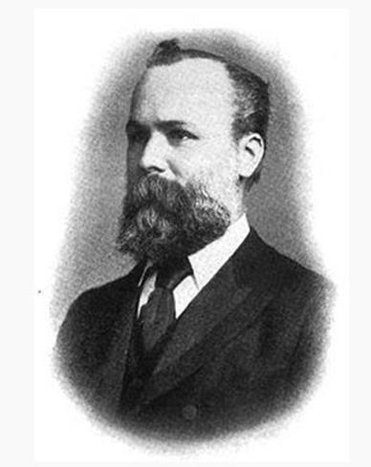
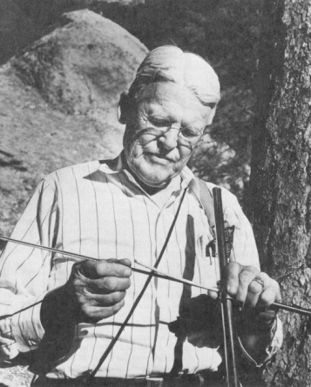
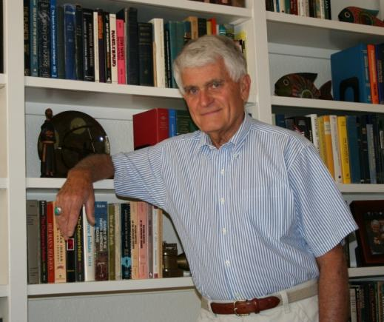
A curious connection
What followed in six weeks of March and early April of 1894 was a comic opera of a one-man, whirlwind site-survey – made by rail and horse-drawn wagon with a small telescope and a large stack of Western Union Telegraph blanks, the latter to keep his anxious employer advised, in real time, of nightly measures of the skies.
---book review by Jack Eddy
Notes:
Add douglass at the 24 inch

Slide 3
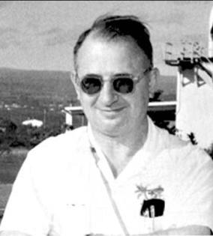
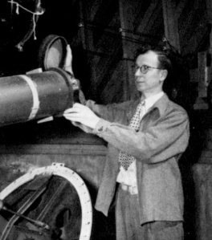
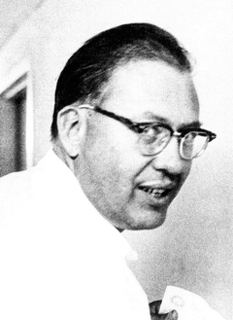
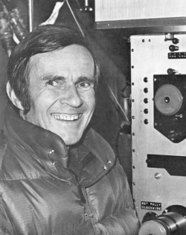
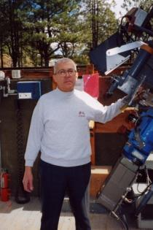
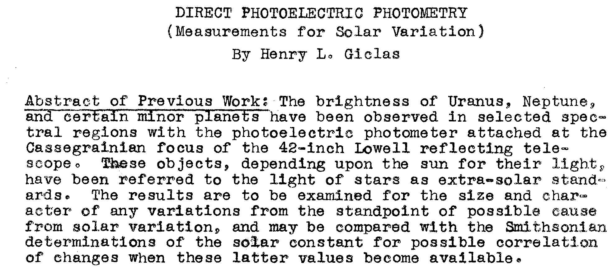
Getting started 1950

Slide 4
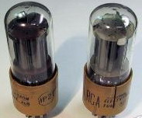
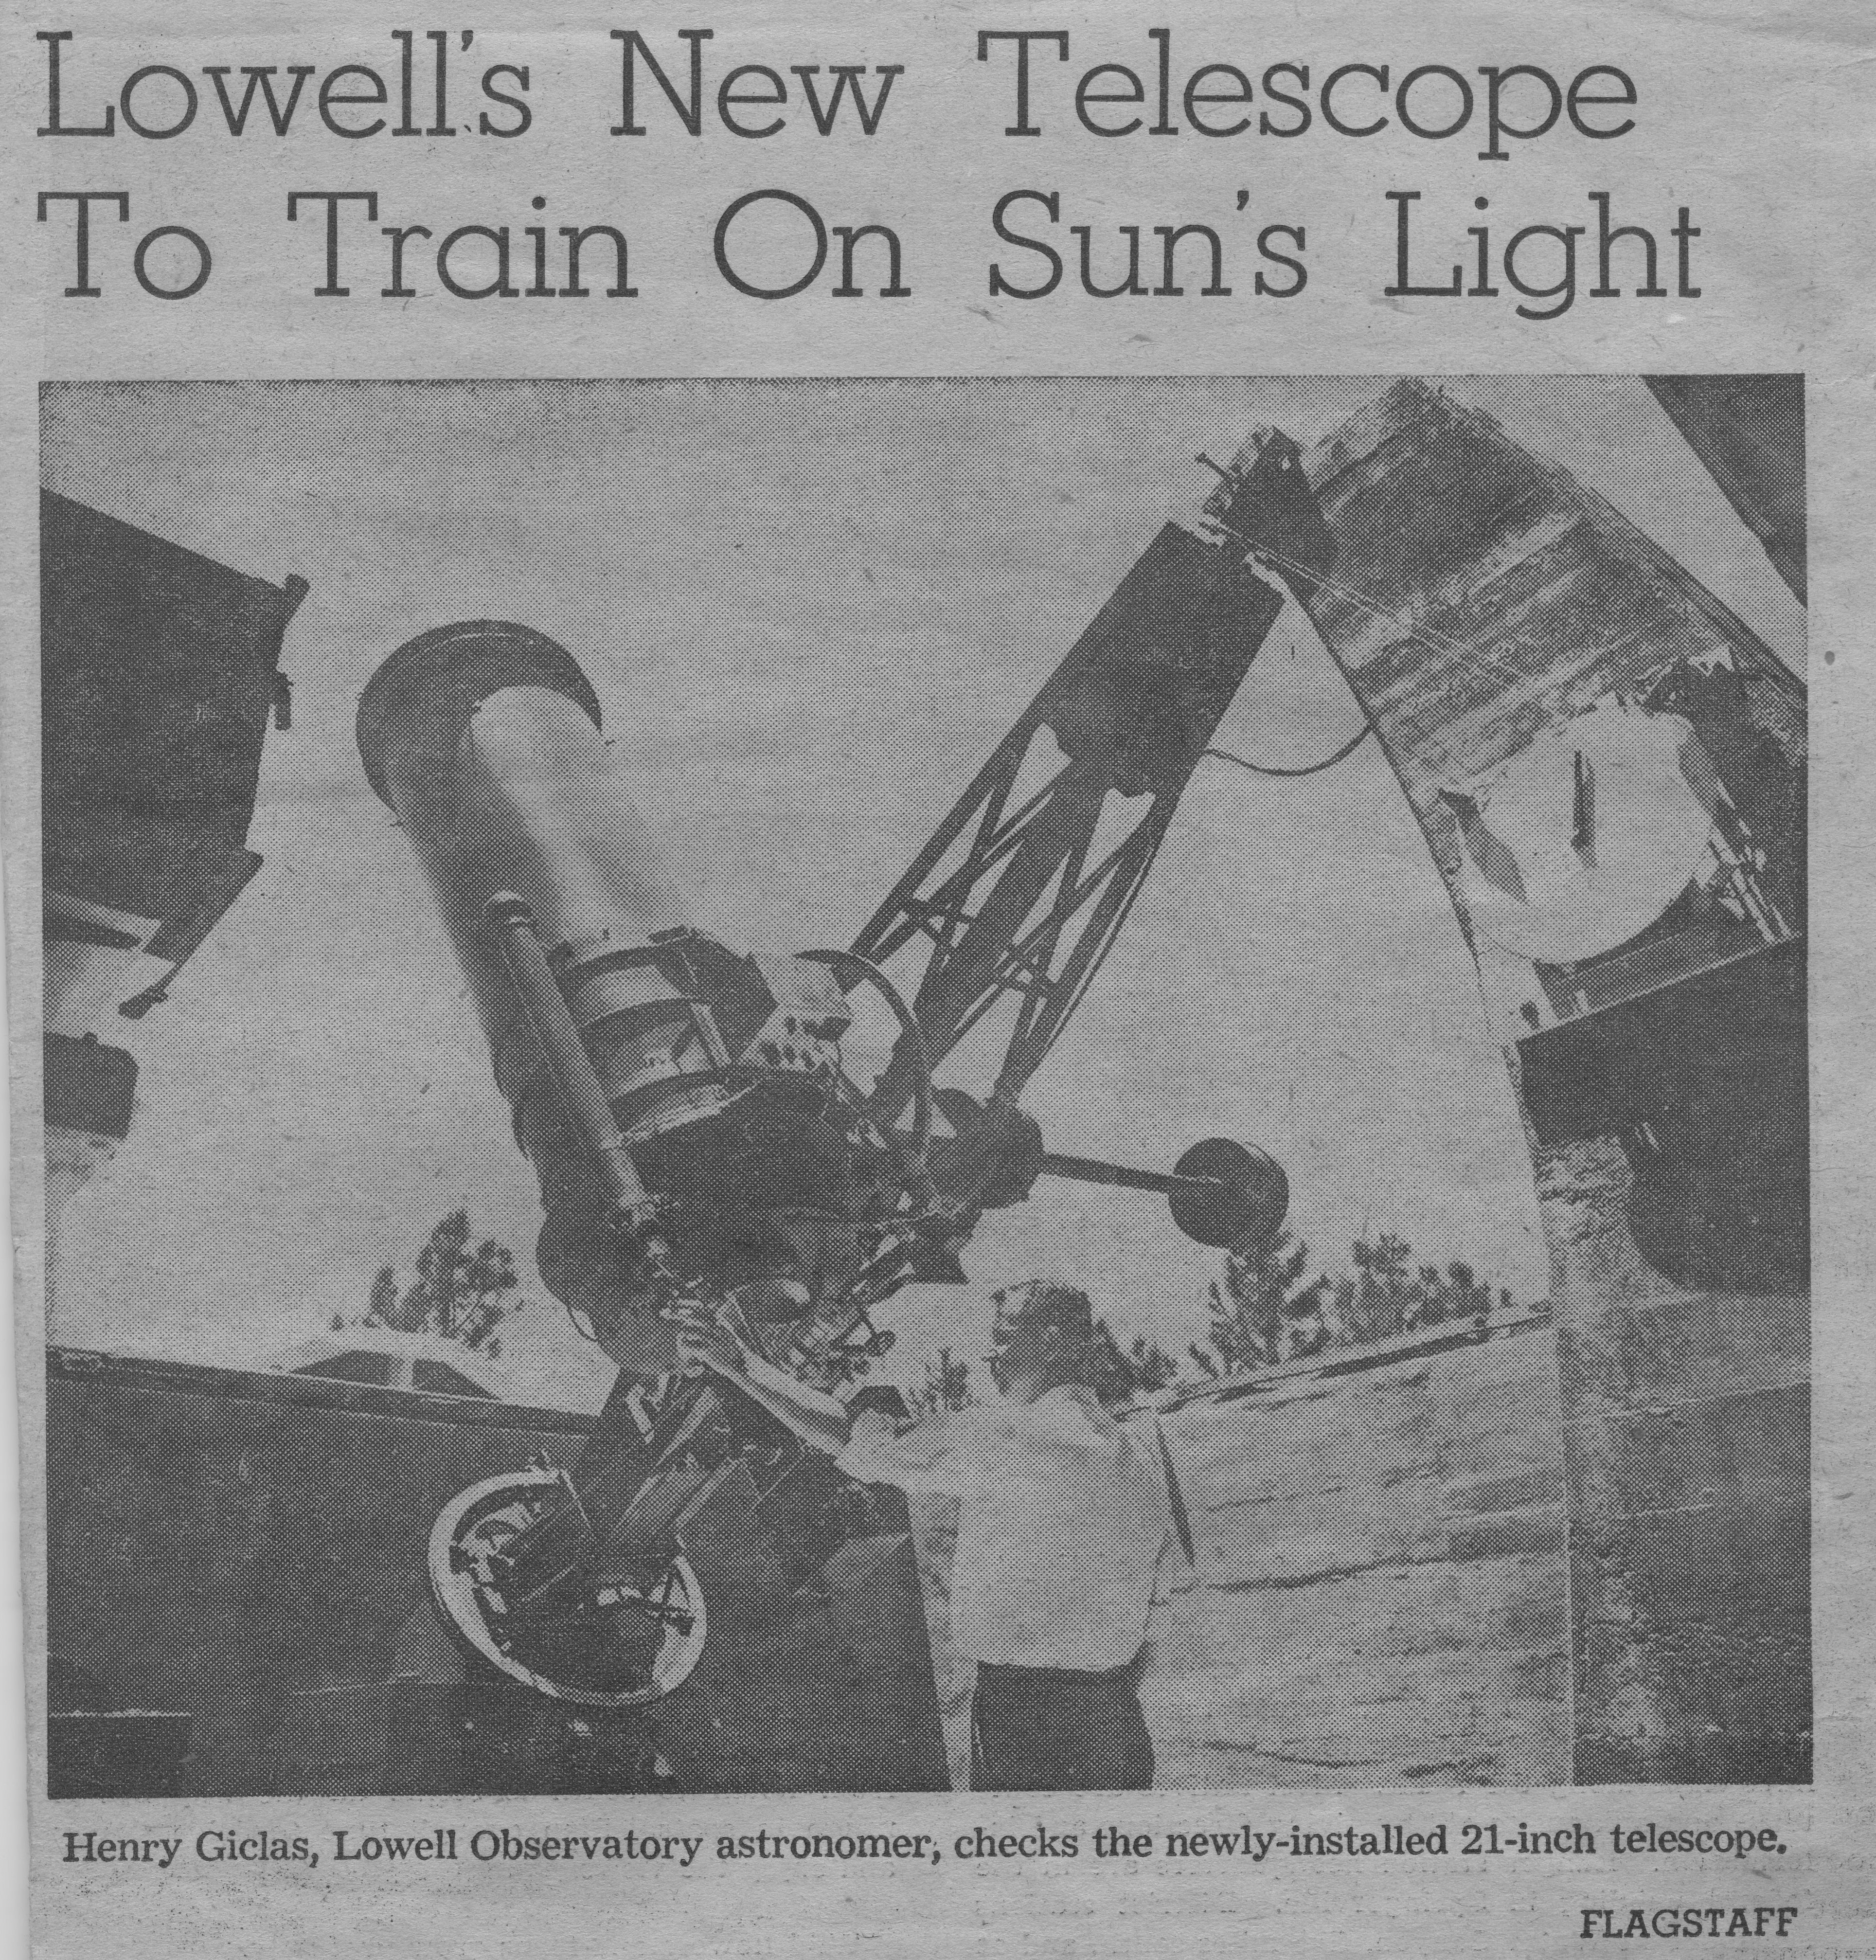
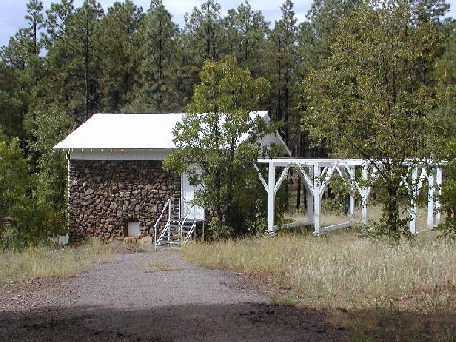
In the beginning

Slide 5
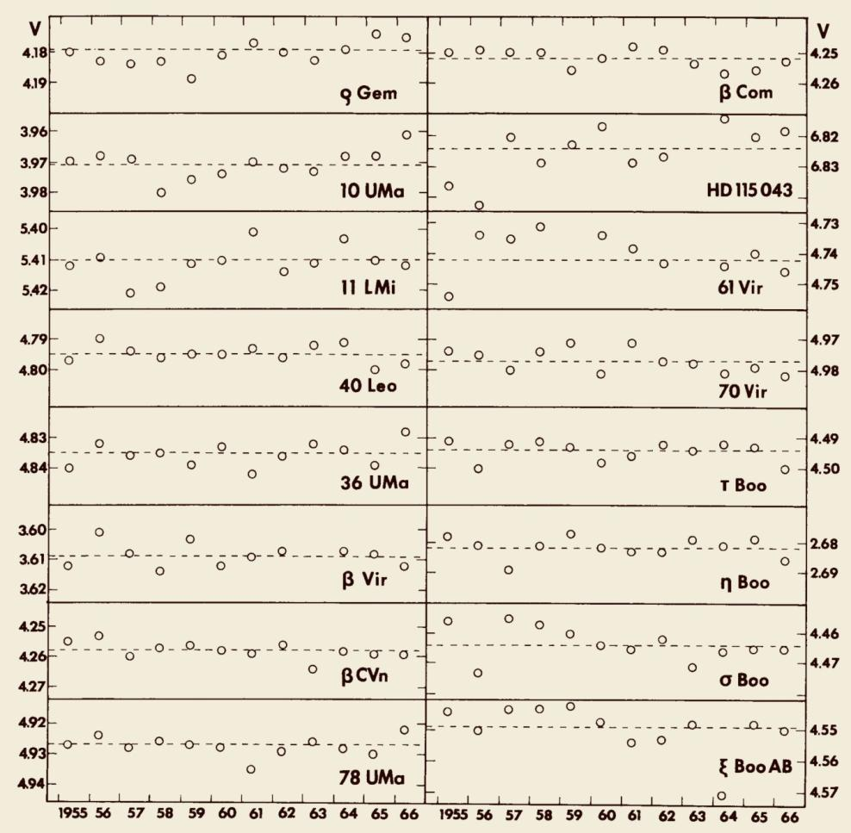
1966: What they learned
”If we assume the sun acts in similar fashion to each of these stars, its variability over a 15-year period probably does not exceed one half of one percent. “
Jerzykiewicz and Serkowski, 1966 Lowell Observatory Bulletin
Notes:
The results for Uranus and Neptune is inconclusive, in part because we didn’t yet have a good value for the oblateness of Uranus. This doesn’t really get settled until we had spacecraft imaging.
But the work on Sun-like stars if fundamental, unique, and set the standard for a generation.
In this 1966 report, authors admitted that they hadn’t learned anything about the Sun (due to intrinsic planetary variability), but they did set sub-1% limits to the variability of a dozen sunlike stars.

Slide 6
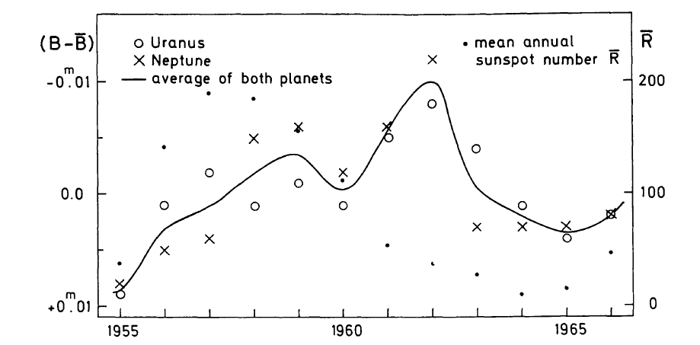
Planets and the solar cycle
D. Labs looks for a sun-planet correlation in the Lowell planetary data
1%

Slide 7
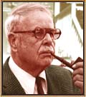
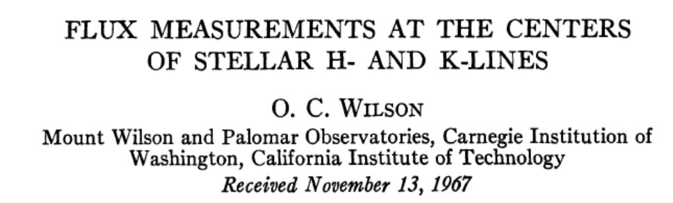
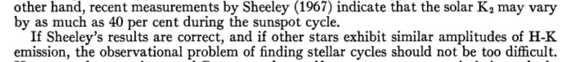
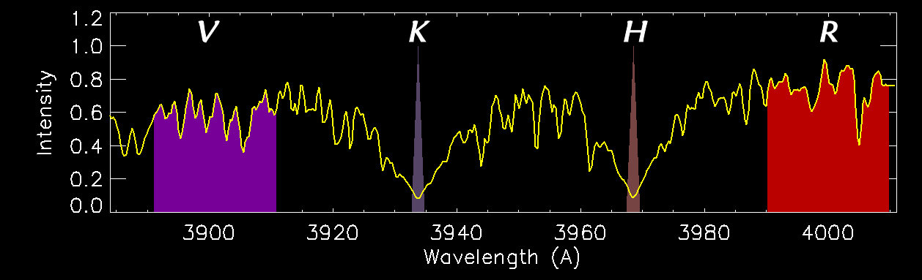
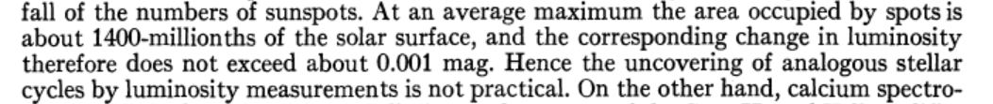
1967: Olin C. Wilson’s great idea
1978 prediction…

Slide 8
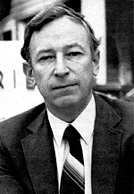
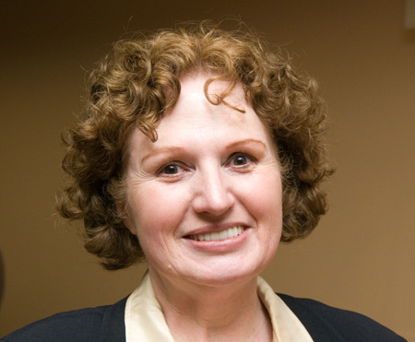
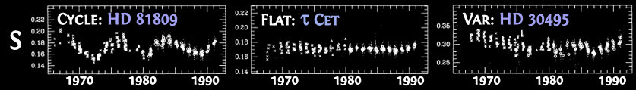
1978-2000: Wilson’s project continues
Three main kinds of variability:
Cycles (!) Flat Noisy

Slide 9
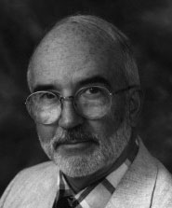
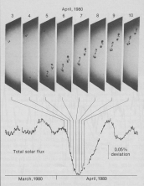
Spots dim the sun and the stars
A star with spots, from Lowell and Mt. Wilson
Sun, from Solar Max Mission
Notes:
Abbott’s intuition was correct, but his measurement was wrong. Shortly after launch of the Solar Maximum Mission in 1980, a dip of total irradiance was recorded as a sunspot group transited the solar disk. The dip is about 0.2%, a far cry from Abbott’s 2%
Dick Willson, then at CalTech, was the developer of the electric substitution activity cavity radiometer.

Slide 10
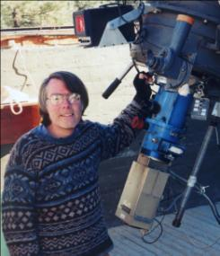
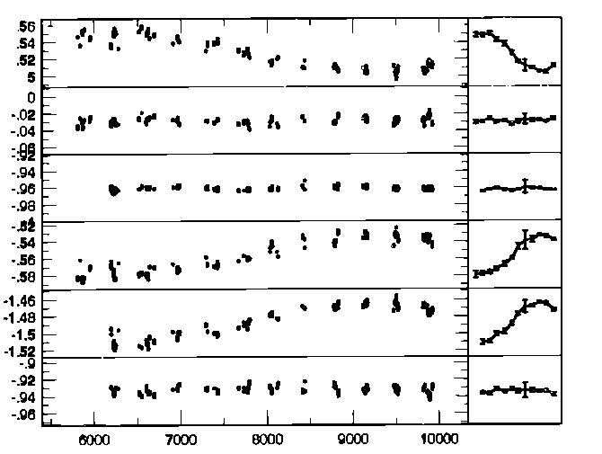
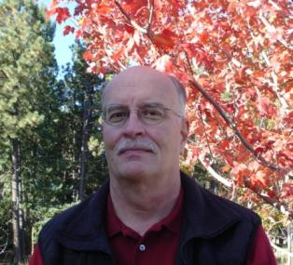
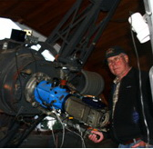
1984-2007: Measuring sunlike stars
night by night yearly avgs
Notes:
Brian Skiff at the telescope on one of 1200 nights.
Brian devoted about 3 man years over a decade and a half, observing solo on this funded project.
These are pairwise lightcurves of the four stars of a quartet group containing a star with a cyclical variation of about 0.06 ma.
Our data now extend to 20 years, counting the additions from Fairborn Observatory robot telescopes

Slide 11
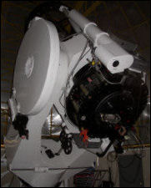
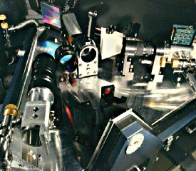
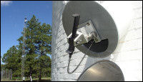
Lowell’s “SSS” project
Solar Stellar Spectrograph

Slide 12
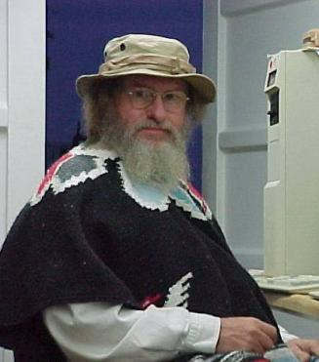
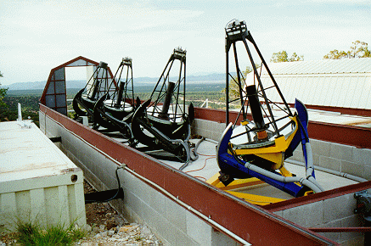
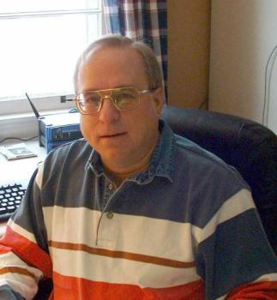
Robotic photometry at Fairborn
Lou Boyd, input
Greg Henry, output
Tennessee State Univ. telescopes at Fairborn Observatory

Slide 13
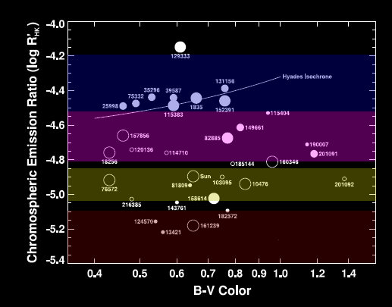
Variations of Sun-like stars

Slide 14
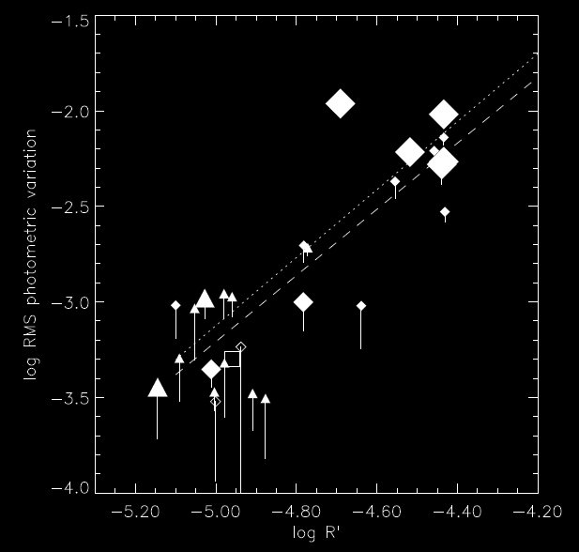
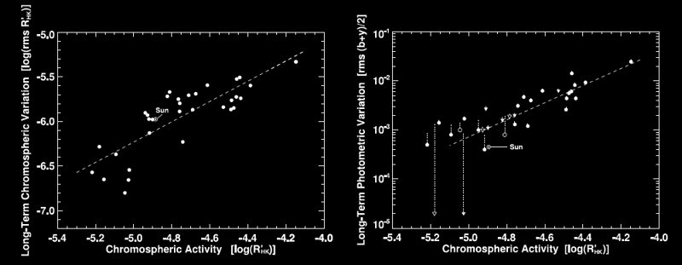
Activity-brightness correlations
HK activity
brightness variation
Age
Age
Age

Slide 15
What’s next ?
The Lowell SSS project and the Fairborn APT photometry project continue to characterize variability among the closest solar analogs (“solar twins”).
We seek evidence of “grand minima” like the Maunder Minimum.
Kepler may reveal portions of low level solar-like activity cycles (but for only 4 years).
And…finally, after 1971, the remnant of the planetary photometry continues, now in its 61st year, mapping out seasonal variations of planetary albedo.

Slide 16
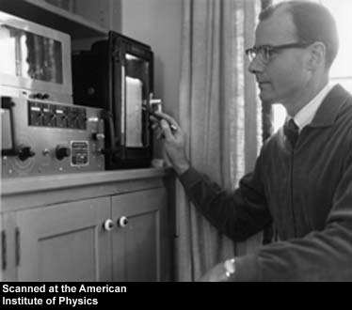
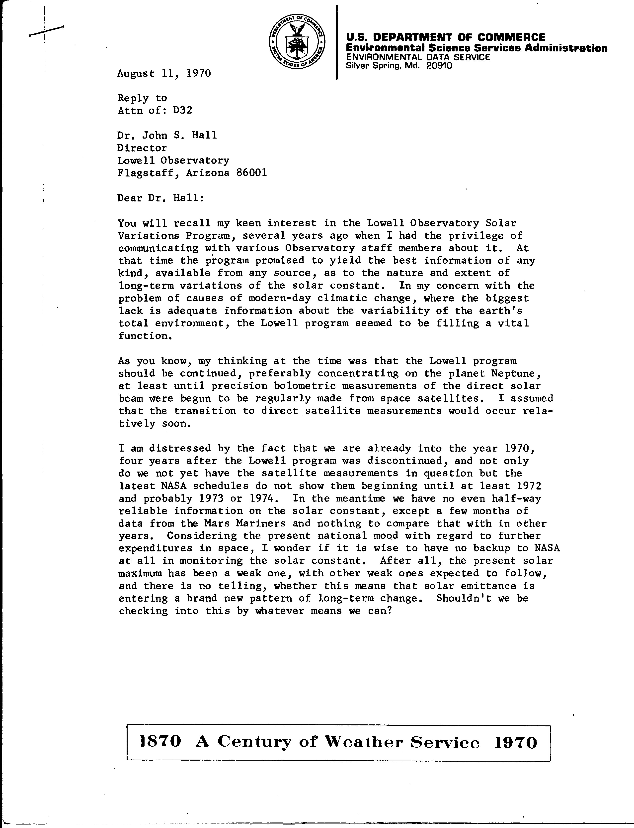
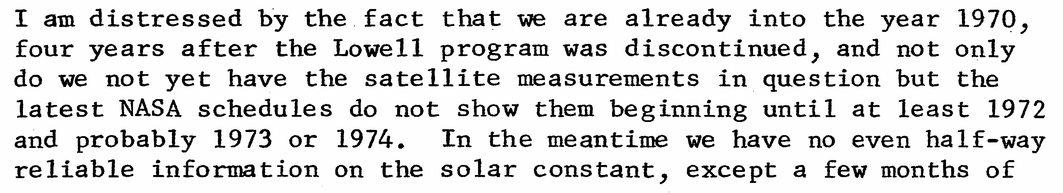
1970: J. Murray Mitchell. Jr. writes…
Notes:
NOAA climatologist J. Murray Mitchell, JR. appealed to John Hall, Lowell Directory, begging him to restart the solar variations program.

Slide 17
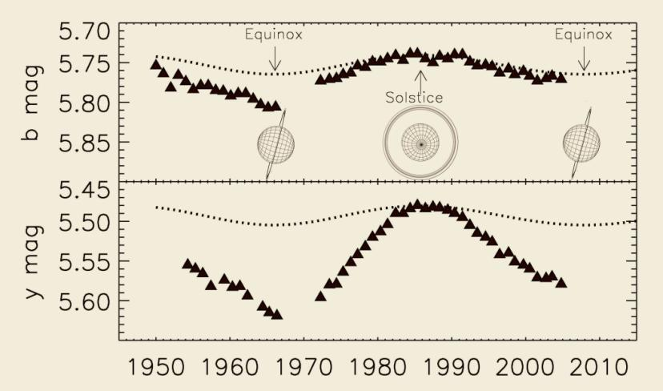
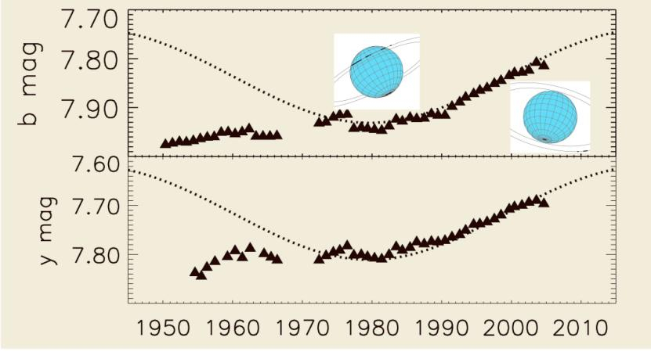
Uranus and Neptune over 60 years
60 years of Lowell photometry produces surprises and a unique long- term record for planetary science.

