Slide 1
The size distribution of Near Earth Objects down to 5 meters
David E. Trilling (NAU)
F. Valdes, L. Allen, D. James, C. Fuentes,
D. Herrera, T. Axelrod, J. Rajagopal
Based on observations with DECam/Blanco/CTIO
Submitted to AAS Journals

Slide 2
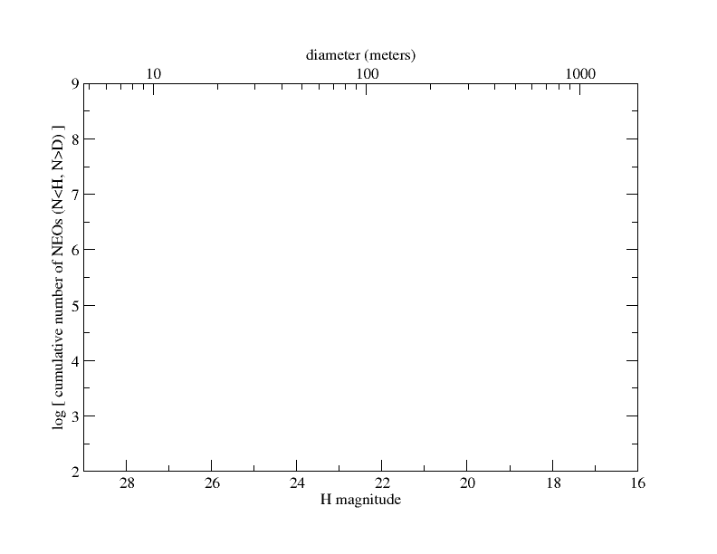
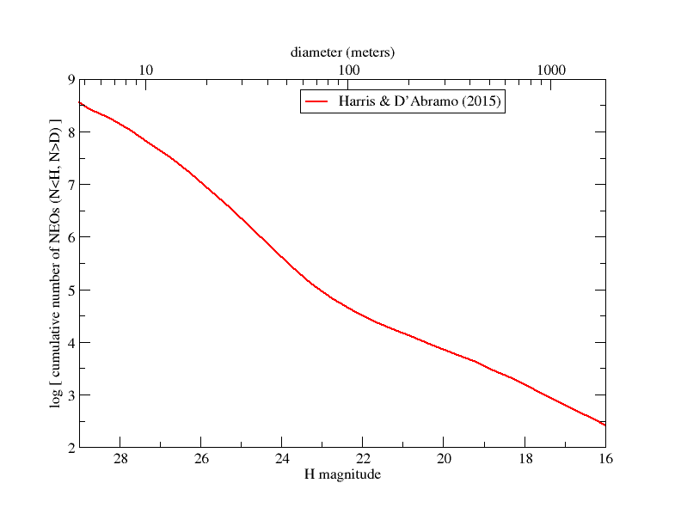

Slide 3
Chelyabinsk
Meteor
Crater

Slide 4
Chelyabinsk
Meteor
Crater

Slide 5
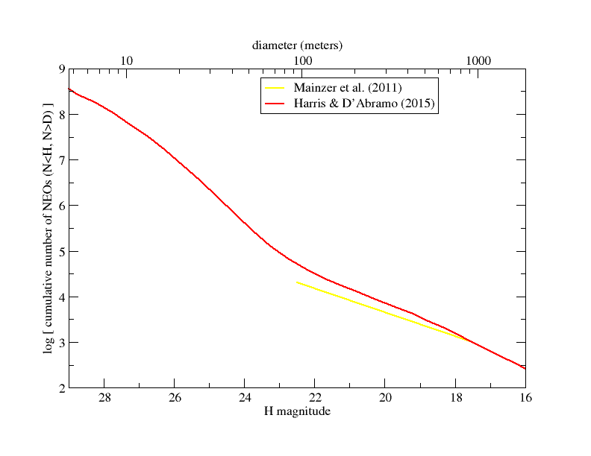
Chelyabinsk
Meteor
Crater

Slide 6
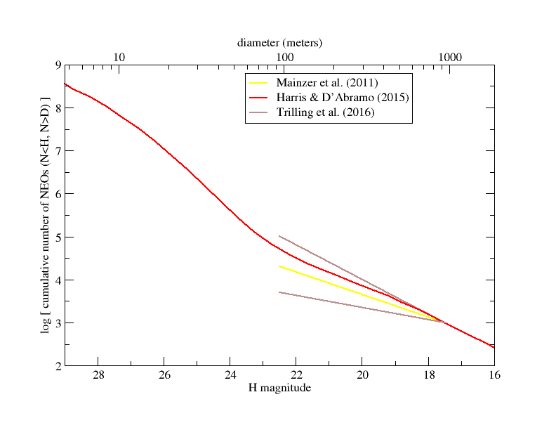
Chelyabinsk
Meteor
Crater

Slide 7
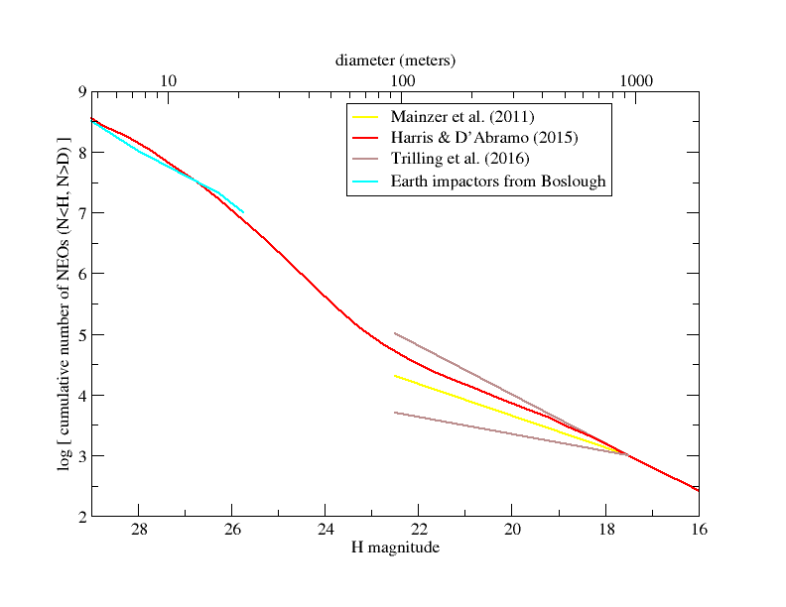
Chelyabinsk
Meteor
Crater

Slide 8
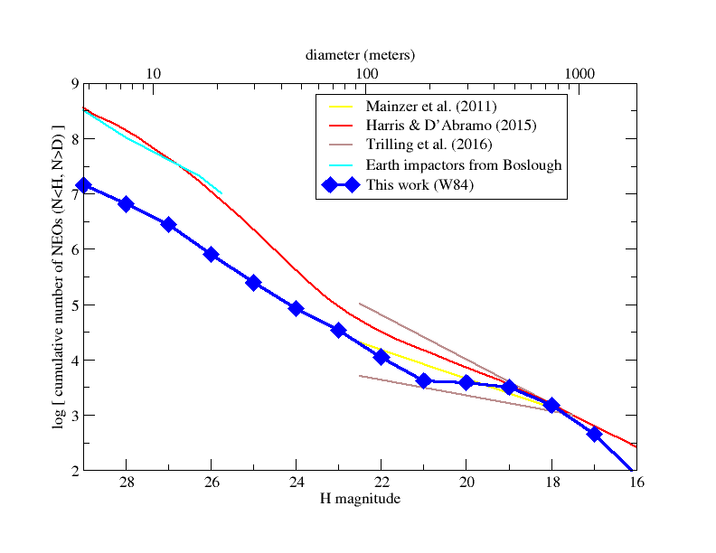
Chelyabinsk
Meteor
Crater

Slide 9
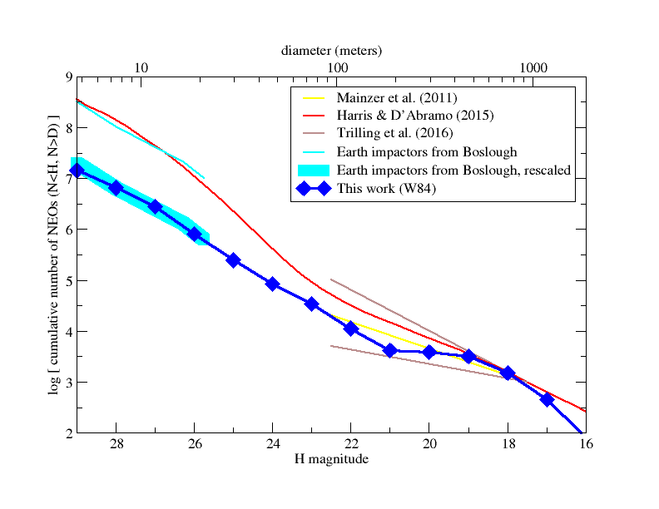
Chelyabinsk
Meteor
Crater

Slide 10
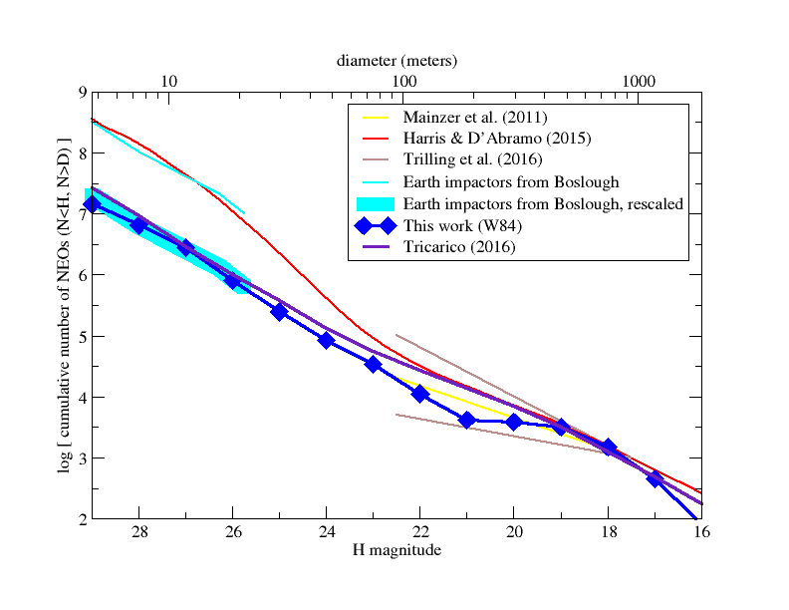
Chelyabinsk
Meteor
Crater

Slide 11
Conclusions
First time size distribution directly measured from 1 km down to 10 meters
3.5 x 10^6 NEOs larger than 10 meters
Factor of ten fewer than previous estimates
Small NEOs have high impact probability – near-Earth tidal disruptions?
Impact risk 10x lower than previous estimates

