Slide 1
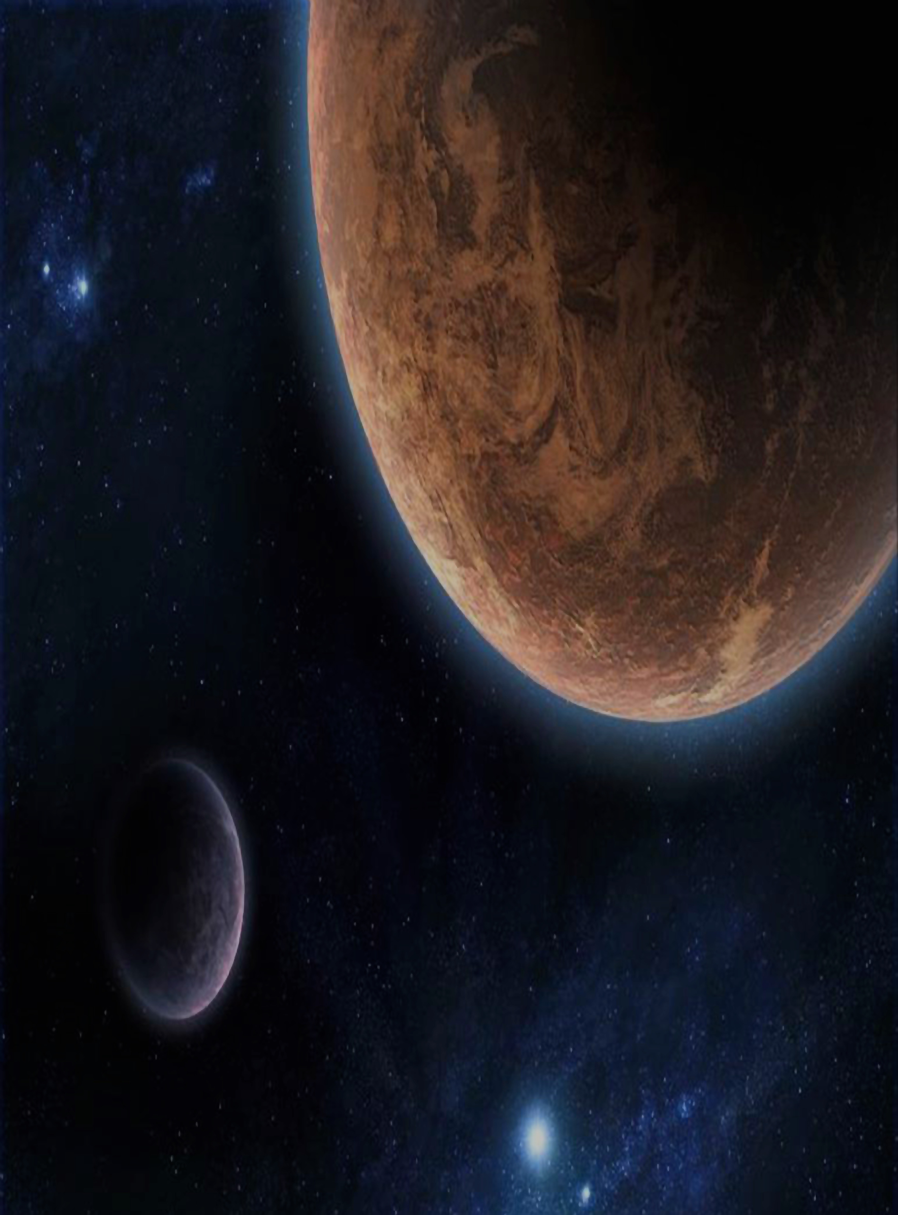
CELESTA
a Catalog of Earth-Like Exoplanet Survey Targets
Colin Orion Chandler¹, Iain Mcdonald², & Stephen Kane³
¹Northern Arizona University, ²Jodrell Bank Centre for Astrophysics, ³San Francisco State University
2016 Flagstaff Astronomy Symposium
Visit CELESTA.info for more information.
Notes:
UNDERGRAD
NAMES + INSTITUTIONS

Slide 2
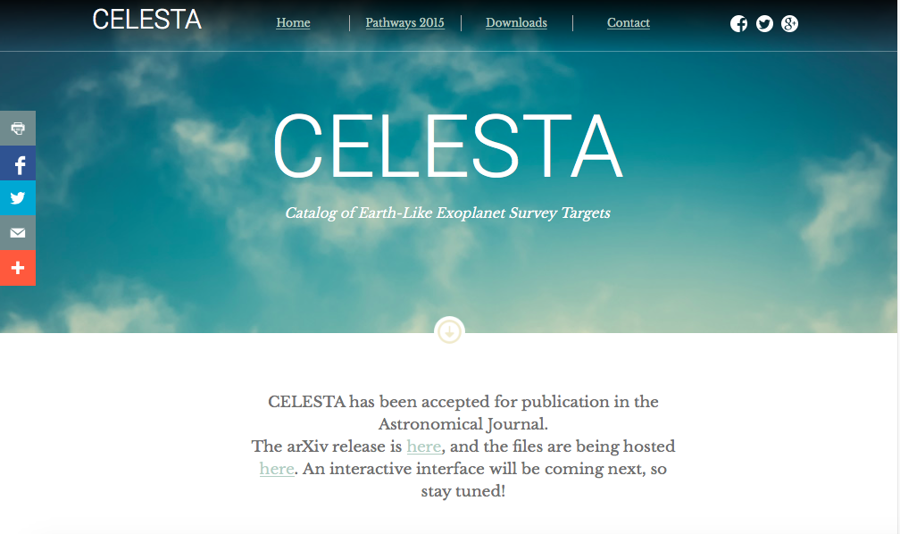
CELESTA.info
Notes:
UNDERGRAD
NAMES + INSTITUTIONS

Slide 3
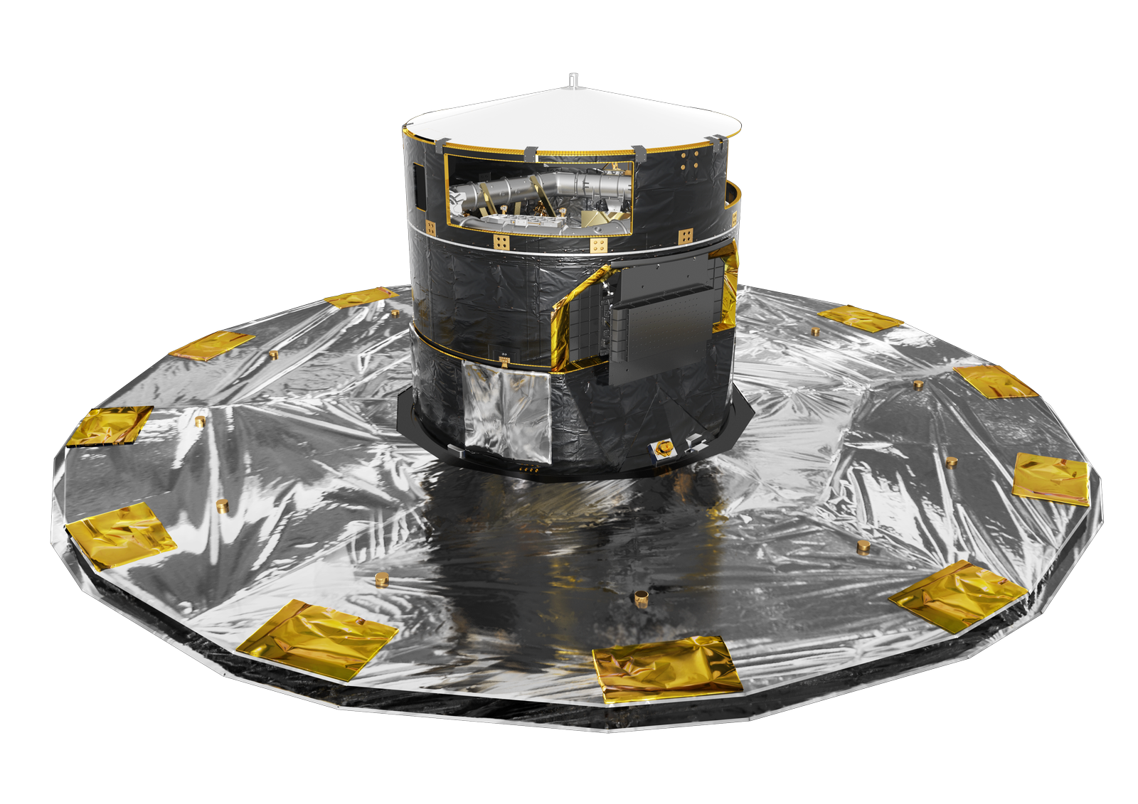
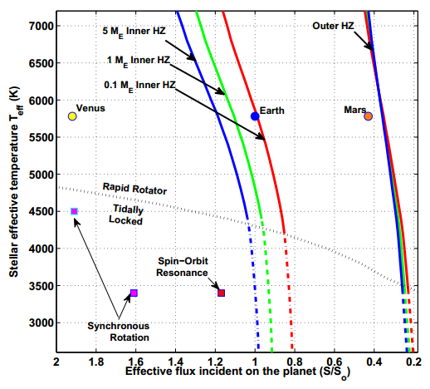
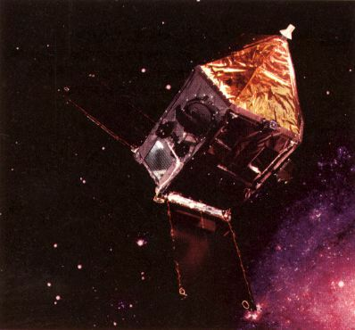
CELESTA: the Catalog of Earth-Like Exoplanet Survey Targets
Colin Orion Chandler¹, Iain Mcdonald², & Stephen Kane³
¹ Northern Arizona University ²Jodrell Bank Centre for Astrophysics ³San Francisco State University
Introduction
CELESTA provides a database of habitable zones as a target selection tool for ongoing and future missions.
Step 1: Aggregate Data
Star catalogs utilized for stellar parameters:
• Hipparcos¹: parallax for distances.
• We created a Stellar Parameter Catalog building upon the work of McDonald et al.³: stellar temperatures and luminosities.
• Kopparapu et al.²: HZ coefficients
• Gaia: future upgrades to CELESTA
References
¹ http://nssdc.gsfc.nasa.gov/nmc/spacecraftDisplay.do?id=1989-062B
²Kopparapu, R.K. et al., 2014. Habitable Zones around Main-sequence Stars: Dependence on Planetary Mass. Astrophysical Journal Letters, 787(2), p.L29.
³McDonald, I., Zijlstra, A.A. & Boyer, M.L., 2012. Fundamental parameters and infrared excesses of Hipparcos stars. Monthly Notices of the Royal Astronomical Society, 427(1), pp.343–357.
⁴ http://sci.esa.int/gaia/55638-artist-impression-of-gaia
Visit CELESTA.info for more information.
Notes:
Discuss sources
What is a HZ
What is “Earth-Like”? 1.6 Earth radius, etc

Slide 4
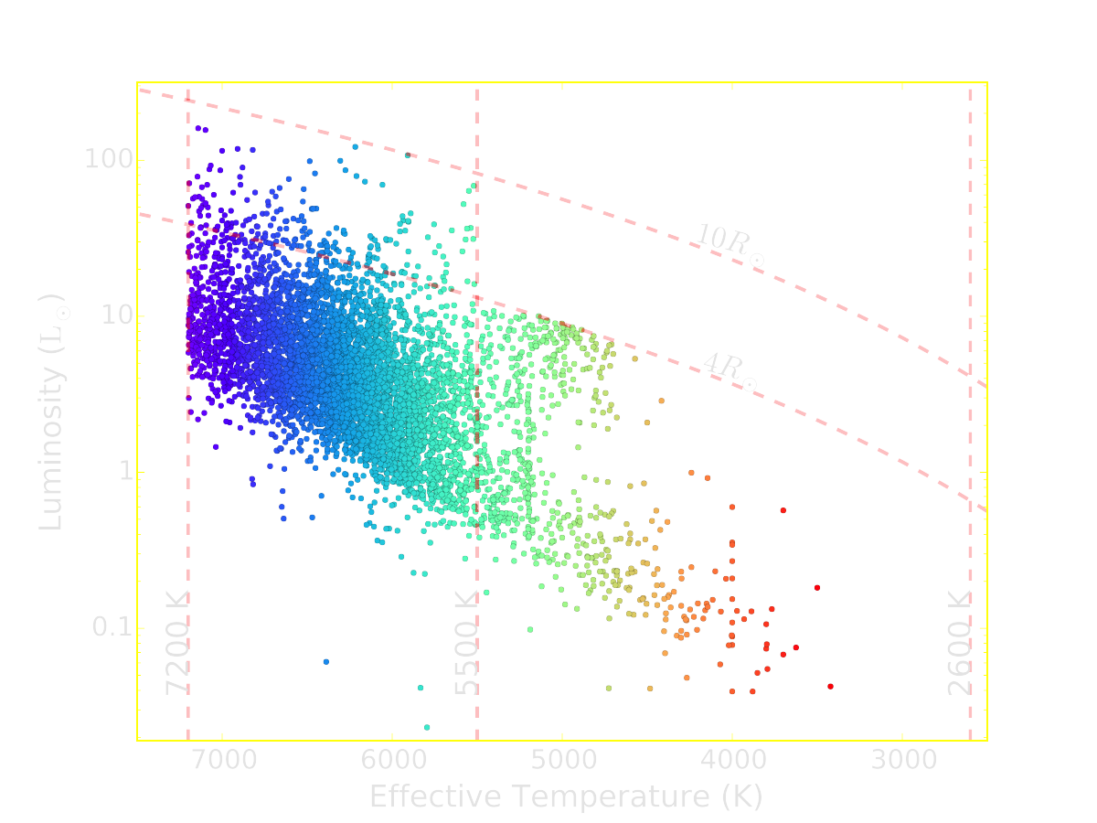
CELESTA: the Catalog of Earth-Like Exoplanet Survey Targets
Colin Orion Chandler¹, Iain Mcdonald², & Stephen Kane³
¹ Northern Arizona University ²Jodrell Bank Centre for Astrophysics ³San Francisco State University
Star Selection
• Stellar temperature: 2,600 K to 7,200 K.
• Error in parallax: <30 % for analysis
• Main-sequence (MS) branch stars, chosen by radii.
Visit CELESTA.info for more information.
Notes:
Explain HRD: Hertzsprung-Russell, plot for astronomers to figure out evolutionary status of star
POINT OUT OBVIOUS CUTOFFS
30% for error

Slide 5
CELESTA: the Catalog of Earth-Like Exoplanet Survey Targets
Colin Orion Chandler¹, Iain Mcdonald², & Stephen Kane³
¹ Northern Arizona University ²Jodrell Bank Centre for Astrophysics ³San Francisco State University
Stellar Distribution after Star Selection
• Red outlines indicate Stellar Parameter Catalog population
• Green bars are stars contained in CELESTA
Visit CELESTA.info for more information.
Notes:
TEFF: Low-T gone because of giants cut; upper: Kopparapu requirement
LUM: Higher the lum, the more cut (giants higher lum)
RAD: Giants, > 1 R_sun, more cuts
Mass: Low-Mass gone (Giants)

Slide 6
CELESTA: the Catalog of Earth-Like Exoplanet Survey Targets
Colin Orion Chandler¹, Iain Mcdonald², & Stephen Kane³
¹ Northern Arizona University ²Jodrell Bank Centre for Astrophysics ³San Francisco State University
Tri-Catalog Comparison
• Comparing CELESTA selected stars to source catalogs
• HIP2 is the revised Hipparcos Catalog (van Leeuwen 2007)
• IRE is the Stellar Parameters Catalog
Visit CELESTA.info for more information.
Notes:
MAGNITUDE: FAVORS FAINTER STARS (GIANTS more likely to be seen by HIP, but those cut)
DISTANCE: Big drop-off over 100 PC b/c of HIP limits, and closest saturate surveys for IRE

Slide 7
CELESTA: the Catalog of Earth-Like Exoplanet Survey Targets
Colin Orion Chandler¹, Iain Mcdonald², & Stephen Kane³
¹ Northern Arizona University ²Jodrell Bank Centre for Astrophysics ³San Francisco State University
Habitable Zone Width Distribution
• Conservative zones necessarily cluster to narrower zones
Visit CELESTA.info for more information.
Notes:
Initially surprising

Slide 8
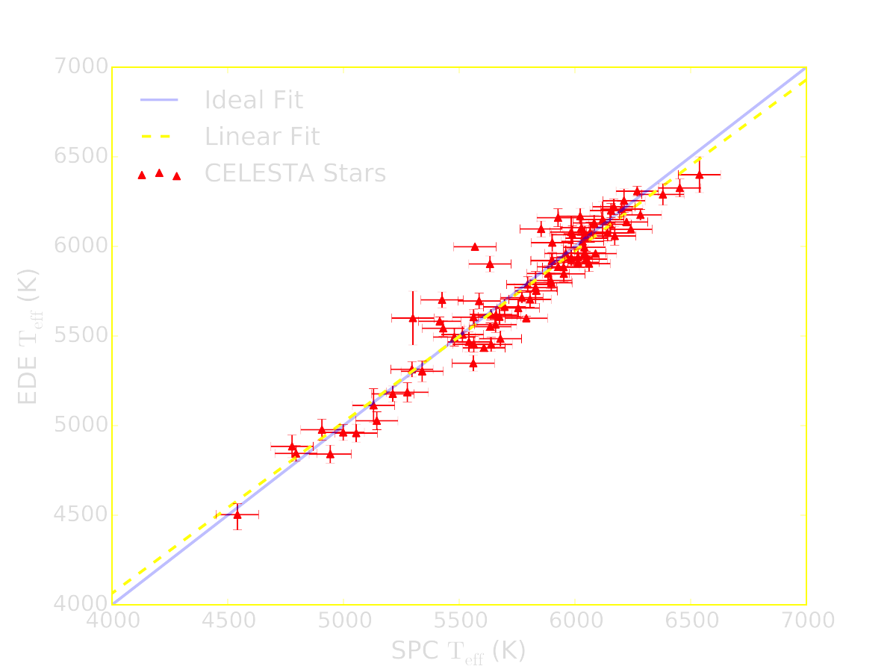
CELESTA: the Catalog of Earth-Like Exoplanet Survey Targets
Colin Orion Chandler¹, Iain Mcdonald², & Stephen Kane³
¹ Northern Arizona University ²Jodrell Bank Centre for Astrophysics ³San Francisco State University
Determining Uncertainty in Temperature
• Comparison of CELESTA to EDE ( http://www.exoplanets.org )
• Uncertainty in CELESTA temperature: ±100 K.
Visit CELESTA.info for more information.
Notes:
Explain EDE
NOTE: 30% E_PLX CUTOFF, left all in catalog
binaries
Linear vs Ideal Fits

Slide 9
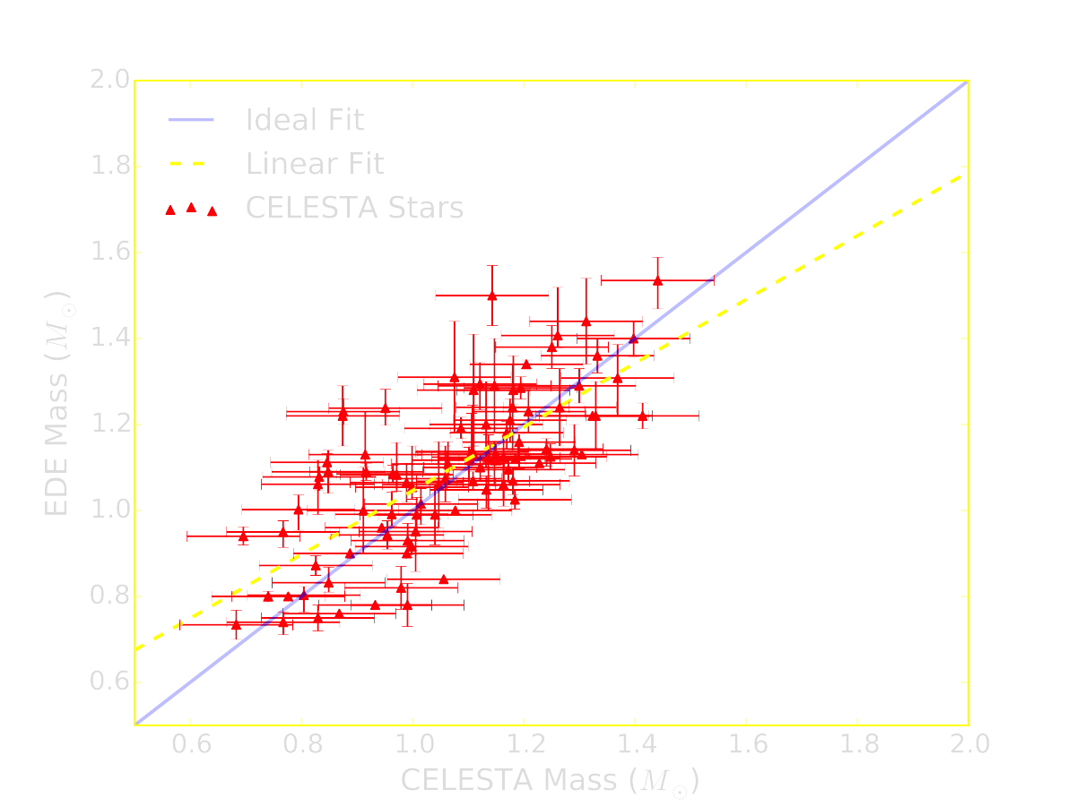
CELESTA: the Catalog of Earth-Like Exoplanet Survey Targets
Colin Orion Chandler¹, Iain Mcdonald², & Stephen Kane³
¹ Northern Arizona University ²Jodrell Bank Centre for Astrophysics ³San Francisco State University
Determining Uncertainty in Mass
• Comparison of CELESTA to EDE ( http://www.exoplanets.org )
• Uncertainty in CELESTA mass: ±0.10 M⊙.
Visit CELESTA.info for more information.
Notes:
MENTION SIGMA CLIPPING; see paper for specific stars

Slide 10
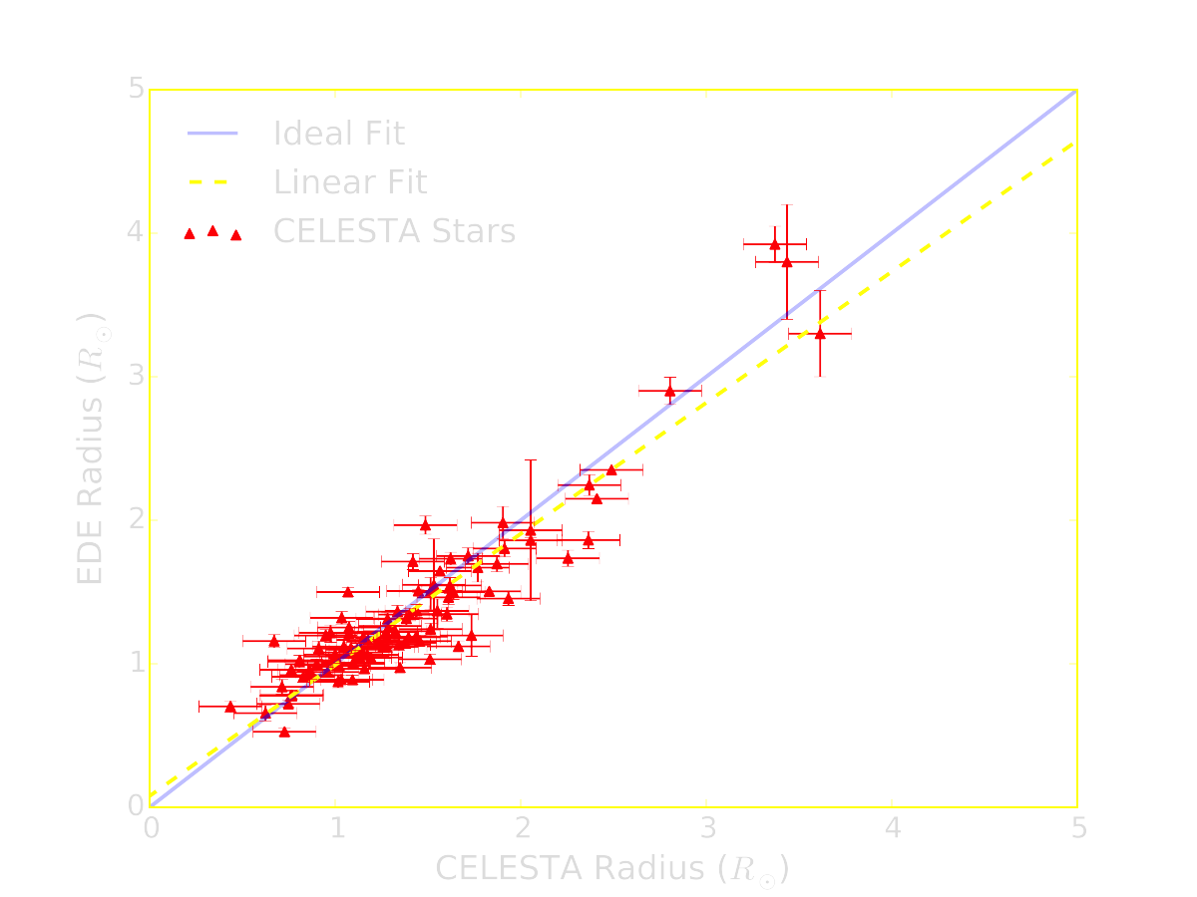
CELESTA: the Catalog of Earth-Like Exoplanet Survey Targets
Colin Orion Chandler¹, Iain Mcdonald², & Stephen Kane³
¹ Northern Arizona University ²Jodrell Bank Centre for Astrophysics ³San Francisco State University
Determining Uncertainty in Radius
• Comparison of CELESTA to EDE ( http://www.exoplanets.org )
• Uncertainty in CELESTA radius: ±0.17 R⊙ .
Visit CELESTA.info for more information.
Notes:
RESULTS: PLEASED

Slide 11
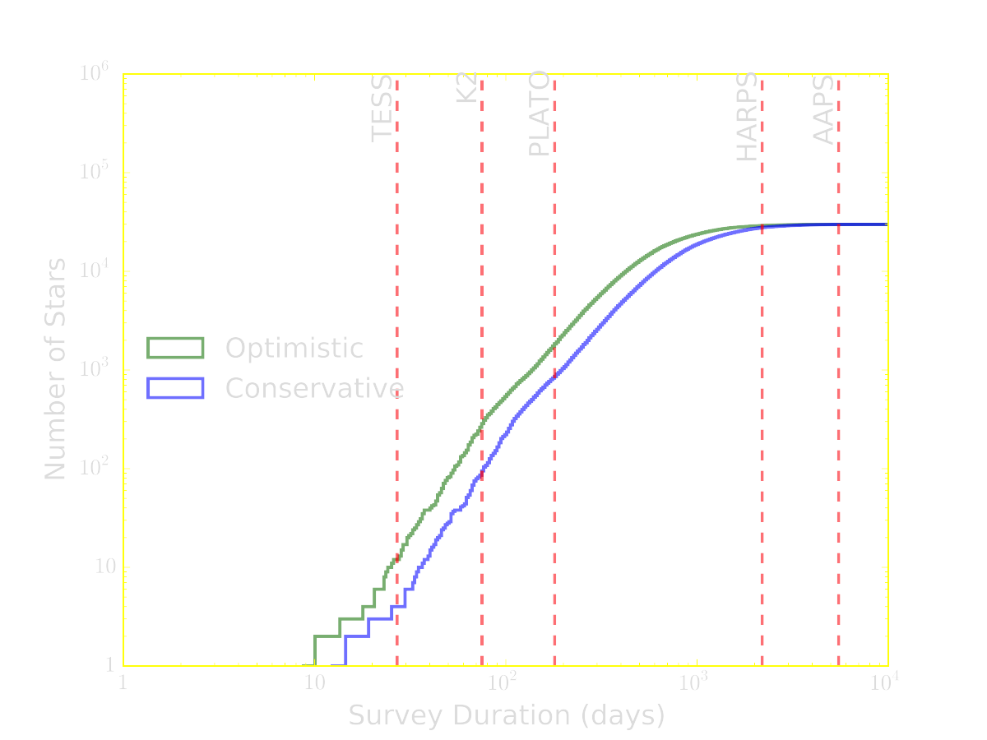
CELESTA: the Catalog of Earth-Like Exoplanet Survey Targets
Colin Orion Chandler¹, Iain Mcdonald², & Stephen Kane³
¹ Northern Arizona University ²Jodrell Bank Centre for Astrophysics ³San Francisco State University
Application: “ROI”
• CELESTA is as an input catalog for target selection with current and upcoming exoplanet surveys.
• Transit and radial velocity (RV) survey sensitivity to planets within the HZ increases as the survey duration increases.
Visit CELESTA.info for more information.
Notes:
LOG LOG, EXPLAIN AXES
Disclaimer re: redenning, all sky survey, etc
Mention TESS and ecliptic pole

Slide 12
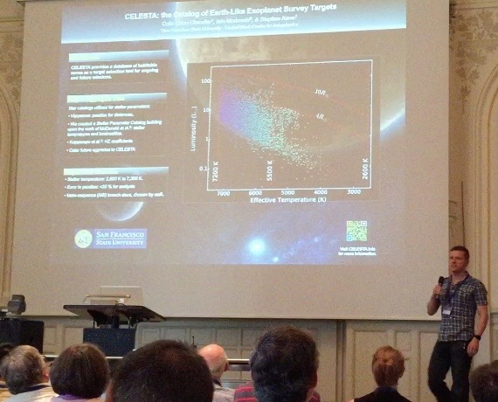

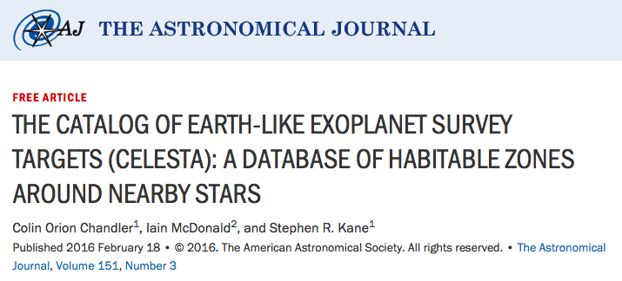
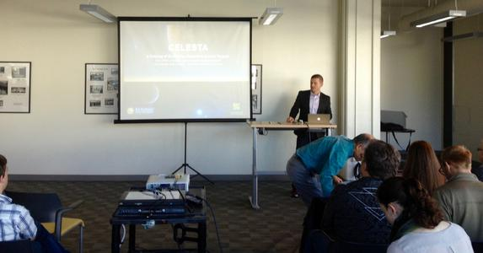
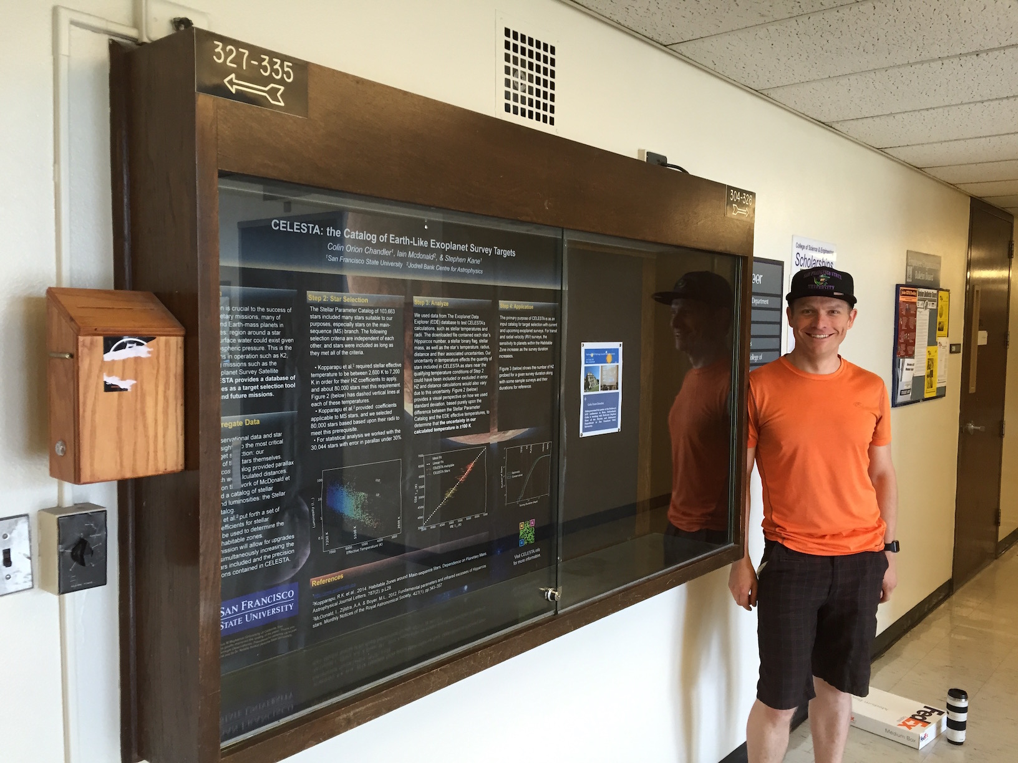
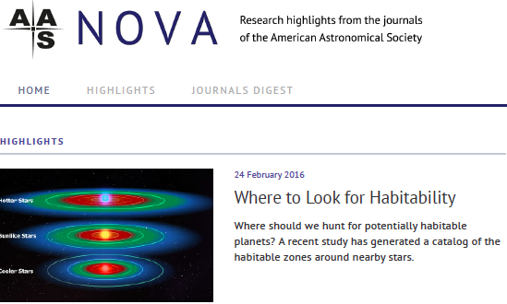
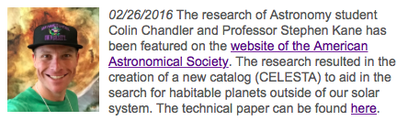
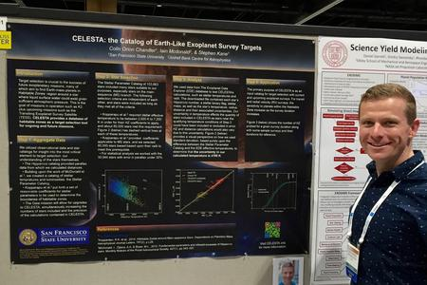
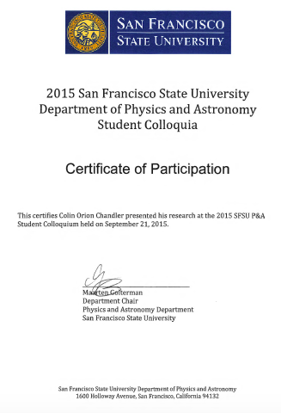
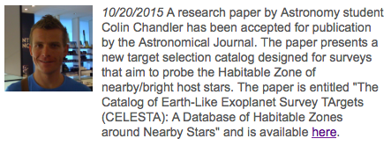
CELESTA: the Catalog of Earth-Like Exoplanet Survey Targets
Colin Orion Chandler¹, Iain Mcdonald², & Stephen Kane³
¹ Northern Arizona University ²Jodrell Bank Centre for Astrophysics ³San Francisco State University
CELESTA: Recognition
TESS
Astronomical Journal
Pathways ‘15
BAEM #15
P&A Showcase
AAS NOVA
AAS #227
P&A News
SFSU P&A Student Colloquium F15
Visit CELESTA.info for more information.
Notes:
LOG LOG, EXPLAIN AXES
Disclaimer re: redenning, all sky survey, etc
Mention TESS and ecliptic pole

Slide 13
CELESTA: What’s Next?
Visit CELESTA.info for more information.
Notes:
MENTION AJ ACCEPTANCE

Slide 14
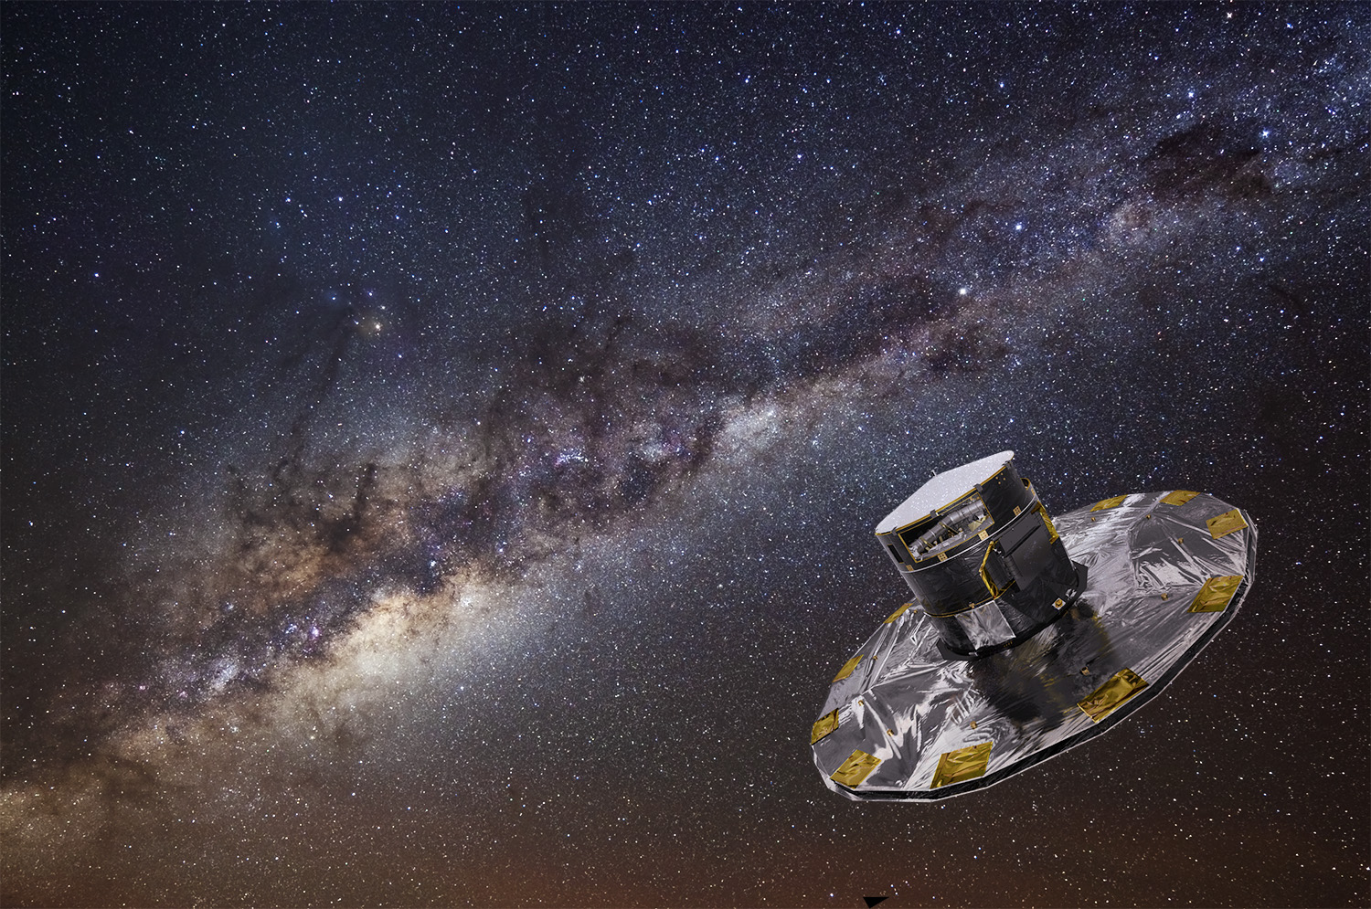
CELESTA: the Catalog of Earth-Like Exoplanet Survey Targets
Colin Orion Chandler¹, Iain Mcdonald², & Stephen Kane³
¹ Northern Arizona University ²Jodrell Bank Centre for Astrophysics ³San Francisco State University
Gaia (today!)

Slide 15

CELESTA: the Catalog of Earth-Like Exoplanet Survey Targets
Colin Orion Chandler¹, Iain Mcdonald², & Stephen Kane³
¹ Northern Arizona University ²Jodrell Bank Centre for Astrophysics ³San Francisco State University
Next Step: Online Presence
• Framework for interactive analysis • Vectors = unlimited resolution • Can update data automatically
Visit CELESTA.info for more information.
Notes:
Mention 200K bug found with this method

Slide 16
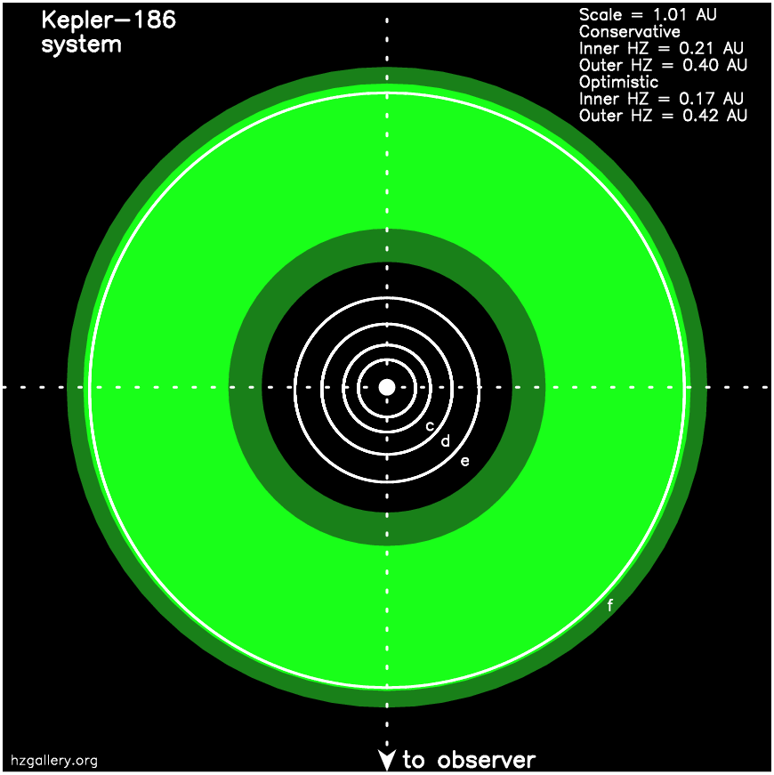
The Habitable Zone Gallery
Stephen Kane¹, Dawn Gelino², Colin Orion Chandler³
¹San Francisco State University ²NASA/Caltech ³Northern Arizona University
Static Image
• Kepler-186 from the Habitable Zone Gallery¹
• Image format: PNG
References
¹http://hzgallery.org
Visit CELESTA.info for more information.

Slide 17
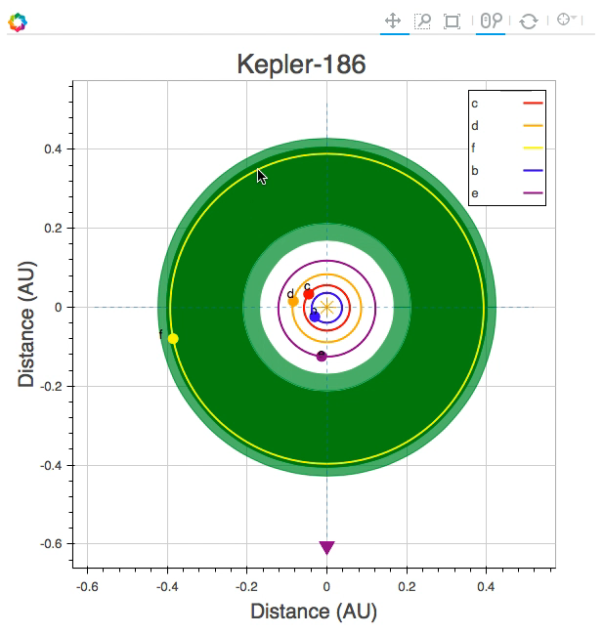
The Habitable Zone Gallery
Stephen Kane¹, Dawn Gelino², Colin Orion Chandler³
¹San Francisco State University ²NASA/Caltech ³Northern Arizona University
Static Image
Interactive Environment
• Kepler-186 from the Habitable Zone Gallery¹
• Image format: PNG
• Kepler-186 with interaction
• Standalone HTML file requires no special software.
• Entire gallery of HTML files generated in < 2 minutes.
References
¹http://hzgallery.org
Visit CELESTA.info for more information.

Slide 18
Conclusions
www.CELESTA.info
What CELESTA Does Now
• Provides HZ distances for 37,000 bright, nearby stars
• Computes the orbital periods for Earth-like exoplanets in those zones
• Calculates stellar parameters (temperature, luminosity, mass, radius)
• Estimates uncertainties by comparing predictions with the EDE ( www.exoplanets.org )
• Determines the number of CELESTA HZs probed for a given survey duration
• Available for download now at http://celesta.info
What is coming
• Interactive online edition
• Bidirectional integration with www.hzgallery.org
• Ability to specify mission parameters (e.g. survey duration, area on sky, magnitude)
• Real-time stellar parameter uncertainty updates with www.exoplanets.org
• Framework for astrometric updates derived from Gaia data
CELESTA Wish-List
• Linkage with additional sources (e.g. M-Dwarf catalogs, Hypatia¹, SIMBAD)
• 3D Interactivity
• Eccentricity effects integration
• Venus Zone calculations
• Ability to utilize other climate/HZ models in calculations²
References
¹ http://physics.sfsu.edu/~nhinkel/hypatia.html
² Requested feature.
Visit CELESTA.info for more information.
Notes:
3D view: eccentricity, variability, ?
this method useful beyond celesta (EDE comparisons)
MENTION CELESTA.INFO

Slide 19
www.CELESTA.info
Visit CELESTA.info for more information.

