Slide 1
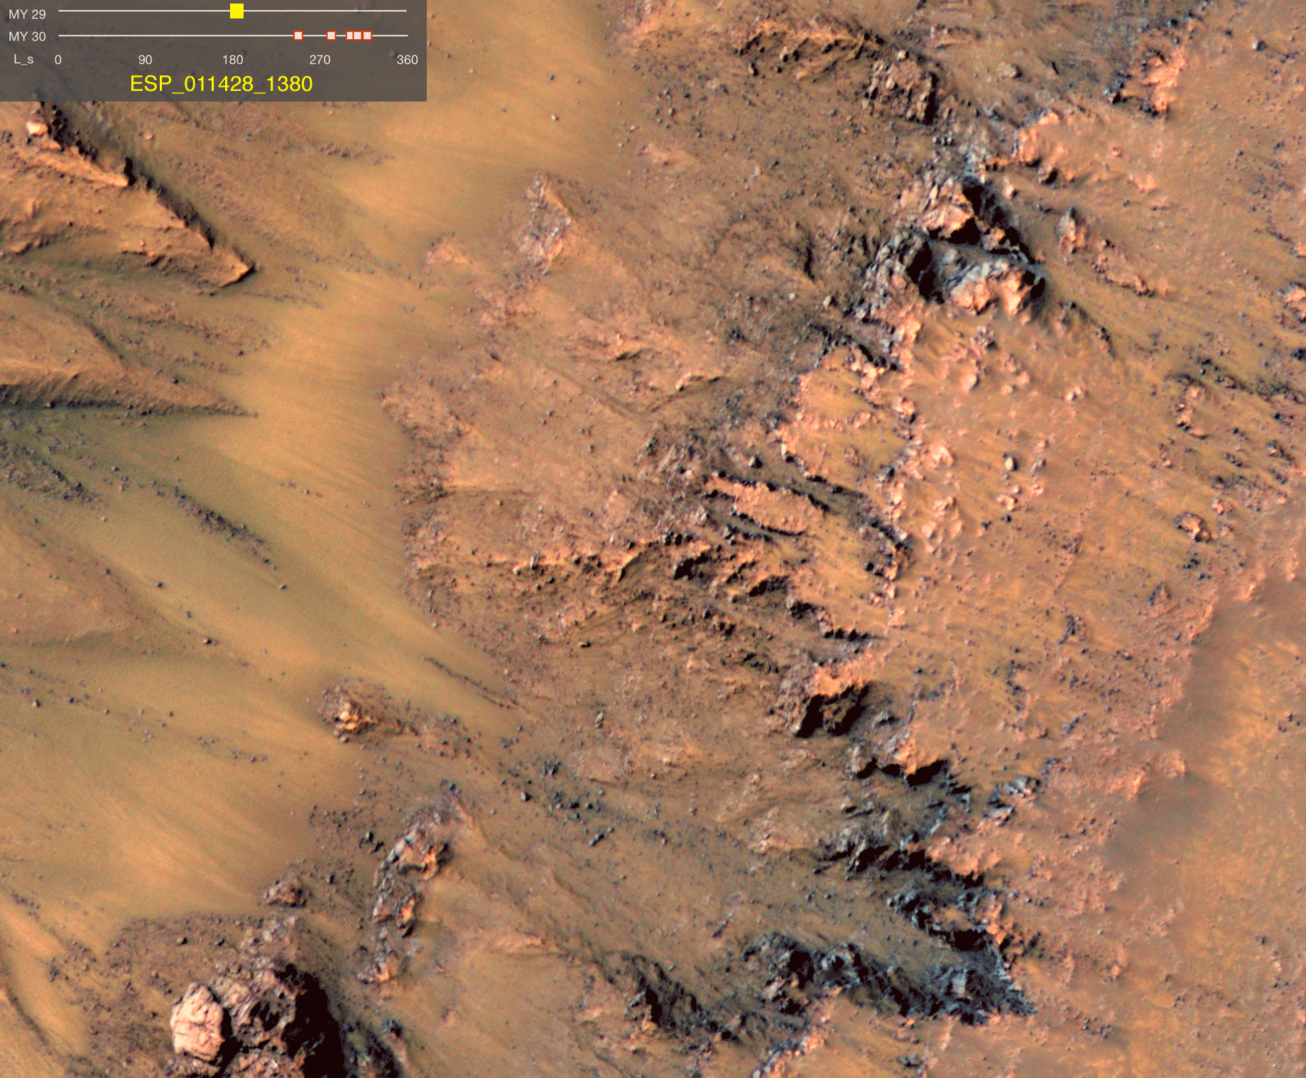
Remote Sensing of Salts and Ices Across the Solar System
Jennifer Hanley
Lowell Observatory

Slide 2
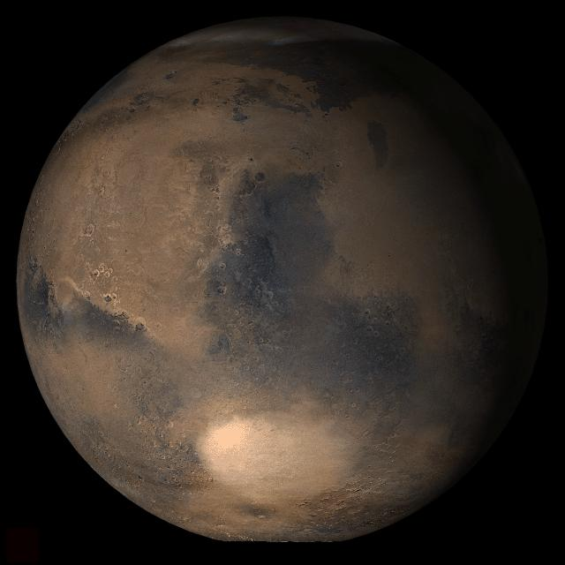
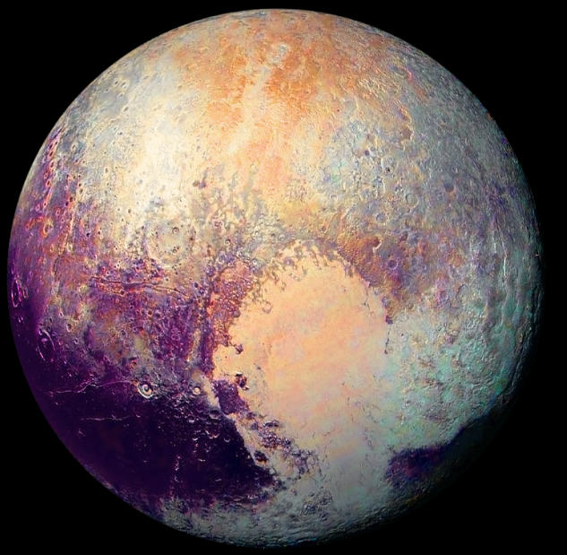
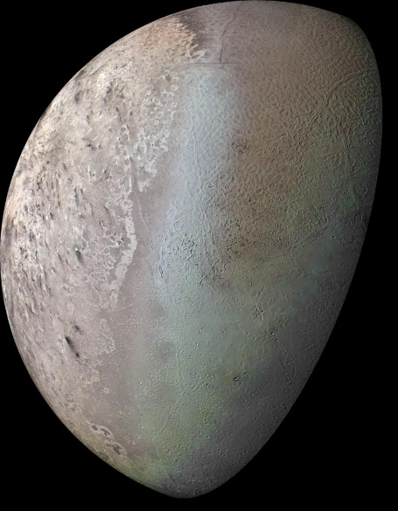
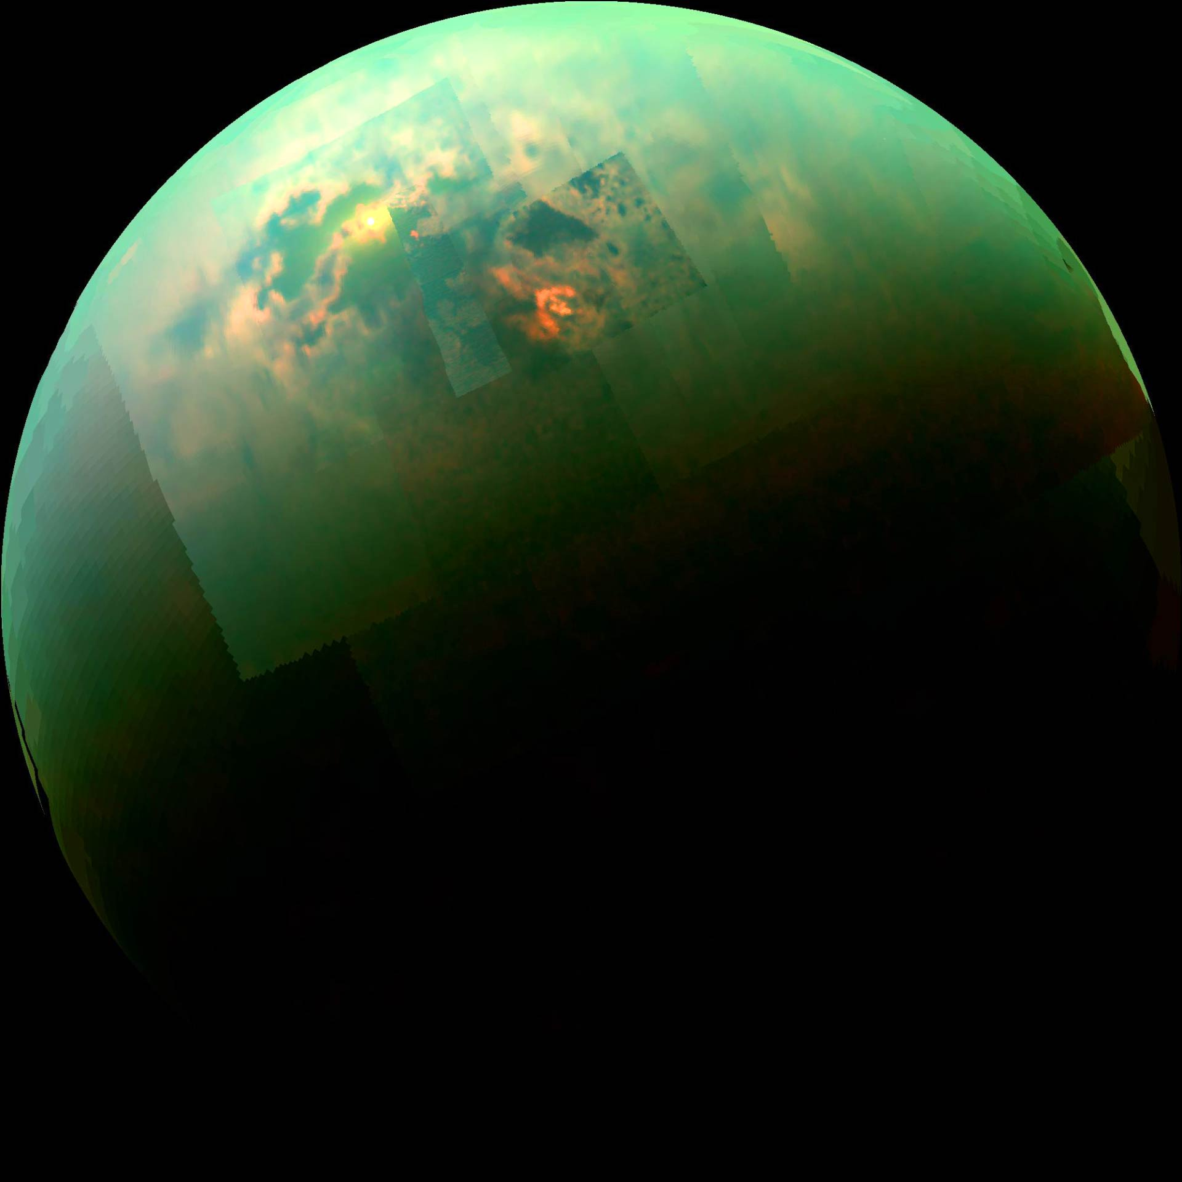
Outline
Salts on Mars
Ices in the Outer Solar System

Slide 3
Chlorine Salts Extend the Stability of Liquid Water
Stability of Pure Water on Earth’s Surface
Ice
Liquid
Water Vapor
0°C
100°C
Stability of Pure Water on Mars’ Surface
Ice
Water Vapor
0°C
10°C
Stability of Perchlorate-Brine on Mars’ Surface
Ice
Liquid
Water Vapor
-70°C
24°C
Notes:
These show the min and max T for each planet – Boiling temp depends on pressure
Earth temps for sea level – in Flagstaff (7000ft) 92.6C
Mars pure water includes lower elevation/higher pressure regions (12mbar) – at Mars avg pressure it would boil at all liquid T
Perchlorate extends stability in both directions – also adding salt lowers evap rate, so any liquid present also exists for longer

Slide 4
Mg(ClO₄)₂∙6H₂O 23°C and 75%RH 18 hour timelapse
Notes:
Salt dissolves in to solution

Slide 5
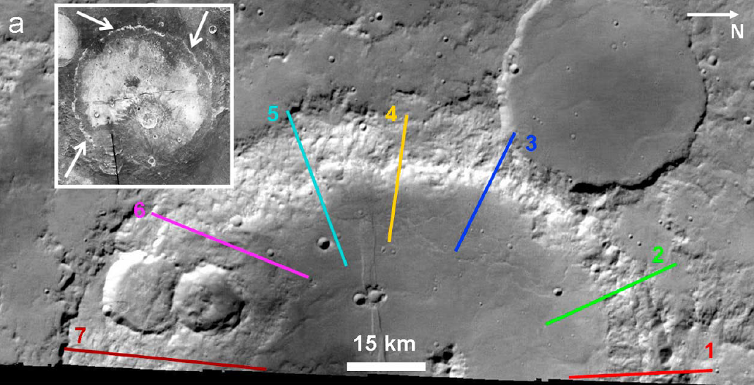
Lots of spectral variability within “salty spectra”
Columbus Crater, Mars
Notes:
Go to typical salty site (Colombus crater) see lots of spectral variability can’t be explained by Mg and Ca sulfates
4 spectral classes we have identified so far – mapped on next slides
Are there similarities to RSL? Can one constrain the other

Slide 6
Lots of spectral variability within “salty spectra”
Mars Data Analysis 2015, PI Hanley
Notes:
Go to typical salty site (Colombus crater) see lots of spectral variability can’t be explained by Mg and Ca sulfates
4 spectral classes we have identified so far – mapped on next slides
Are there similarities to RSL? Can one constrain the other

Slide 7
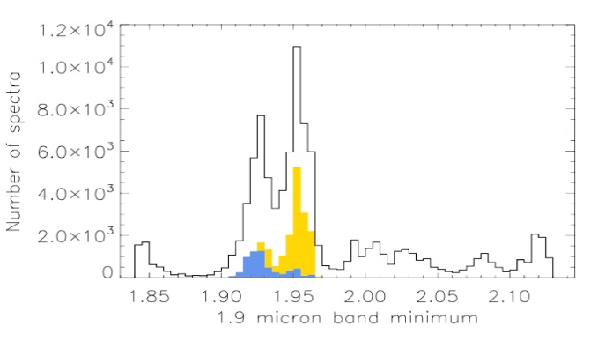
Lots of spectral variability within “salty spectra”
Notes:
Mapped by using new set of band parameters – band depth, band location, and combinations of bands
Talk through each panel
A visible albedo
B position of 1.9um band
Histogram – shows distribution of 1.9 location
C depth of 1.9

Slide 8
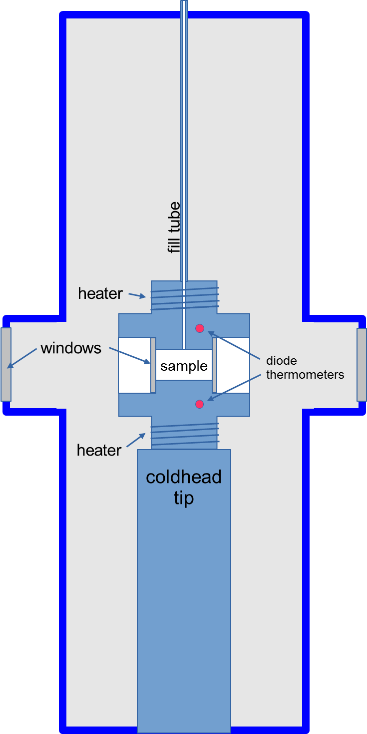
Ice Lab at NAU
Notes:
CH4 + N2 held at a constant temperature for long enough to allow the ice and liquid to fully equilibrate. At 86.6 K the ice crystals sank (A), while at 80.6 K the crystals floated (C). Between 83.8 K and 84.1 K we bracketed the neutral buoyancy point of the crystals (B).

Slide 9
Titan

Slide 11
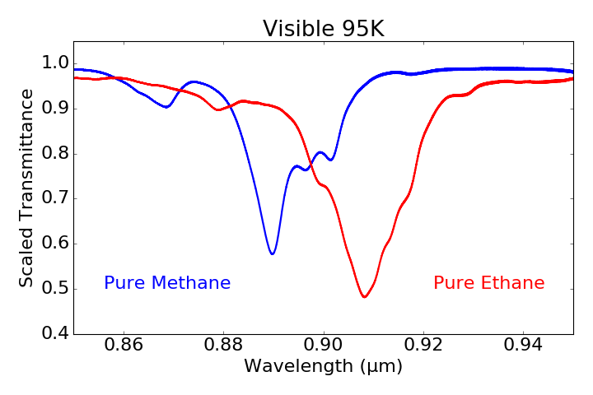

Slide 12
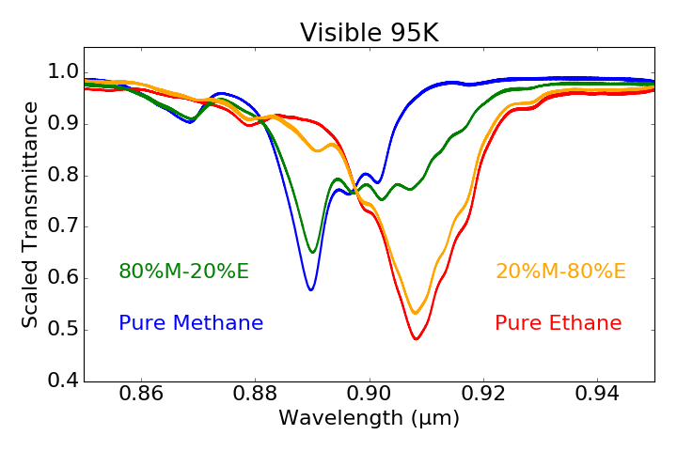

Slide 13
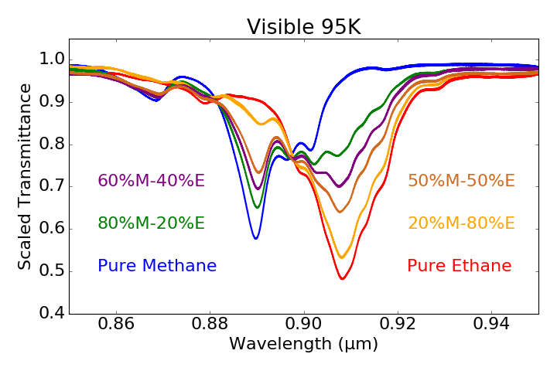

Slide 14
Continuing Work
Refine parameters used to identify chlorine salts on Mars
Look at previous landing sites and other known chlorine salts locations
Mid-infrared useful for distinguishing between chlorine and sulfate salts?
Explore spectral and physical properties of more mixtures for Titan’s lakes, as well for Pluto, Triton and other outer SS objects

Slide 15
Jennifer Hanley
Lowell Observatory

Slide 16
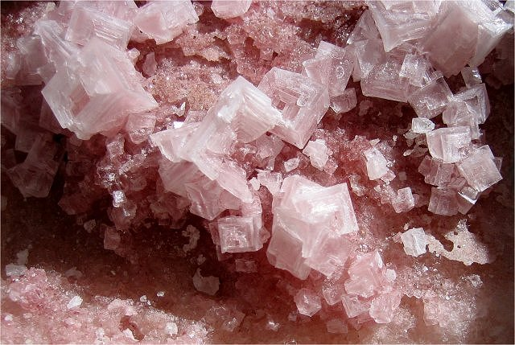
Extremophiles (Halophiles)
Bacteria down to 18% NaCl and -25°C
(Mykytczuk et al, 2013)
Haloarchea and Cyanobacteria occur within halite crusts
(Davila et al, 2008, Wierzchos et al, 2006, Cockell and Raven, 2004)
Perchlorate and Chlorate-reducing bacteria
(e.g. Oren et al, 2013)

Slide 17
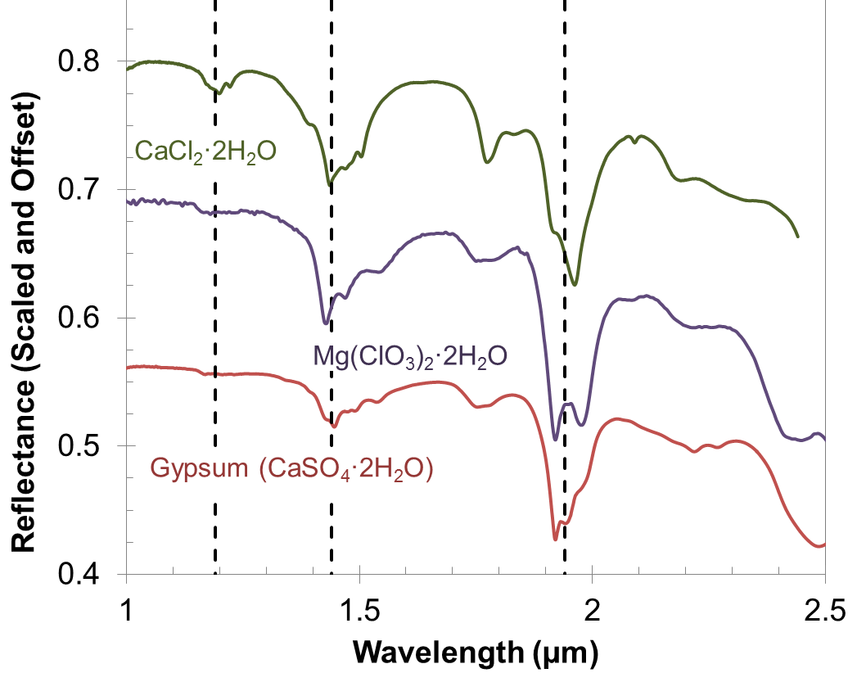
Mapping a specific spectral class
Mars Data Analysis 2015, PI Hanley
Notes:
Only mapping 3 spectral classes, but clearly more there.

Slide 18
Recurring Slope Lineae (RSL)
Ojha et al (2015) Nature Geosciences

Slide 19
Methane+Ethane Rain

Slide 20
Methane+Ethane Melting Currents

