Slide 1
Formation of Charon’s Red
Polar Caps
Will Grundy
New Horizons Surface Composition Science Theme Team Lead

Slide 2
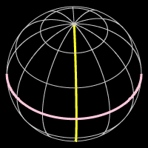
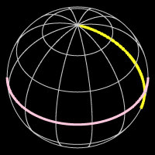
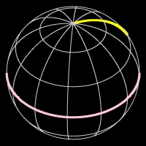
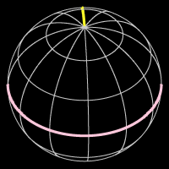
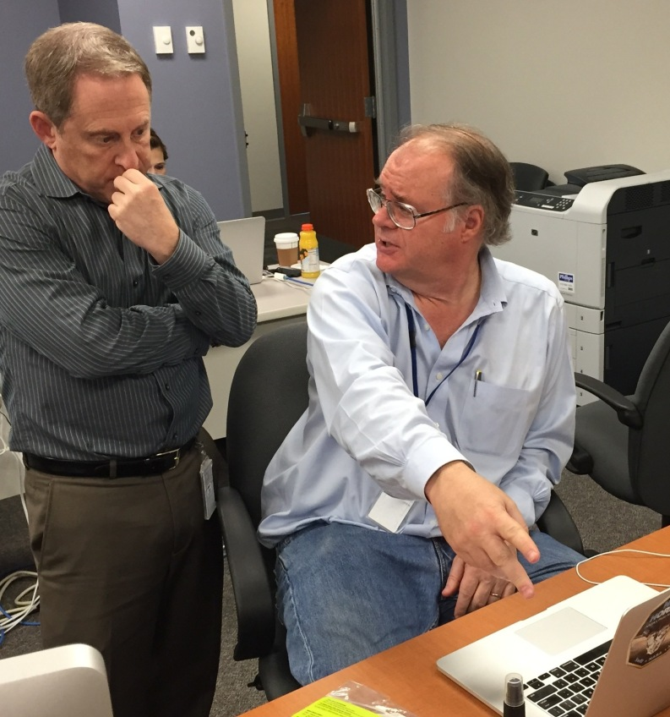
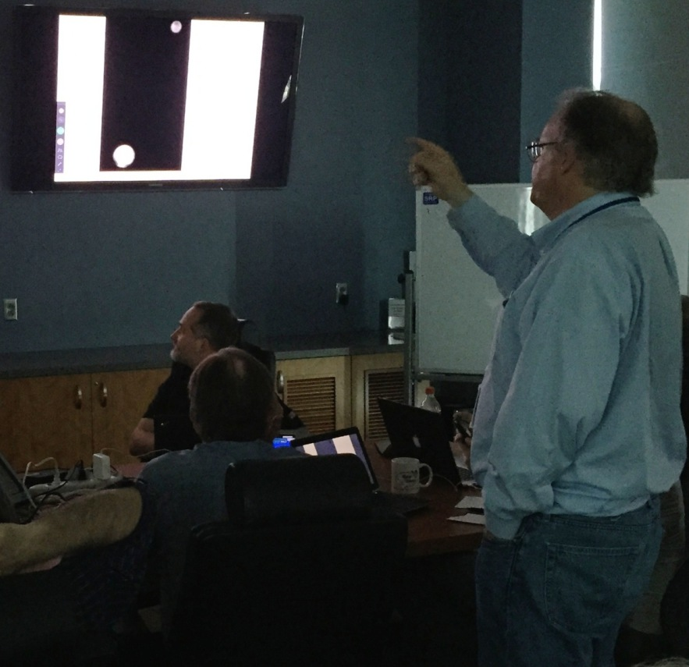
Formation of Charon's Red Polar Caps
358°
288°
245°
177°
Early June 2015

Slide 3
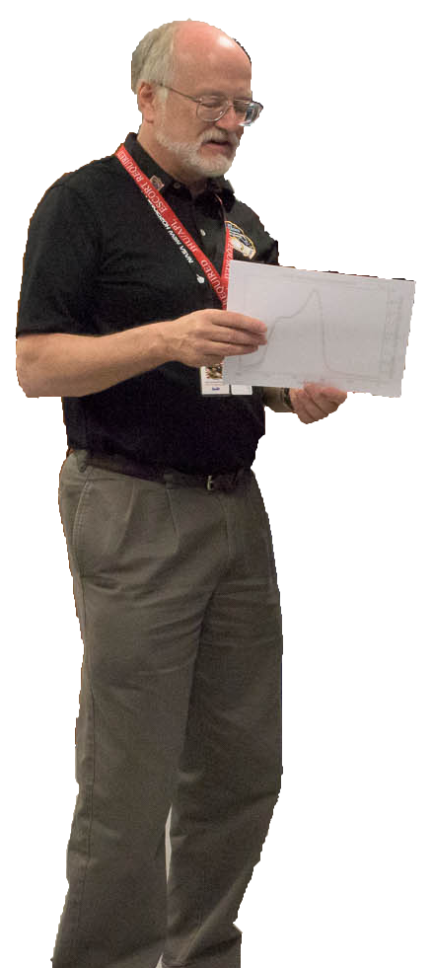
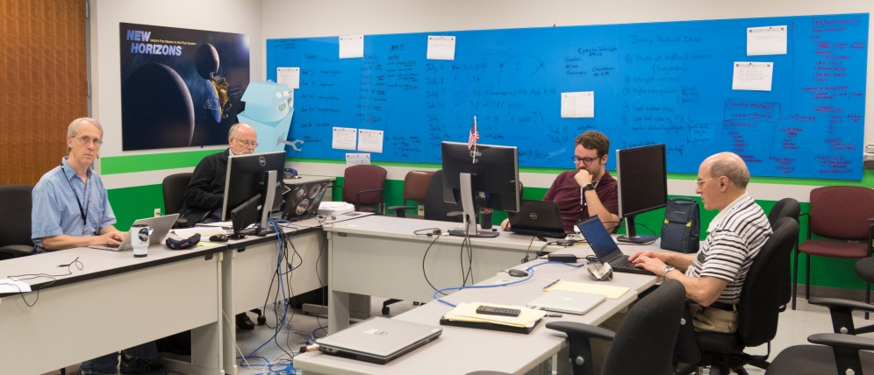
A Planetary Whodunnit

Slide 4
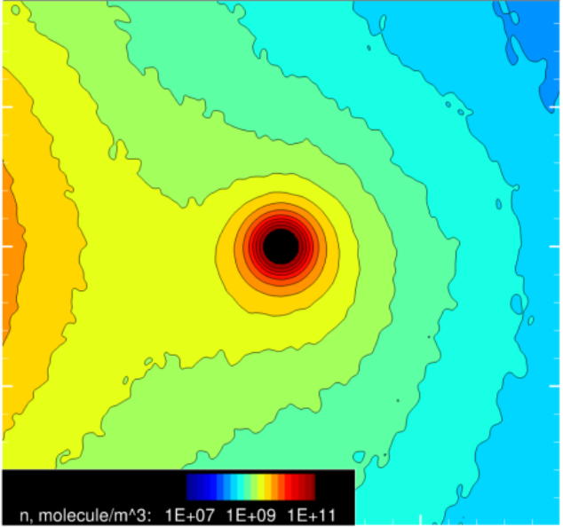
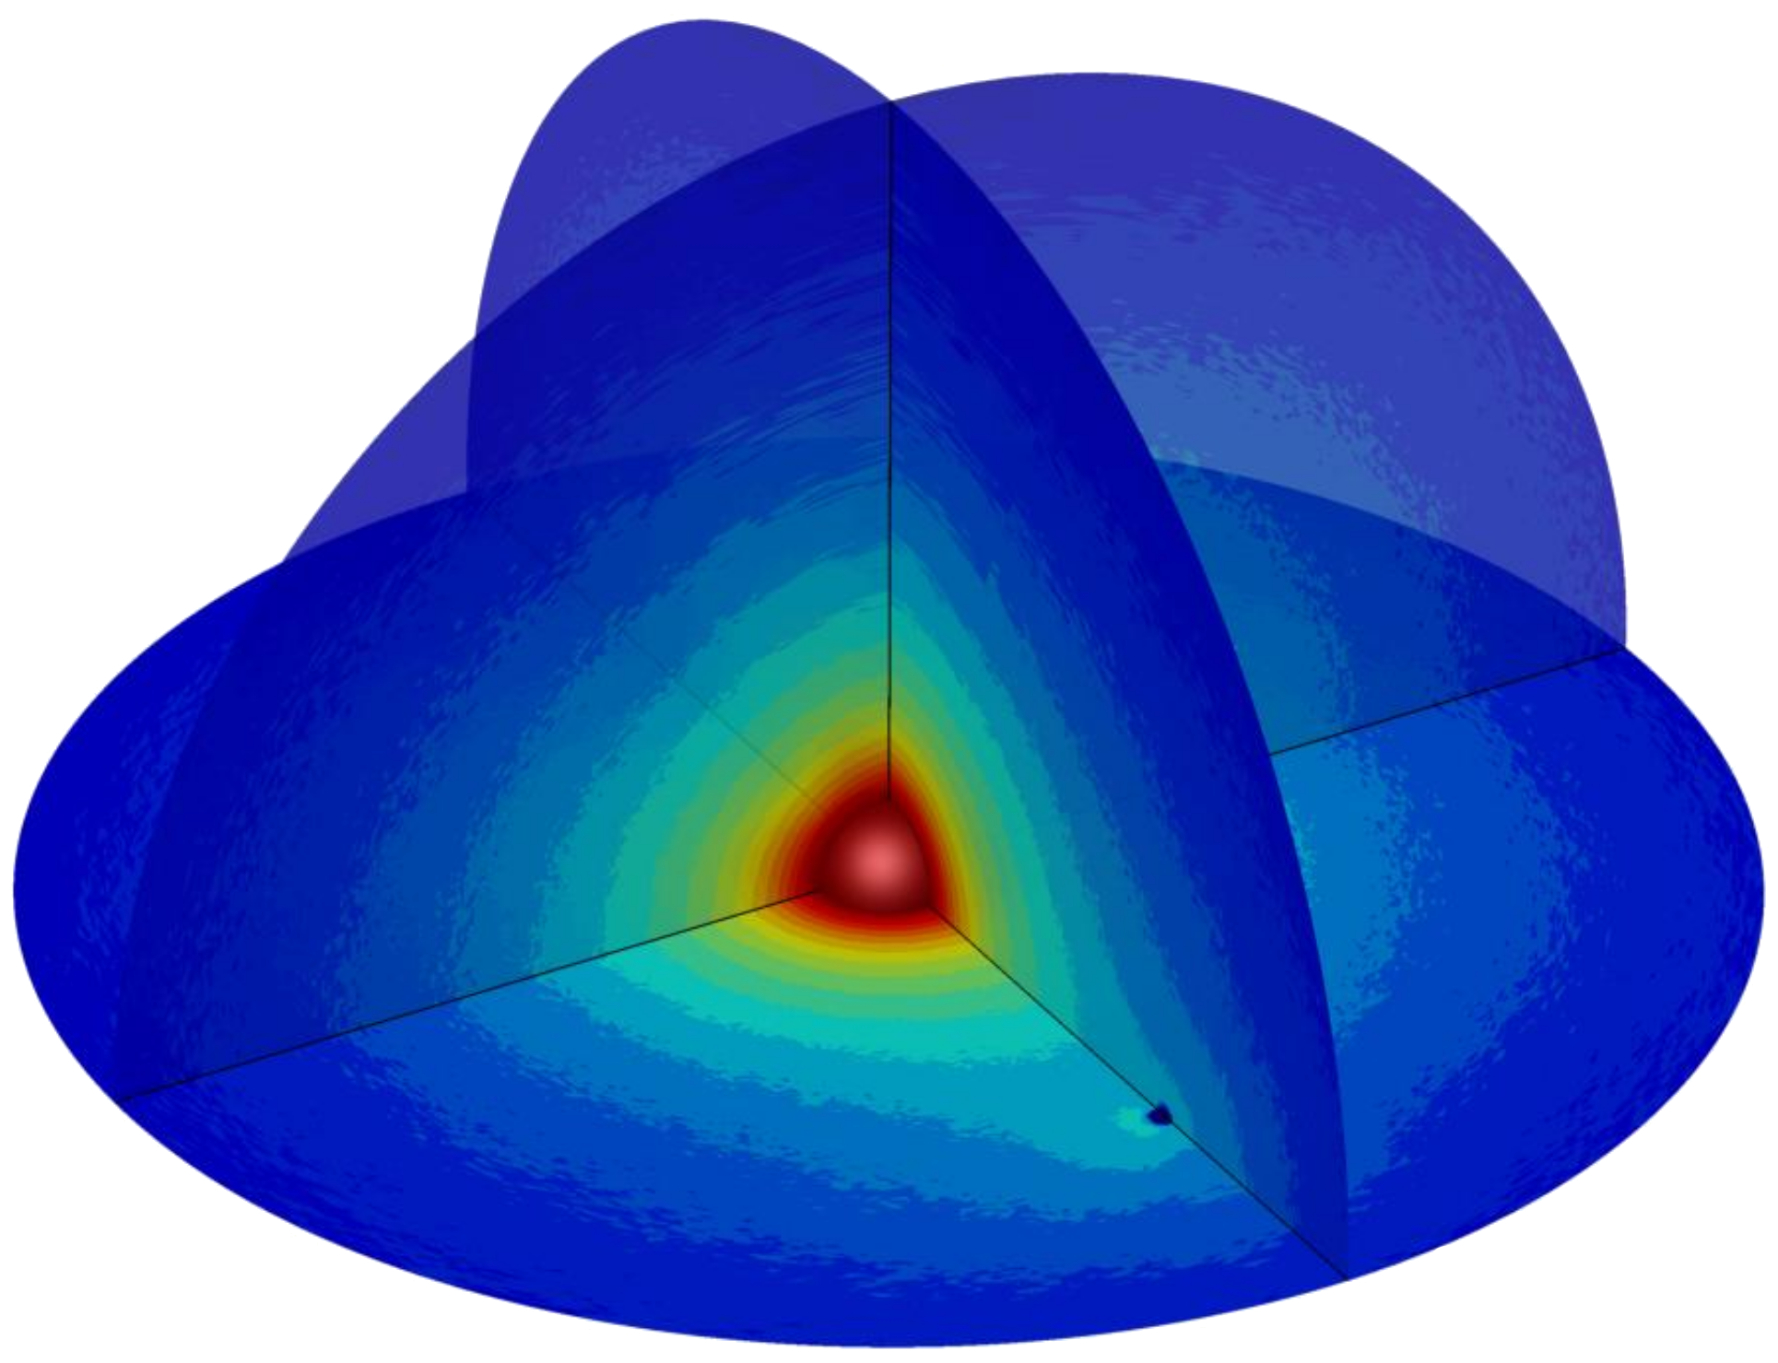
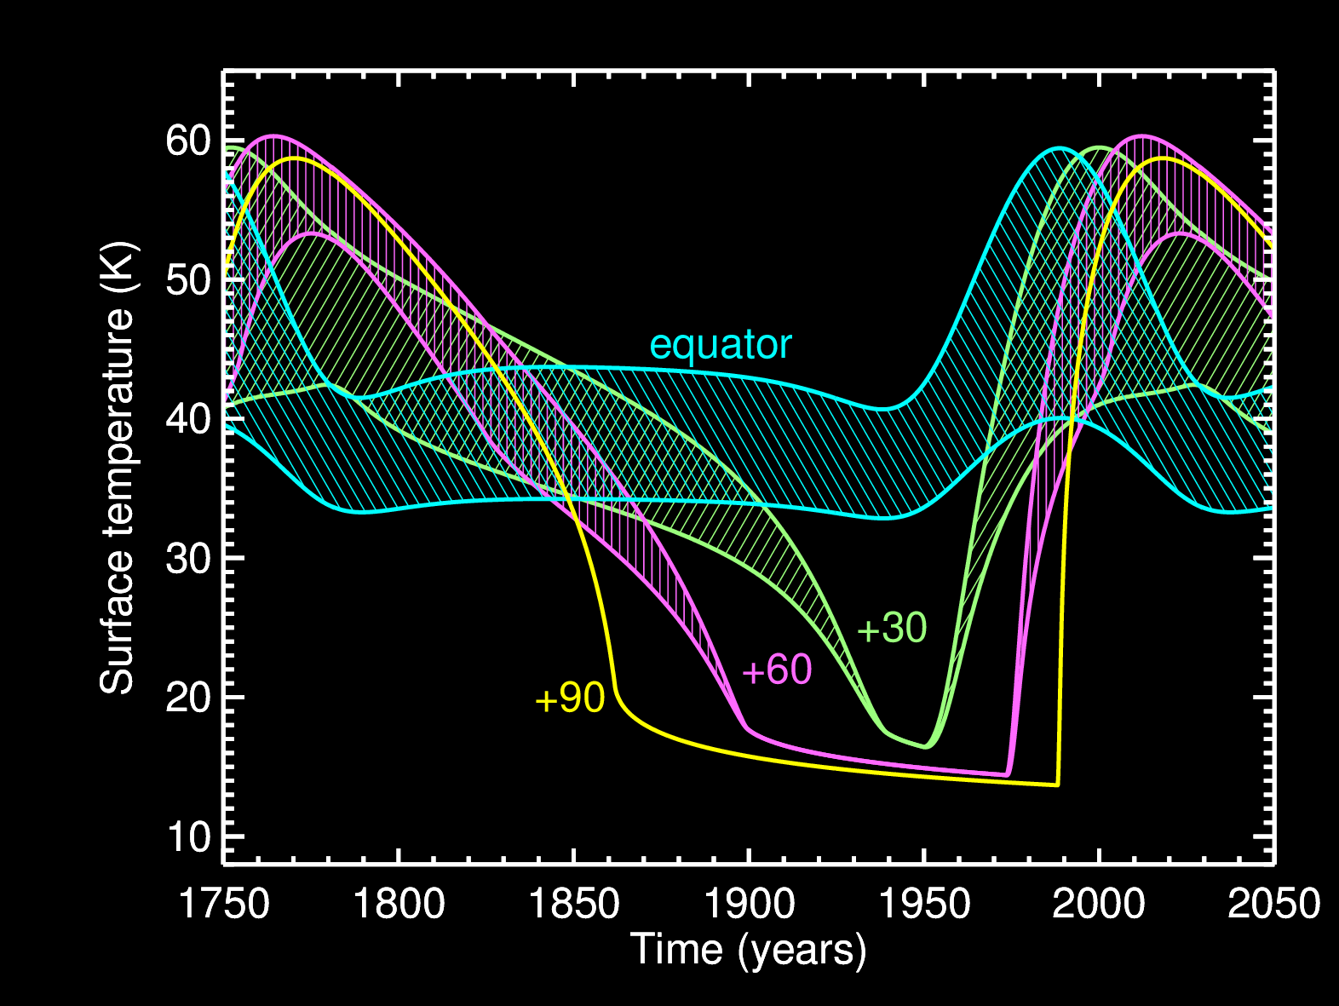
Hypothesized Mechanism
Pluto’s escaping atmosphere (CH₄)
Influence of Charon’s gravity
Long, dark, winters
Cold-trapping for decades until the Sun rises again
Hoey et al. 2016
Grundy et al. 2016

Slide 5
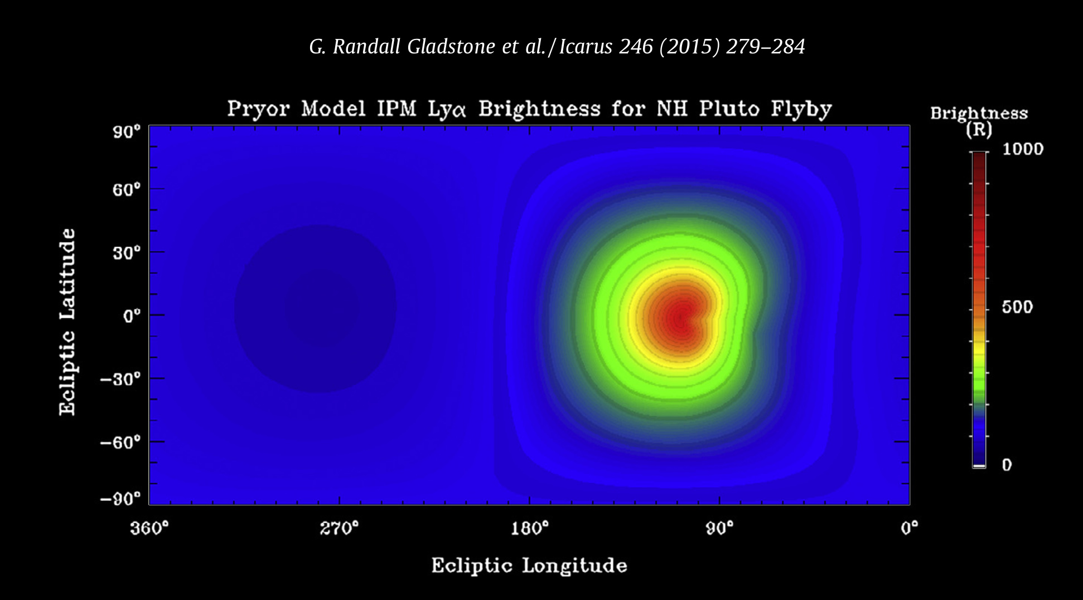
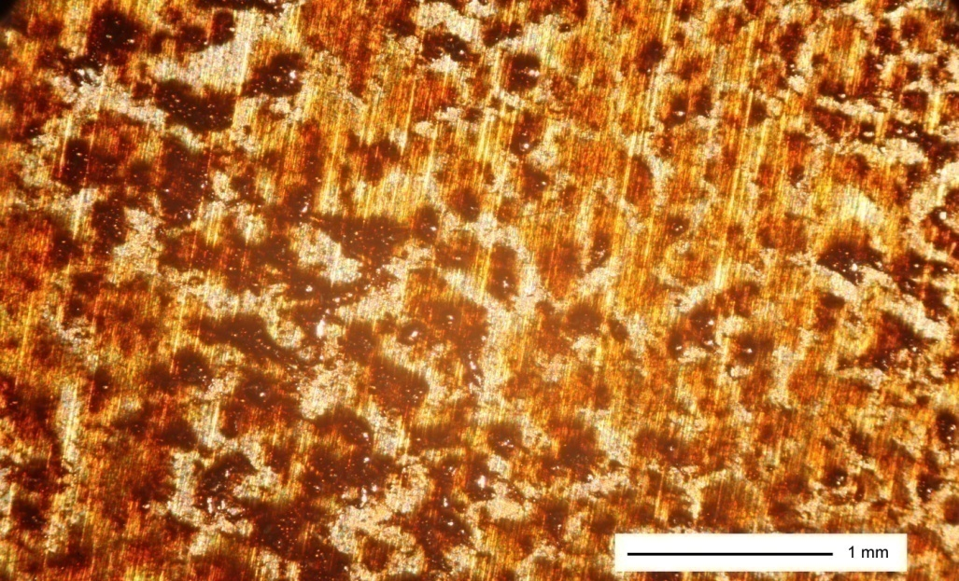
Hypothesized Mechanism
Irradiated by scattered Ly α
Production of heavier, less volatile species
These remain when methane sublimates away in spring
Feedstock for subsequent tholin production
Accumulation rate of order mm per million years
Faster than satellite dust infall, but comparable to impact gardening

Slide 6
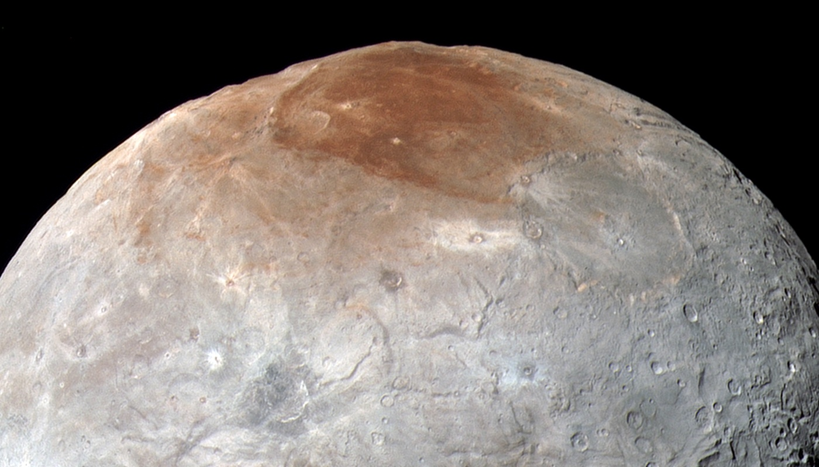
Better Imagery

Slide 7
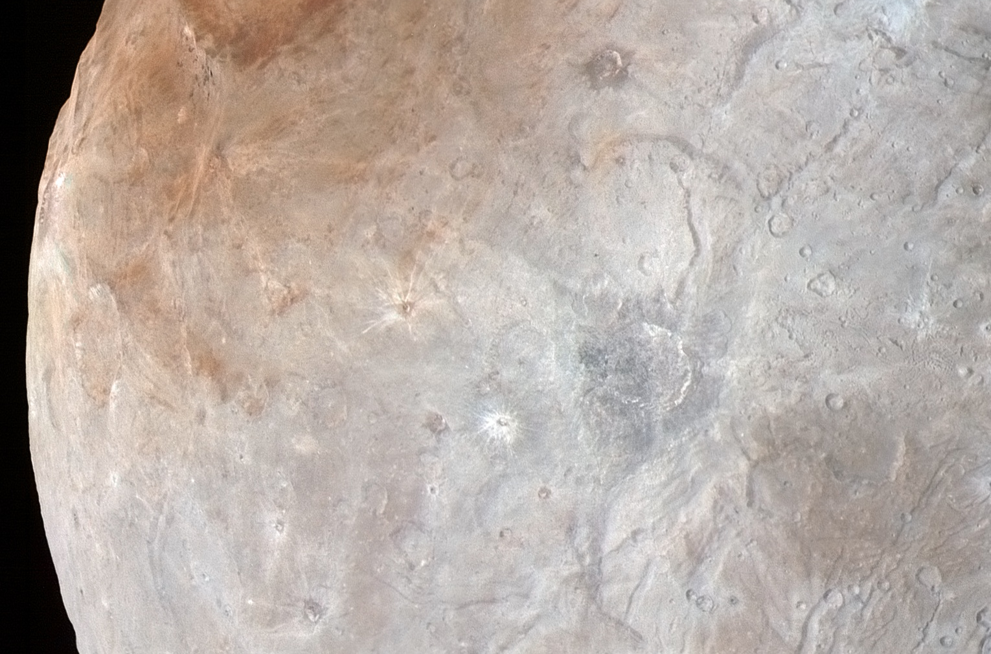
Highest Resolution Imagery

Slide 8
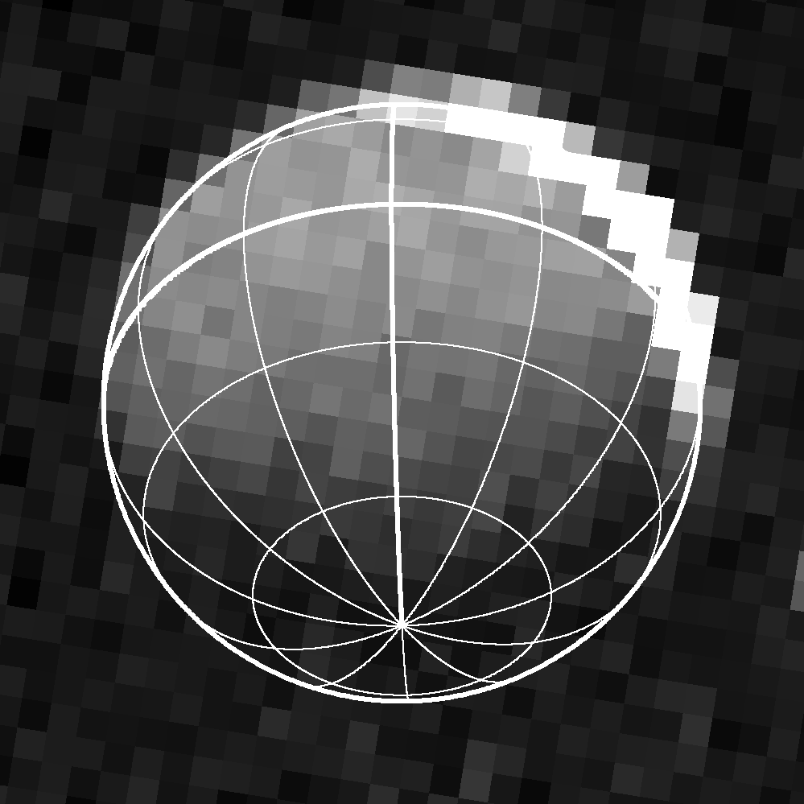
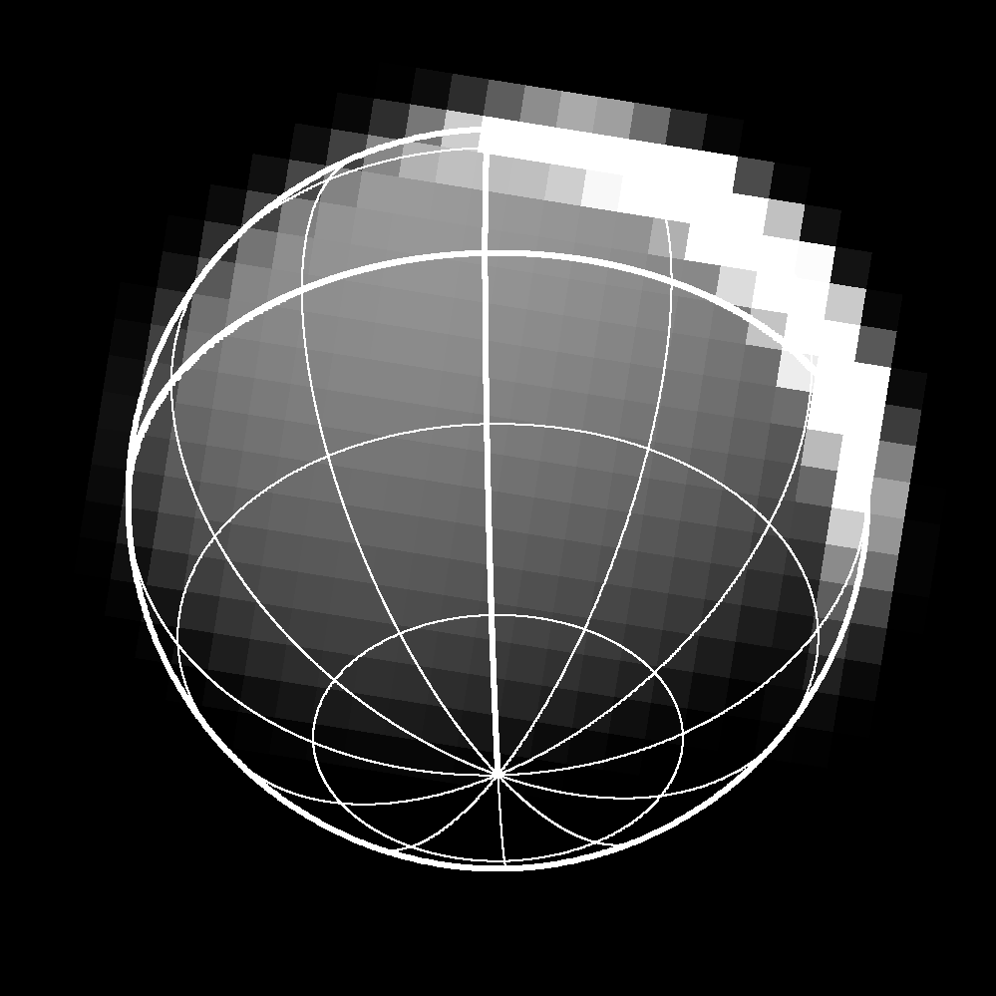
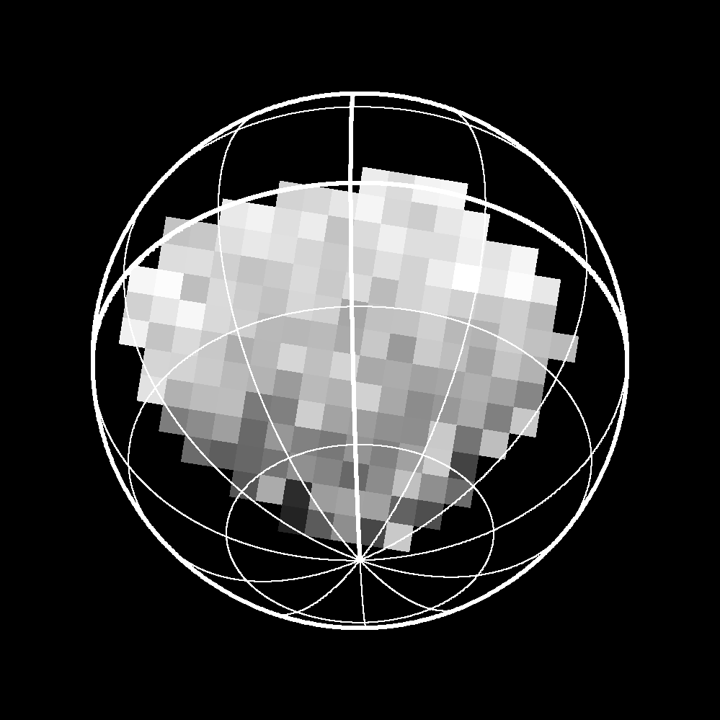
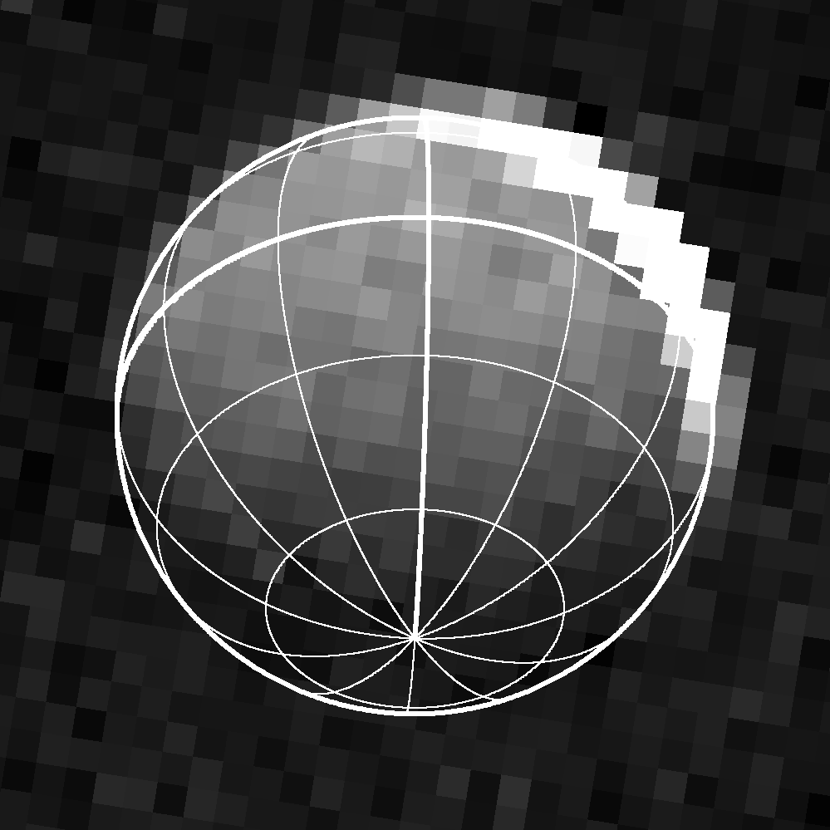
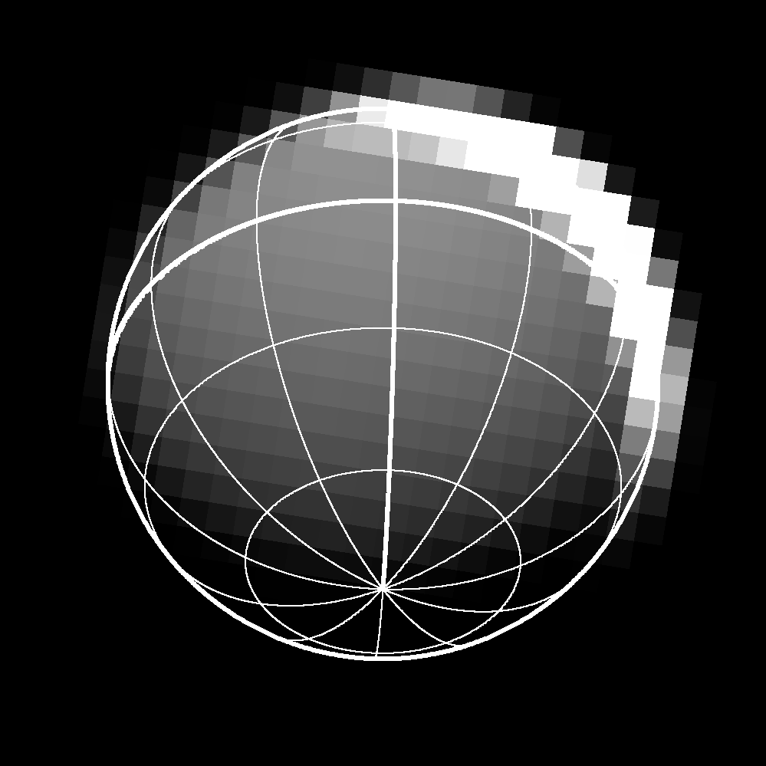
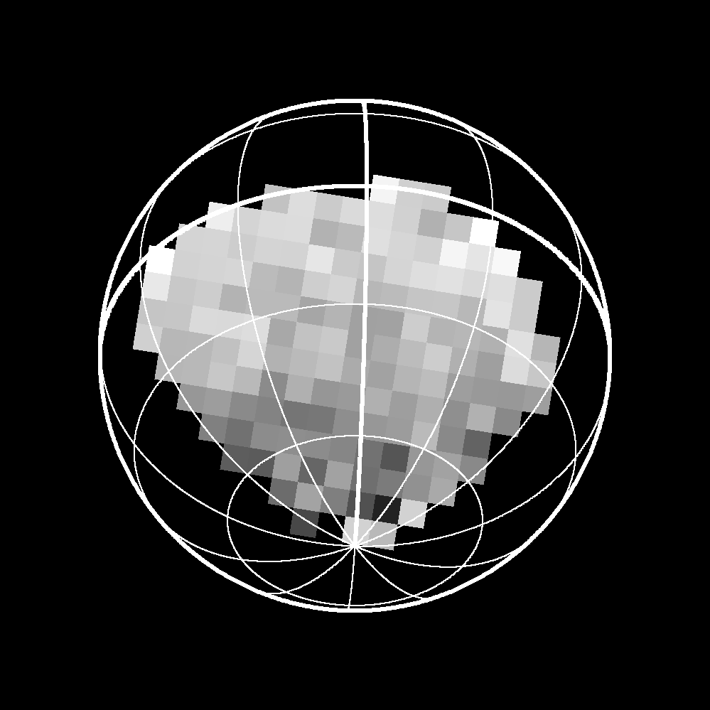
Winter Pole in Pluto-Shine
Stack
1
Stack
2
data
model
ratio

Slide 9
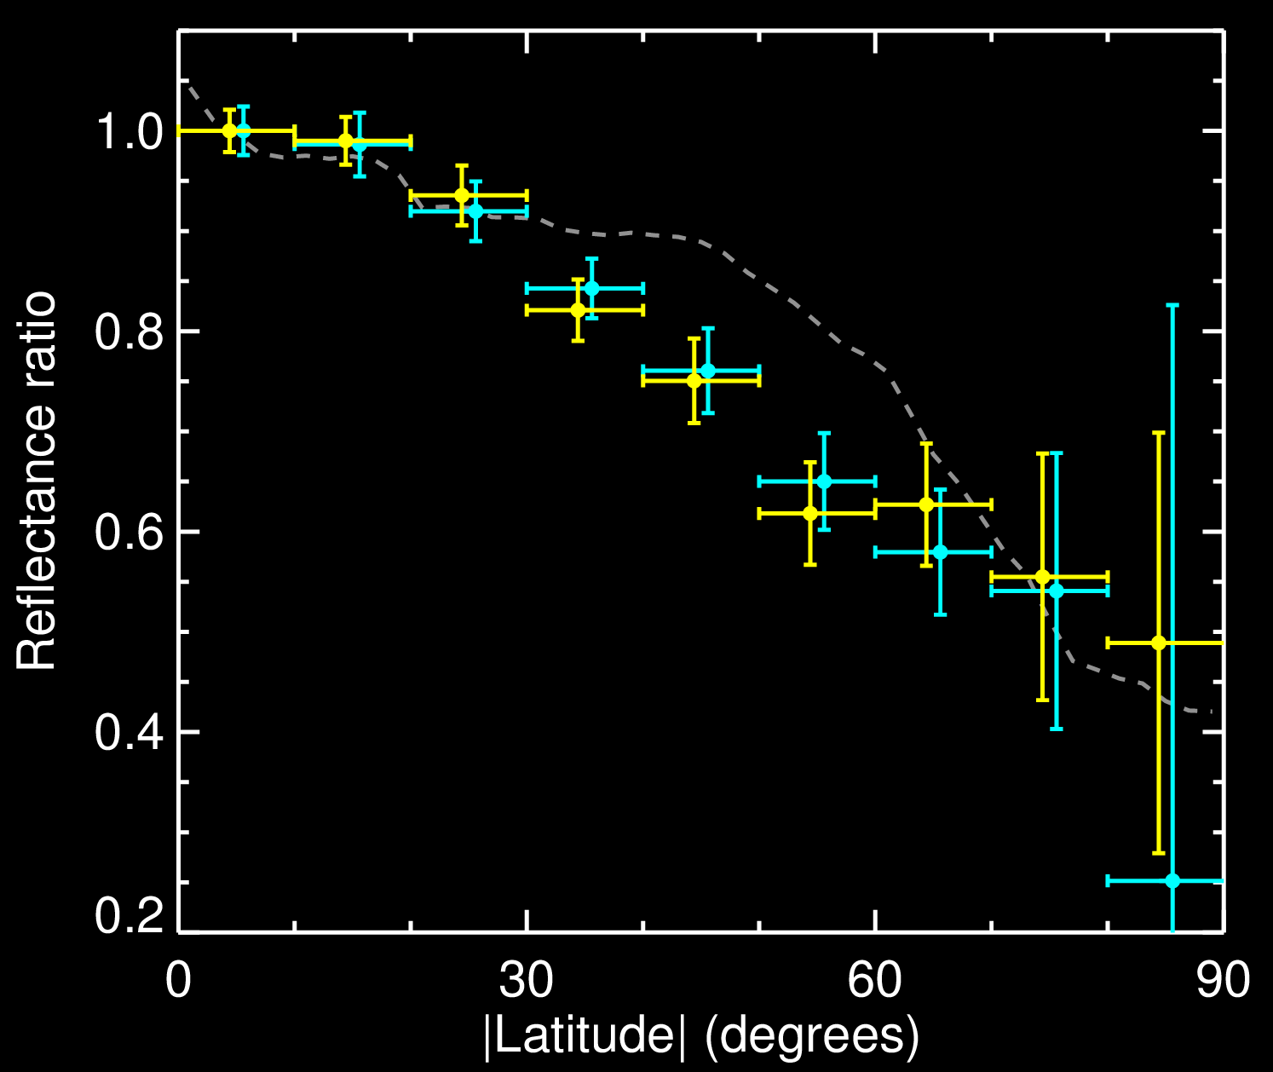
Comparison of S and N Hemispheres

Slide 11
Backup Slides

Slide 12
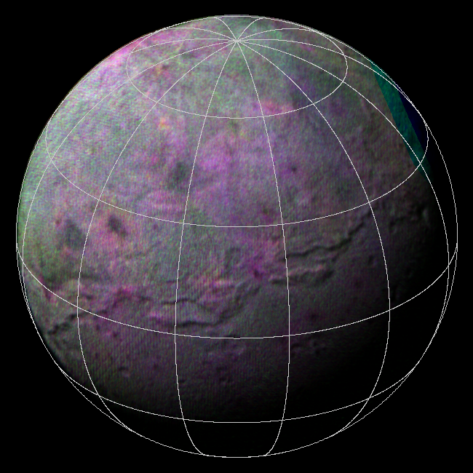
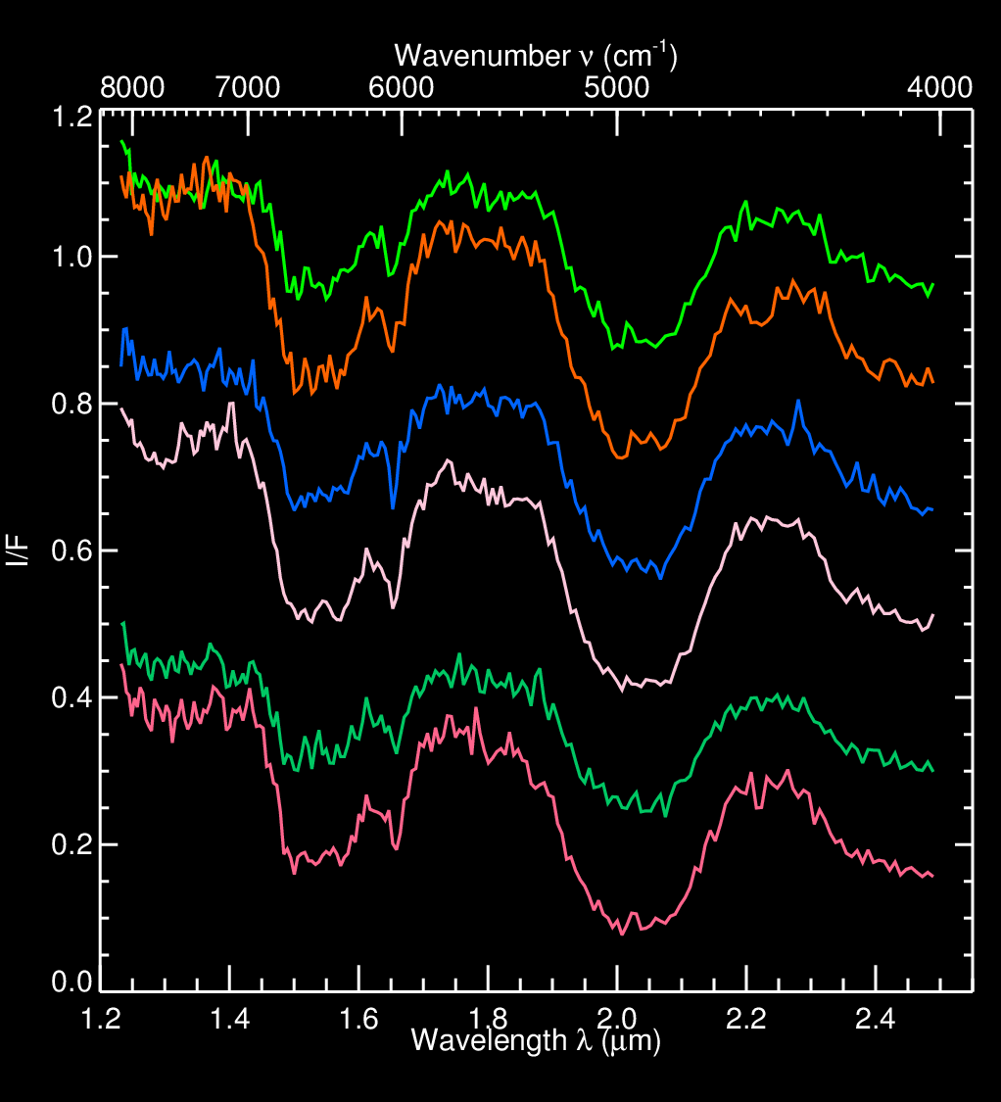
IR Spectroscopy
I/F (offset)

Slide 13
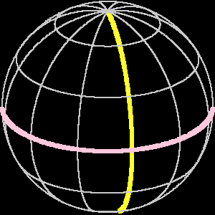
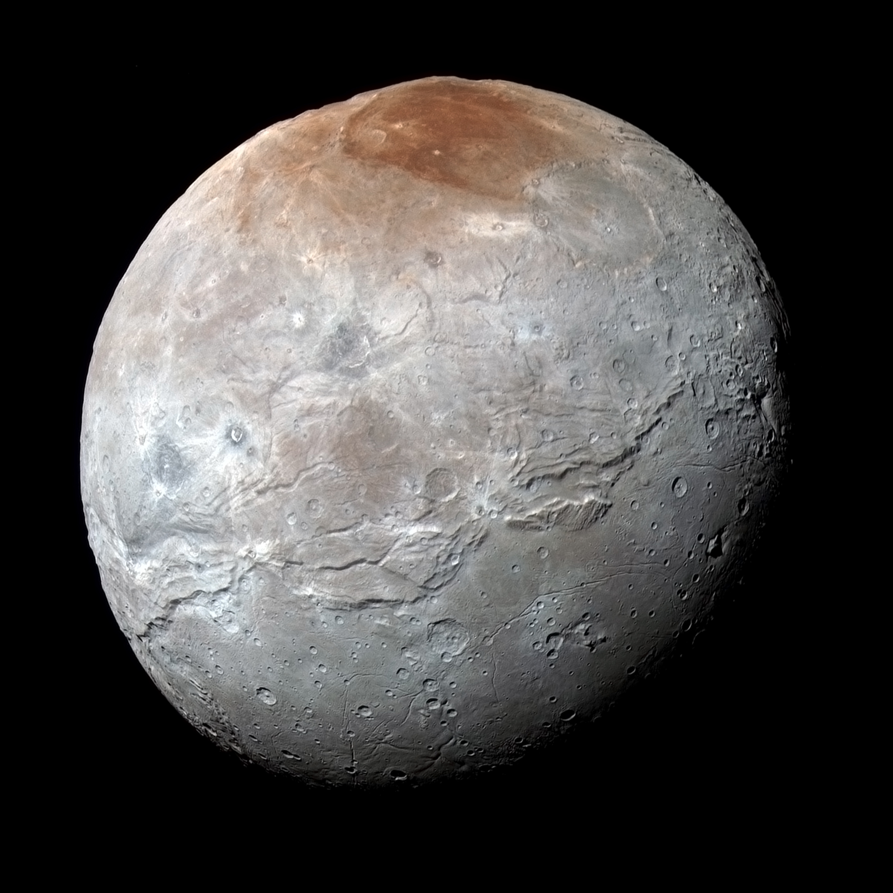
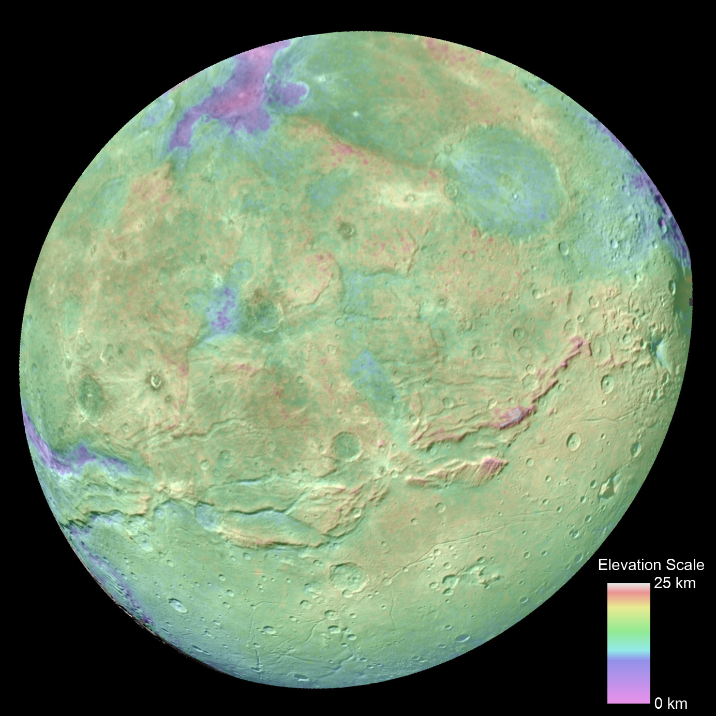
Color and Topography
400 km

Slide 14
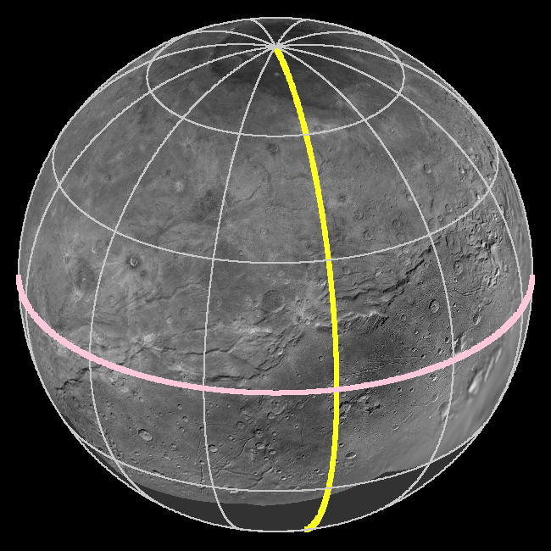
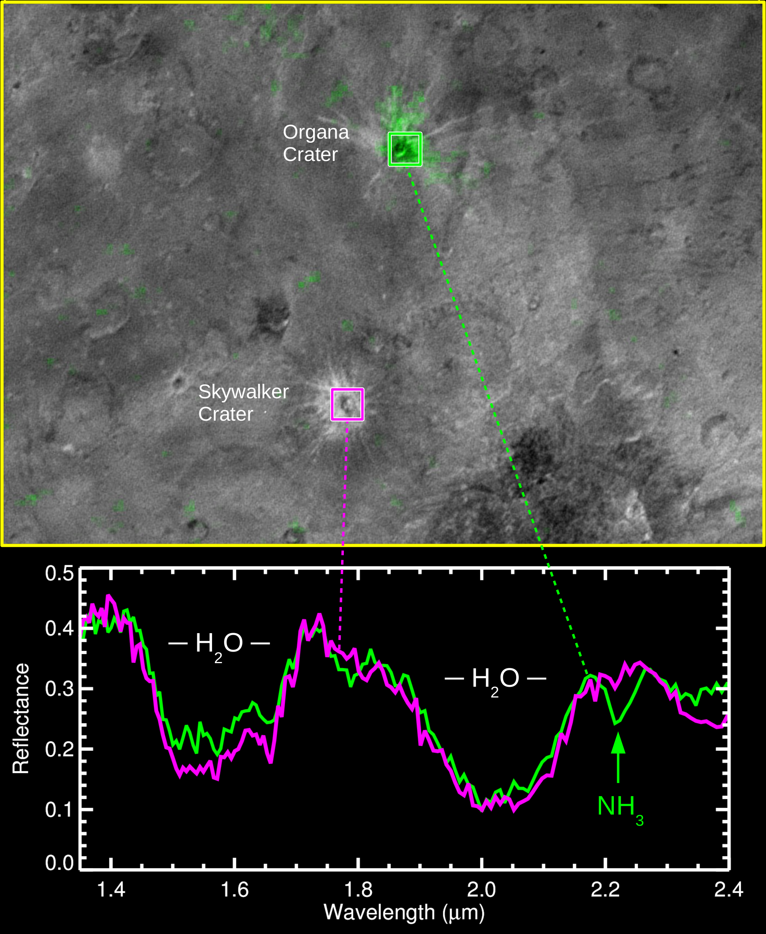
Isolated NH₃-Rich Outcrops

Slide 15
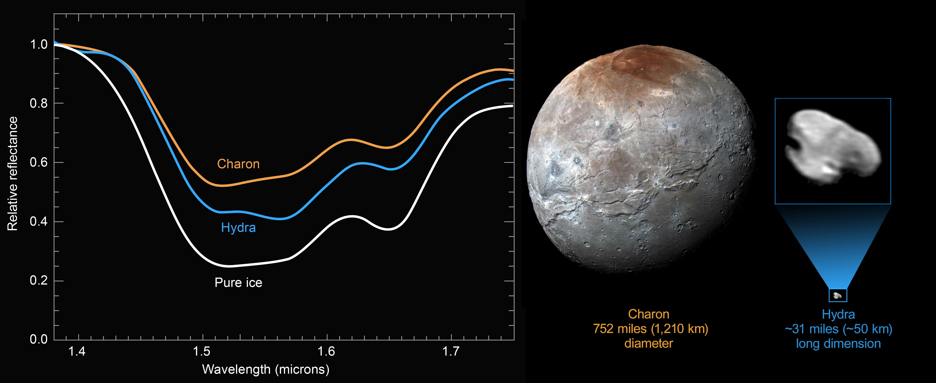
Bright, Clean H₂O Ice
Notes:
Made from differentiated mantle material
Small sats kept clean by erosion?

