Slide 1
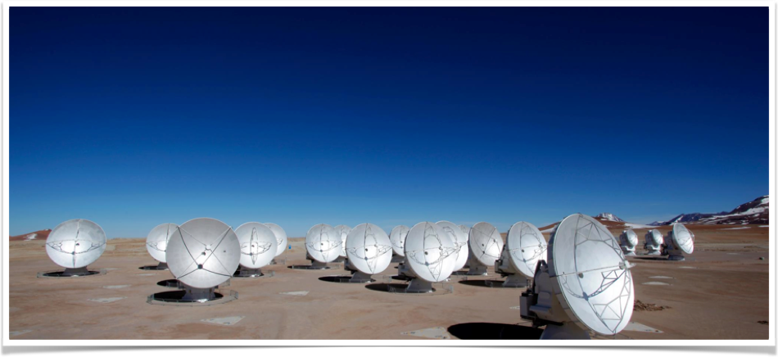
ALMA observation of Ceres’ Surface Temperature.
Titus, Li, Sykes, Ip, Lai, Moullet
Where Astronomy Meets Planetary Science

Slide 2
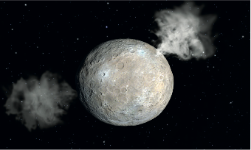
Motivation
Original Questions
Why do ground based observations when we have a spacecraft in orbit?
Figure from Nature
Can we detect the edge of the ice table?
Can we see two distinct hemispheres?
Camberlain et al.,2009
Can we provide context for Dawn observations?
We need to be observing Ceres long after Dawn has died.
Low-spatial resolution but complete annual coverage
Episodic events need to be observed. (e.g Küpper et al., 2014)
Insensitive to T < 180 K
Precludes Early Morning or Mid/Late afternoon Observations
Precludes Polar Observations
Solar System Observations
Principle Investigator J.-Y. Li
Funded for a 5 year Mission.

Slide 3
Data/Models Processing Steps
Data (ALMA)
Models
Radio Calibration
Map Projection
Meta Data e.g. Local Time
KRC Models
Interpolated to Observations
Thermal Gradient Correction; Convert to Radiance
Limb (IFOV) Correction
Compare “Radiance” profiles
Best-Fit Parameter Maps

Slide 4
ALMA Observations and Processing
Data Observation Dates
31 Oct 2015
2 Nov 2015
12 Nov 2015
Data
Heliocentric = 2.97 au, geocentric = 2.9 - 3.1 au, phase = 19°
9 hours on source of Ceres, covering one full rotation
Band 6 continuum, 260 GHz (1.2 mm), 30-50 mas/beam = 60-100 km at Ceres
Self-Calibration
Map Projection and Meta-Data
Simple Cylindrical Projection
Local Time; Emission Angles

Slide 5
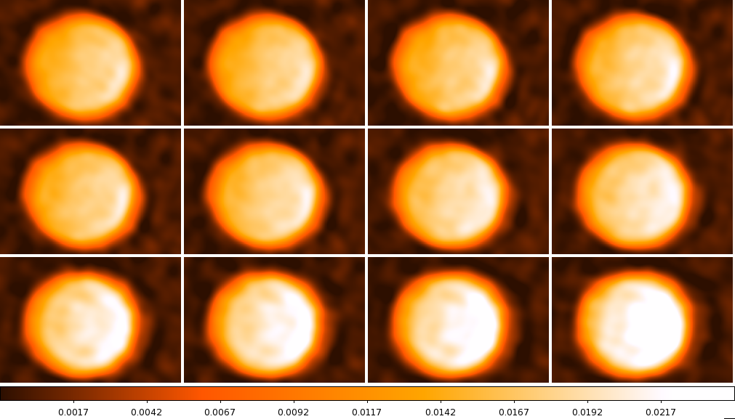
Oct 31-Nov 1, 2015, 10 min integration in each panel

Slide 6
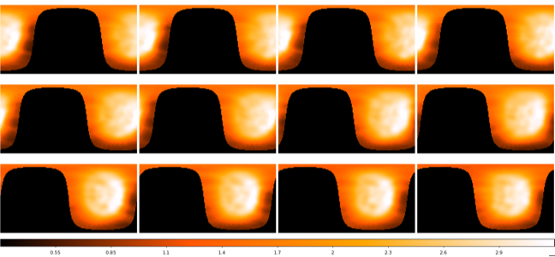
Projected Thermal Flux Maps

Slide 7
Thermal Models:
4 Models
Thermal Gradient

Slide 8
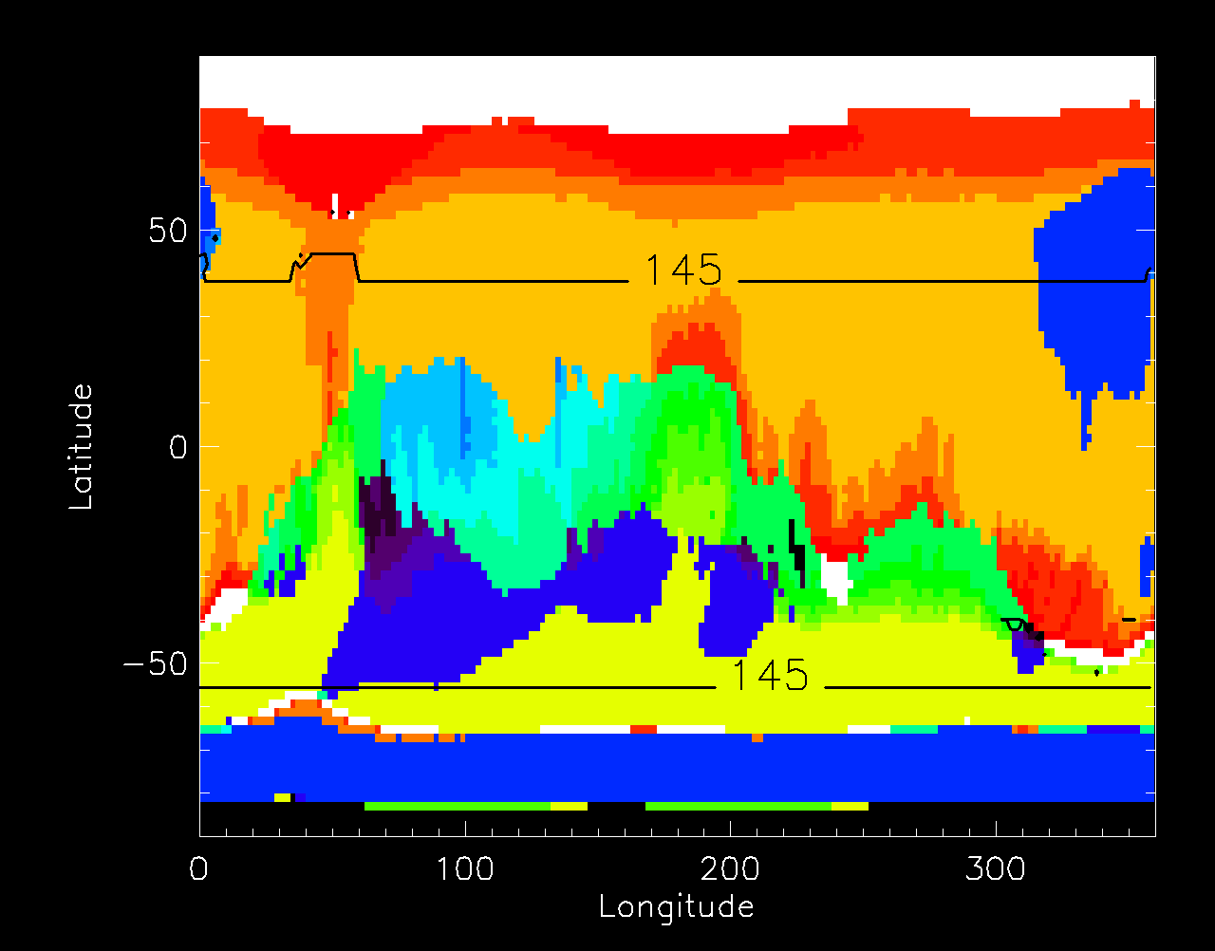
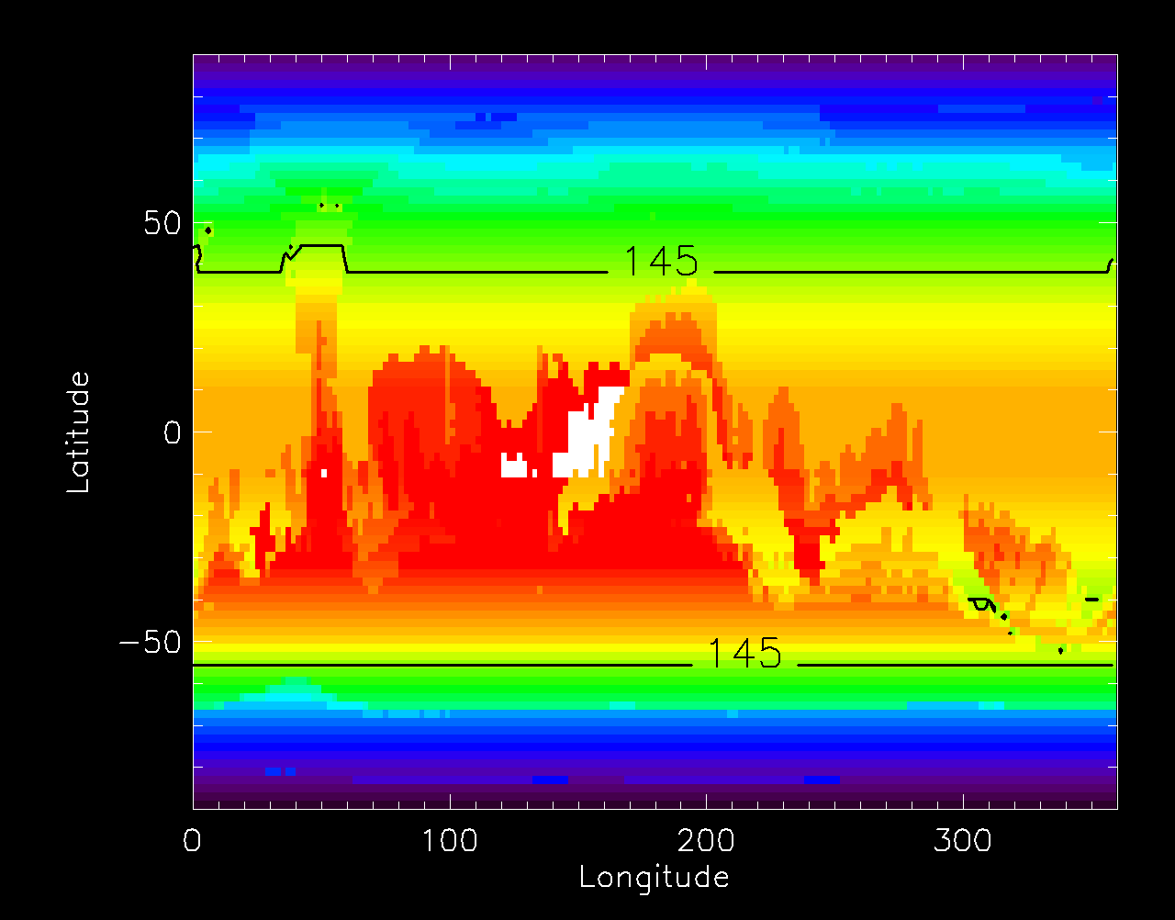
20 Thermal Models
# of Cases | TI | Effective Emissivity | Ice Table
4 | 11 | 0.9 (Smooth) 0.7 (Rough) | N & Y
4 | 15 | 0.9 (Smooth) 0.7 (Rough) | N & Y
4 | 21 | 0.9 (Smooth) 0.7 (Rough) | N & Y
4 | 30 | 0.9 (Smooth) 0.7 (Rough) | N & Y
4 | 42 | 0.9 (Smooth) 0.7 (Rough) | N & Y
Creates a Thermal Physical Unit Map
Use the model results to calculate annual mean temperature.

Slide 9
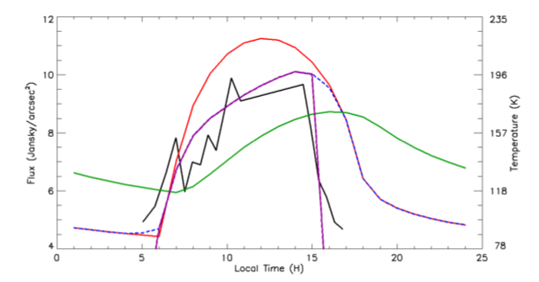
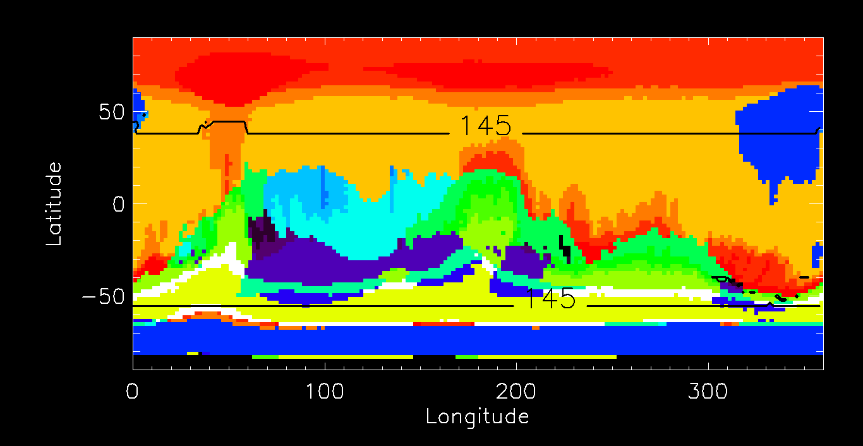
Questions?
Figure from Nature

