Slide 1
Utilizing Raman Spectroscopy to determine Phase Diagrams of Outer Solar System Ices
Shyanne Dustrud
Will Grundy, Anna Engle, Gerrick Lindberg
Department of Chemistry, Northern Arizona University

Slide 2
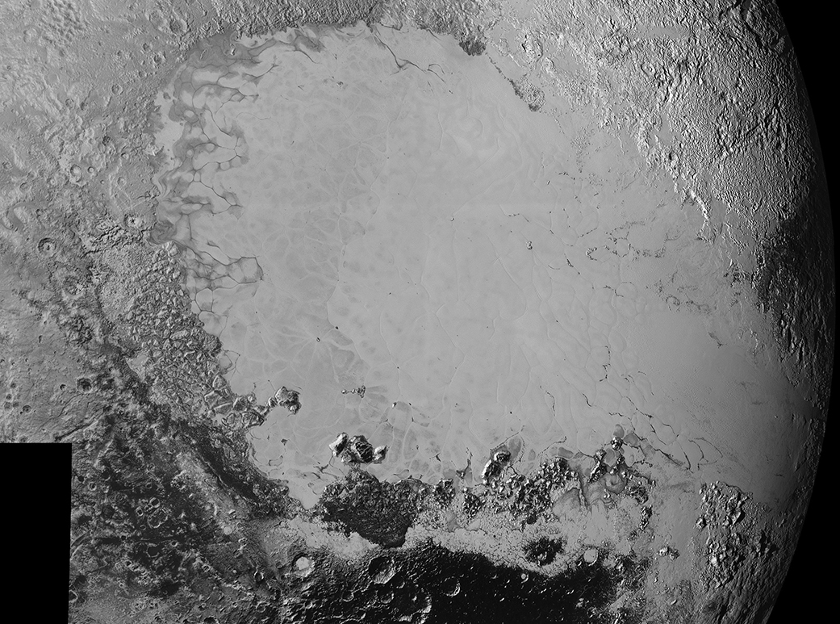
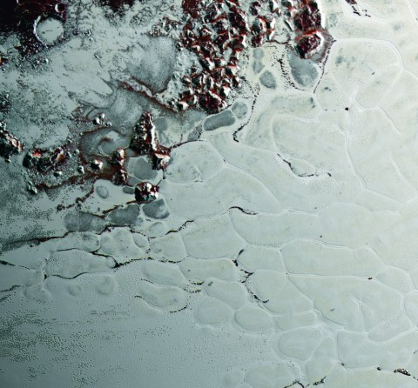
Motivation

Slide 3
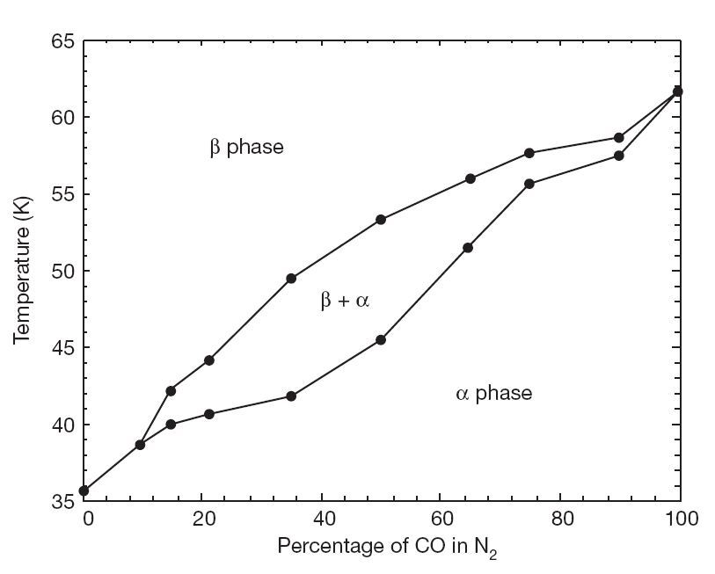
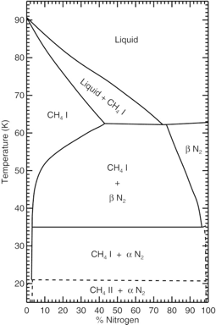
Phase Diagrams
CH₄ – N₂
CO – N₂

Slide 4
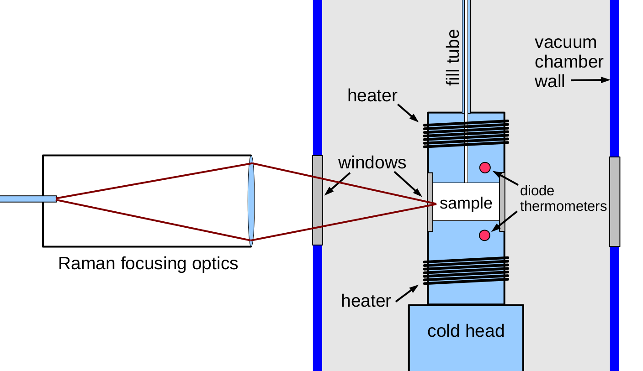
Astrophysics Ice Lab

Slide 6
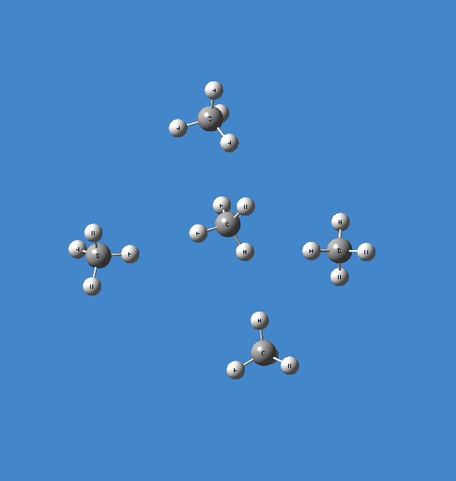
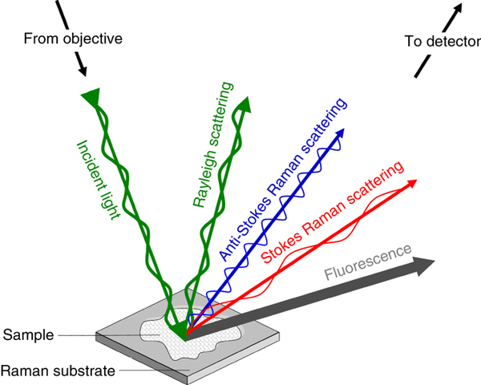
Raman Spectroscopy

Slide 7
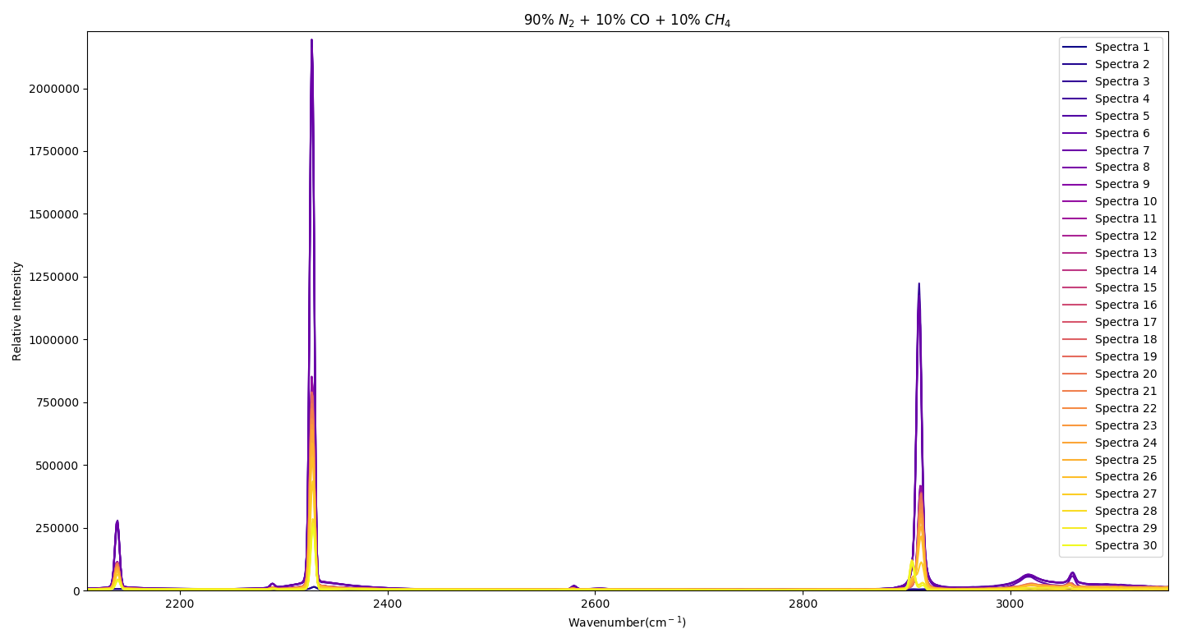

Slide 8
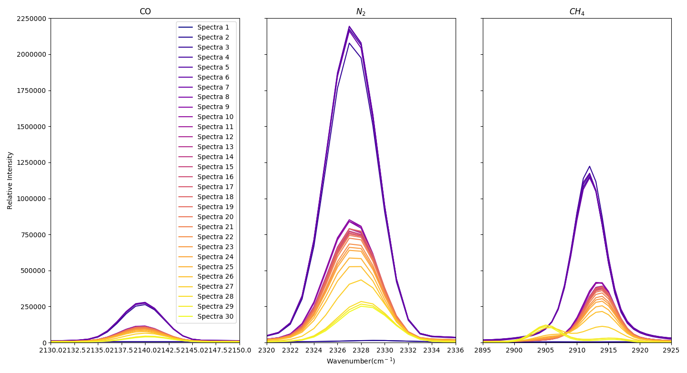

Slide 9
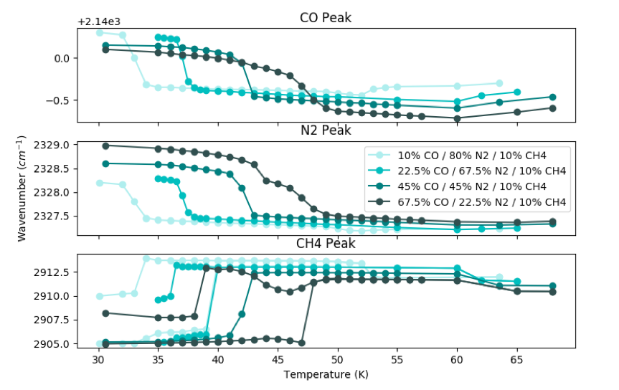

Slide 10
Acknowledgements
The Astrophysics Ice Lab, Lowell Observatory & NAU
Jennifer Hanley, Stephen Tegler, David Trilling, Randy Dillingham
Department of Physics and Astronomy REU Program
Anna Engle –University of Maryland
Monsoon, the High Performing Computing Cluster
Notes:
Add Will, Jennifer, Garrett, Dave, Randy, etc etc

