Slide 1
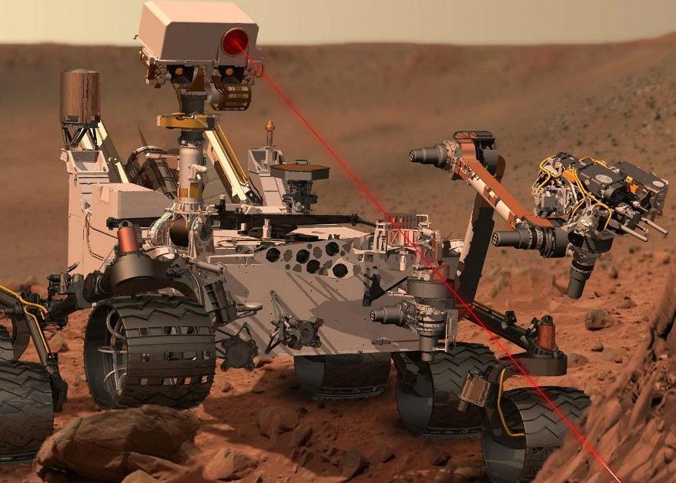
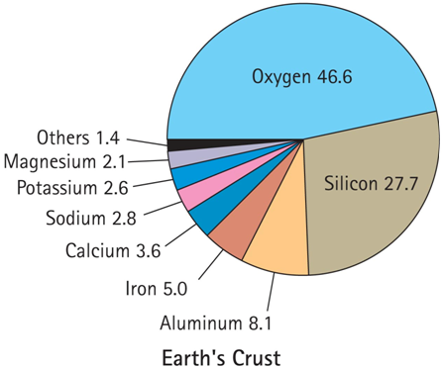
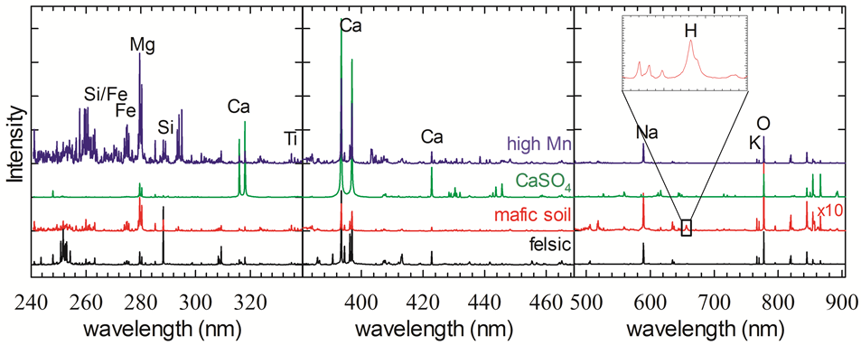
Python Spectral Analysis Tool (PySAT) for Point Spectra
Ryan Anderson¹, Nicholas Finch¹, Sam Clegg², Trevor Graff³, Dick Morris³, Jay Laura¹, Lisa Gaddis¹
¹USGS Astrogeology, ²Los Alamos, ³NASA JSC

Slide 2
What does PySAT Do?
Preprocessing and data manipulation:
Masking
Normalization
Remove rows (improvements soon)
Define folds, training, test sets
Continuum removal (multiple algorithms)
Dimensionality reduction (PCA, ICA, etc.)
Calibration Transfer (in progress)
Peak fitting (coming soon)
Band math (coming soon)
Peak binning (new)
Etc.
Multivariate Regression
K-fold cross validation
Train multivariate regression models (leverage scikit-learn):
Ordinary Least Squares (OLS)
Partial Least Squares (PLS)
Gaussian Process (GP)
Support Vector Machines (SVM)
Bayesian Ridge Regression (BRR)
Lasso
Elastic net
Orthogonal Matching Pursuit (OMP)
Least Angle Regression (LARS)
Automatic Relevance Determination (ARD)
Blend “sub-models”

Slide 3
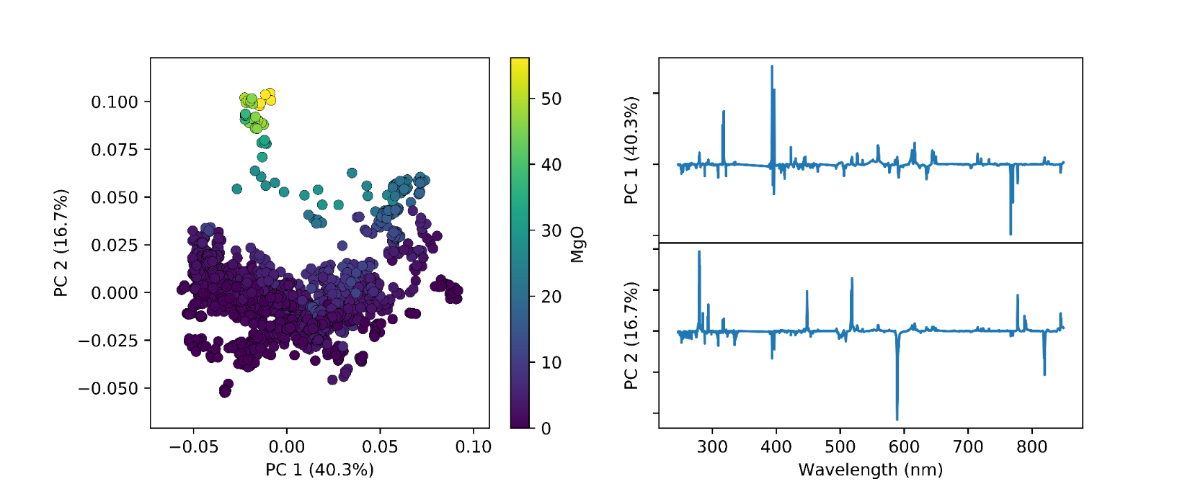
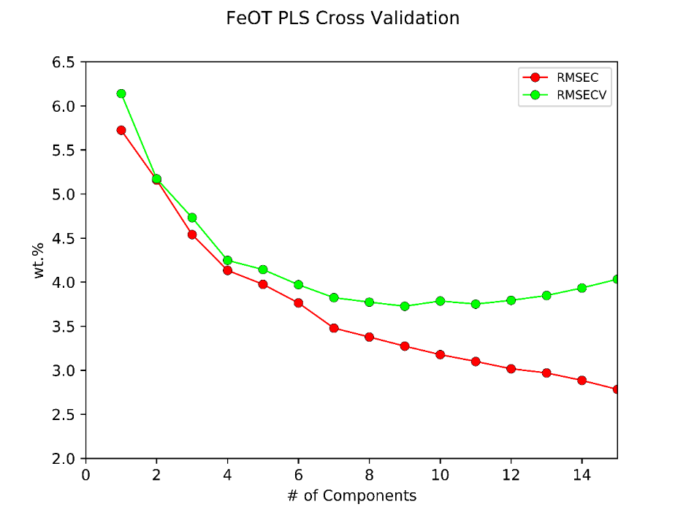
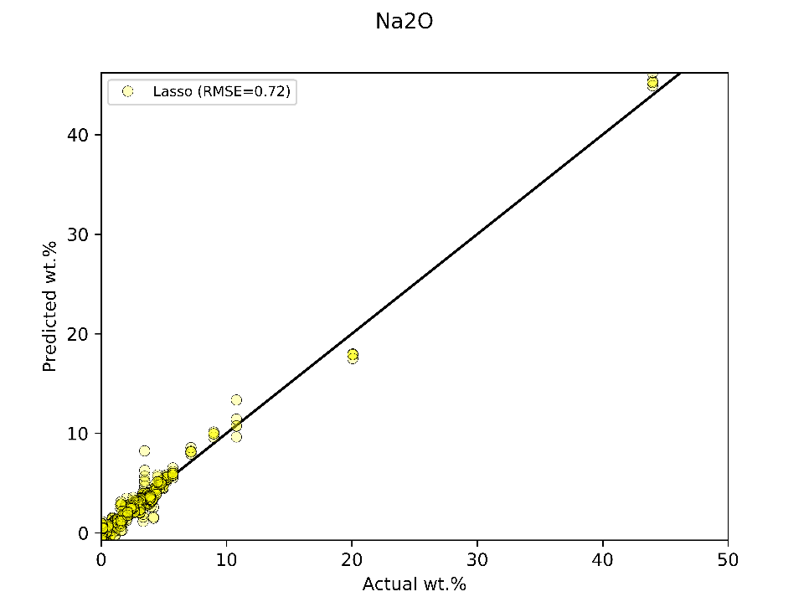
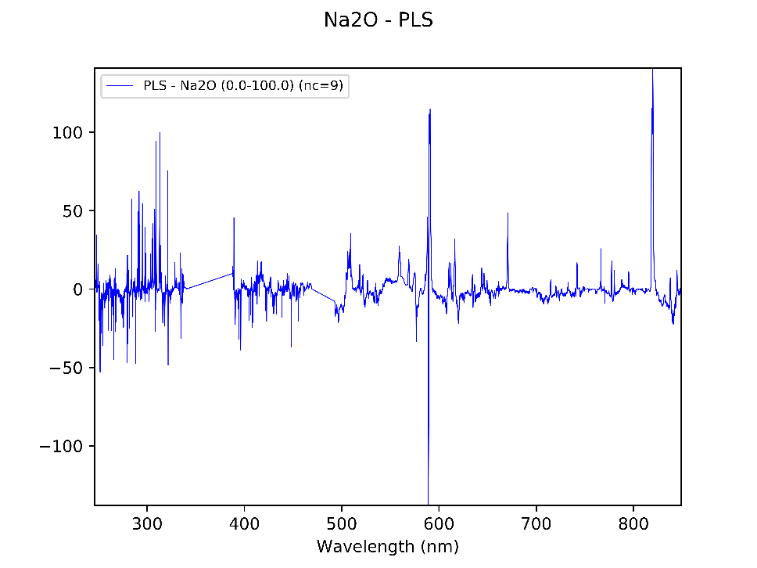
Plus Some Plotting Capabilities

Slide 4
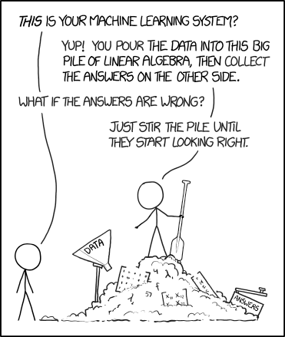
What does PySAT Do?
It helps scientists “stir the pile”!
https://xkcd.com/1838/

Slide 5
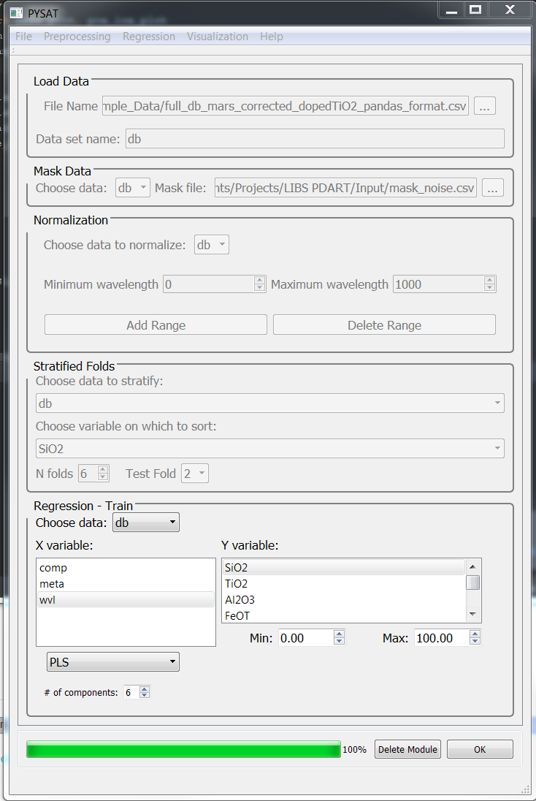
PySAT Point Spectra Tool: Interface
Tool is designed with a modular interface
Works with .csv files
Users can design “workflows” composed of discrete data processing steps
Workflows can be saved and restored

Slide 6
Conclusion
PySAT point spectra tool is spectra processing and regression software
Free
Open source
Python-based (leverages scikit-learn and other libraries)
Graphical interface
Flexible but powerful
Want to try it?
https://github.com/USGS-Astrogeology/PySAT
https://github.com/USGS-Astrogeology/PySAT_Point_Spectra_GUI
Development is ongoing:
Streamlining code and interface
Clustering and classification
Improve dimensionality reduction
Outlier removal
Band math
Peak fitting
More advanced data manipulation
Calibration transfer methods
Etc.
Is PySAT missing some capability you would use? Let me know!
Ryan Anderson
rbanderson@usgs.gov

