Slide 1
Mapping the extent of the LMC and SMC with Gaia
David Kelly
Advisor: Dr. Michael West
Notes:
Include Dr. Varney, Dr. Wade, and Dr. Prayaga

Slide 2
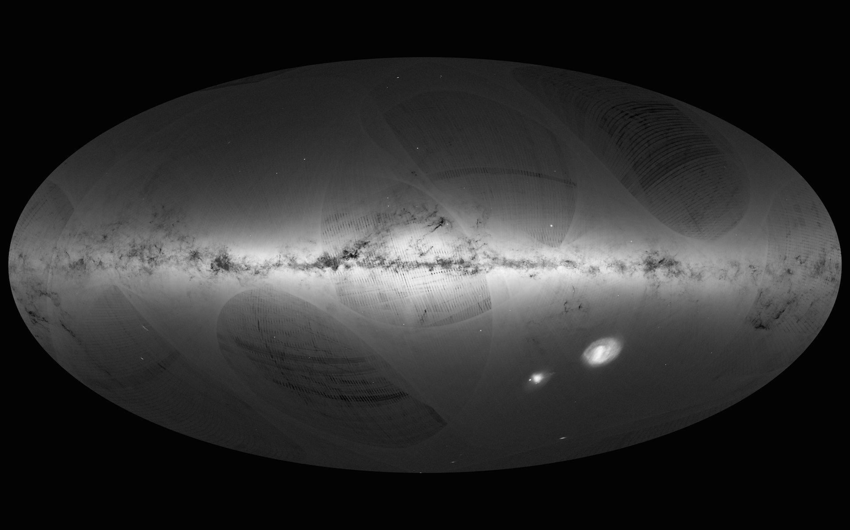
Milky Way
Description
Our home galaxy
About 400 Billion stars
About 180 kly diameter
Date: 14 September 2016
Satellite: Gaia
Copyright: ESA/Gaia/DPAC
LMC
SMC
Notes:
Langmuir Monolayers are one molecule layers of amphiphilic molecules, with the tail end being hydrophobic, and the head being hydrophilic. Because of the amphiphilic nature of the molecules they naturally make great lubricants and and controlled coatings at the nanoscale.

Slide 3
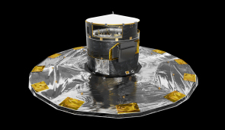
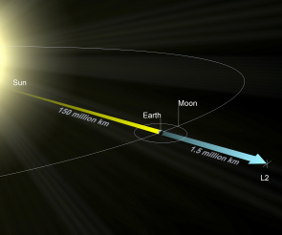
Gaia
Artist's impression of Gaia.
Credit: ESA/ATG medialab
Description
Launched in December 2013
5 years of operation
Observation of of over a billion stars
The second Lagrangian point, L2. Credit: ESA
Notes:
Our goal with our simulation is to test new models for the monolayers. We are using a hard triangle model and a variable soft shell model. The Variable soft shell model is where in the simulation the heads of the molecules can’t intersect but the tails can interact with each other, the hard Triangle model is where the heads of the molecules are modeled like the real-life structure, three atoms forming a hard triangle, here the the the atoms move as one unit. These model were never tested so the interactions may yield interesting results.

Slide 4
Project Purpose and Methods
Purpose
Actuate densities of LMC and SMC
Finding hidden structures
Methods
Choosing a large,
homogeneous unbiased sample of stars with accurate positions,
Getting an estimated density of stars using a voronoi tessellation, and
Using that to subtract the star counts in the Milky Way until the excess of the Magellanic clouds are left.
Notes:
Our Monte Carlo is a Metropolis Monte Carlo. *(Use Smart Art, refer to picture and Dimitri’s notes)
1 cycle is proposing a change in every particle’s position once
Wait until we reach thermal equilibrium before measuring data

Slide 5
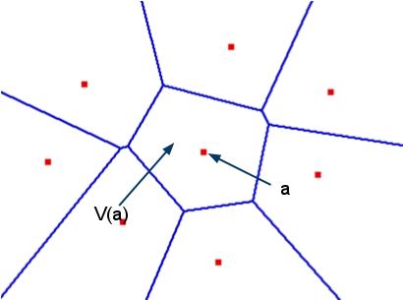
Voronoi Tessellation
Voronoi tessellations find regions closer to a particular star than any other star.
The stars are all contained in individual voronoi cells which have an area.
Notes:
Identical to previous process, measurements are made after skipping several cycles. Need measurements to be from independent configurations. If there aren’t enough cycles, the configurations are correlated and not independent

Slide 6
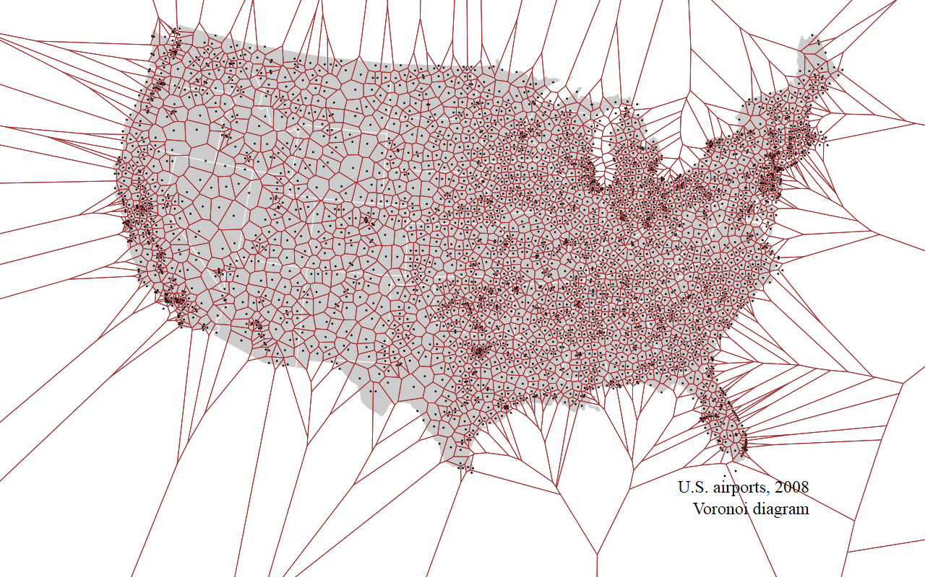
Voronoi Example
Density of Airports in the US
Notes:
Parallel Tempering increases the accuracy of the measurements made in the simulation by allowing mixing between configurations with high and low temperatures, so certain configurations don’t become trapped in lower free energy minima.

Slide 7
Future Works
Finish coding the density map
Add Nearest Neighbor and Bayesian statistics for comparison
Recreate and compare with popular methods of NGC density estimation

Slide 8
Thank You

