Slide 1
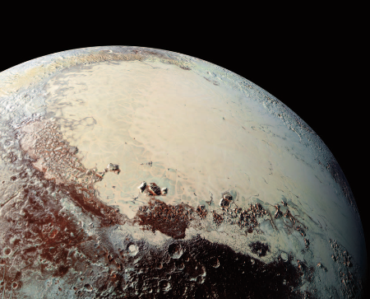
Laboratory Experiments of Ices Relevant to Outer Solar System Bodies
Anna Engle
Jennifer Hanley

Slide 2
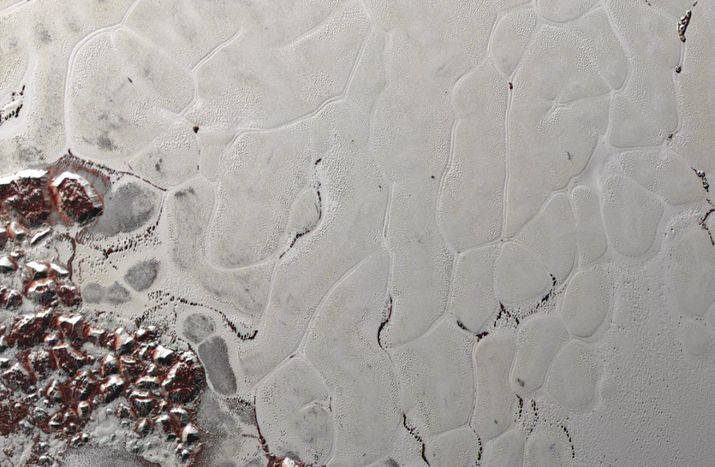
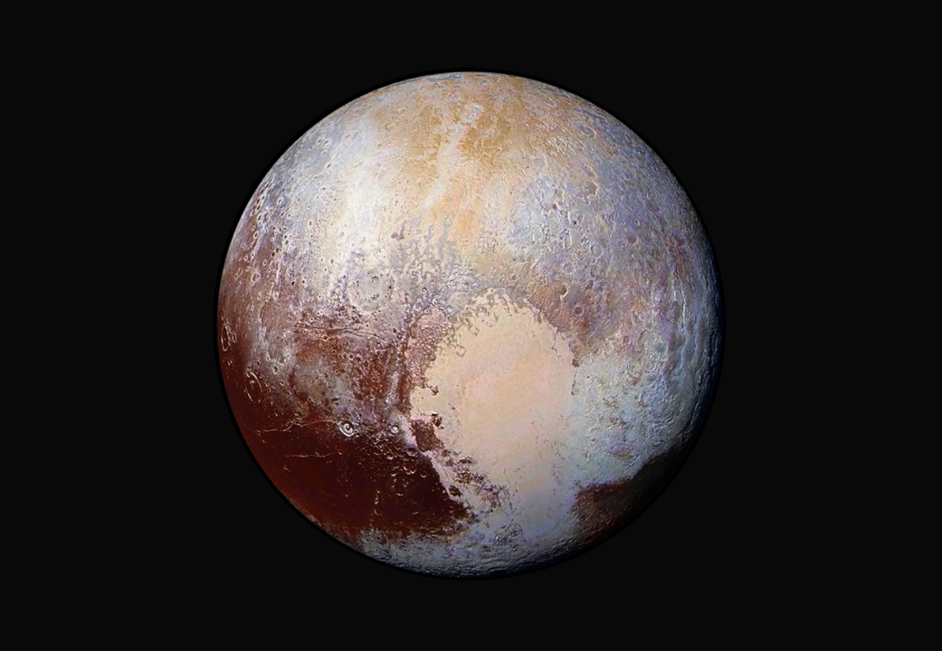
Outer Solar System bodies, such as Pluto, contain a mixture of carbon monoxide (CO) and nitrogen (N₂) ices on the surface.

Slide 3
Pluto’s Tombaugh Regio, and in particular the convective cells of Sputnik Planitia, shows significant signs of CO-N₂ composition.

Slide 4
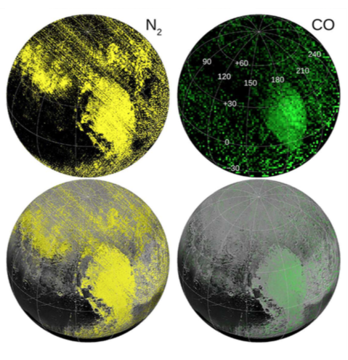
Pluto’s Tombaugh Regio, and in particular the convective cells of Sputnik Planitia, shows significant signs of CO-N₂ composition.
Grundy et al., Science (2016)

Slide 5
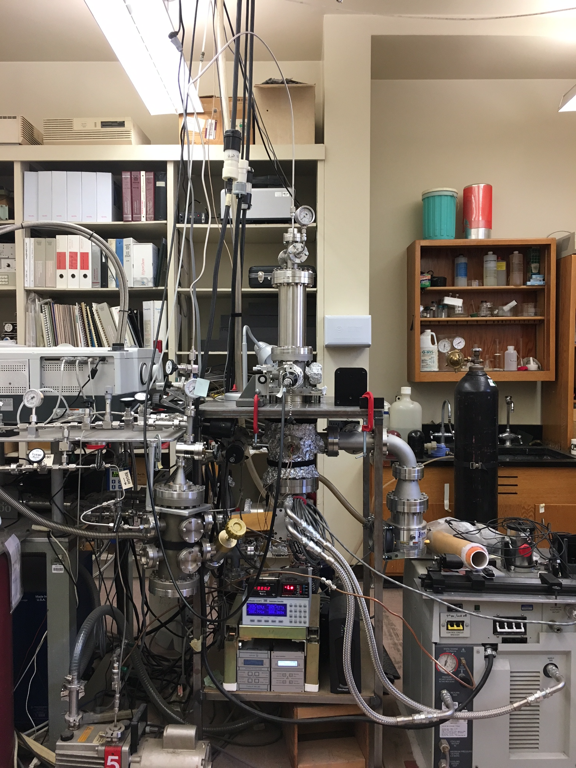
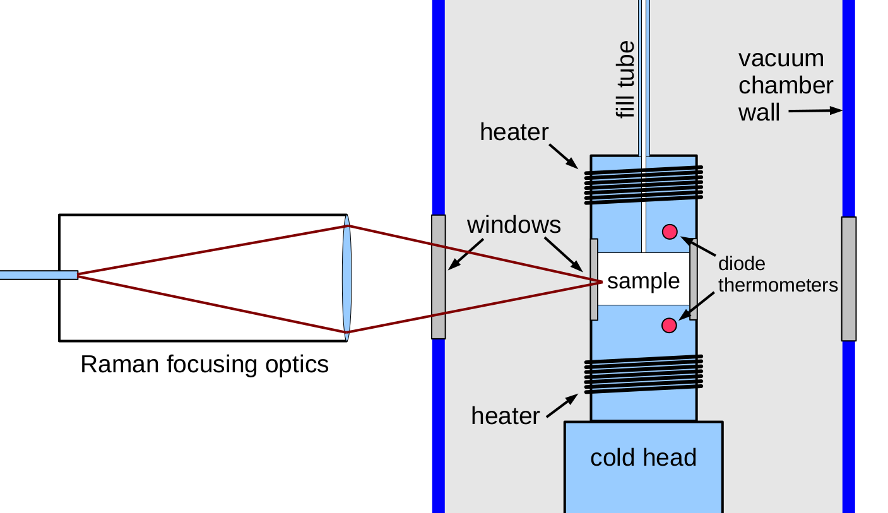
Astrophysical Ice Lab’s Raman spectrometer

Slide 6
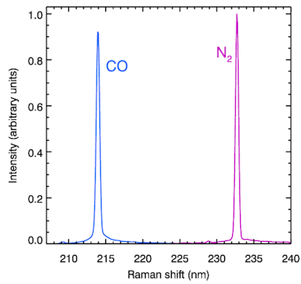
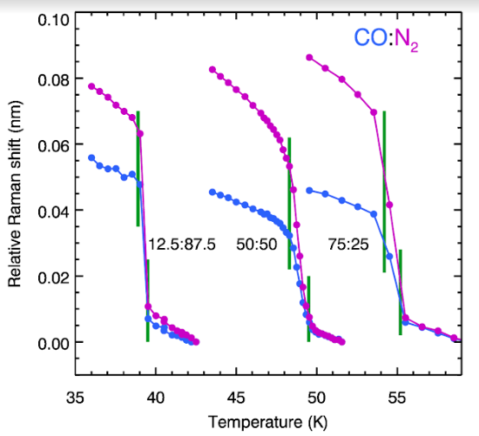
Probing CO-N₂ Ices with Raman

Slide 7
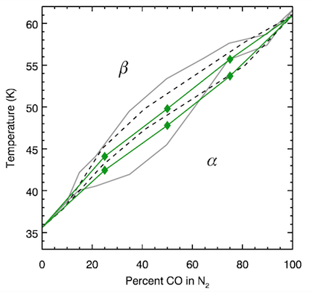
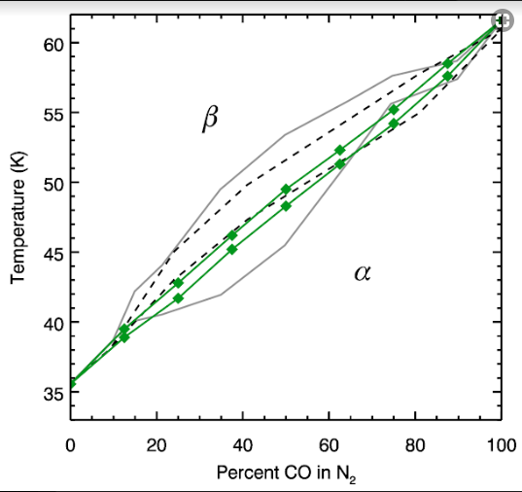
Angwin & Wasserman, J., Chem. Phys. (1966)
Vetter et al., Low Temp Phys. (2007)

Slide 8
Future Work
Constrain area of liquidus for CO-N₂ system
Begin experiments on CH₄-C₂H₆ binary and N₂-CH₄-C₂H₆ ternary systems for application towards potential two-liquid system in Titan’s lakes
Begin modeling molecular dynamics of binary and ternary systems relevant to Titan’s lakes

Slide 9
Conclusions
It is valuable to explore ice mixtures, such as CO and N2, experimentally especially in regards to outer Solar System bodies.
Raman spectroscopy is a viable tool for probing phase transitions.
Refining phase diagrams allows for a keener understanding of thermodynamic processes occurring on the surface of icy bodies.

Slide 10
Acknowledgements
Jennifer Hanley, Lowell Observatory, Research Advisor
Will Grundy, Lowell Observatory
Stephen Tegler, NAU
Gerrick Lindberg, NAU

