Slide 1
Central Pit Craters Across the Solar System
Nadine G. Barlow
Aviva Maine
Sierra Ferguson
Dept. Physics and Astronomy
Northern Arizona University
Flagstaff, AZ 86011-6010 USA

Slide 2
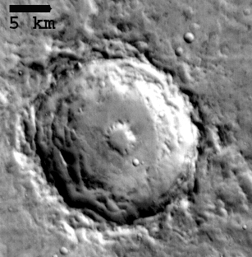
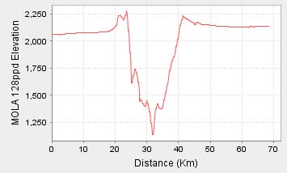
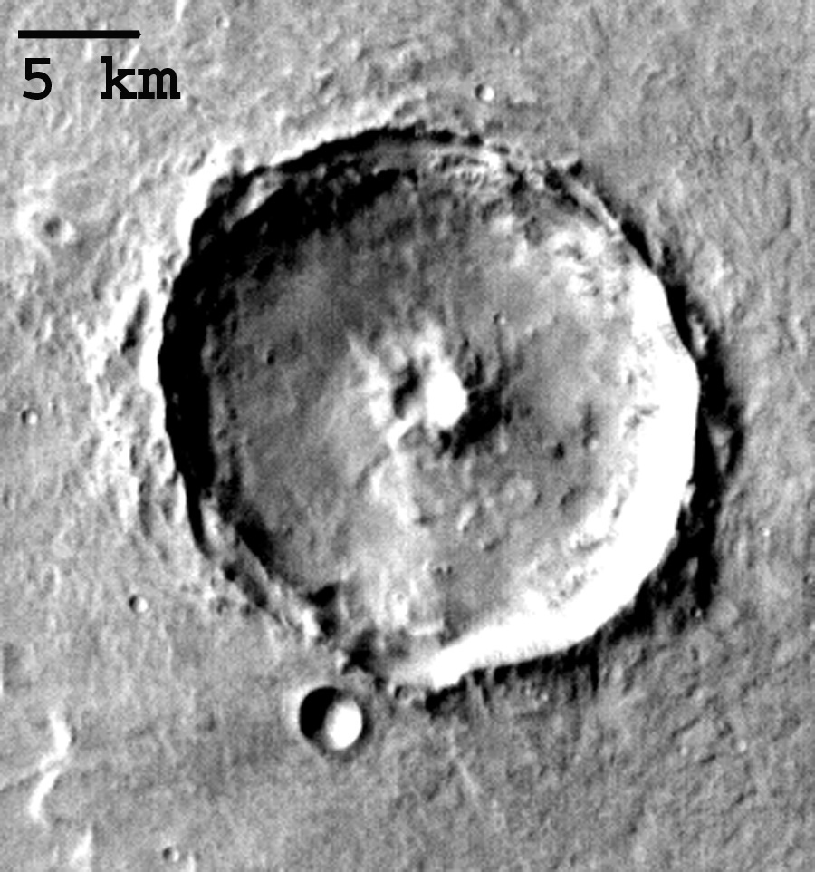
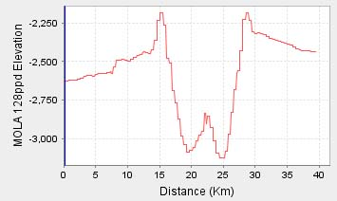
What are Central Pit Craters?
Craters which contain central depression, either directly on floor (floor pit) or on central rise/peak (summit pit).
Distinct from peak rings.
Seen on icy bodies such as Mars, Ganymede, and Callisto. Reported to also occur on volatile-poor bodies (Mercury, the Moon).

Slide 3
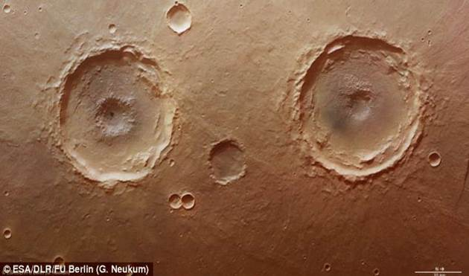
Proposed Formation Mechanisms for Central Pits
Escape of vaporized target volatiles (Wood et al., 1978)
Central peak collapse (Passey and Shoemaker, 1982)
Layered targets (Greeley et al., 1982)
Collapse of weak core materials/melt drainage (Croft, 1981; Senft and Stewart, 2011; Elder et al., 2012)
Explosive release of volatiles interacting with impact melt (Williams et al., 2015)

Slide 4
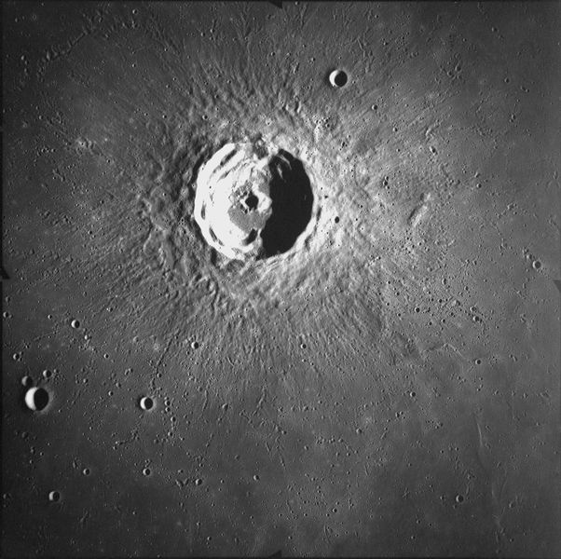
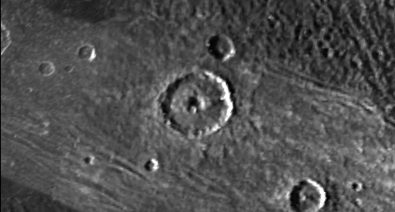
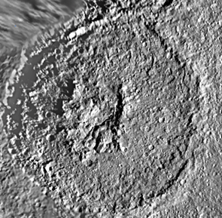
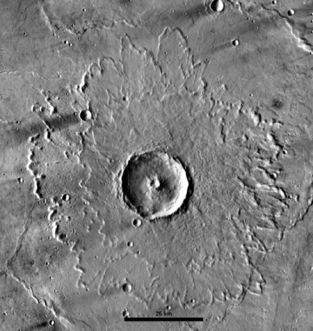
Objectives of this Project
Compare central pit craters across the solar system: Mercury, the Moon, Mars, Ganymede, Callisto, Tethys, Dione, Rhea (may be adding Ceres)
Determine similarities and differences between central pit craters on volatile-richer vs volatile-poorer bodies
Use results to determine if a single formation model can explain all central pit craters, if multiple models are needed, or if a new model is indicated.
Moon
Mercury
Ganymede
Tethys
Mars

Slide 5
Methodology
Datasets for central pit survey:
Mercury: MESSENGER MDIS global mosaic (250 m/pixel)
Moon: LRO WAC global mosaic (100 m/pixel)
Mars: THEMIS daytime IR global mosaic (100 m/pixel)
Ganymede and Callisto: Galileo and Voyager (60 km/pixel-400 m/pixel)
Dione, Rhea, and Tethys: Cassini and Voyager (250-400 m/pixel)
Divided into floor pit or summit pit (use topo data when available)
Floor pits subdivided into rimmed and unrimmed pits
Geographic coordinates, crater diameter, preservational state, and underlying geologic unit determined.
Pit diameter measured and D_{p}/D_{c} computed
For Mars, using variety of image, mineralogical, and topographical datasets for detailed geomorphic and structural mapping of selected fresh central pit craters.

Slide 6
Observations: Pit Types
 | Mercury | Moon | Mars | Ganymede | Tethys* | Dione* | Rhea*
# Floor pits | 7 | 8 | 1161 | 471 | 13 | 12 | 12
# Summit pits | 15 | 2 | 625 | 0?
D_{c} range (km)--floor | 13.9-30.7 | 10.5-55.4 | 5.0-114.0 | 12.0-143.8 | 10.9-450.0 | 17.0-74.9 | 16.7-230.0
D_{c} range (km)--summit | 16.2-30.7 | 28.9-30.4 | 5.1-125.4
Median D_{c} (km)--floor | 17.2 | 35.3 | 13.8 | 38.1 | 22.5 | 32.9 | 46.1
Median D_{c} (km)--summit | 25.0 | 29.7 | 14.4
* Pits have not been divided into floor and summit pits

Slide 7
Observations: D_{p}/D_{c}
 | Mercury | Moon | Mars | Ganymede | Tethys* | Dione* | Rhea*
D_{p}/D_{c} range—floor | 0.08-0.15 | 0.08-0.16 | 0.02-0.48 | 0.06-0.43 | 0.14-0.42 | 0.15-0.32 | 0.17-0.33
D_{p}/D_{c} range—summit | 0.07-0.15 | 0.06-0.11 | 0.02-0.29
Median D_{p}/D_{c}—floor | 0.14 | 0.12 | 0.16 | 0.20 | 0.18 | 0.22 | 0.23
Median D_{p}/D_{c}--summit | 0.11 | 0.08 | 0.12
* Pits have not been divided into floor and summit pits

Slide 8
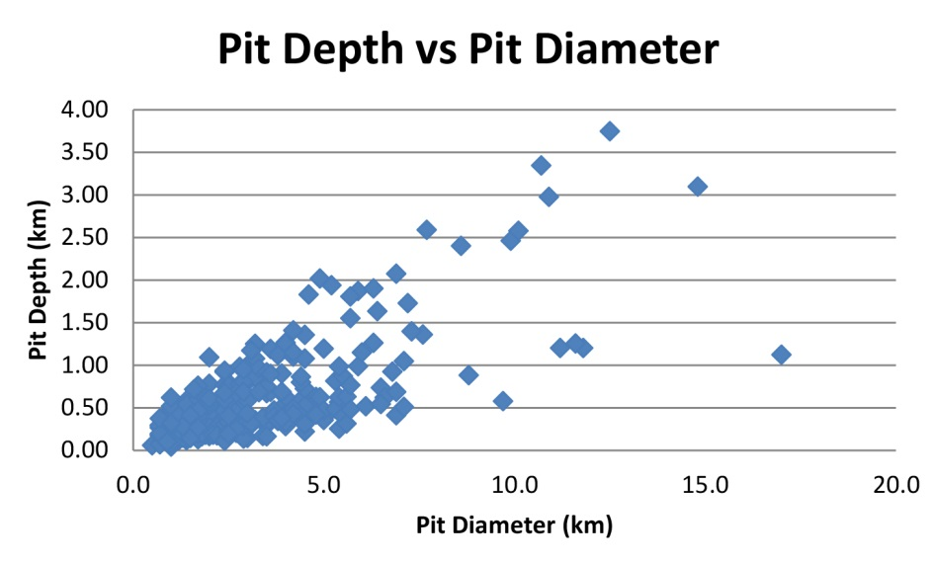
Observations: Pit Depth
Craters display a well-known depth/diameter relationship. Do pits have a similar relationship?
Used shadow length technique of Chappelow and Sharpton (2002) to determine depths of a sample of Martian floor pit craters (N = 320).
Result: random distribution

Slide 9
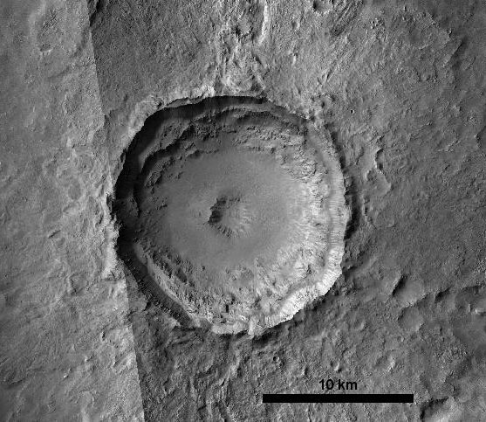
Detailed Mapping
Esira crater (Mars)
16.3-km diameter
8.9°N 313.4°E
Rimmed floor pit crater
Observations
Uplifted megablocks in pit rim
Impact melt has flowed from crater floor into pit

Slide 10
Overall Trends
No correlation of central pit occurrence with specific geologic units.
On Mars, unrimmed floor pits more common on volcanic units; rimmed floor pits and summit pits more common in highlands regions.
Floor pits tend to be larger relative to parent crater than summit pits.
Central pit craters are rarer on volatile-poor bodies and on bodies with lower surface gravity.
Floor pits are more prevalent as concentration of target volatiles increases.
No depth-diameter relationship exists for pits.
D_{p}/D_{c} is consistently higher for bodies with volatile-rich crusts (Ganymede, Tethys, Dione, Rhea) than for volatile-poor crusts (Moon, Mercury). Mars is an intermediate case.
D_{p}/D_{c} tends to increase as surface gravity increases from Moon to Mercury to Mars. Similar trend not seem among Tethys, Dione, Rhea, and Ganymede.

Slide 11
Implications for Formation Models
Still early in the analysis but
D_{p}/D_{c} vs gravity trends suggests that collapse of weaker material may be responsible for pit formation on Moon, Mercury, and Mars.
Lack of similar trend for volatile-rich bodies suggest crustal volatiles can mask this effect.
Prevalence of rimmed floor pits plus identification of uplifted megablocks in Esira’s pit rim indicate uplift is involved as well as collapse.
Identification of impact melt flowing from Esira’s floor into pit indicates pit formation is essentially contemporaneous with crater formation.
These results indicate that formation models involving only collapse and/or only volatile targets cannot explain all the central pit craters in the solar system.
Funding from NASA Mars Data Analysis and Planetary Geology and Geophysics Programs

