Slide 1

Isolation of Luminous Blue Variables:
The Implications of their Evolution
Erin Aadland
Coauthors: Phil Massey, Kathryn Neugent, Maria Drout

Slide 2

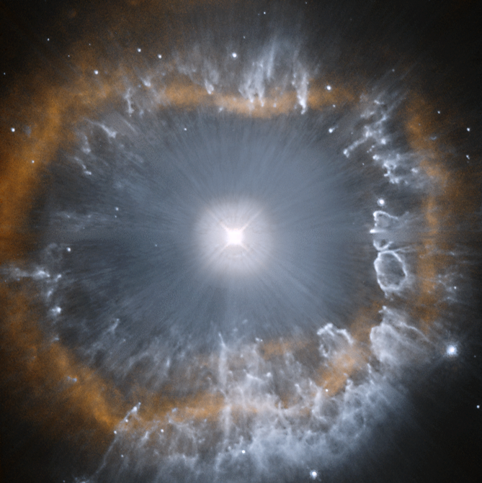
Massive Stars
LBV: AG Carinae
O-type stars
Luminous Blue Variables (LBV)
Wolf-Rayet (WR):
  WN
  WC
Red Supergiants (RSG)
Picture from the Hubble Space Telescope
Notes:
LBVs:
-short lifetimes
-transitionary phase
-undergo episodic mass loss on the order of 10^-6 to 10^-4 solar masses per yr
O-type stars:
-example in Orion Trapezium cluster: one of the stars Theta Orionis C
RSG:
Although the most luminous RSGs come from stars with initial masses of 30 solar masses, most RSGs are expected to be descended from O-type stars of 15 solar masses and below.
-Betelgous

Slide 3
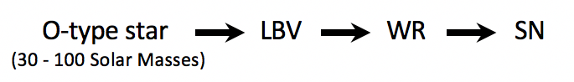
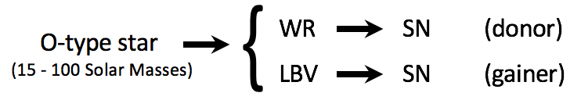
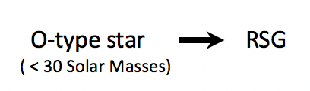
Isolation of Massive Stars
Single Star Evolution:
Binary Star Evolution:
RSG Evolution:
Notes:
Issue is the evolution
Learn something about how they evolve/form by they isolation
O-star samples: spectroscopic is incomplete

Slide 4
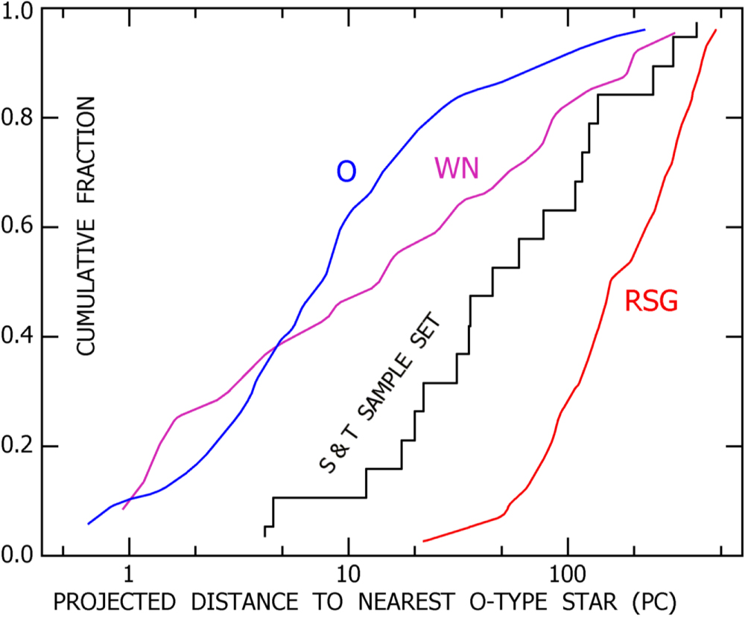
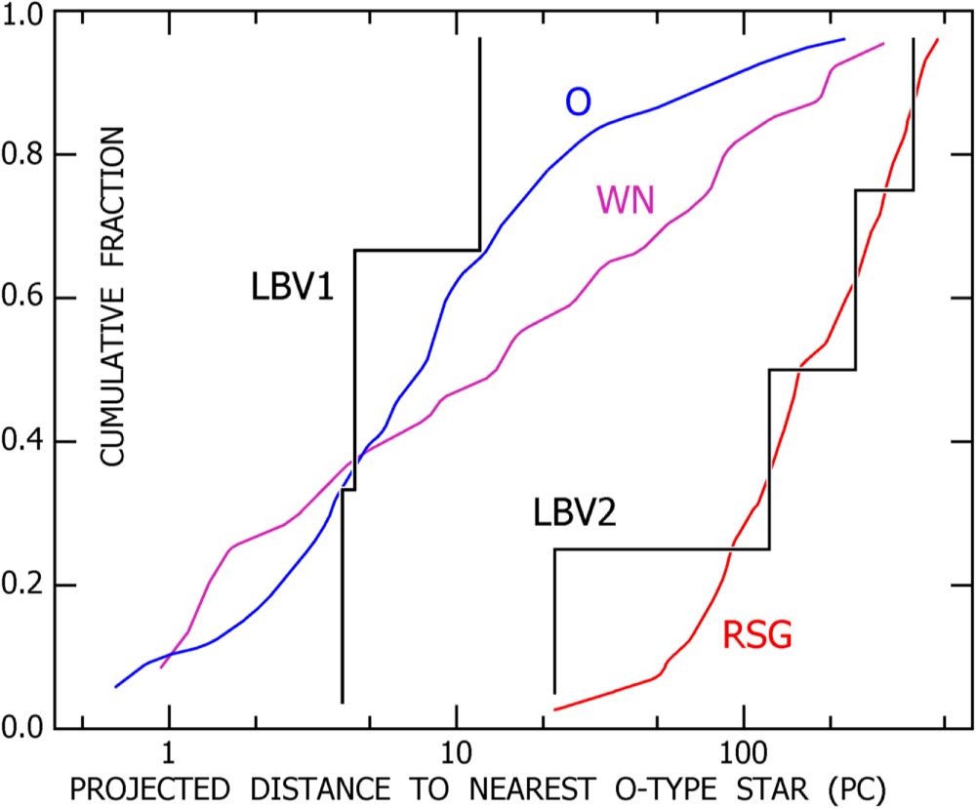
Smith et al., 2015
Large Magellanic Cloud
Humphreys et al., 2016
LBV0
Smith, N., & Tombleson, R. 2015, MNRAS, 447, 598
Humphreys, R. M., Weis, K., Davidson, K., & Gordon, M. S. 2016, ApJ, 825, 64

Slide 5
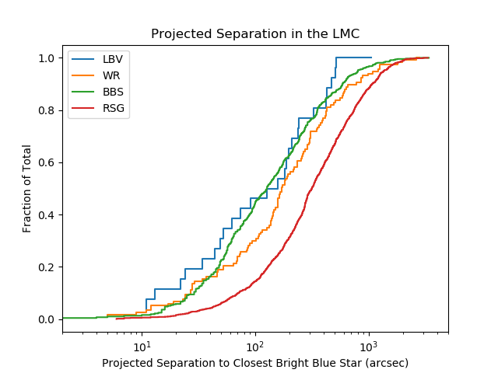
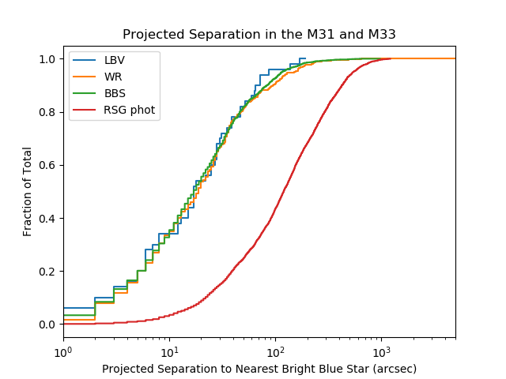
LBV
LBV
RSG
RSG
Notes:
BBS: O-type stars fainter than 15 solar masses are late-type O stars early in their lives and are too faint and not intrinsically blue enough to be included
so looking at stars > 25 solar masses to restrict the sample into those that evolve into LBVs given the standard view
There are differences in the sample selections

Slide 6
Conclusion
Single Massive star evolution: O-type stars -> LBVs -> WRs
Our results were consistent with the standard picture of massive star evolution
No evidence for binary system

