Slide 1
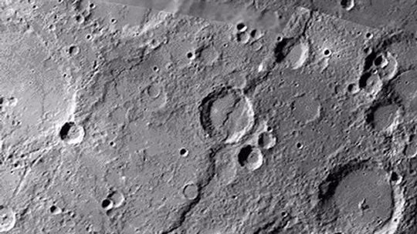
Dating Tectonic Activity on Mercury’s Large-Scale Lobate-Scarp Thrust Faults
Nadine G. Barlow
Dept. Physics & Astronomy, Northern AZ University
And
Maria E. Banks
NASA/Goddard Space Flight Center

Slide 2
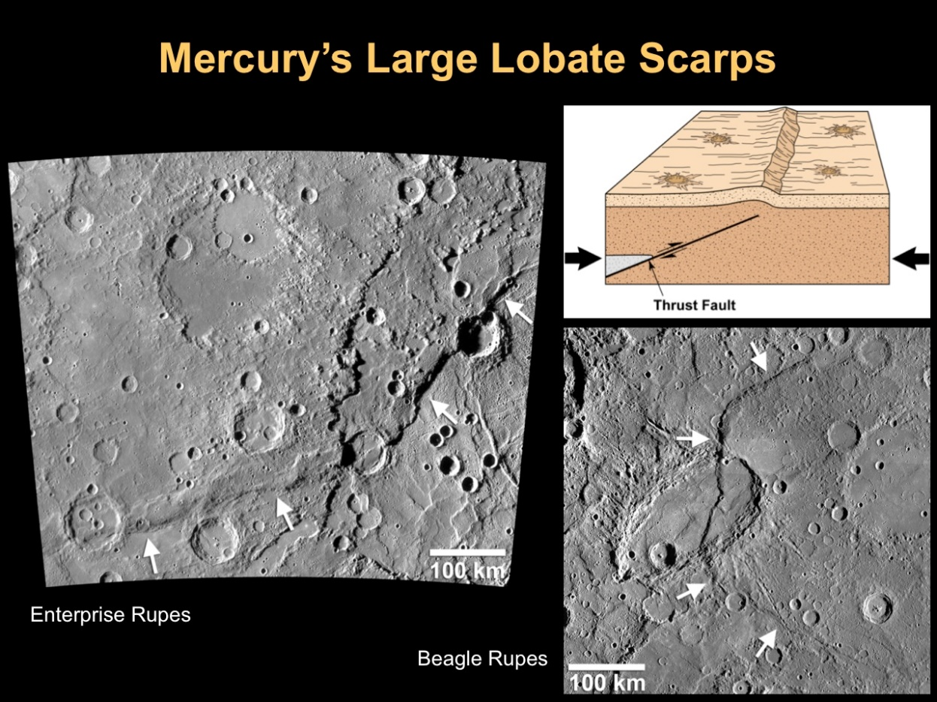
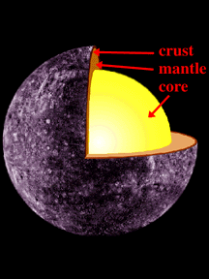
Lobate Scarp Thrust Faults
First detected in Mariner 10 images. Now seen to be global based on MESSENGER images.
Question: Is Mercury still shrinking today?

Slide 3
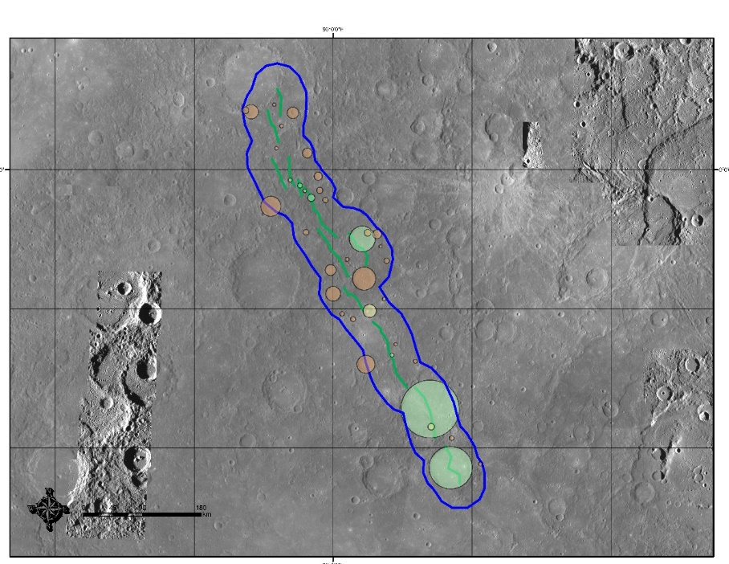
Crater Age Dating
Superposed craters provide constraints on age of feature.
For narrow features like faults, typically use Buffered Crater Counting Technique with only crater directly superposing fault.
We developed a Modified Cater Counting Technique for this study.
Measure diameters of craters directly superposing or transected by fault.
Use mean diameter to calculate buffer size (S_{buffer} = 1.5D).
Classify craters in buffer zone as post- or pre-dating the fault based on morphology.
Period | Estimated Age | Crater Characteristics
Kuiperian | <300 Ma | Rays, fine-scale ejecta structures, secondary craters, sharp rims
Mansurian | 300 Ma – 1.7 Ga | No rays, but fine-scale ejecta structures preserved; slight crater degradation
Calorian | 1.7-3.8 Ga | Well-preserved crater features but often filled with smooth plains material. Little to no ejecta.
Tolstojan | 3.8-4.0 Ga | Degraded craters and basins.
Pre-Tolstojan | >4.0 Ga | Highly degraded basins and multi-ring basins.
(Banks et al., 2017; Spudis and Guest, 1988)

Slide 4
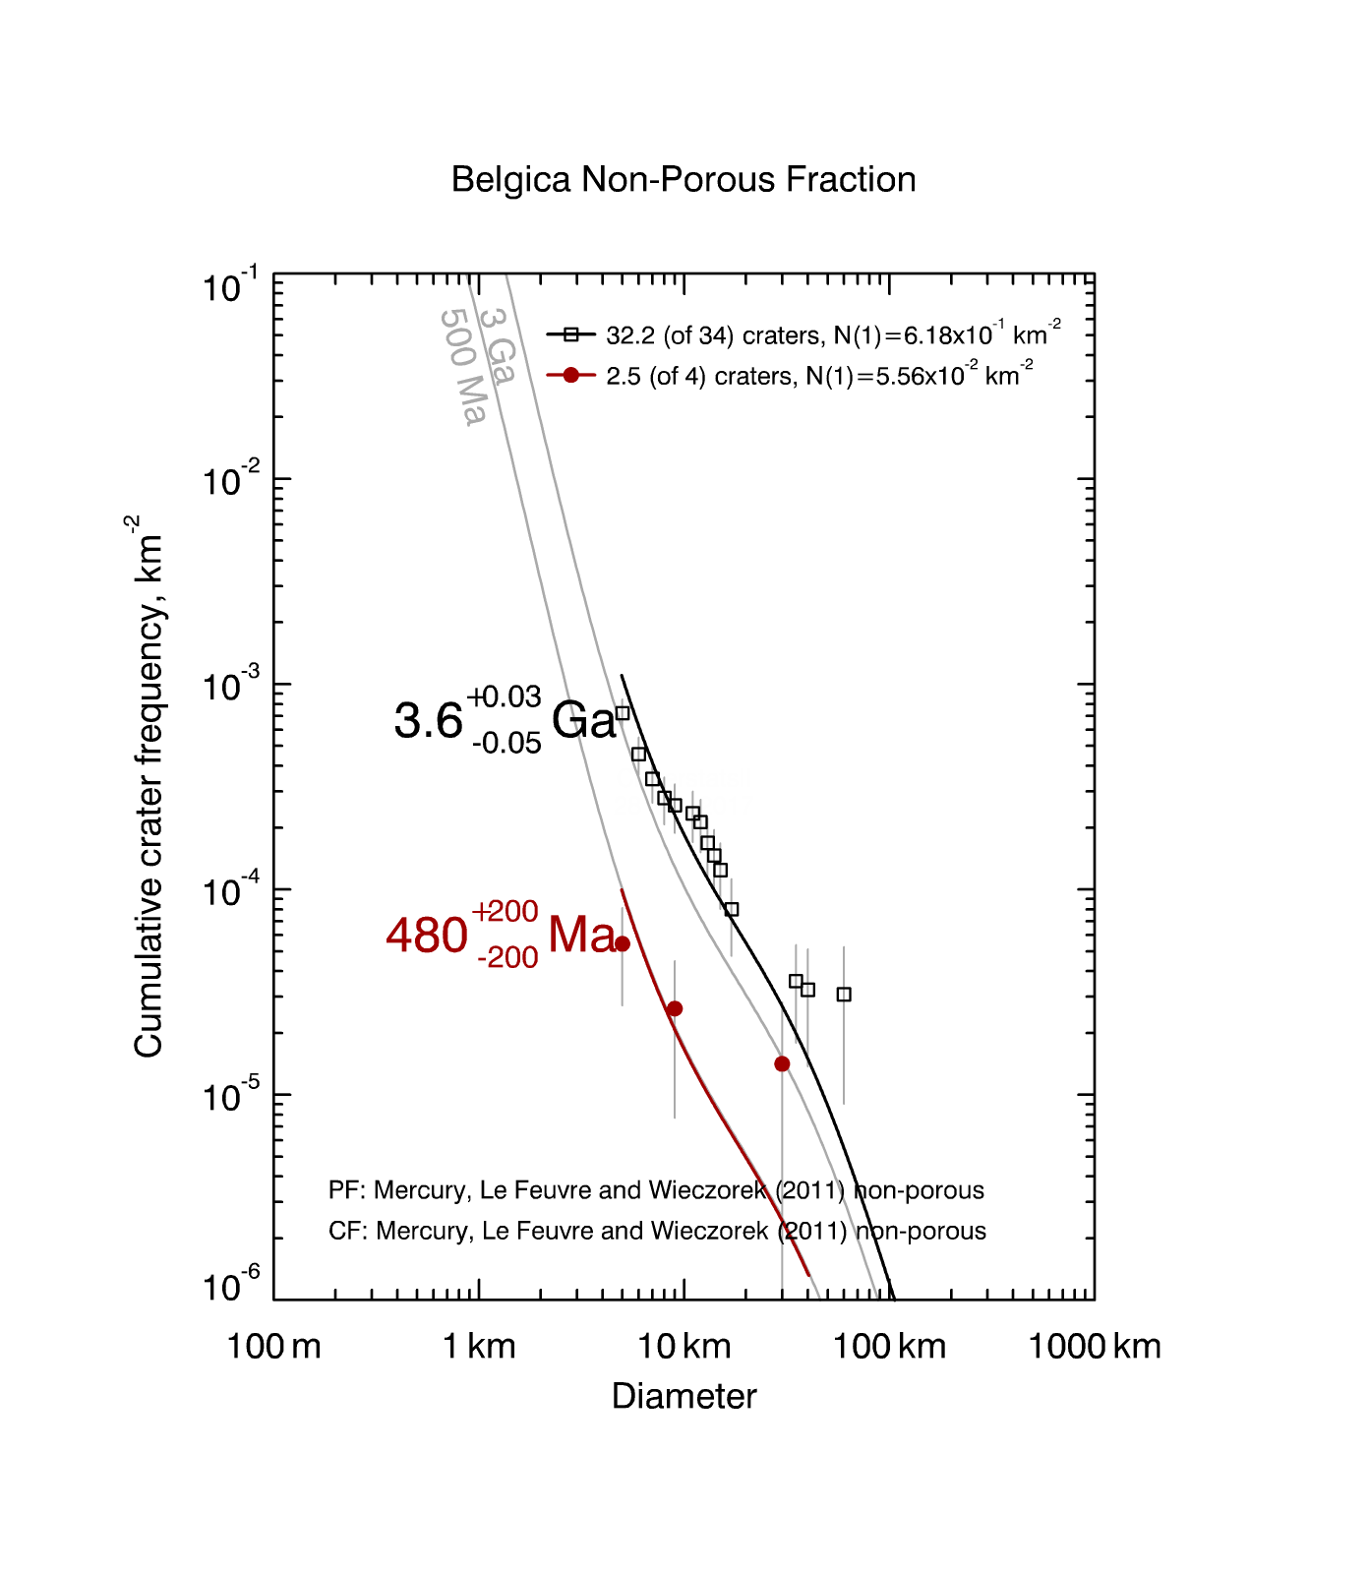
Crater Size-Frequency Distribution Analysis
Used both Marchi et al. (2009) and LeFeuvre and Wieczorak (2011) production functions. Gave similar results.
Determined ages for both superposed and transected craters to constrain timing.

Slide 5
Vostok
Heemskerck, La Dauphine, Pourquoi-Pas, Zeehan
Discovery, Zanya
Nautilus
Adventure
Astrolabe
Eltanin
Endeavour
Gjoa
Resolution
Santa Maria
Terror
Beagle
Duyfken (east)
Mirni
Paramour
Calypso
Carnegie
Enterprise
Alvin
Belgica
Blossom
Fram
Hero
Palmer
Victoria
Duyfken
(west)
Pre-
Tolstojan Tolstojan
~3.9 ~3.7 ~1.7 0.28 0
Calorian Mansurian Kuiperian
Time before present, Ga
[Banks et al., 2017; Ernst et al., 2017]

