Slide 1
Meteorite or Wrong!

Slide 2
Goals:
Physical characteristics of meteorites
Differences between Earth rocks and space rocks

Slide 3
A
B
C
D

Slide 4
Let’s begin
What’s between Earth and Space?

Slide 5
The Atmosphere
Meteorites have to be kind of big and strong to make it through
What if a rock isn’t strong?

Slide 6
Notes:
Go to the video
Astronomy 101 picture of the solar system:
Inner = dry
Outer = icy
Snow line – place where water ice can exist since temperatures are low enough
Study of asteroids and meteorites show that this picture doesn’t totally represent what is observed
Nominally anhydrous meteorites (e.g., ordinaries) have some evidence for coaccreted water
The carbonaceous chondrites have fairly extensive interactions with water
The evidence for this is aqueous alteration – the chemical reaction between liquid water and silicates producing hydrated minerals

Slide 7
Meteor

Slide 8
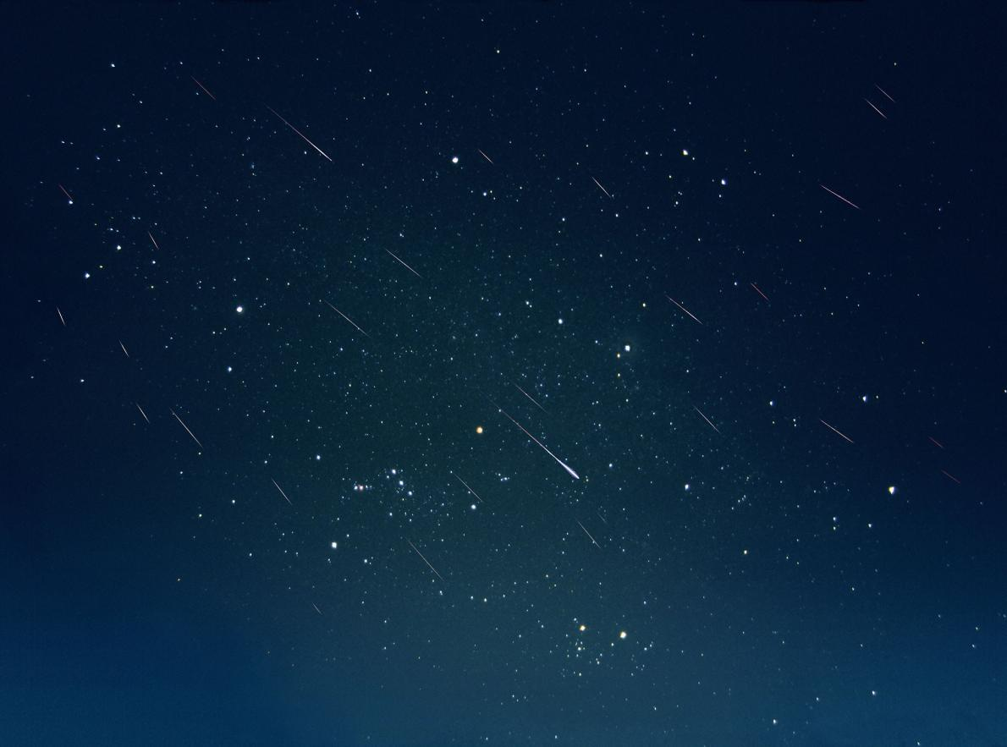
Meteors or shooting stars
B.A.E. INC., ALAMY

Slide 9
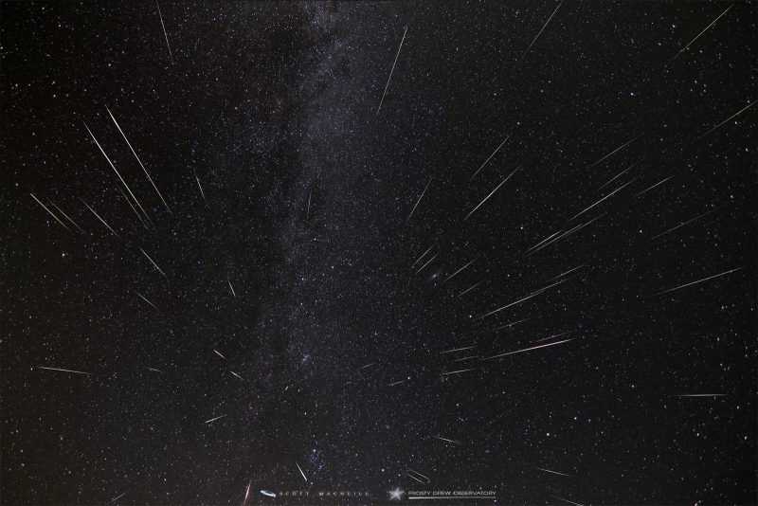
Meteor Showers
Comet tails of regular comets

Slide 10
Why do meteors glow?
Traveling fast! 45,000 mph or faster
Runs into the atmosphere
Vaporizes the outside
If they are small (less than 8 inches in diameter), they totally vaporize

Slide 11
Shooting stars tend to be weaker than meteorites
They have more porosity.
Do any of our rocks have high porosity?

Slide 12
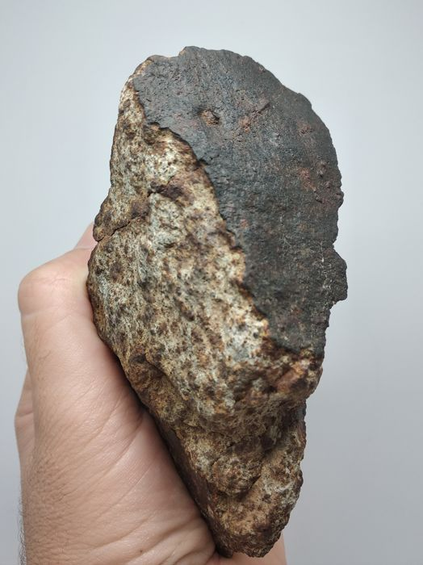
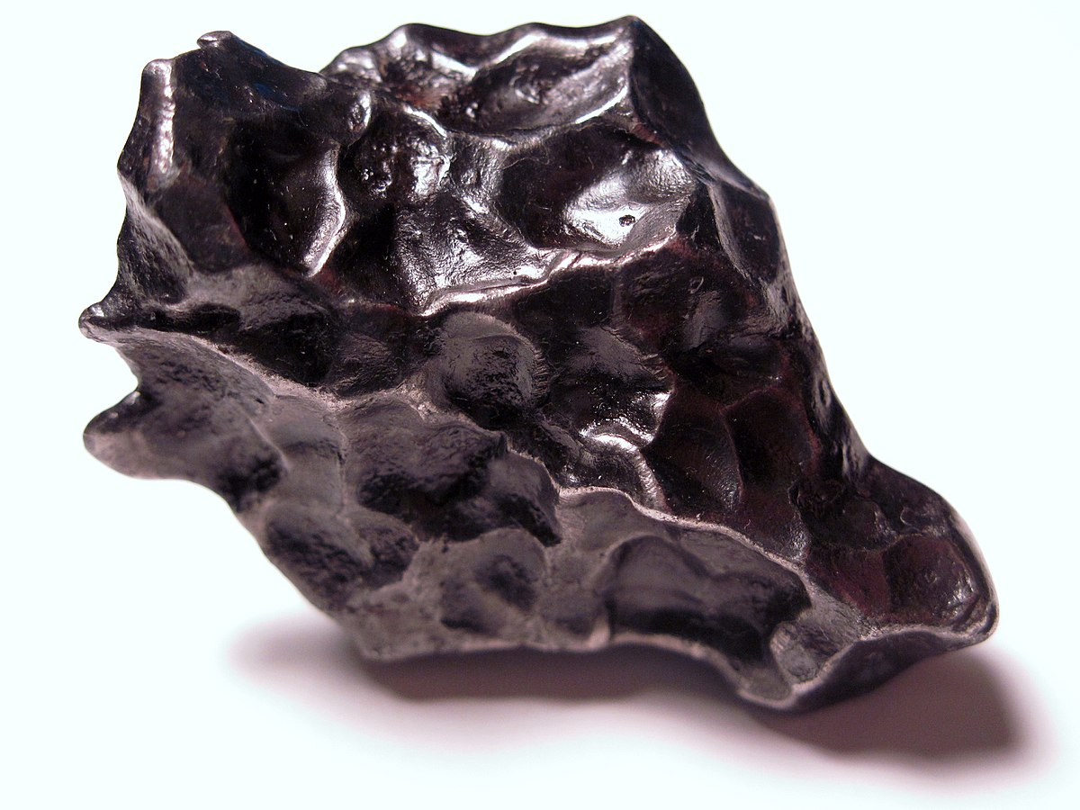
Regmaglypts
Fusion Crust

Slide 13
A
B
C
D

Slide 14
Causes of high density?
What is at the center of planet Earth?

Slide 15
Some asteroids got big enough to form cores but then had some kind of catastrophic collision, breaking them up
These can form iron meteorites
We see a fair number of these because they are so strong and can survive on earth’s surface

Slide 16
Not everything iron is a meteorite
Slag and loadstone can often be mistaken for meteorites
We can tell the difference through the techniques we’ve learned about, more sophisticated chemical tests or looking for Widmanstätten patterns

Slide 17
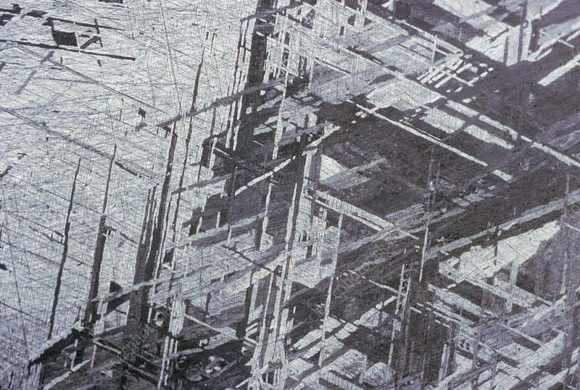

Slide 18
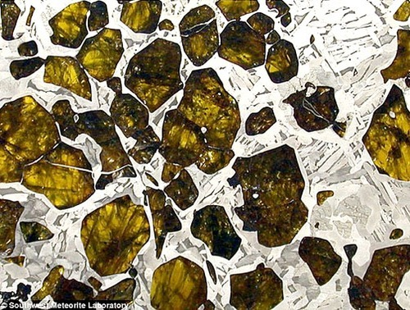
Stoney-iron
Core mantle boundaries
Stoney-iron

Slide 19
Other asteroids never formed cores
The iron-nickel metal never sank to a core
Flecks of iron can be found in these meteorites

Slide 20
Magnet test
What is going to react to a magnet?
Let’s try!

Slide 21
A
B
C
D

Slide 22
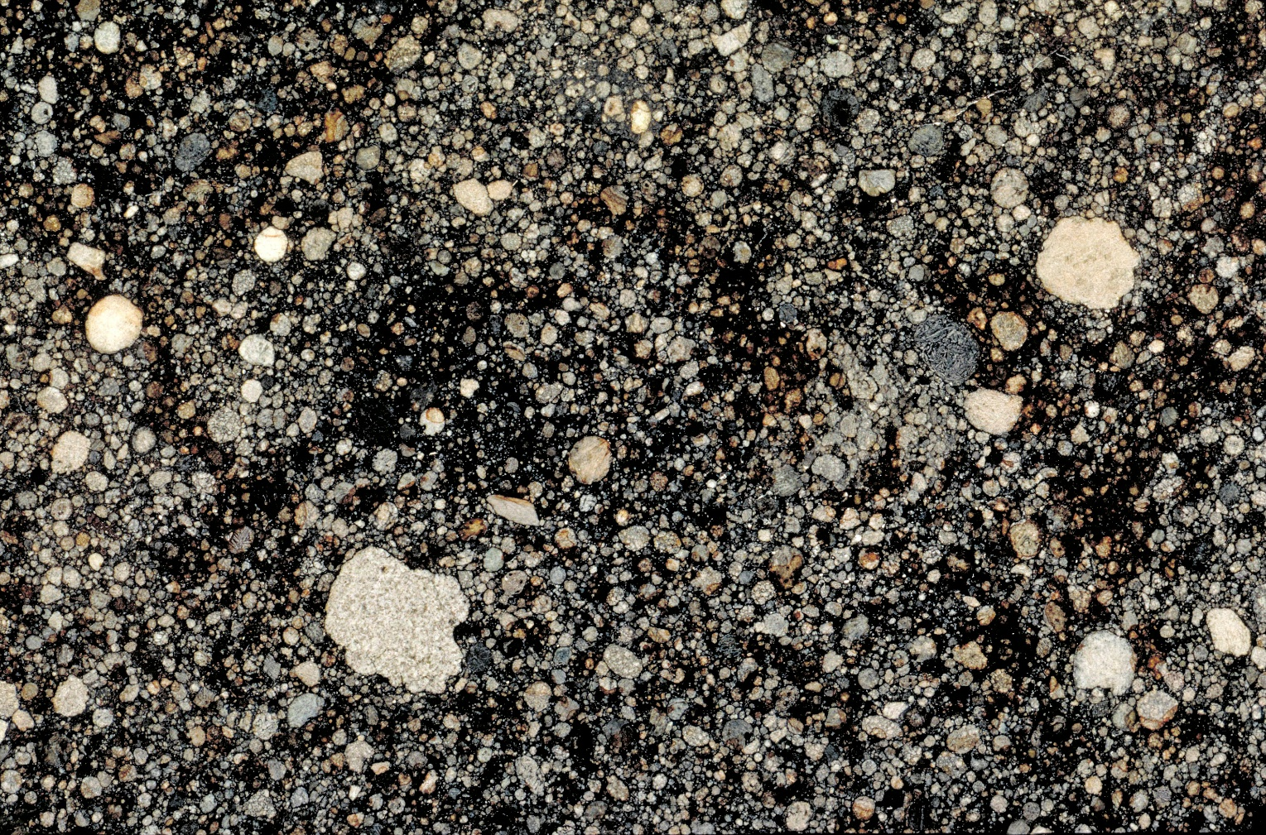
Allende, CV3 http://naturalhistory.si.edu

Slide 23
Do any of our samples have chondrules?

Slide 24
A
B
C
D

Slide 25
We have found the meteorites!

Slide 26
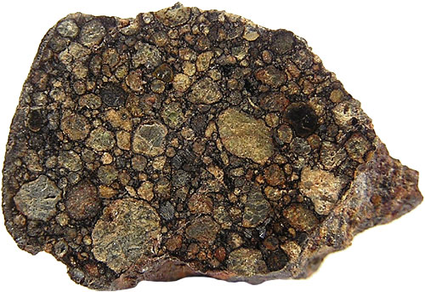
Why Study meteorites?
Some tell us about core-forming bodies
Some tell us about the early solar system

Slide 27
Very primitive
Organic molecules
Some have water
Allende, CV3 http://naturalhistory.si.edu

Slide 28
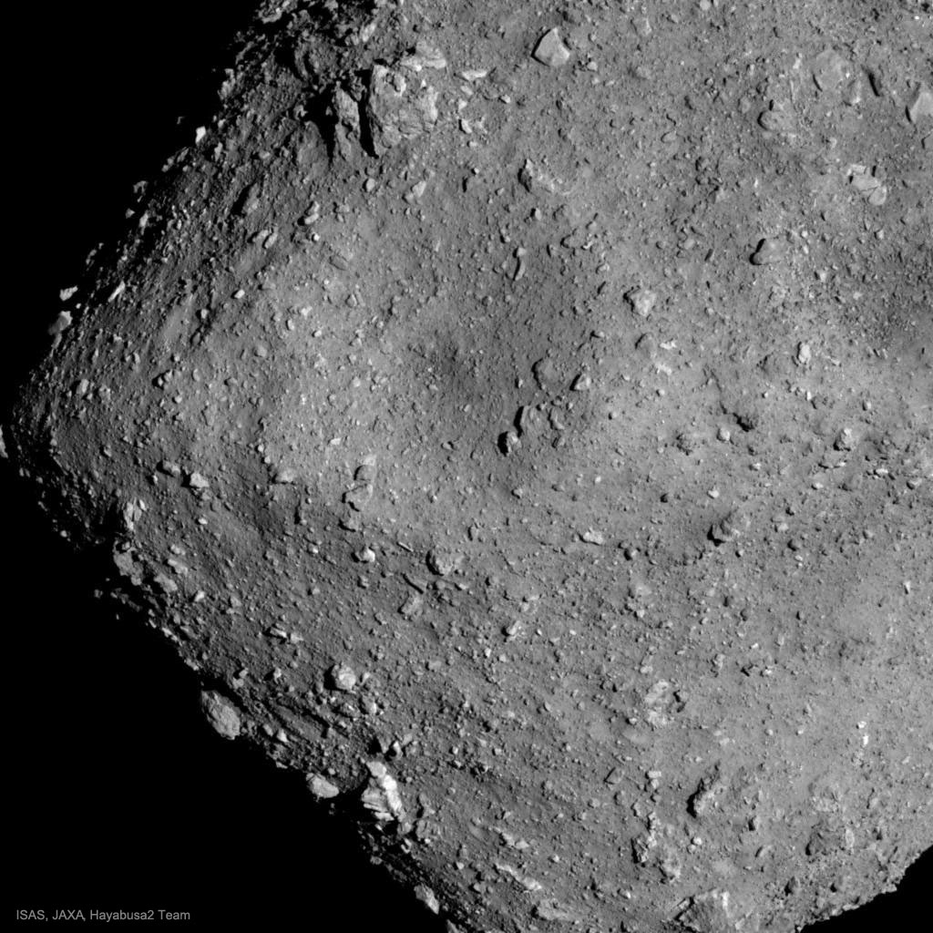
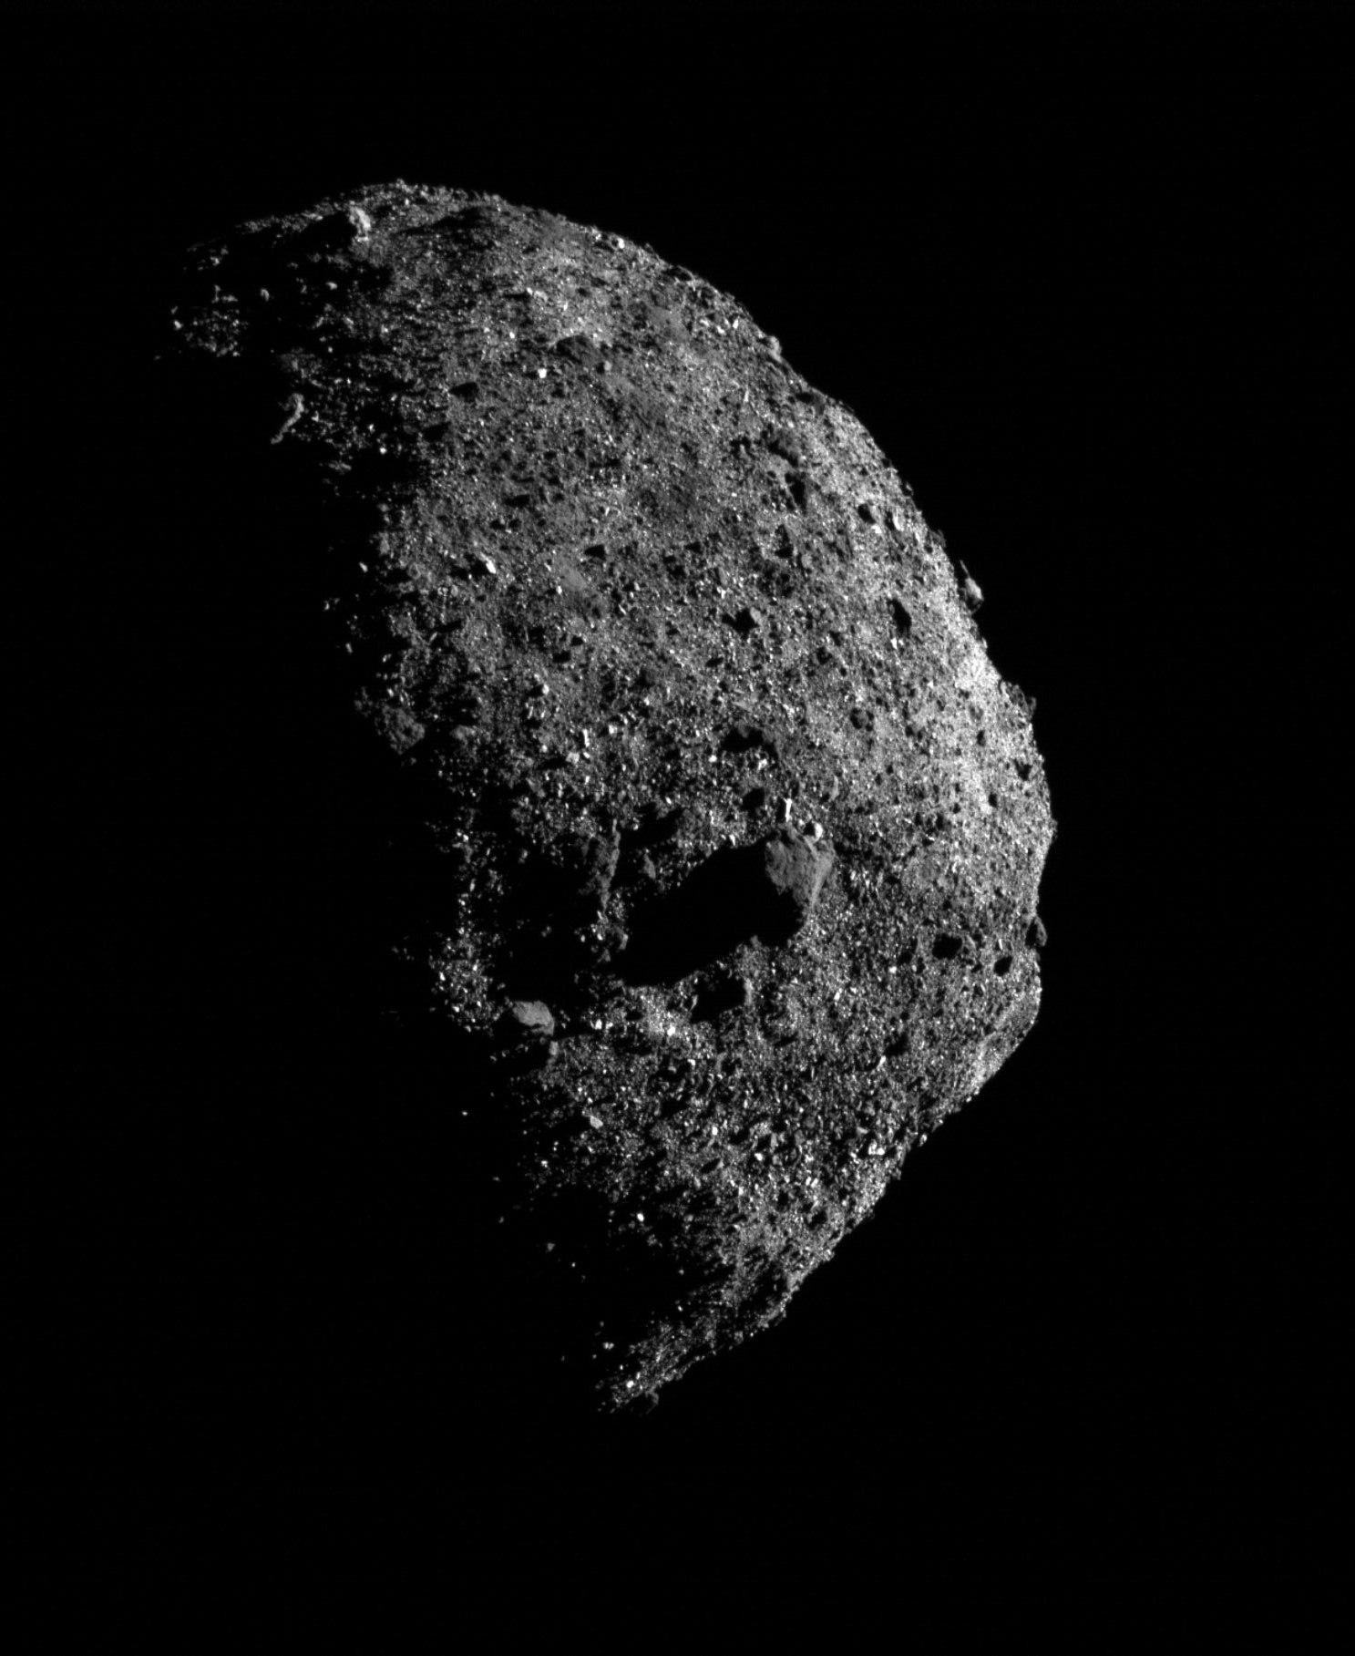
Bennu
Ryugu

Slide 29
Current Solar System
Main Asteroid Belt
Snow line
Jupiter
Earth
Proto-Sun
Mars

Slide 30
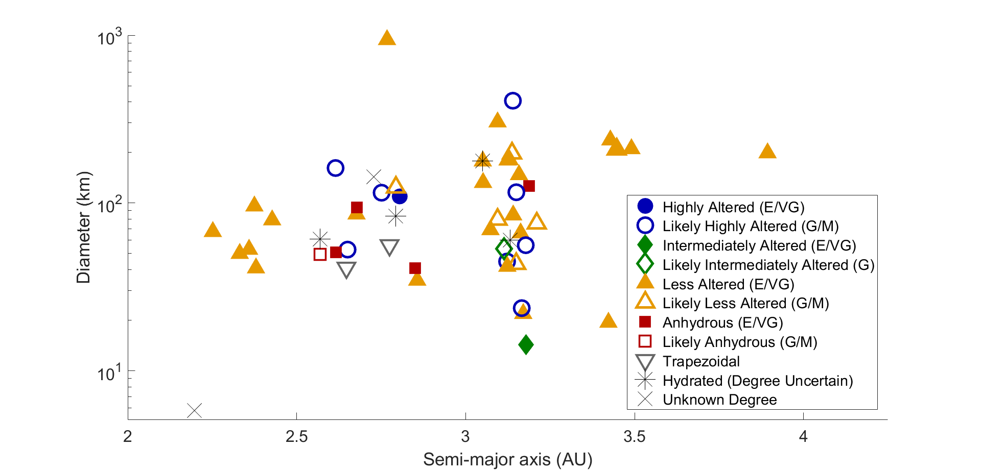
Hydrated minerals are widespread
Asteroids with Water
Anhydrous asteroids or unknown
Notes:
Just hydrated asteroids
No relationship with size, heliocentric distance
Local heterogeneities to produce different degrees; could be related to impact history or internal thermal evolution

Slide 31
Snow line
Main Asteroid Belt
Jupiter
Earth
Proto- sun
Mars
Notes:
So the snow line itself must have moved inwards. This is predicted from disk models but the first observation evidence.

Slide 32
Proto-asteroid Belt
Jupiter
Earth
Proto- sun
Mars
Modern Asteroid Belt
Jupiter
Earth
Proto- sun
Mars

Slide 33
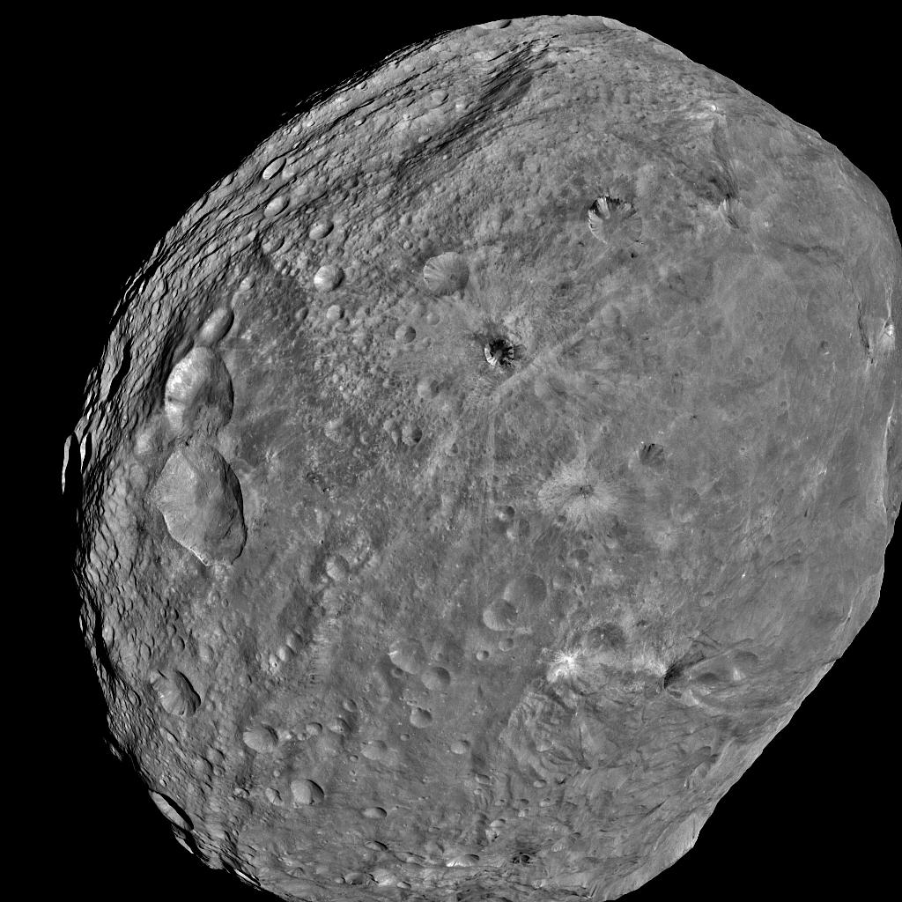
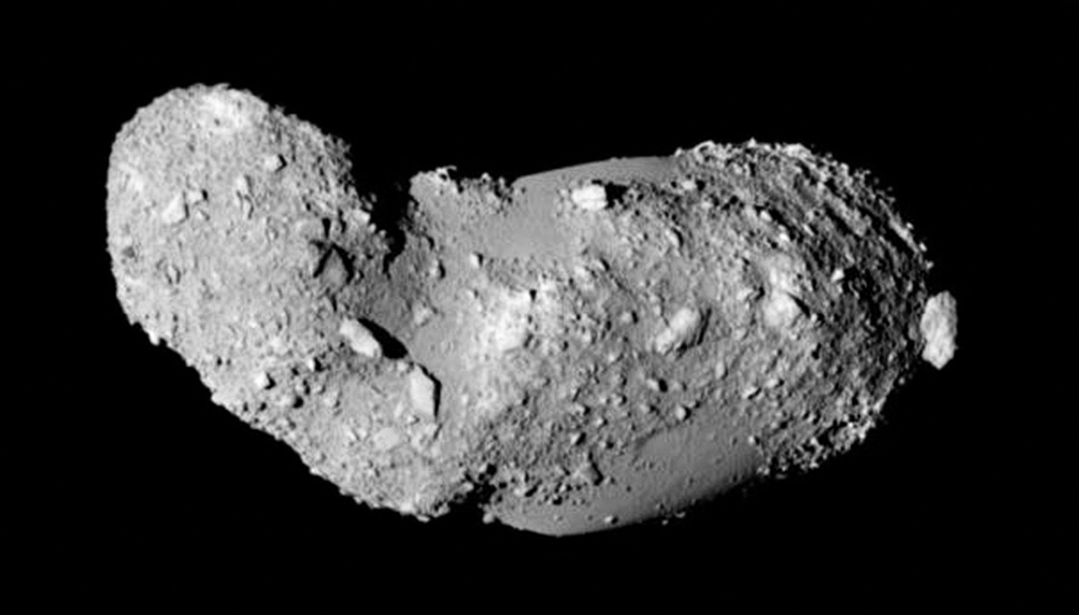
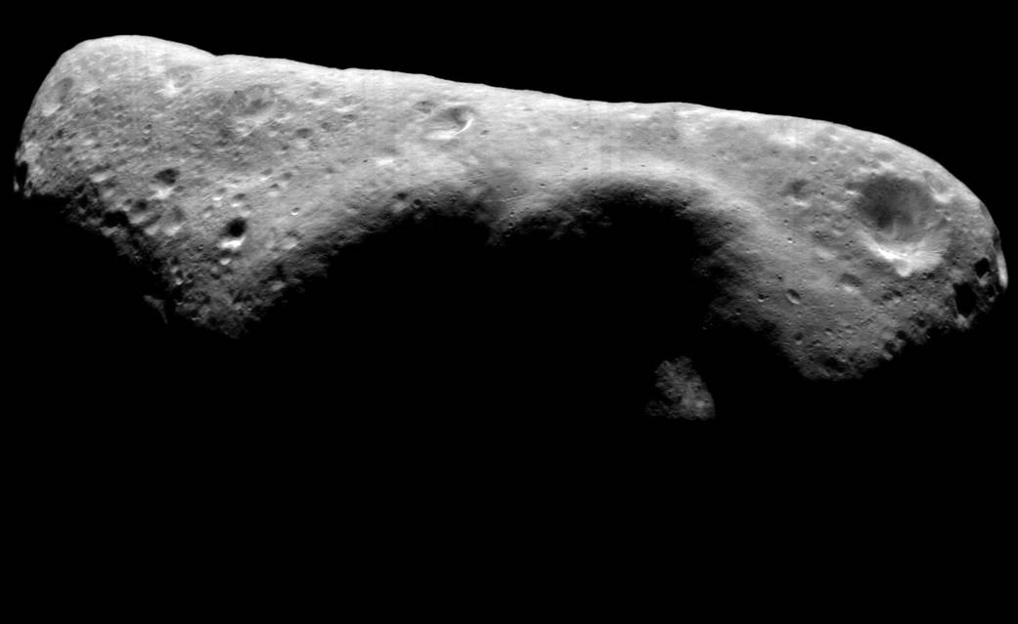
Notes:
Vesta – size of Arizona
Eros 10 mi in longest dimension
Itokawa – 3 football fields

Slide 34
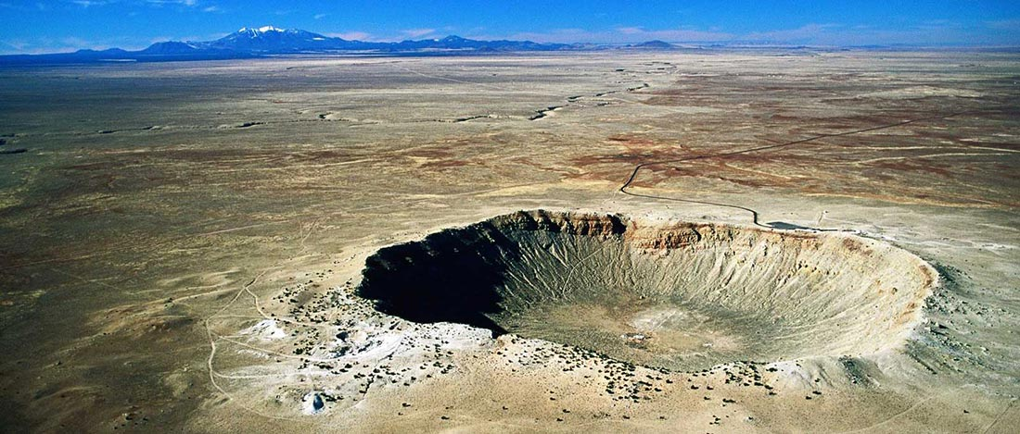
Sizes of asteroids and meteors
Meteors or shooting stars – millimeters to ~20 cm
20 cm – ~10 m
10 m asteroids and greater – craters
Can be dangerous
NASA is working on finding them!

Slide 35
Tektite
Breccia
Impactite

Slide 36
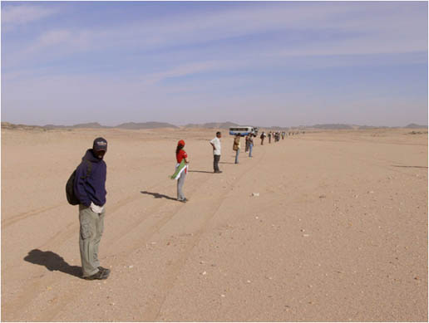
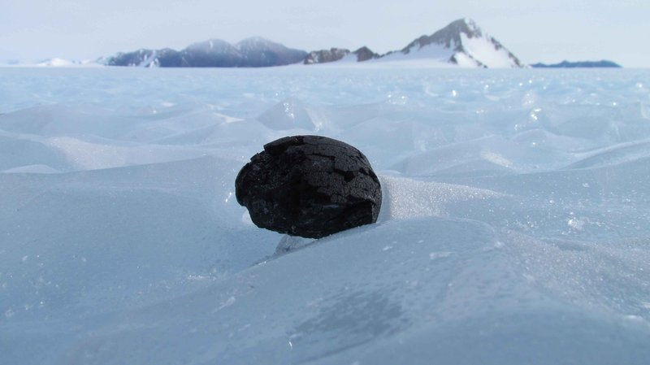
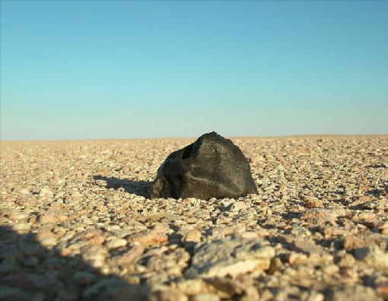
Where do we find meteorites?

