Slide 1
Measuring the Size of the New Horizons Flyby Target
(AKA: 2014 MU69 or 486958 or Ultima Thule)
Larry Wasserman
Astronomer, Lowell Observatory

Slide 2
Before we can discuss what we did, I need to answer an number of questions to understand what we are doing and why.
Why would NASA want to know the size of this object well in advance? After all, they are going to fly by it and can measure it from the pictures. And, can’t they just take a picture from the ground now?
Second question first: Why can’t we do this from the ground?
The problem is that this object is very small (maybe 10-15 miles across) and very far away (4 billion miles). As a result it shows no discernable size in even our largest telescopes. Even most asteroids in the asteroid belt which are (about) 20 times bigger and 20 times closer show no discernable size in a large telescope. In fact, this object is so small, so faint, and in a very crowded region of the sky in the southern Milky Way, that it can’t even be detected by the largest ground-based telescopes. It was discovered by Hubble.

Slide 3
Why does NASA want to find out the size well in advance?
When we observe an object like this, we measure how bright it appears to be at the Earth and we also know how far away it is. That tells us how intrinsically bright it actually is. But an object which has an intrinsic brightness of “X” can be a dark large object or a bright small object. They both will have the same intrinsic brightness and we don’t know which unless we know the object’s actual size. NASA needed to set exposure times for the flyby well in advance and needed to know if they will be looking at a bright object or a dark object. Hence they needed to know the object’s size long before the actual flyby.
For planning, we guessed a size (10-15 miles) by assuming a reasonable brightness and deriving the corresponding size.

Slide 4
So, how do we measure the size of an object that’s too small to see as a disc in our telescopes?
We use a technique called “occultation” from the verb “to occult” which means “cut off from view by interposing something”.
Think of every star as a light source. Then, every object in the Solar System casts a shadow from every star. These shadows move around as the Solar System object moves in its orbit. Each shadow is the size of the cross section of the object and occasionally a shadow may pass over the Earth. If you happen to be in a location where the shadow passes over you, then you would see the star disappear behind the object and, some time later, reappear on the other side. We say that the star was occulted by the object.

Slide 5
So, assuming a spherical object, an observer near the top of the shadow will see a short disappearance. Those near the middle see a longer disappearance, and those near the bottom also see a short disappearance. We can convert those disappearance times to lengths since we know how fast the object is moving (distance = velocity * time) and thus reconstruct the size of the shadow. But the shadow is a cross section of the object and by measuring the shadow, we measure the object.
Note that as the shadow passes across the Earth, it generates a strip within which the occultation might be observed. This is the “ground track.”

Slide 7
How do we know when and where a shadow will cross the earth for a particular object in the Solar System?
We need two things:
A list of stars and their positions in the sky. We currently have such a list which contains about a billion stars.
An accurate “ephemeris” for the desired object. An ephemeris is a way of telling where the object will be in the sky at a given time.
We then run the object against the star list in the computer. We look for stars that the object will pass close to and then see if the shadow of that star will cross the earth and, if so, where and when.

Slide 8
But we can’t use all the occultations we predict:
Consider a bright object occulting a star which is much fainter than it is. When the star disappears behind the object, there is no noticeable drop and thus nothing to time. Such events are ignored.
It’s possible that the ground track goes mostly over a part of the Earth that is in daylight. That’s no good.
It’s possible that the ground track goes mostly over water. That’s no good.
It’s possible that the ground track goes somewhere we might not want to go. That’s no good.
The ground track may also go somewhere without existing telescopes. Then we have to take telescopes with us.

Slide 9
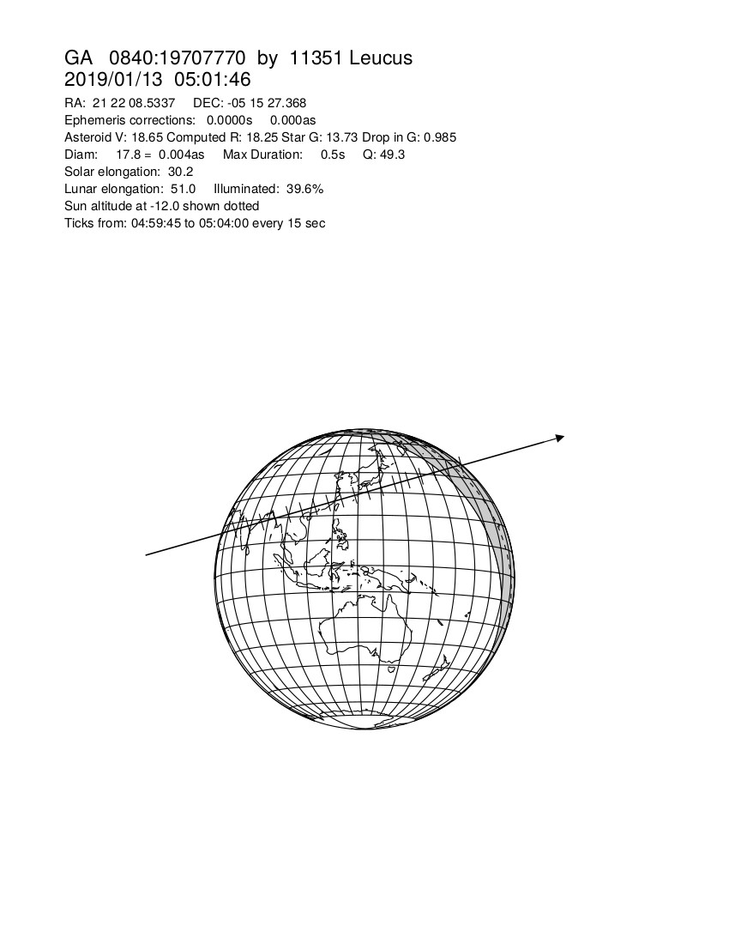

Slide 10
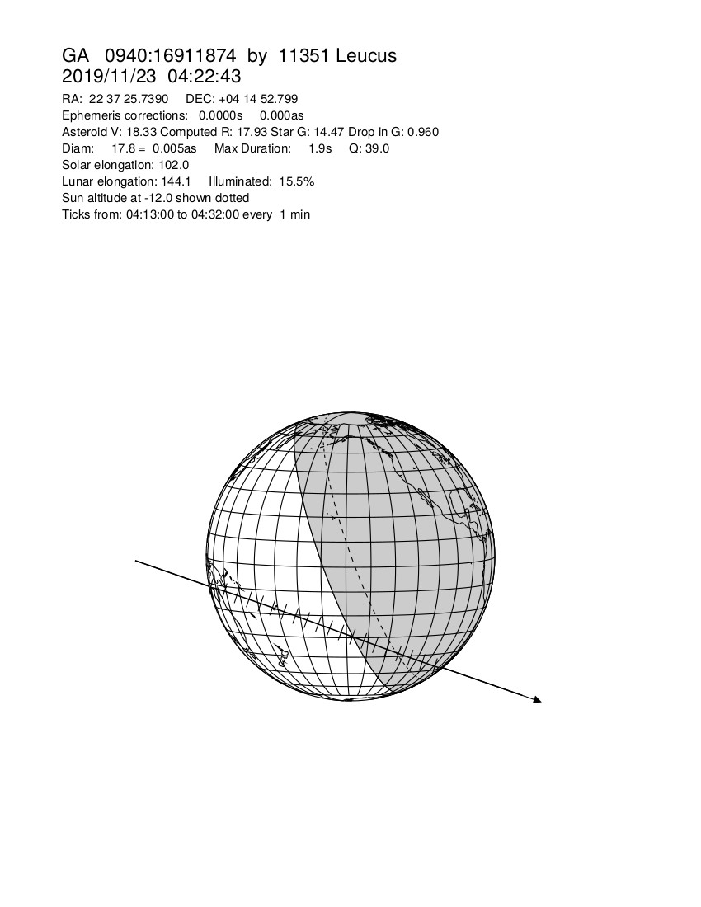

Slide 11
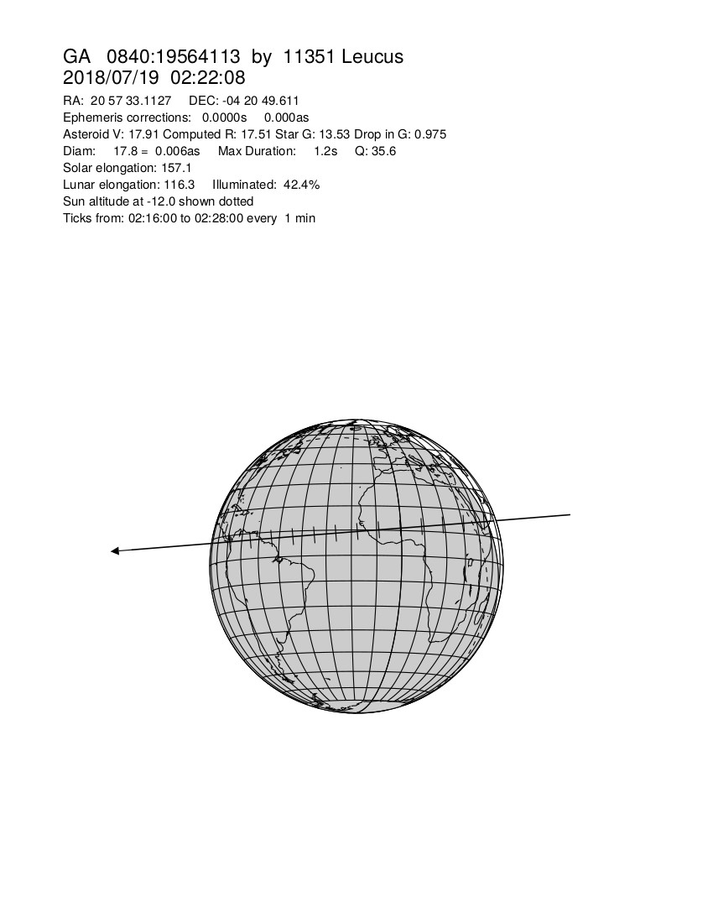

Slide 12
Now we can take a look at a real event to see what is involved in doing this in practice.

Slide 13
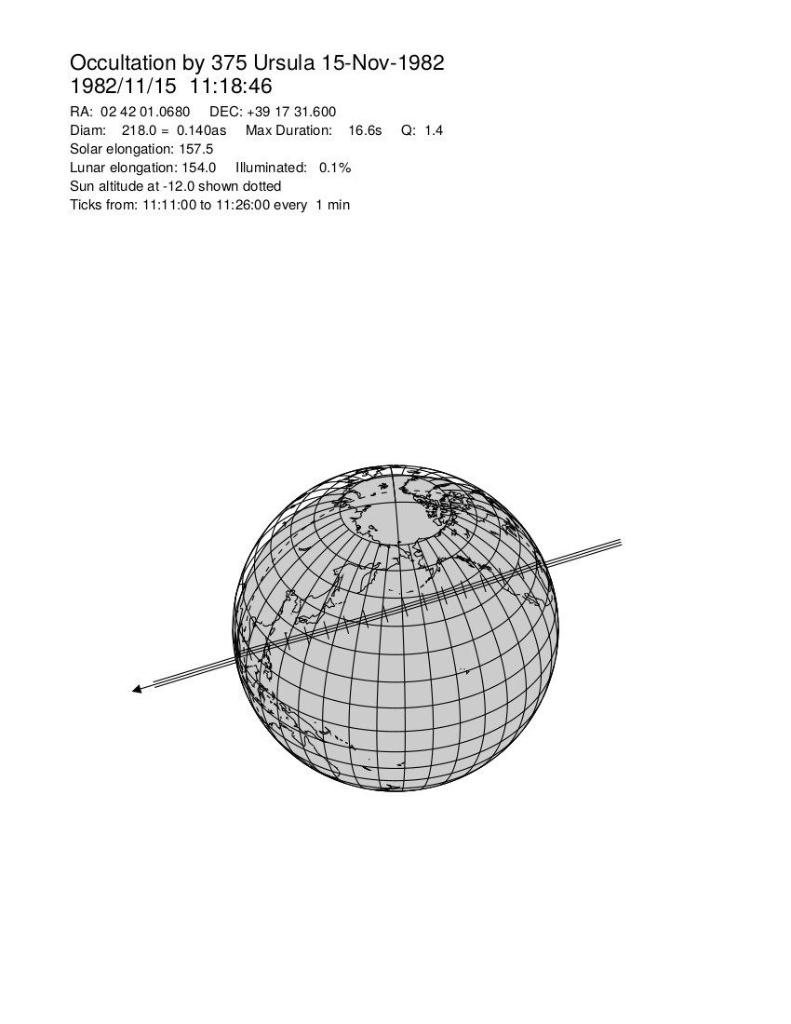

Slide 14
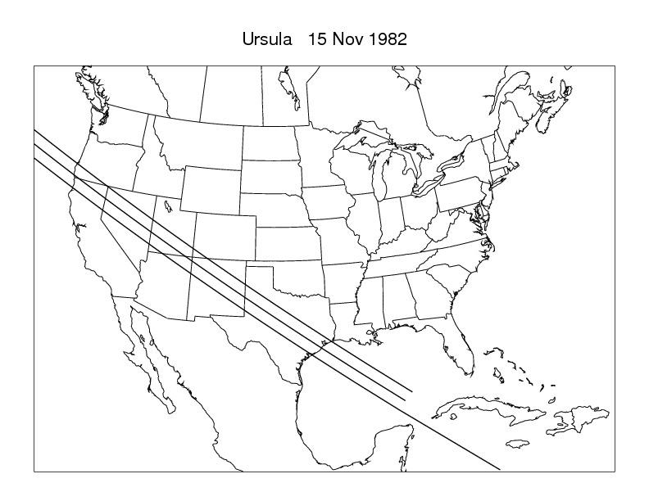

Slide 15
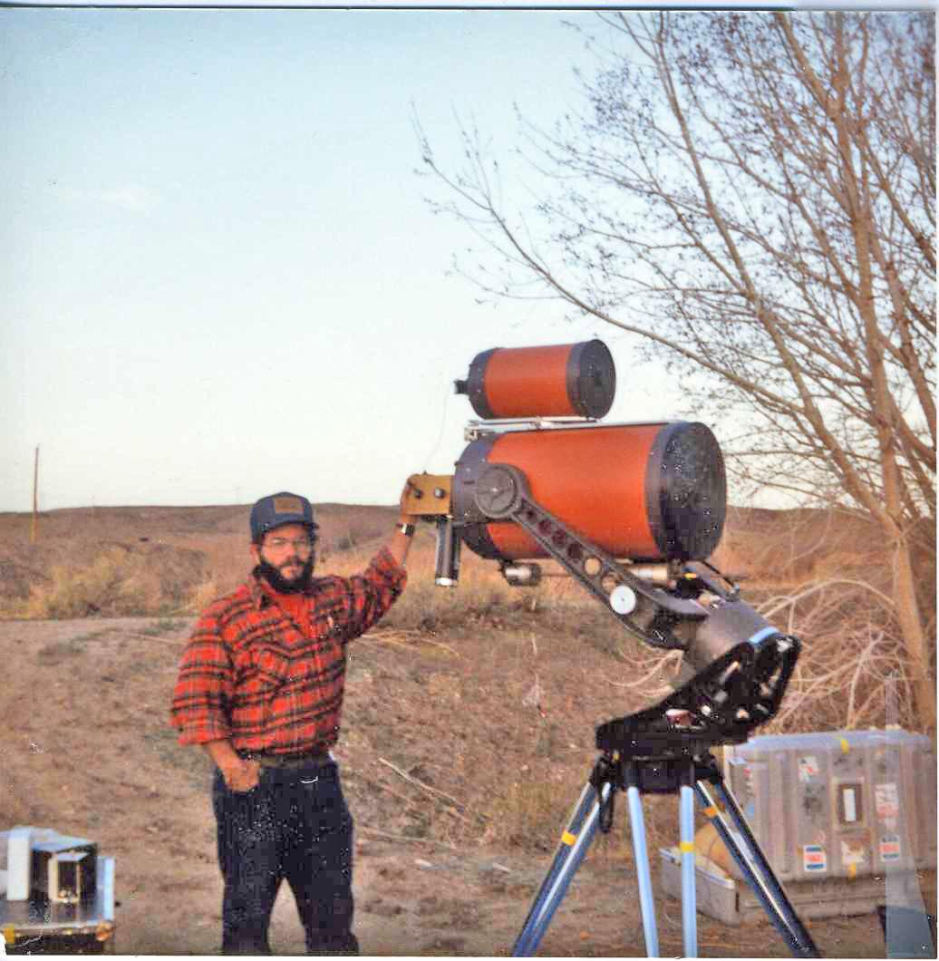

Slide 16
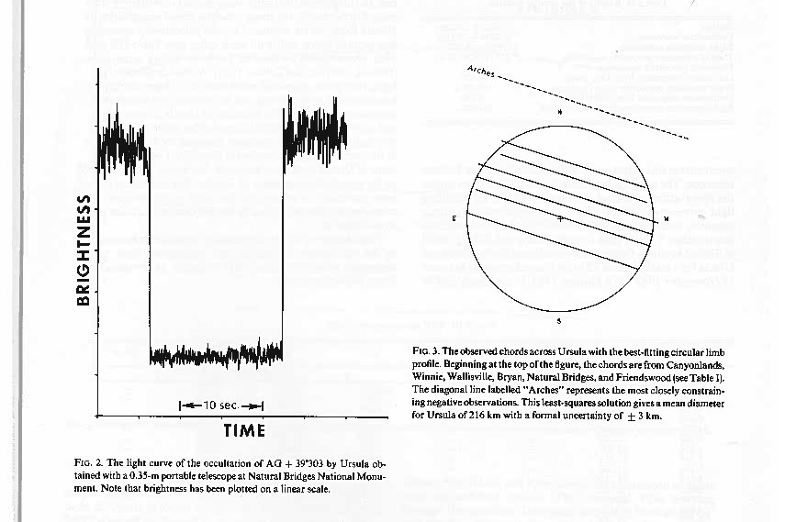

Slide 17
Predictions use measured data (star and ephemeris). All measures have errors and uncertainties. Does the real ground track go anywhere near the computer predicted ground track.
If the ephemeris for the occulting body is wrong by, say, the equivalent of one object diameter, then the actual ground track will be one track width off from the predicted. Similarly, if the star position is off by that amount, the same thing will happen. How far off is one object diameter? We measure the error as an angle which is defined by the diameter of the object divided by its distance. For Ursula, that angle is 0.13 arcseconds. This is equivalent to the diameter of a quarter as seen from 23.5 miles away! An error in the star position and/or the ephemeris greater than this will mean the actual track will not overlap the predicted track.
Actually, the original prediction had an error 2 ½ times this minimum! So the actual track was 2 ½ track widths from the original computer prediction. Only by refining the computer prediction by measuring the positions of the star and asteroid pre-event and correcting the erorrs were we able to actually observe this event.

Slide 18
Given all that, we get to the primary topic of this talk -- measuring the size of 2014 MU69 by occultation
I was asked to do occultation predictions for this object for 2017. I found three possible events. All occurred near opposition for MU69 which means that the dark side of the Earth is facing MU69. So, no daylight problems. The major problem here is that MU69 is 15 times smaller than 375 Ursula and 20 times further away. As a result, the angle corresponding to one track width is MUCH smaller -- 0.00049 arcsec (0.49 milli-arc sec), so the position of the star and the ephemeris of the object need to be known to a MUCH higher precision. Note that 0.00049 arcsec is the angle subtended by the edge of a quarter in Flagstaff as seen from Tucson, 250 miles away.

Slide 19
Fortunately, two spacecraft arrived in time to help solve the problem. The GAIA spacecraft, launched by the European Space Agency measured the positions of a billion stars with enough precision so that the errors in the positions of the occulted stars would not shift the ground tracks at all. Then, the Hubble Space Telescope could be used to observe and correct the ephemeris of MU69, so we were fairly confident that we knew where the ground tracks would be… at least to within a track width or two.
Note: The errors in the positions of the stars measured by GAIA are 10x better than we need. They are good to 0.00005 arc sec (0.05 milli-arc-sec = 50 micro-arc-sec), equivalent to the thickness of a quarter in Flagstaff, as seen from New York City!

Slide 20
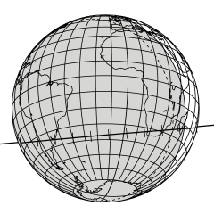
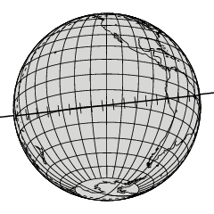
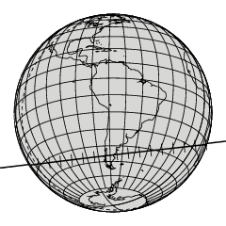
Three occultation campaigns
2017 June 3
2017 July 10
2017 July 17
Cross-track error 45 km, 1.5 mas
g’ = 15.33 Moon 66%, 103° Argentina: 12 stations South Africa: 13 stations Many fixed stations
Cross-track error 14 km, 0.48 mas
g’ = 15.67 Moon 99%, 17°
SOFIA A few fixed stations
Cross-track error 14 km, 0.46 mas g’ = 12.60 Moon 46%, 105°
Argentina: 24 stations Many fixed stations

Slide 21
Each of these occultations is a very narrow track. How do you get several observers into the shadow?
Only way to set up a “picket fence.” You put a lot of telescopes in the field, each separated by maybe a fifth to a third the expected track width and you spread them wider than the track in order to cover the uncertainties in the star position and ephemeris (mostly in the ephemeris for these events -- the GAIA positions are very good.
So, NASA purchased 25 16” Sky-Watcher, portable, goto, Dobsonian alt-az telescopes (1800 mm focal length, f4.4 focal ratio) with QHY174M-GPS CMOS cooled cameras. The camera is operated via a Windows laptop computer with SharpCam commercial software. The telescope and camera cooler are powered by a 12V automobile battery pack. The computer runs from its own battery.
In this case, “portable” means four packing cases per telescope and the necessity for two observers per telescope.

Slide 22
And why are these telescopes an improvement over what we used with Ursula?
No polar alignment needed. Just point to two known bright stars.
The camera allows us to watch the event live on a computer screen. On reduction you can ratio the candidate star to a field star to remove (thin) clouds. And, to some extend, we can correct for wind shake.
Much easier to find a target, especially a faint target -- star hopping just doesn’t work for 16th mag stars.
Data recorded with GPS timing data imbedded. Old system used reel to reel tape recorder with WWV recorded on one channel.
Battery vs motor generator.
But a few stupid design features -- eg finder (falls out, bad location) and the telescope needs to be collimated with each use (we carry a laser collimator in each system)

Slide 23
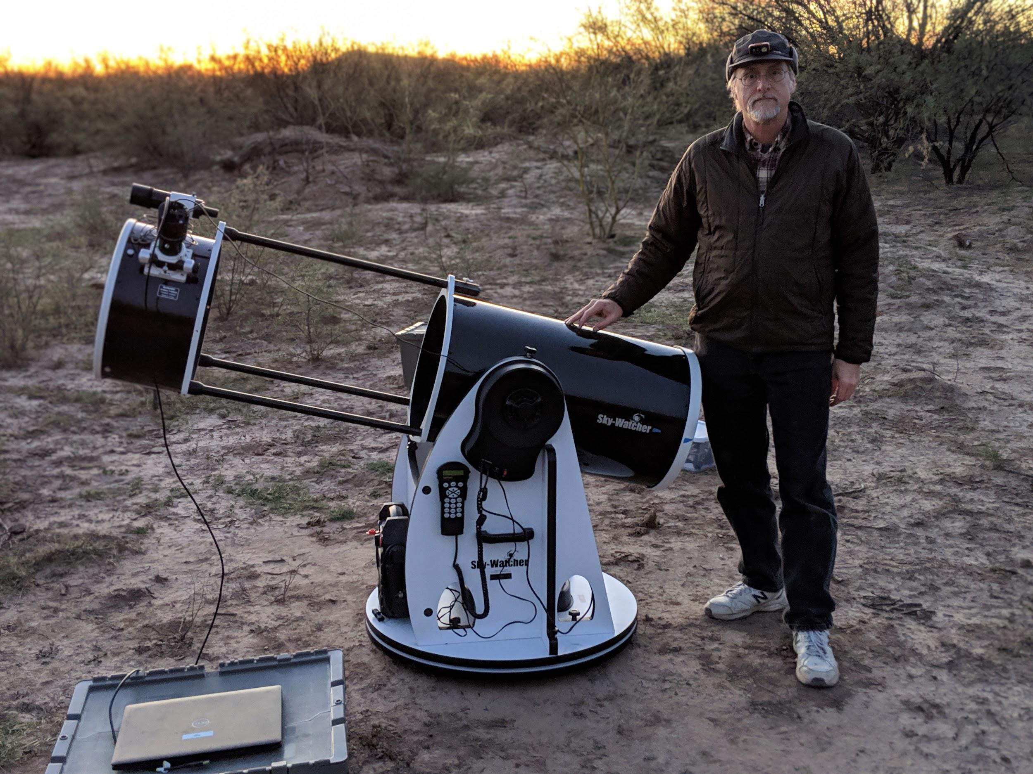

Slide 24
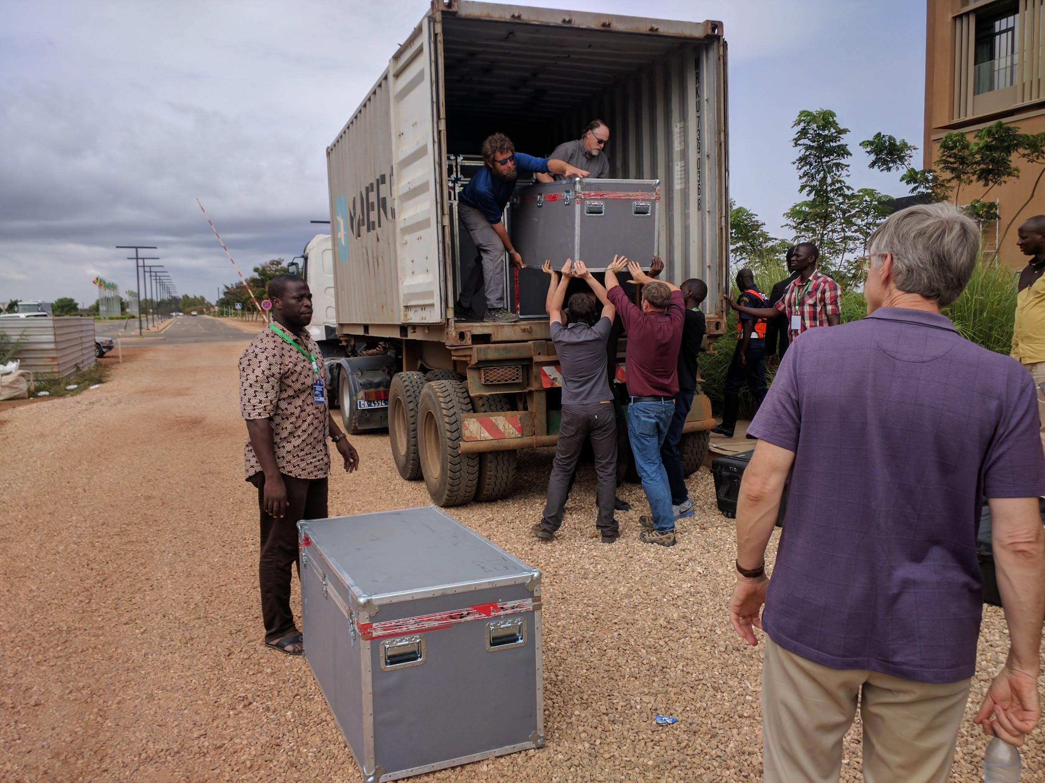

Slide 25
Occultation #1
June 3, 2017
Argentina (near Mendoza) and South Africa

Slide 26
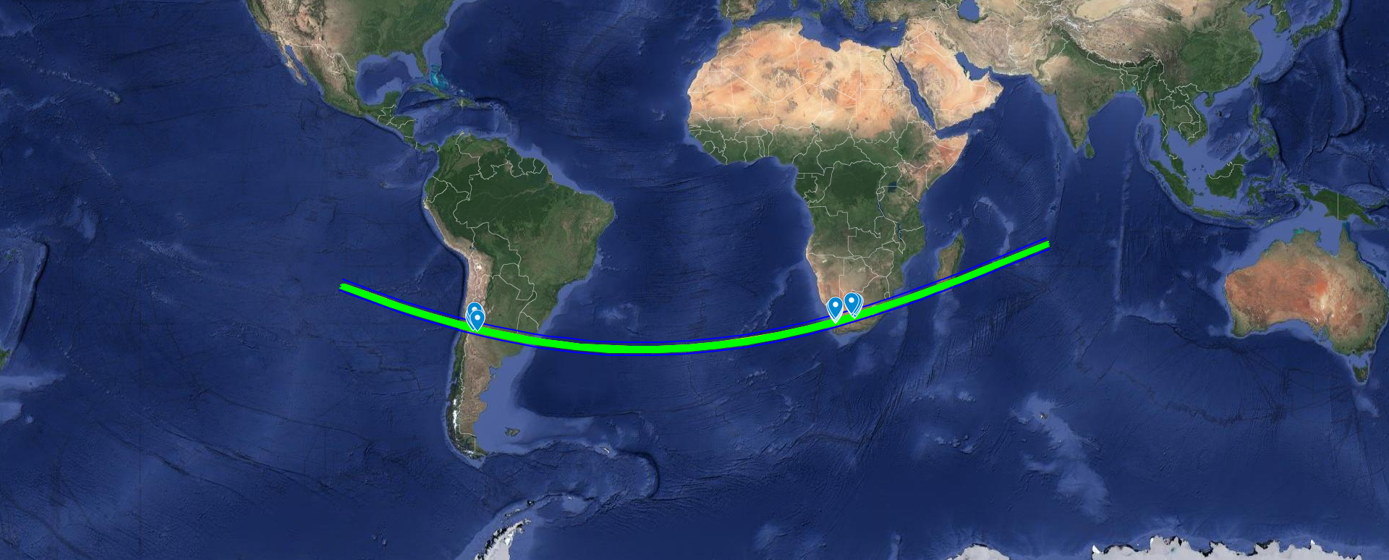

Slide 27
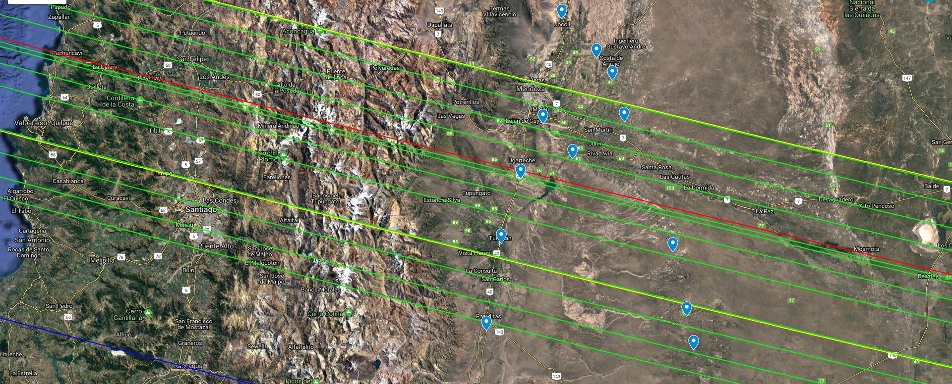

Slide 28
What Happened?
We had 12 telescopes in Argentina, 13 in South Aftrica. So we had 50 observers. We rented 25 trucks to carry the equipment. I was in Argentina, where we also had one local person per team who spoke both English and Spanish in case of emergency. We had the cooperation of the Argentinian Space Agency, the local police, the air force and the coast guard. We had NASA officials tag along. The weather cooperated.
AND…..
Nobody saw anything. We found out later after more data was obtained on the ephemeris of MU69, that the ephemeris was off enough that the shadow missed our picket fence. Nobody ever said that this was easy.

Slide 29
Occultation #2
July 10, 2017
Over the Atlantic Ocean with
SOFIA (Stratospheric Observatory
For Infrared Astronomy)

Slide 30
Three occultation campaigns
2017 June 3
2017 July 10
2017 July 17
Cross-track error 45 km, 1.5 mas
g’ = 15.33 Moon 66%, 103° Argentina: 12 stations South Africa: 13 stations Many fixed stations
Cross-track error 14 km, 0.48 mas
g’ = 15.67 Moon 99%, 17°
SOFIA A few fixed stations
Cross-track error 14 km, 0.46 mas g’ = 12.60 Moon 46%, 105°
Argentina: 24 stations Many fixed stations

Slide 31
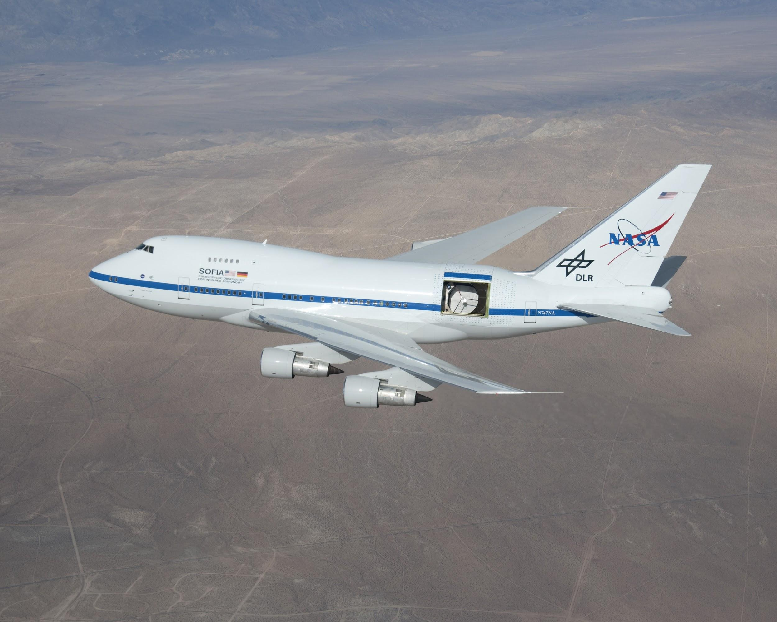

Slide 32
What Happened?
It’s hard to put a 747 going 500 MPH into a 15 mile wide track at the right time as the shadow goes by at about 12 MPS (~43000 MPH). I didn’t get to go for this one, but they missed on this one too.
Even if they had gotten a positive result, only one observation of an occultation only gives a lower limit to the size.
Note added well after the event --- it turns out they got one data point that was attributed to the occultation -- the duration of the occultation was less than the readout frequency of the CCD.

Slide 33
Occultation #3
July 17, 2017
Argentina (Comodoro Rivadavia)
The LAST chance

Slide 34
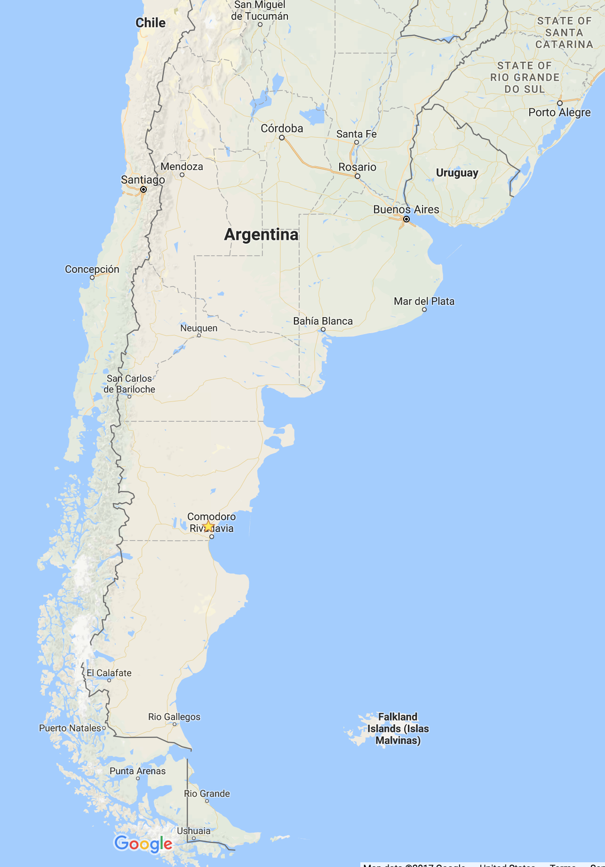
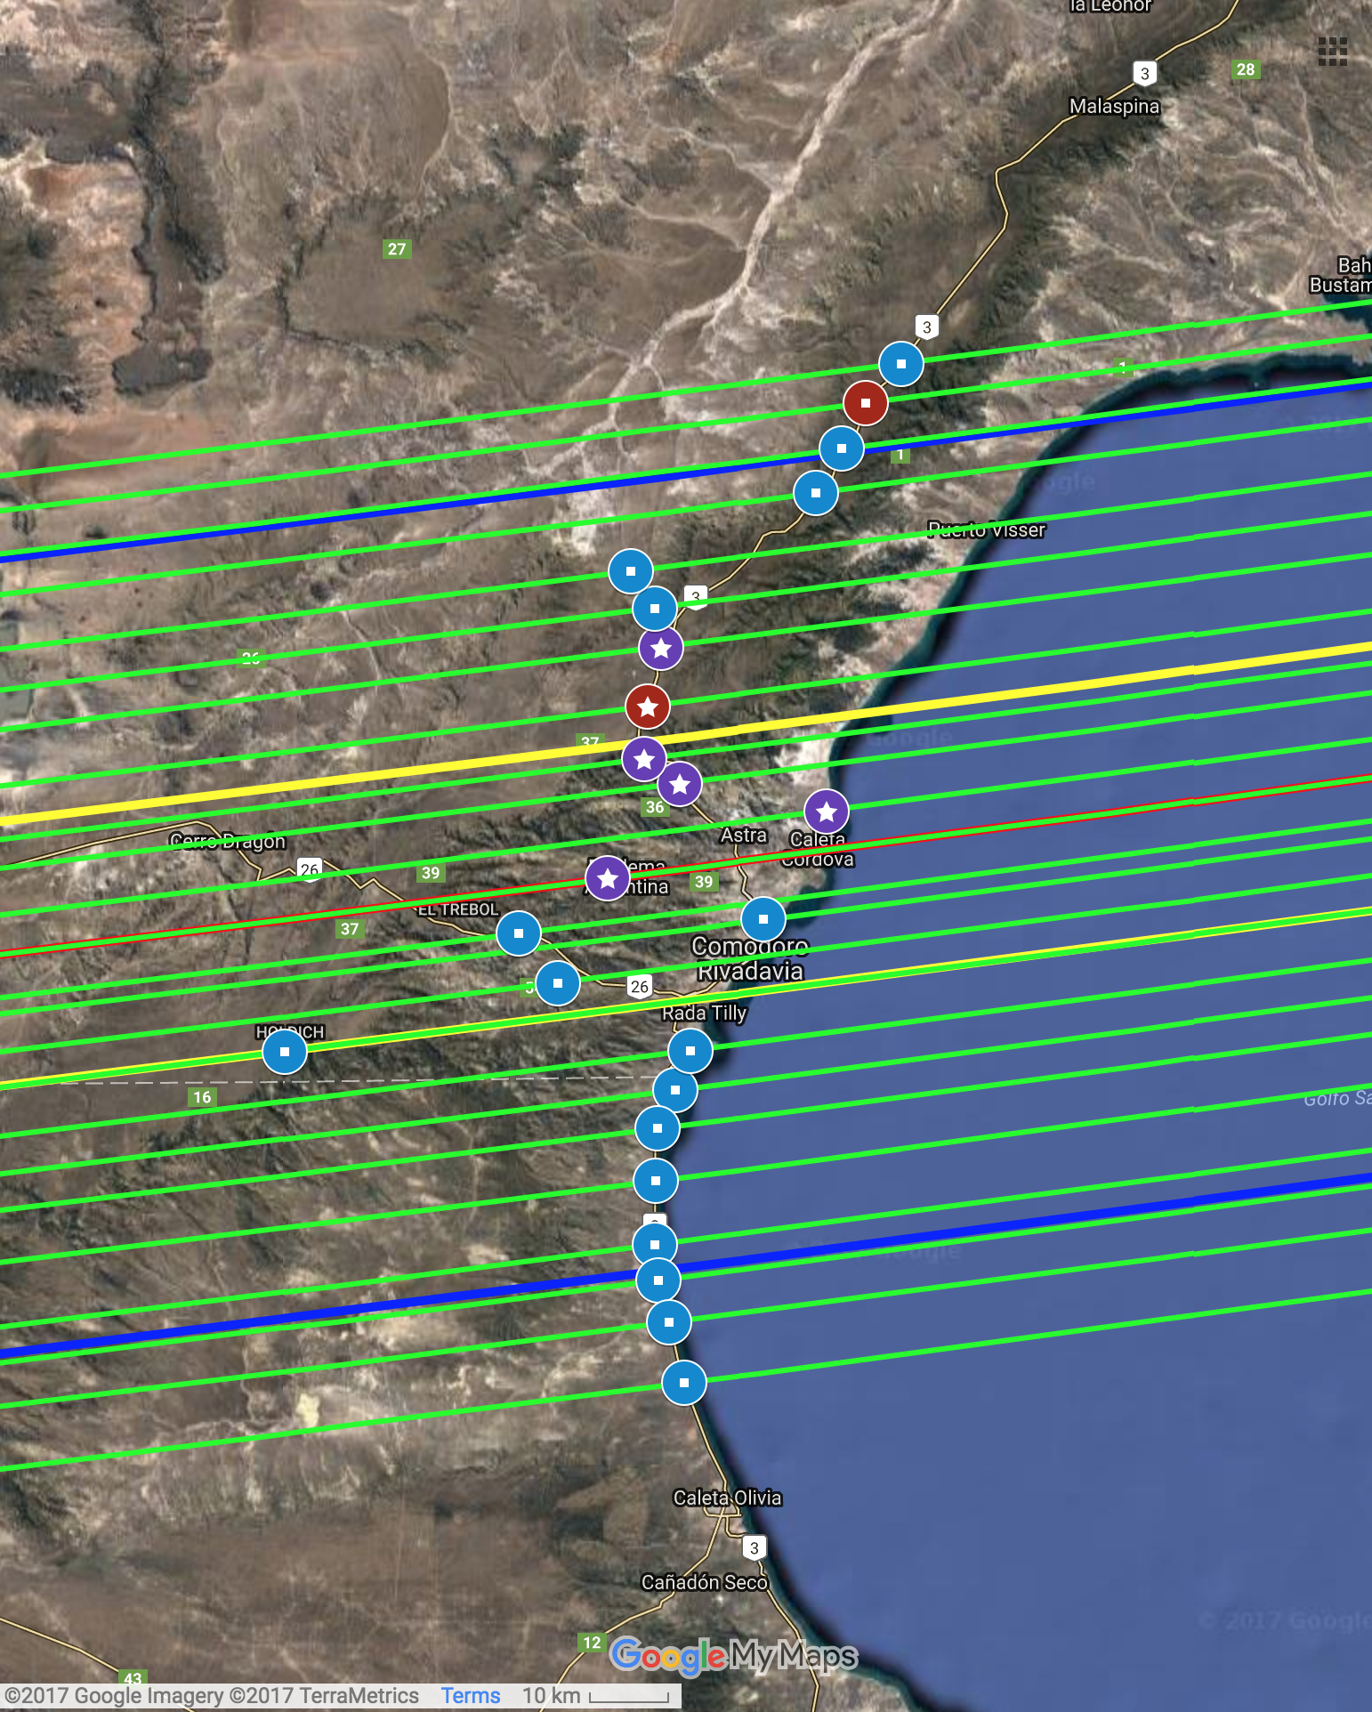
Deployment overview
2017 July 17
Cross-track error 14 km, 0.46 mas g’ = 12.60 Moon 46%, 105°
Argentina: 24 stations Many fixed stations

Slide 35
What Happened?
Basically a repeat performance of the first event, except that everybody was in the same location and not distributed over two countries. We had 24 telescopes, 48 observers, 24 trucks, one local person per team. And, again we had the cooperation of the Argentinian Space Agency, the city government, the local police, the air force, and the coast guard. We had NASA officials tag along again.
This time it was COLD (July is winter in Argentina) and windy, which made it seem even colder. And the telescopes are sensitive to wind shake.
Several teams were set up in rest areas just off the main north/south highway which connects Comodoro Rivadavia to Buenos Aries. We found that on our practice night (the night before the actual event) that the lights of passing trucks were a problem. So the state closed the highway for several hours on event night (think about closing I-40 or I-10 for several hours for science).
AND...

Slide 36
SUCCESS!!!
5 Tracks Across MU69

Slide 37
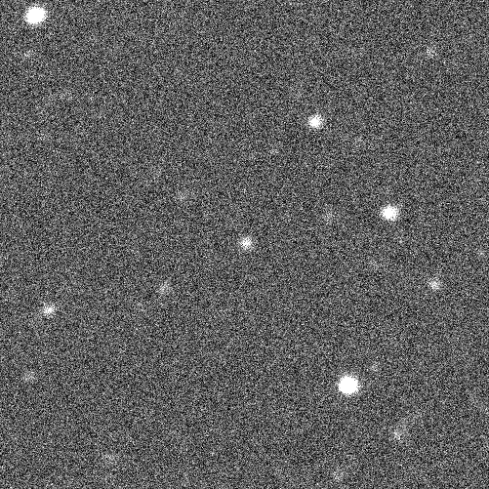
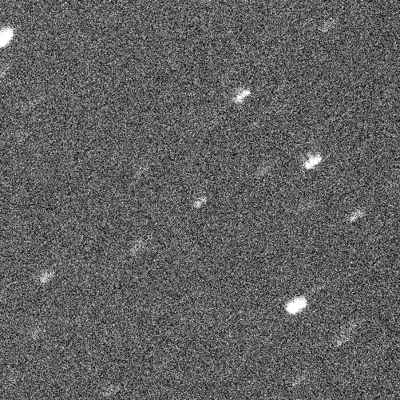
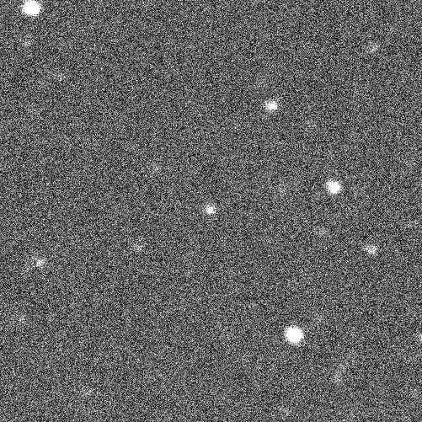
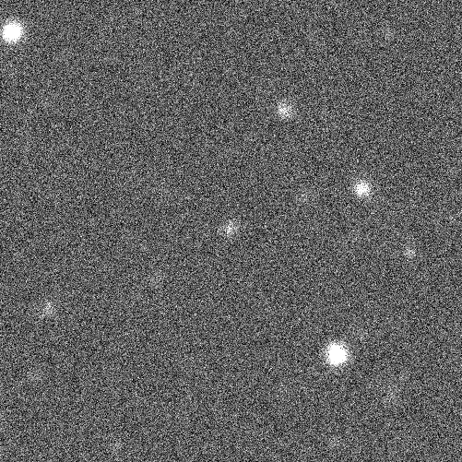
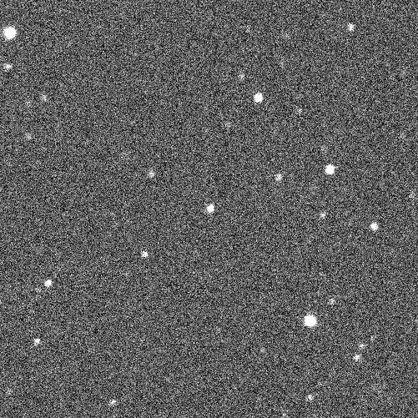
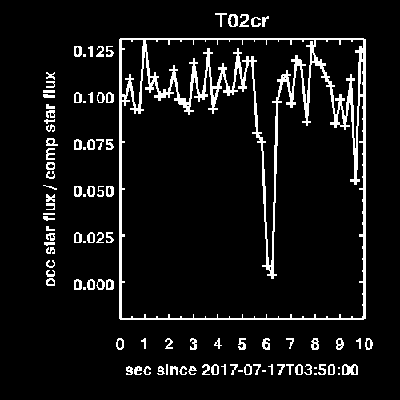
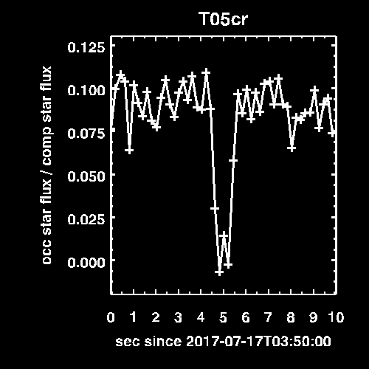
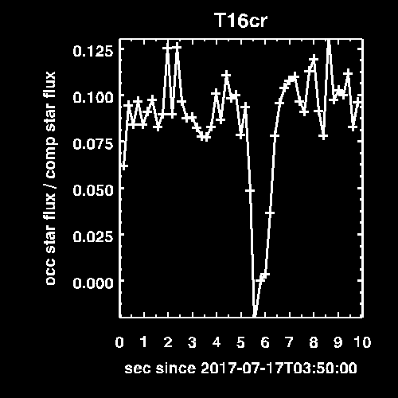
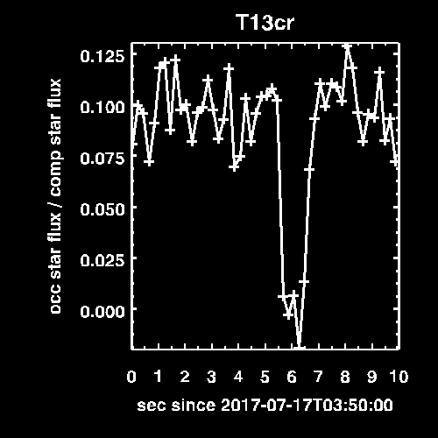
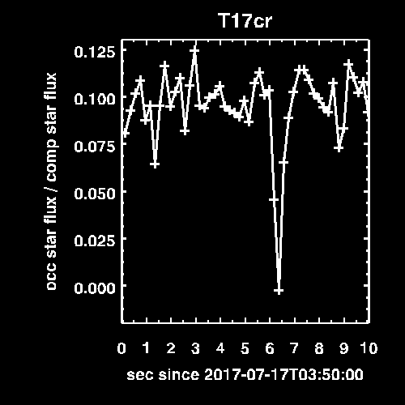
Five Detections, south to north
T02
T05
T16
T13
T17

Slide 38
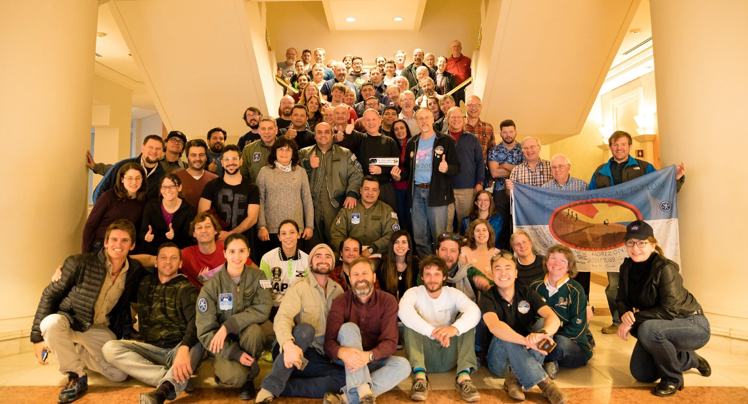
Acknowledgments
https:/
Any observers we missed! ☹
Universidad Nacional de la Patagonia San Juan Bosco
Marcelo Marquez
CONAE
John Fazio and the United States Embassy in Argentina
Mayor and government of Comodoro Rivadavia
Chief of Police of Chubut and Santa Cruz
Argentinian Air Force
Gaia
Hubble
NASA & New Horizons

Slide 39
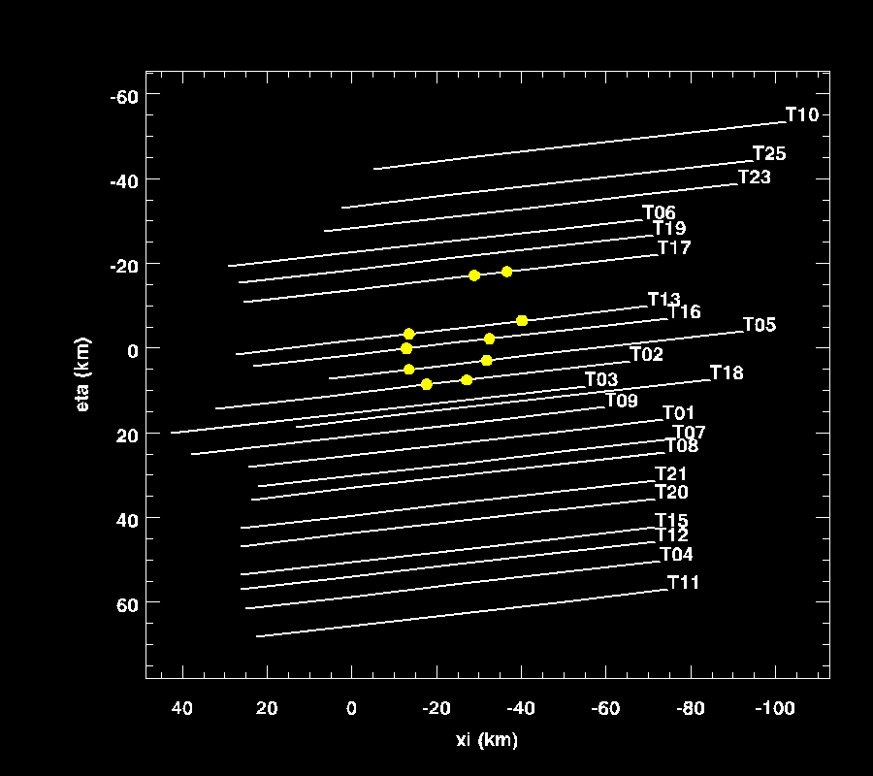
July 17 data

Slide 40
One object
Elliptical fit shown here does not account for “bite”
a:b axis ratio 1.7
spin pole must be within ~43° of line of sight to match light curve constraint*
V albedo = 0.09
convex and potato shaped asteroids are normal
17 km
9.9 km
*See 504.07: Susan Benecchi’s talk about MU69’s Light Curve

Slide 41
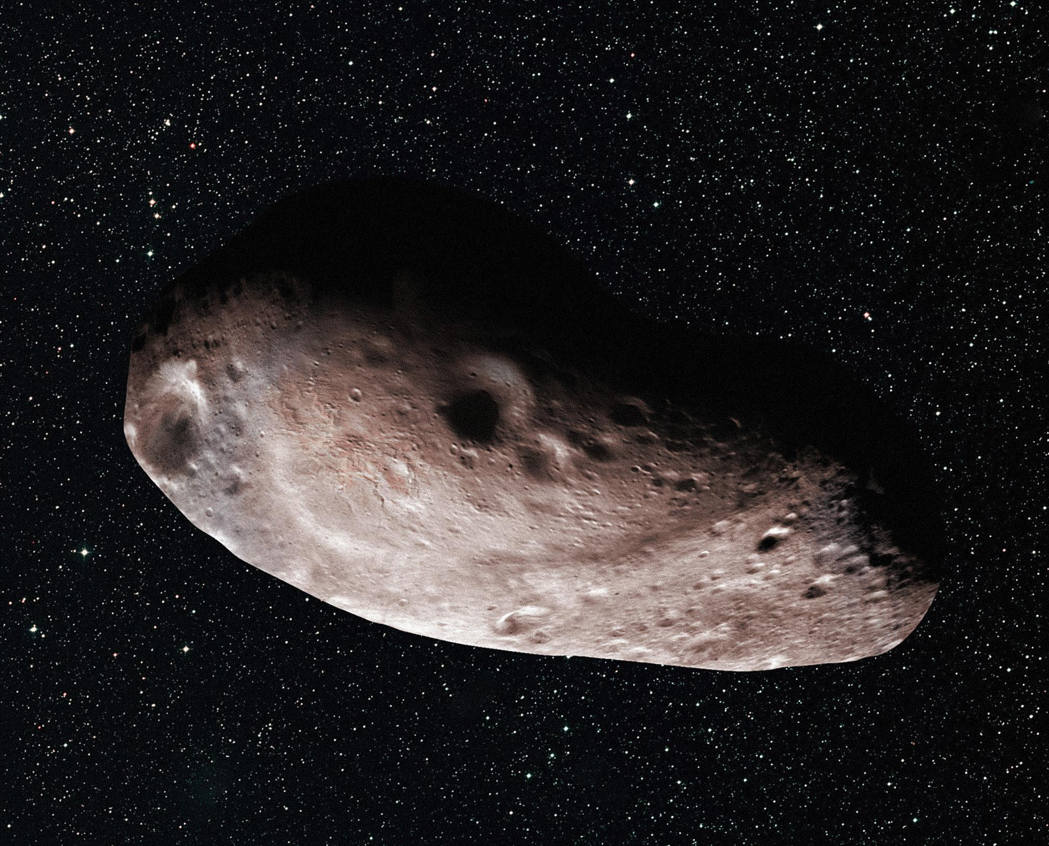

Slide 42
Stuck-Like-Glue Object
Like single object case, spin pole must be within ~43° of line of sight to match light curve constraint.
More detailed shape– accounts for “bite”.
Contact binaries are common in the solar system.
V albedo ~ 0.10,
F350LP albedo = 0.094
7.9 km
33 km
9.8 km
13 km

Slide 43
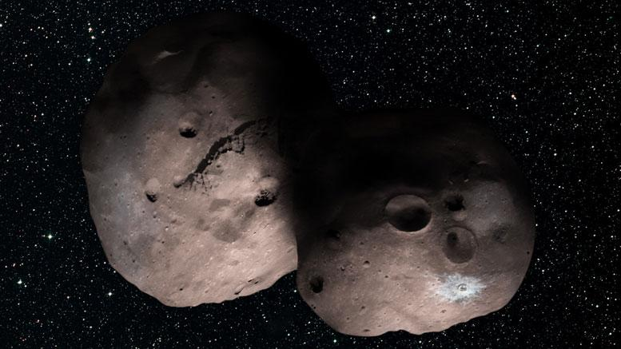

Slide 44
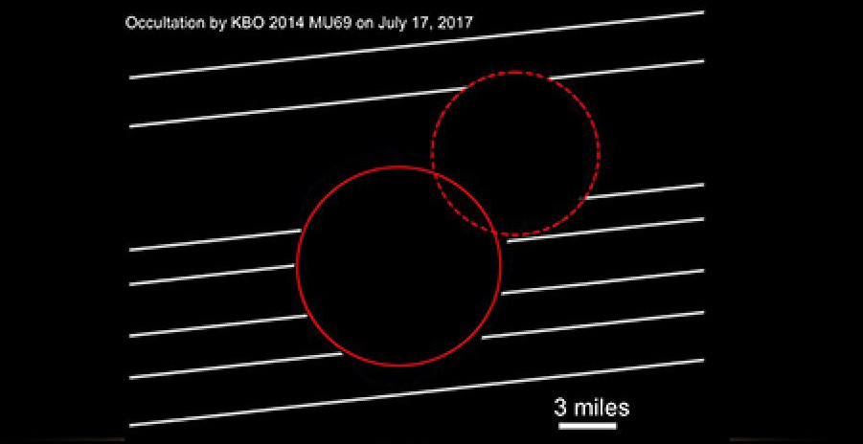

Slide 45
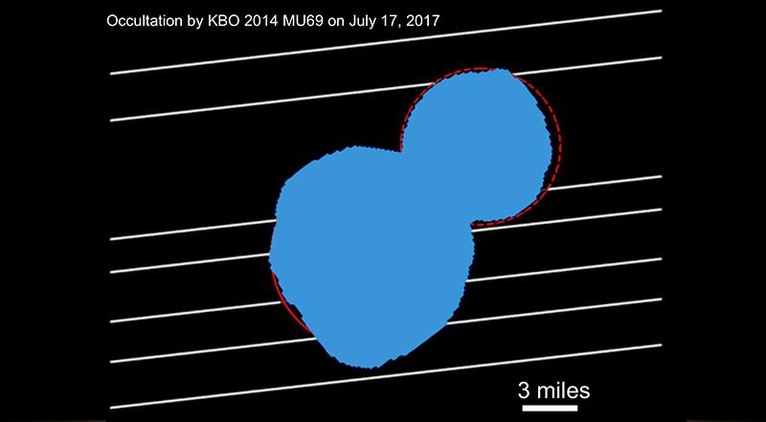

Slide 46
Bur we were somewhat fooled -- MU69 had presented a “false front” to both the occultation and to the incoming spacecraft, The actual 3-dimensional shape was somewhat of a surprise when the spacecraft passed MU69 and looked back. We were assuming two spheres stuck together, but the actual shape was considerably different.

Slide 47
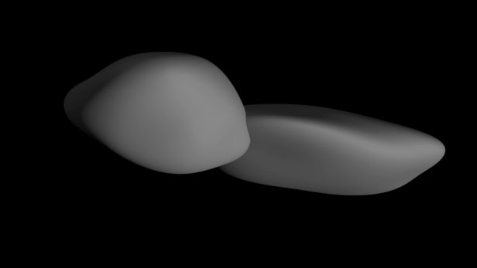

Slide 49
But NASA was not done yet. I was asked to look for additional occultations in 2018
Why? If possible, they wanted to check on the results from the 2017 success. But they also wanted to check the ephemeris. If even one team was successful, then the fact that the event occurred at the predicted time and at the predicted location confirms that the ephemeris of the object is still correct. Since the actual flyby circumstance is based on that ephemeris, they wanted to be certain that MU69 will be in the expected location in space when New Horizons arrived.
The occultation prediction showed that there would only be one possible occultation in 2018.

Slide 50
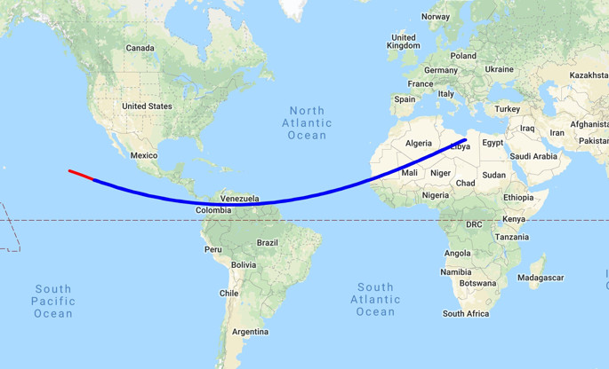

Slide 51
Six telescopes and teams were sent to Colombia, nineteen to Senegal. I don’t
know much about the Colombia group except that they were all clouded out.
In Senegal, we again had two astronomers per telescope plus a local person who spoke French and also the local dialect. Ours was a geology professor at the nearby university. This time we also had a local driver for each team -- a very good idea. The government also insisted that we also have two gendarmes (with rifles) go along with us to each observing site.
The government considered all this a Good Thing for science education in Senegal and all of us went to a press conference with the Senegalese president and members of his cabinet. Afterwards we all got to meet him and there was a group picture.

Slide 52
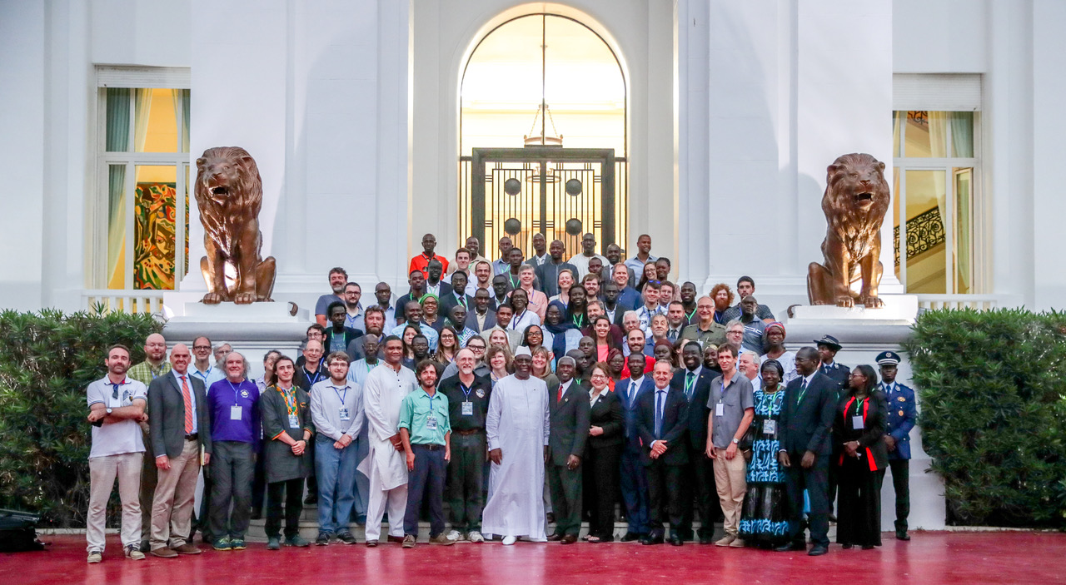

Slide 53
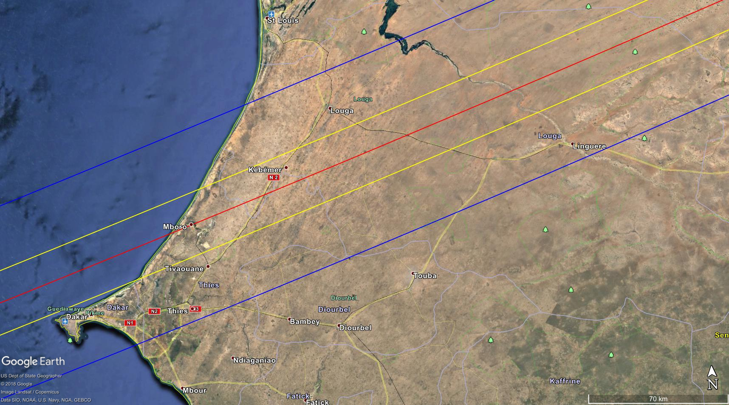

Slide 54
So what Happened?
Only two of the teams got an actual occultation (everyone else had clouds), but that was enough to confirm to NASA that we knew that the ephemeris for MU69 was still correct and that the spacecraft and MU69 would end up at the same location in space at the time of closest approach of the spacecraft to MU69.

